Slide 1

Amazing Grace: Meaning, History, Theology
Origins and doctrine of a timeless hymn
Notes:
Image source: Microsoft 365 content library

Slide 2
Amazing Grace Teaching Guide
Notes:
Amazing Grace — Meaning, History, and Theology, Why Amazing Grace Matters in Christian Worship, John Newton and the Historical Background of the Hymn, Biblical Foundations of Amazing Grace, Theological Themes: Grace, Redemption, Salvation, and Mercy, Theological Meaning of the Hymn’s Verses, Spiritual Applications for Believers Today, Discussion Questions for Teaching and Group Study, Conclusion: The Enduring Message of Amazing Grace

Slide 3
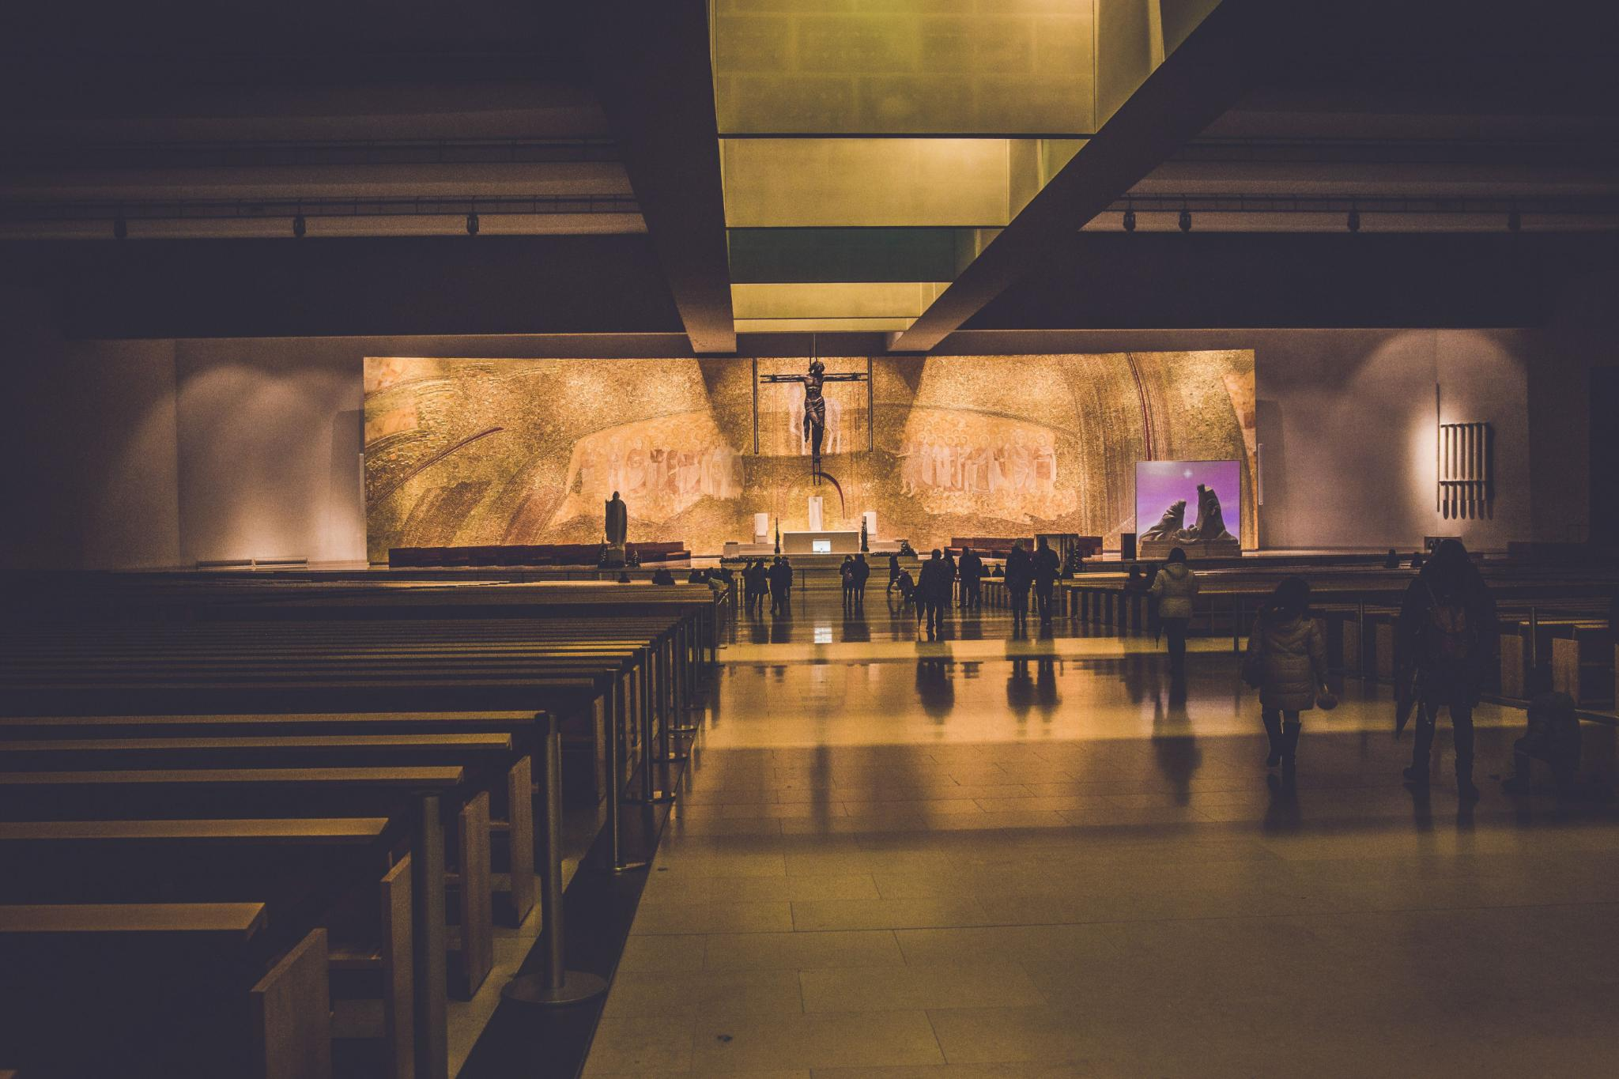
Amazing Grace: Meaning & Theology
“Salvation is an undeserved gift from God.”
Meaning
A simple confession that God seeks the lost, opens blind eyes, and moves worshipers toward humility, gratitude, and praise.
History
Sung across revivals and liturgies—from baptisms to funerals—its accessible language has served generations in public worship and private devotion.
Theology
Catechetical and experiential: sola gratia, repentance, sanctification, and perseverance—testimony to God’s mercy and confession of who we were apart from it.
Notes:
“Amazing Grace” is one of the most recognized and enduring hymns in Christian worship, cherished across denominations, cultures, and generations. Its power lies in its simplicity and its deep theological resonance. The hymn articulates the core of the Christian gospel: that salvation is an undeserved gift from God, given to sinners through Jesus Christ. From the opening declaration of wonder at God’s grace, the hymn draws worshipers into a posture of humility, gratitude, and praise. It does not focus on human effort or religious achievement, but on God’s initiative in saving those who were lost, blind, and spiritually helpless. As a teaching hymn, it functions catechetically, reinforcing foundational doctrines such as justification by grace, repentance, sanctification, and perseverance in faith. Historically, the hymn has been sung in revival meetings, formal liturgies, funerals, baptisms, and personal devotions, showing its remarkable adaptability and pastoral usefulness. Theologically, it resonates with the Reformation emphasis on sola gratia while also expressing the experiential dimension of salvation—the lived reality of being transformed by mercy. The hymn’s language is accessible, allowing believers of all ages and levels of theological training to grasp its message, yet it remains profound enough to sustain lifelong reflection. In worship, “Amazing Grace” functions as both testimony and confession: testimony to what God has done and confession of who we were apart from His mercy. As this presentation explores the hymn’s background, biblical foundations, and theological themes, it invites teachers and worshipers alike to rediscover why this hymn continues to shape Christian faith and practice around the world.
Image source: Microsoft 365 content library

Slide 4

Why Amazing Grace Matters
Re-centers worship on God
It shifts attention from religious performance to divine mercy, anchoring praise in what God has done for sinners who cannot save themselves.
Pastoral language for the heart
The “lost” to “found” confession gives words for repentance and assurance—especially in grief, renewal, and moments of reflection.
Unites and strengthens the church
Familiarity supports confident congregational singing and communal faith, while “grace will lead us home” nurtures hope and perseverance.
Notes:
“Amazing Grace” remains vital to Christian worship because it centers the believer’s attention on God’s redemptive work rather than human religious performance. In a worship culture that can easily drift toward self-expression or moral achievement, this hymn reorients the church toward gratitude for divine mercy. It reminds congregations that worship begins with remembering who God is and what He has done for sinners who could not save themselves. The hymn also serves a pastoral role by giving language to both repentance and assurance. Many believers identify deeply with the confession of being “lost” and the joy of being “found,” making the hymn especially meaningful during moments of spiritual renewal, grief, or reflection. Liturgically, it functions well as a response to Scripture readings about grace, forgiveness, or conversion, reinforcing biblical truth through song. Additionally, the hymn fosters unity within the body of Christ. Because it is widely known, it allows congregations to sing confidently and together, embodying the communal nature of faith. Its emphasis on God’s sustaining grace “that will lead us home” offers hope and perseverance, encouraging believers to trust God through trials and uncertainty. In teaching settings, the hymn provides a gateway into discussions about salvation, sanctification, and Christian assurance. Ultimately, “Amazing Grace” matters because it consistently directs glory to God, nurtures humble faith, and anchors worship in the gospel message that stands at the heart of Christianity.
Image source: Microsoft 365 content library

Slide 5

John Newton and Amazing Grace
From rebellion to awakening
Newton worked in the transatlantic slave trade—later recalling it with deep remorse. In 1748, a violent storm at sea drove him to cry out to God for mercy, beginning a gradual conversion marked by repentance.
Pastor and hymn writer
He left the slave trade, studied theology, and became an Anglican pastor. “Amazing Grace” (1772) was written as a New Year’s Day sermon illustration reflecting on 1 Chronicles 17—grace experienced, not abstract.
Legacy and historical impact
The hymn spread widely in the 19th century, especially in America, through revivals and congregational singing. Newton’s later support of abolition (including William Wilberforce) echoes the transformation the hymn proclaims.
Notes:
John Newton (1725–1807), the author of “Amazing Grace,” lived a life marked by moral rebellion, divine intervention, and profound transformation. Early in life, Newton worked in the transatlantic slave trade, a period he later described with deep remorse. In 1748, during a violent storm at sea, Newton experienced a spiritual awakening that led him to cry out to God for mercy. While his conversion was gradual, this event marked the beginning of a lifelong journey toward faith and repentance. Newton eventually left the slave trade, studied theology, and became an Anglican pastor. “Amazing Grace” was written in 1772 as part of a sermon illustration for New Year’s Day, reflecting on 1 Chronicles 17. The hymn draws directly from Newton’s personal experience of God’s mercy, making it both theologically rich and deeply pastoral. His awareness of sin and gratitude for grace shaped the hymn’s honest and hopeful tone. Historically, the hymn gained widespread popularity in the 19th century, particularly in America, where it became associated with revival movements and congregational singing. Newton’s later involvement in the abolition movement, including his support of William Wilberforce, further underscores the transformative power of grace that the hymn proclaims. Understanding Newton’s story helps worshipers see the hymn not as abstract theology, but as lived testimony to God’s redeeming love.
Image source: Microsoft 365 content library

Slide 6

Biblical Foundations of Amazing Grace
Grace initiates salvation
Ephesians 2:8–9 anchors the hymn: salvation is by grace through faith, not by works—leaving no room for boasting and highlighting God’s initiative.
Lost, found, blind, and seeing
Luke 15 echoes the “lost and found” refrain in God’s joy over repentant sinners. John 9 and 2 Corinthians 4:6 frame grace as illumination—God opening eyes and hearts to see.
Grace trains and completes the work
Titus 2:11–12 portrays grace as both saving and instructive, shaping godly lives over time. Philippians 1:6 and Romans 8:30 secure future hope: God finishes what He begins.
Woven together, these passages make “Amazing Grace” a sung summary of the biblical doctrine of salvation—rendering Scripture memorable and accessible through worship.
Notes:
The theological message of “Amazing Grace” is deeply rooted in Scripture, drawing together multiple biblical themes into a cohesive expression of the gospel. Ephesians 2:8–9 provides a clear foundation, teaching that salvation comes by grace through faith and not by works, so that no one may boast. This truth undergirds the hymn’s emphasis on God’s initiative in salvation. The imagery of being lost and found echoes passages such as Luke 15, where Jesus describes God’s joy over repentant sinners. John 9 and 2 Corinthians 4:6 inform the theme of spiritual blindness and sight, pointing to God’s power to illuminate hearts through grace. Titus 2:11–12 highlights grace as not only saving but also instructive, shaping believers into godly lives, which resonates with the hymn’s vision of transformation over time. Finally, the promise of future hope aligns with passages like Philippians 1:6 and Romans 8:30, assuring believers that the God who begins the work of salvation will bring it to completion. By weaving together these scriptural threads, “Amazing Grace” functions as a sung summary of the biblical doctrine of salvation, making Scripture memorable and accessible through worship.
Image source: Microsoft 365 content library

Slide 7

Theological Themes in Amazing Grace
Grace & Redemption
Grace is God’s unearned favor that transforms the undeserving; redemption assumes a costly rescue that rests on Christ’s work.
Salvation as a Journey
Salvation is holistic—conversion, ongoing growth, and final restoration—echoing the biblical past, present, and future of being saved.
Mercy & Christian Living
Mercy meets weakness with compassion, inviting repentance and hope; the hymn shapes gratitude, dependence, and trust in sustaining grace.
Notes:
At the heart of “Amazing Grace” is a robust theology of grace—God’s unmerited favor toward undeserving sinners. Grace is presented as both astonishing and transformative, challenging any notion that salvation can be earned. Closely related is the theme of redemption, which implies a costly rescue from bondage. While the hymn does not explicitly detail the atonement, it presupposes Christ’s redemptive work as the basis for forgiveness and new life. Salvation in the hymn is portrayed as a holistic journey, encompassing conversion, ongoing growth, and final restoration. This aligns with the biblical understanding of salvation as past, present, and future. Divine mercy is another central theme, emphasizing God’s compassionate response to human sin and weakness. Mercy tempers judgment and invites repentance, offering hope rather than despair. Together, these doctrines form a coherent theological vision that magnifies God’s character while humbling the believer. The hymn teaches not only what Christians believe, but how they should live—in gratitude, dependence, and trust in God’s sustaining grace.
Image source: Microsoft 365 content library

Slide 8

Theological Meaning of the Verses
Conversion
Grace rescues the lost and grants spiritual sight, establishing the believer’s new life in God.
Perseverance
Through dangers and fears, grace sustains and protects, grounding trust in God’s faithful guidance.
Glorification
The verses culminate in promised fulfillment—eternal communion with God and enduring hope.
Notes:
Each verse of “Amazing Grace” contributes to a theological progression that mirrors the Christian life. The opening verse centers on conversion, expressing wonder at grace that saves and grants spiritual sight. This establishes the foundational experience of being rescued by God. Subsequent verses reflect on God’s guidance and protection through life’s trials, emphasizing that grace is not only for the beginning of faith but for its continuation. The acknowledgment of dangers and fears underscores human vulnerability, while attributing preservation to divine grace reinforces trust in God’s faithfulness. Later verses look forward to the fulfillment of God’s promises, pointing believers toward eternal hope. The vision of dwelling with God forever situates the Christian story within an eschatological framework, reminding worshipers that salvation culminates in communion with God. Together, the verses trace a journey from conversion to perseverance to glorification, offering a concise theological narrative that aligns with Scripture and pastoral experience.
Image source: Microsoft 365 content library

Slide 9

Spiritual Applications Today
Humility & Gratitude
“Amazing Grace” reminds believers that their standing before God rests entirely on grace, guarding against spiritual pride.
Trust & Hope
It encourages confidence in God’s sustaining presence through uncertainty and lifts the eyes toward the future fulfillment of His promises.
Repentance & Compassionate Witness
Grace shapes ongoing growth and moves believers to extend mercy to others in daily relationships and faithful discipleship.
Notes:
“Amazing Grace” invites believers to respond personally and practically to the truths it proclaims. First, it calls Christians to humility, reminding them that their standing before God rests entirely on grace. This humility fosters gratitude and guards against spiritual pride. Second, the hymn encourages trust in God’s sustaining presence through life’s uncertainties, reinforcing confidence in His promises. Third, it invites ongoing repentance and growth, acknowledging that grace continues to shape believers over time. Fourth, it inspires compassionate witness, as those who have received mercy are called to extend it to others. Finally, the hymn nurtures hope, lifting the eyes of believers toward the future fulfillment of God’s redemptive plan. In these ways, the hymn moves beyond emotional comfort to active discipleship, shaping attitudes, relationships, and daily faithfulness.
Image source: Microsoft 365 content library

Slide 10

Discussion Questions for Group Study
Discussion around “Amazing Grace” creates space for theological reflection and personal sharing as participants explore how the hymn’s message aligns with their understanding of salvation and how Scripture deepens that understanding.
Reflecting on John Newton’s story helps groups consider the real-life impact of grace and the process of transformation over time.
Questions about spiritual blindness and sight invite honest conversation about growth and struggle in faith, while the hymn’s future hope encourages believers to articulate confidence in God’s promises.
These conversations strengthen doctrinal clarity and build community as believers testify to God’s work in their lives and encourage one another in faith.
Notes:
Discussion around “Amazing Grace” provides rich opportunities for theological reflection and personal sharing. Participants can explore how the hymn’s message aligns with their understanding of salvation and how Scripture deepens that understanding. Reflecting on John Newton’s story helps groups consider the real-life impact of grace and the process of transformation over time. Questions about spiritual blindness and sight invite honest conversation about growth and struggle in faith. Considering the hymn’s future hope encourages believers to articulate their confidence in God’s promises. Such discussions not only enhance doctrinal clarity but also build community by allowing believers to testify to God’s work in their lives and encourage one another in faith.
Image source: Microsoft 365 content library

Slide 11
Conclusion: The Enduring Message of Amazing Grace
Gospel-Centered Grace
The hymn keeps worship anchored in God’s saving grace and the heart of Christian faith.
Salvation Is God’s Work
It reminds the church that redemption begins and ends with God, not human effort.
Teaching & Worship
As doctrine in song, it forms belief and unites voices in praise across generations.
Comfort & Assurance
In joy or sorrow, it offers hope—calling believers to grateful, trust-filled lives.
Notes:
The enduring power of “Amazing Grace” lies in its faithful proclamation of the gospel and its pastoral sensitivity to the human condition. By centering on God’s grace, the hymn continually draws worshipers back to the heart of Christian faith. It reminds the church that salvation is God’s work from beginning to end and that believers live every moment dependent on His mercy. As a teaching tool, it reinforces biblical doctrine; as a worship song, it unites voices in praise; and as a pastoral resource, it offers comfort, hope, and assurance. Whether sung in moments of joy or sorrow, “Amazing Grace” invites believers to marvel anew at God’s redeeming love and to respond with lives shaped by gratitude and trust. In this way, the hymn continues to fulfill its purpose: giving glory to God through the testimony of transformed lives.

