Slide 1
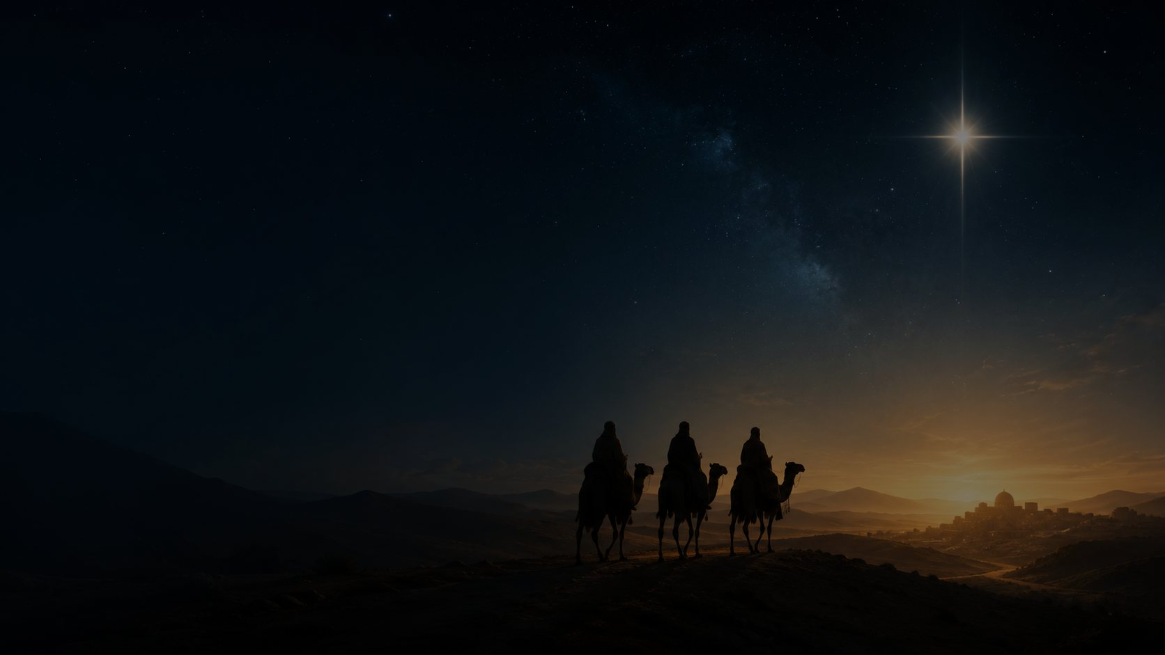
As with Gladness
Men of Old
An Epiphany hymn of guidance, worship, offering, and eternal hope
William Chatterton Dix • 1859
Tune: DIX • Conrad Kocher, adapted by William Henry Monk
Primary Scripture: Matthew 2:10-11
Prepared for teaching and small group use - hymninfo.com
HymnInfo.com

Slide 2

Teaching Aim
UNDERSTAND
The wise men’s journey becomes a pattern of Christian discipleship: receiving light, seeking Christ, worshiping him, and bringing our best.
FEEL
A renewed joy that Christ is the Light who draws the nations and guides his people toward glory.
PRACTICE
Bring worship, obedience, generosity, and hope into ordinary life as an offering to Christ the King.
Prepared for teaching and small group use - hymninfo.com
HymnInfo.com

Slide 3
Why This Hymn Matters Today
This hymn helps the church sing the Gospel movement of Epiphany: God gives light, Christ is revealed, worshipers come near, and the nations are invited to adore the King.
It turns a biblical story into prayerful discipleship.
It teaches that guidance should lead us to Christ, not merely to answers.
It connects offering with whole-life consecration.
It lifts weary pilgrims toward the final light of God’s city.
When they saw the star, they rejoiced with exceedingly great joy.
Matthew 2:10
Prepared for teaching and small group use - hymninfo.com
HymnInfo.com

Slide 4

Hymn Identity
FIRST LINE
COMPOSER SOURCE
As with gladness men of old
Conrad Kocher (1786-1872)
AUTHOR
ADAPTATION
William Chatterton Dix (1837-1898)
William Henry Monk for English hymn use
YEAR
METER
1859
7.7.7.7.7.7
TUNE
SEASON
DIX
Epiphany
Prepared for teaching and small group use - hymninfo.com
HymnInfo.com

Slide 5

Historical Background
William Chatterton Dix wrote the hymn for Epiphany and published it in Hymns of Love and Joy in 1859. Its inclusion in Hymns Ancient and Modern helped establish its place in English-language worship.
The tune DIX came through Conrad Kocher’s melody and William Henry Monk’s adaptation. Its calm forward movement fits the hymn’s theme of pilgrimage toward Christ.
A traditional illness account is often repeated in hymn commentary, but the strongest teaching points rest on the securely documented publication and hymn use.
Prepared for teaching and small group use - hymninfo.com
HymnInfo.com

Slide 6
Biblical Foundation: Matthew 2
The hymn begins with the wise men’s response to Christ: they see the star, rejoice greatly, come to the child, fall down in worship, and open their treasures.
FOUR MOVEMENTS IN MATTHEW 2:10-11
Guidance: the star leads them onward.
Joy: their search is marked by gladness.
Worship: they bow before Christ.
Offering: their treasures become homage.
Prepared for teaching and small group use - hymninfo.com
HymnInfo.com

Slide 7
Scripture Echoes
ISAIAH 60:3
JOHN 8:12
Nations come to God’s light.
Christ is the Light of the world.
PSALM 72:10-11
REVELATION 21:23-24
Kings bring tribute and all nations serve the righteous King.
The Lamb illumines the final city.
Together these passages show that Epiphany is not only about a star in the sky. It is about Christ revealed as King, Light, and hope for the nations.
Prepared for teaching and small group use - hymninfo.com
HymnInfo.com

Slide 8
The Magi’s Pattern
SEE
SEEK
BOW
BRING
HOPE
God gives light
The heart moves toward Christ
Worship bends before the King
The whole life becomes offering
The journey ends in glory
The hymn’s pastoral power is its movement. It does not merely retell the story; it trains believers in the response of faith.
Prepared for teaching and small group use - hymninfo.com
HymnInfo.com

Slide 9
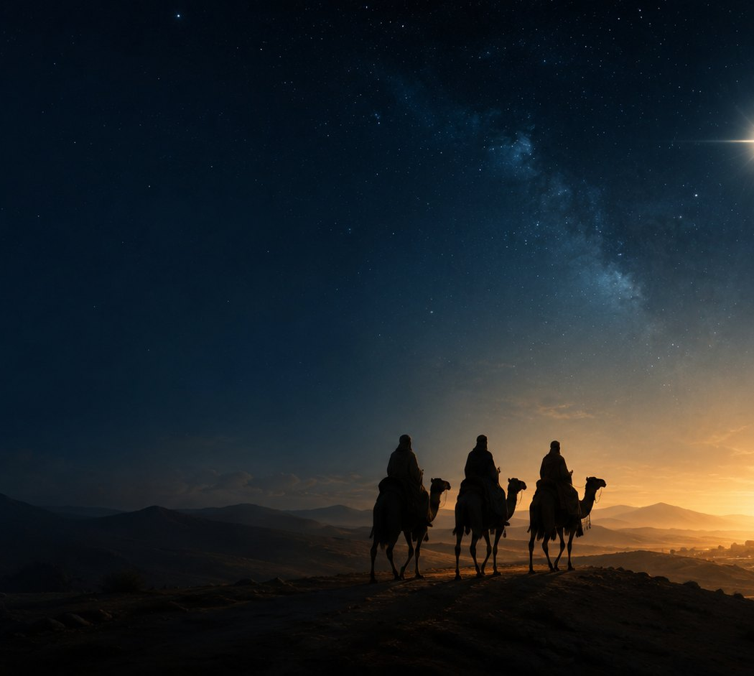
Stanza 1: Guided Joy
The opening stanza remembers the wise men beholding the guiding star with gladness. Their joy becomes a prayer that believers may continue to see the splendor of Christ.
TEACHING EMPHASIS
God’s guidance is gracious before it is demanded.
True guidance leads toward Christ, not away from him.
Joy belongs to Christian obedience.
So, most gracious Lord, may we evermore your splendor see.
Stanza 1
Prepared for teaching and small group use - hymninfo.com
HymnInfo.com

Slide 10
Stanza 2: Reverent Seeking
The second stanza moves from the journey to the act of worship. The wise men bow before Christ, and the church is invited to seek him with reverence and holy urgency.
Worship is not mere admiration; it is surrender.
The lowly manger reveals the King whom heaven and earth adore.
The throne of grace is approached with humble confidence.
Leader prompt: What keeps believers from “hurrying” toward Christ in prayer, worship, and obedience?
Prepared for teaching and small group use - hymninfo.com
HymnInfo.com

Slide 11

Stanza 3: Offering Our Best
The gifts of the wise men become a picture of whole-life consecration. We bring our “costliest treasures” not to purchase grace, but to honor Christ as heavenly King.
OFFERINGS TO NAME IN CLASS
Time and attention
Obedience in a costly area
Generosity and service
Repentance and surrendered pride
Skills used for the church’s good
Prepared for teaching and small group use - hymninfo.com
HymnInfo.com

Slide 12
Stanza 4: Pilgrim Perseverance
The hymn becomes a prayer for Christ to remain with his people and help them walk in his holy way. The Epiphany journey turns into a lifelong pilgrimage of obedience.
PASTORAL CONNECTIONS
For the weary: Christ walks with pilgrims.
For the wandering: Christ calls us back to his holy way.
For the hopeful: earthly things are passing, but the kingdom remains.
Prepared for teaching and small group use - hymninfo.com
HymnInfo.com

Slide 13

Stanza 5: The Heavenly City
The final stanza lifts the congregation beyond earthly signs to the city where Christ himself is light, joy, crown, and everlasting sun.
No created light is needed.
No clouds hide his glory.
The journey ends in praise.
The nations walk in the Lamb’s light.
The city has no need for the sun... for the very glory of God illuminated it.
Revelation 21:23
Prepared for teaching and small group use - hymninfo.com
HymnInfo.com

Slide 14
Theological Themes
REVELATION
God graciously gives light and draws seekers to Christ.
WORSHIP
The proper response to Christ is humble adoration.
OFFERING
True worship brings the whole self to the King.
DISCIPLESHIP
Guidance becomes holy walking.
HOPE
The pilgrim road ends in the unveiled glory of God.
Prepared for teaching and small group use - hymninfo.com
HymnInfo.com

Slide 15
Christ the Light of the World
The star is temporary. Christ is eternal. Epiphany faith learns to receive signs gratefully without mistaking them for the Savior.
FROM PROPHECY TO FULFILLMENT
Isaiah: nations come to the brightness of God’s rising.
Matthew: the wise men rejoice and worship Christ.
John: Jesus declares himself the Light of the world.
Revelation: the Lamb illumines the redeemed city.
Teaching caution: the star is a guide; Christ is the goal.
Prepared for teaching and small group use - hymninfo.com
HymnInfo.com

Slide 16
Literary and Musical Observations
TEXT MOVEMENT
TUNE CHARACTER
Biblical narrative becomes prayer.
The repeated “as...so” pattern connects the wise men with today’s worshipers.
The emotional tone is reverent, bright, and pilgrim-like.
DIX is balanced and dignified.
The 7.7.7.7.7.7 meter supports clear congregational phrasing.
A steady tempo helps the hymn feel like faithful forward motion.
CHOIR AND CONGREGATION
Choirs can shape each stanza with gentle dynamic growth, especially from the earthly journey to the final vision of heavenly light.
Prepared for teaching and small group use - hymninfo.com
HymnInfo.com

Slide 17
Pastoral and Worship Use
USEFUL OCCASIONS
Epiphany and the Christmas season
Services about Christ as Light and King
Mission or nations-focused worship
Offering or consecration themes
Lessons on guidance, pilgrimage, and hope
SERVICE PLACEMENT
Opening hymn, hymn after Scripture, response to sermon, or closing hymn that sends the congregation to follow Christ’s light.
Prepared for teaching and small group use - hymninfo.com
HymnInfo.com

Slide 18
Teaching Questions
How does Matthew 2:10-11 shape the hymn’s central message?
What does the image of light teach about Christ and Christian discipleship?
How does the hymn turn the wise men’s journey into a model for believers?
What might it mean to bring your best to Christ in ordinary life?
How does the final stanza encourage weary pilgrims?
Invite learners to move from observation to response: What will I seek, bow before, bring, and hope for this week?
Prepared for teaching and small group use - hymninfo.com
HymnInfo.com

Slide 19
Application: Follow the Light
Seek
Begin each day by asking Christ to guide one concrete decision.
Bow
Practice reverent prayer before rushing into requests.
Bring
Offer one costly act of obedience, generosity, or service.
Walk
Take one step away from darkness and toward Christ’s holy way.
Hope
Read Revelation 21:23-24 and pray for endurance.
Prepared for teaching and small group use - hymninfo.com
HymnInfo.com

Slide 20
Suggested Lesson Flow
30-MINUTE LESSON
60-MINUTE LESSON
Read Matthew 2:10-11 and sing one stanza.
Explain hymn identity and Epiphany setting.
Teach the five movements: see, seek, bow, bring, hope.
Discuss one application question and close in prayer.
Read Matthew 2, Isaiah 60:3, and Revelation 21:23-24.
Walk stanza by stanza with Scripture connections.
Discuss offering as whole-life consecration.
Plan one congregational or personal response.
Close by singing the final stanza.
For choirs: use the lesson to deepen phrasing, tone, and theological intention before rehearsal.
Prepared for teaching and small group use - hymninfo.com
HymnInfo.com

Slide 21
Closing Summary and Prayer
As with Gladness Men of Old leads worshipers from the star to Christ, from seeking to worship, from gifts to whole-life offering, and from earthly pilgrimage to the unveiled light of God’s city.
Lord Jesus Christ, Light of the world, guide us to seek you with joy, worship you with reverence, offer you our best, and walk in hope until we see your glory fully. Amen.
© HymnInfo.com. Free for personal, church, classroom, and small-group teaching use. Please do not sell, repost, or redistribute as downloadable files without permission.
Prepared for teaching and small group use - hymninfo.com
HymnInfo.com

