Slide 1
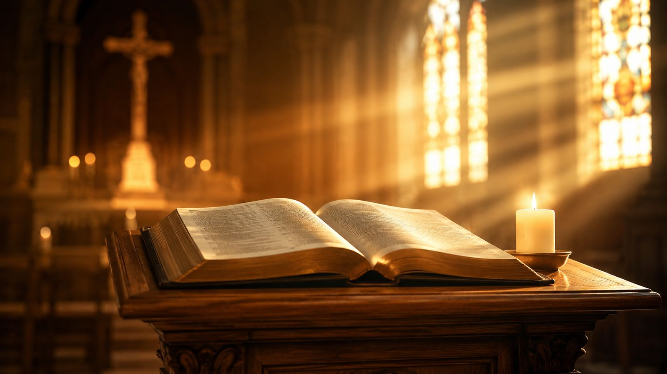
Hymn Study Teaching Guide
Begin, My Tongue, Some Heavenly Theme
First line: Begin, my tongue, some heavenly theme
Isaac Watts • 1707
Common Meter • often sung to MANOAH
Primary Scripture: Psalm 89:1-2
Prepared for teaching and small group use - hymninfo.com

Slide 2
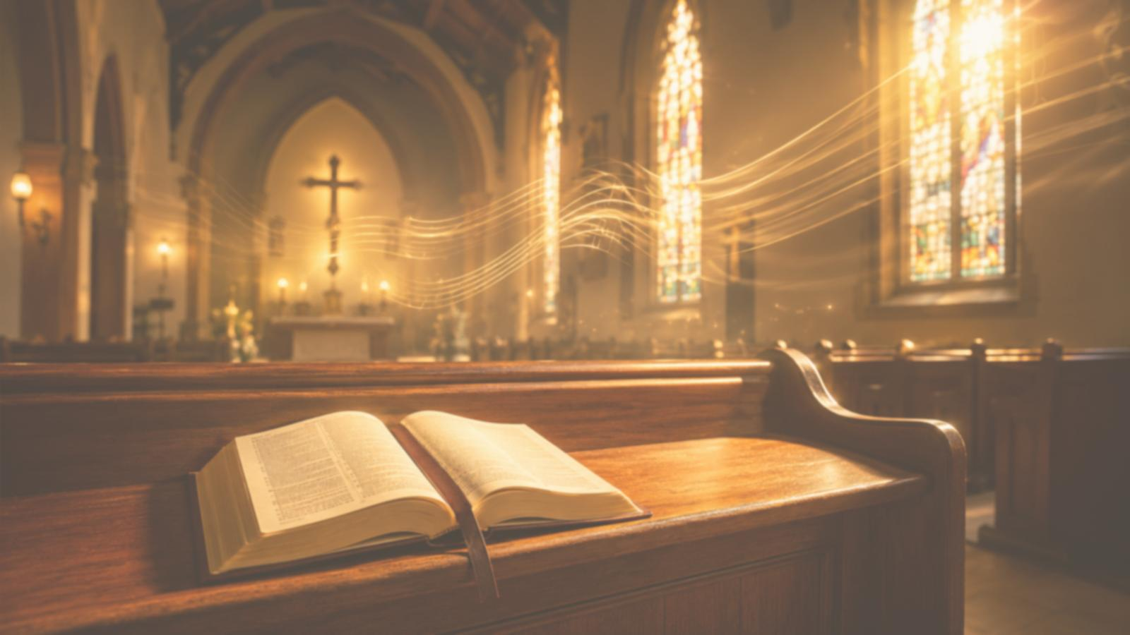
Teaching Aim
By the end of the lesson, learners should be able to:
✓
♥
→
Understand
Feel
Practice
God's promises rest on his unchanging faithfulness.
Assurance that Christian hope is grounded in God's word, not mood.
Answer God's revealed faithfulness with praise, trust, and testimony.
Prepared for teaching and small group use - hymninfo.com

Slide 3
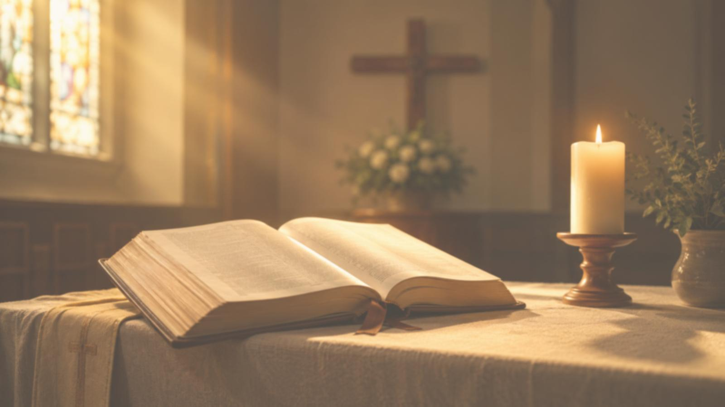
Hymn Identity
TITLE
Begin, My Tongue, Some Heavenly Theme
Core emphasis
FIRST LINE
Begin, my tongue, some heavenly theme
Praise begins with God’s own revealed faithfulness.
Creation, providence, and grace all display one reliable Lord.
The church sings because God’s promise can be trusted.
AUTHOR
Isaac Watts (1674-1748)
COMMON TUNE
MANOAH
METER
Common Meter (8.6.8.6)
SETTING
Watts’s Hymns and Spiritual Songs, 1707
Prepared for teaching and small group use - hymninfo.com

Slide 4
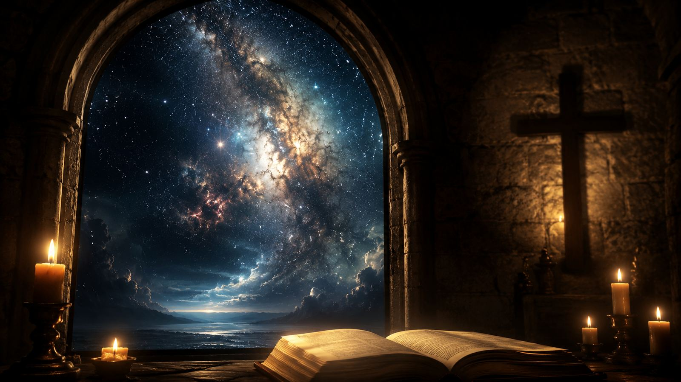
Section 1
The Faithfulness of God in His Promises
A hymn that teaches praise as confident testimony.
Prepared for teaching and small group use - hymninfo.com

Slide 5
Historical Background
Isaac Watts and English hymnody
Published in 1707 in Hymns and Spiritual Songs.
Identified in older indexes under “The faithfulness of God in his promises.”
Watts helped English-speaking churches sing Christian doctrine in congregational form.
Teaching caution
The text appears with several Common Meter tunes.
MANOAH is a frequent pairing; ST. MAGNUS and ST. ANNE also appear in hymnals.
DUKE STREET is Long Meter and is not a natural fit.
Prepared for teaching and small group use - hymninfo.com

Slide 6
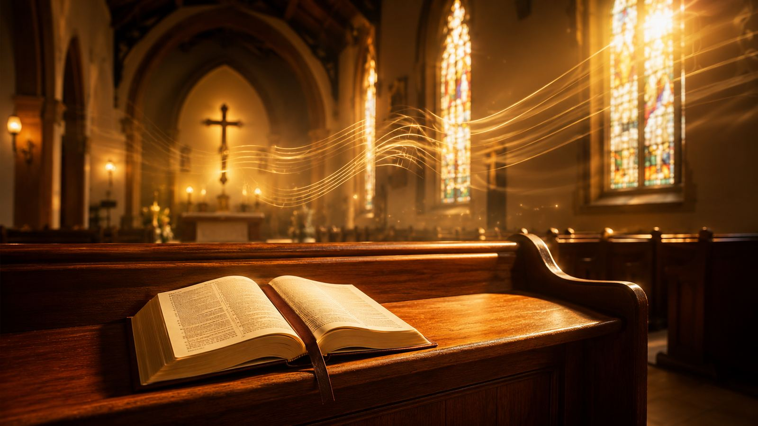
Why This Hymn Matters Today
Ministry value
Faith needs a stronger anchor than feeling.
Worship: opens or answers Scripture reading
An anxious church needs songs of settled promise.
A distracted church needs words that train the tongue to praise.
A weary church needs assurance rooted in God’s character.
Teaching: ties doctrine to song
Pastoral care: steadies hope
Choir: rewards clear textual singing
Prepared for teaching and small group use - hymninfo.com

Slide 7

Biblical Foundation
Primary text
Supporting passages
Psalm 89:1-2
Psalm 145:3-4 - one generation commends God’s works.
Hebrews 10:23 - hold fast because the Promiser is faithful.
2 Corinthians 1:20 - God’s promises find their “Yes” in Christ.
Hebrews 1:3 - the Son upholds all things by his powerful word.
The mouth makes God’s faithfulness known.
Love stands firm forever.
Faithfulness is established in the heavens.
Prepared for teaching and small group use - hymninfo.com

Slide 8
Section 2
The Hymn’s Movement
From summoned praise to personal assurance.
Prepared for teaching and small group use - hymninfo.com

Slide 9
Stanza 1: The Tongue Is Called to Praise
The hymn begins with a summons. Praise is not a private mood only; it becomes spoken testimony before God and neighbor.
Teaching emphasis
Ask: What “heavenly theme” should fill our speech?
Connect to Psalm 89: faithful love made known with the mouth.
Teach praise as disciplined witness, not mere religious ornament.
Prepared for teaching and small group use - hymninfo.com

Slide 10
Stanza 2: God’s Promise Is Sweet and Strong
Watts points the singer toward God’s faithfulness, power, grace, love, and truth. Promise and character belong together.
Teaching emphasis
Assurance is grounded in who God is.
Promises are “sweet” because they come from a faithful Lord.
The church sings hope so the heart can learn trust.
Prepared for teaching and small group use - hymninfo.com

Slide 11
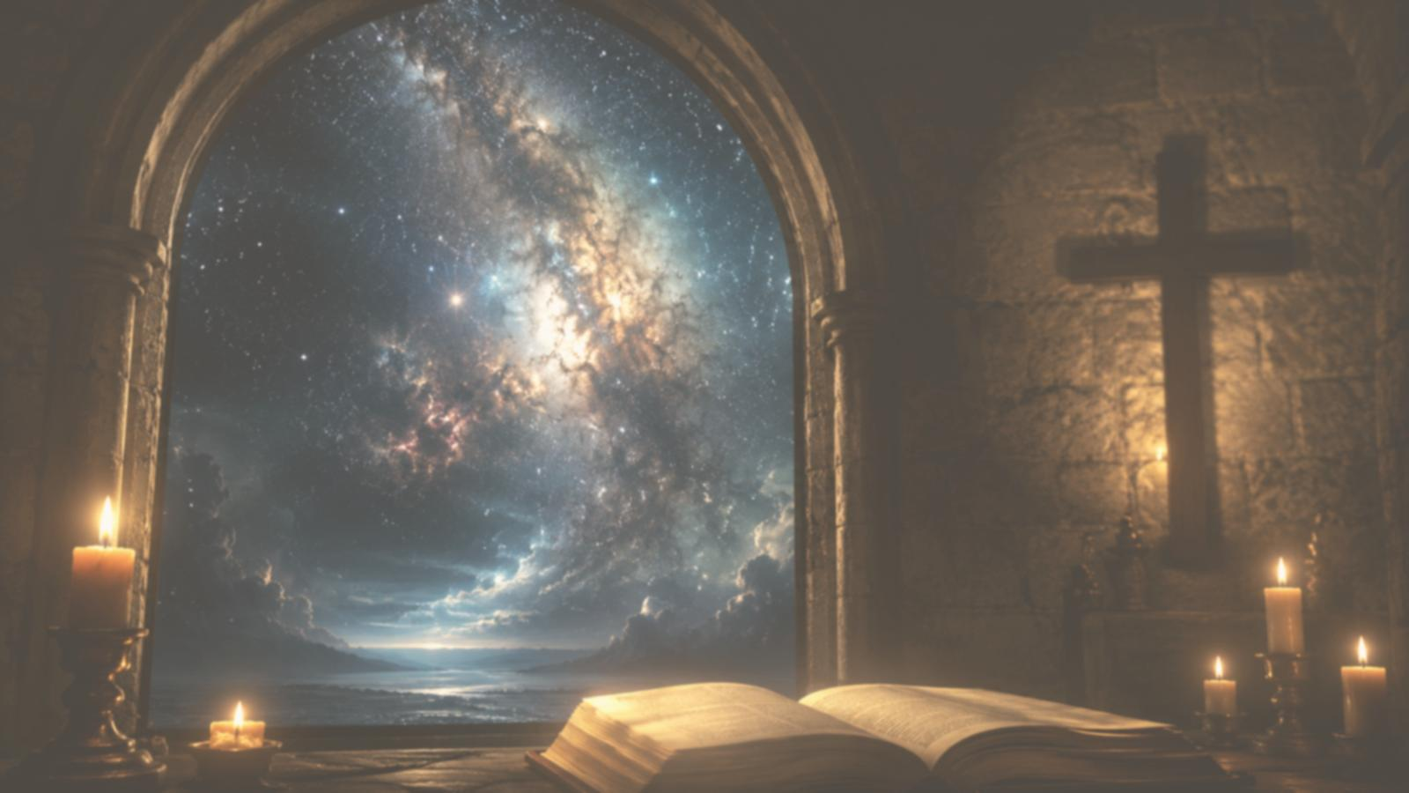
Stanza 3: The Word That Built the Skies
The hymn joins creation and revelation: the word that displays power in the heavens also speaks grace to God’s people.
Teaching emphasis
Use Hebrews 1:3: Christ upholds all things by his word.
The same God who sustains creation sustains faith.
Do not separate cosmic power from covenant mercy.
Prepared for teaching and small group use - hymninfo.com

Slide 12

Stanza 4: Assurance Heard Personally
The closing movement turns the doctrine of promise into personal comfort: God’s word raises the song of the believer.
Teaching emphasis
God’s promise becomes pastoral consolation.
Assurance should lead to praise, not spiritual pride.
Christ is the “Yes” of God’s promises.
Prepared for teaching and small group use - hymninfo.com

Slide 13
Theological Themes
Six truths to listen for when teaching or singing this hymn
Faithfulness
Promise
Providence
God keeps his word.
Christian hope rests on revelation.
The Creator sustains what he has made.
Assurance
Praise
Christ
Confidence grows from God’s character.
The tongue becomes witness.
God’s promises find their Yes in the Son.
Prepared for teaching and small group use - hymninfo.com

Slide 14
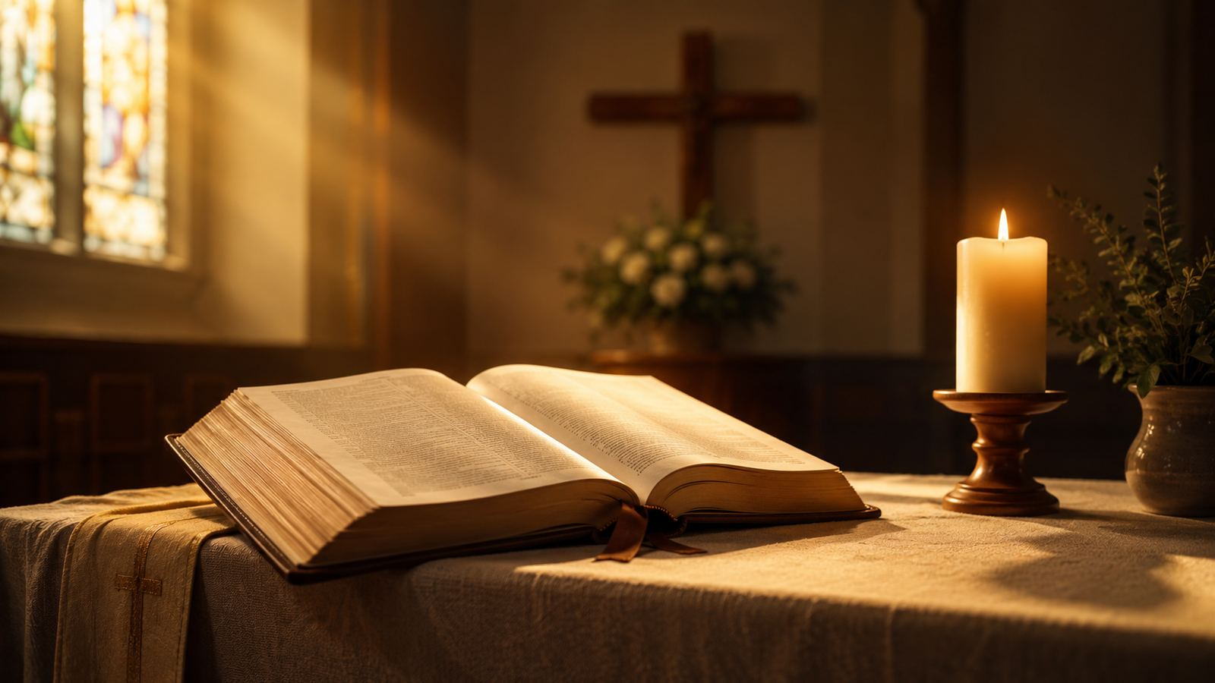
Literary and Musical Observations
Textual movement
Musical use
Speech is summoned to a high subject.
God’s works and name are greater than the singer can exhaust.
The hymn moves from doctrine to assurance.
Common Meter (8.6.8.6): familiar, sturdy, and singable.
MANOAH carries gentle strength and clear phrasing.
Choose a tempo that lets the congregation hear “word,” “promise,” and “faithfulness.”
Prepared for teaching and small group use - hymninfo.com

Slide 15
Pastoral and Worship Use
Use it when...
Lead it with...
Best paired with
Opening a service of praise
Responding to Scripture
Teaching assurance
Giving thanks for providence
Clear diction
Moderate tempo
A spoken Scripture frame
Brief explanation of promise
Psalm 89
Hebrews 10
2 Corinthians 1
Sermons on God’s promises
Prepared for teaching and small group use - hymninfo.com

Slide 16
Teaching Questions
1
What does it mean for Christian speech to take up a heavenly theme?
2
How does the hymn connect God’s mighty works with God’s faithful promises?
3
Why is the faithfulness of God important when a believer feels weak?
4
How does Hebrews 10:23 sharpen the hymn’s message?
5
How can congregational singing help people remember God’s promises?
Prepared for teaching and small group use - hymninfo.com

Slide 17
Application and Lesson Flow
Practice this week
Suggested lesson flow
Choose one promise of God to memorize.
Speak one testimony of God’s faithfulness to another believer.
Begin prayer by naming God’s works before asking for needs.
Sing a Common Meter tune slowly and listen for the doctrine.
30 minutes: Scripture, hymn identity, one stanza, discussion, prayer.
60 minutes: Add historical background, full hymn movement, tune notes, and applications.
Close by asking: Which promise of God do we need to hold fast today?
Prepared for teaching and small group use - hymninfo.com

Slide 18
Closing Summary
God’s promises are trustworthy because God is faithful.
The Word that sustains creation also speaks grace.
Praise becomes testimony when the church sings what God has promised.
Lord, tune our speech to your faithfulness, steady our hope in your promises, and raise our song through Jesus Christ. Amen.
© HymnInfo.com. Free for personal, church, classroom, and small-group teaching use. Please do not sell, repost, or redistribute as downloadable files without permission.
Prepared for teaching and small group use - hymninfo.com

