Slide 1

Blest Be the Tie That Binds
A hymn study on Christian fellowship and unity in Christ
First line: Blest be the tie that binds our hearts in Christian love
John Fawcett • 1782 • Tune: DENNIS • Colossians 3:14
Prepared for teaching and small group use - hymninfo.com

Slide 2
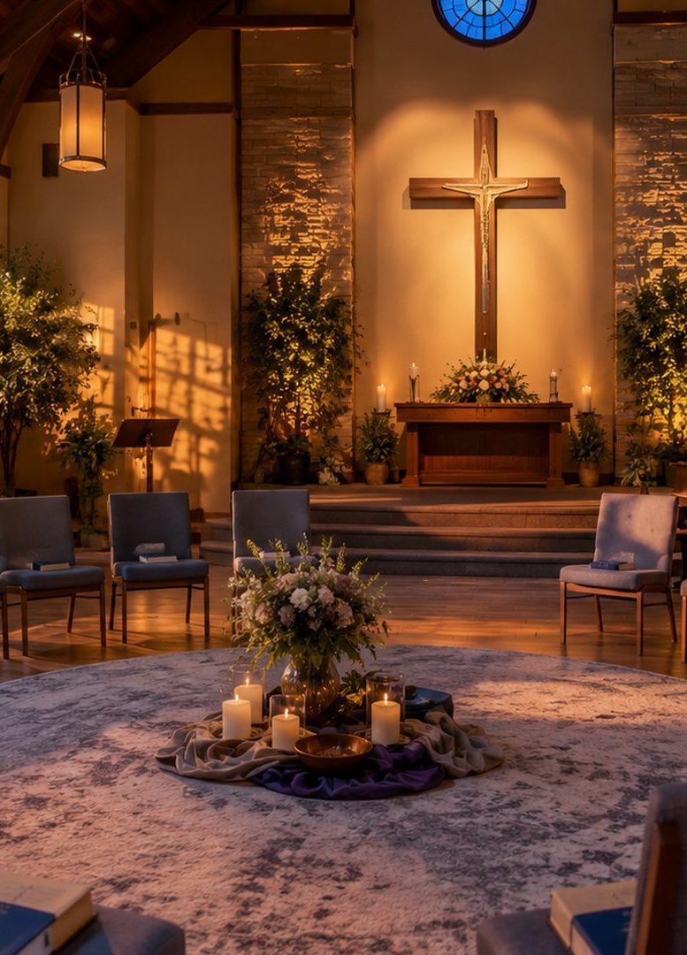
Teaching Aim
Understand, feel, and practice the fellowship Christ gives.
Understand
Unity in Christ is more than social warmth.
Feel
The tenderness of shared prayer, burdens, and hope.
Practice
Concrete love through prayer, repair, and care.
Prepared for teaching and small group use - hymninfo.com

Slide 3

Hymn Identity
A pastoral hymn of brotherly love and the communion of believers.
Author: John Fawcett, English Baptist pastor and hymn writer
First publication: 1782, under the heading Brotherly Love
Tune: DENNIS, commonly associated with Johann Georg Nägeli and Lowell Mason
Meter: Short Meter, 6.6.8.6
Prepared for teaching and small group use - hymninfo.com

Slide 4

John Fawcett
Pastor and hymn writer with a heart for congregational life.
Served Baptist congregations in Yorkshire.
Wrote with a pastor's care for ordinary church life.
The familiar story of remaining with his congregation is best taught as a cherished tradition.
The hymn gives language for affection, prayer, parting, and hope.
Prepared for teaching and small group use - hymninfo.com

Slide 5
The Tune DENNIS
A gentle Short Meter tune that carries the text with warmth.
Commonly attributed to Johann Georg Nägeli.
Arranged by Lowell Mason for nineteenth-century hymnal use.
Modest range and steady phrases help congregations sing thoughtfully.
Best sung with warmth, clear phrasing, and unhurried tempo.
Prepared for teaching and small group use - hymninfo.com

Slide 6
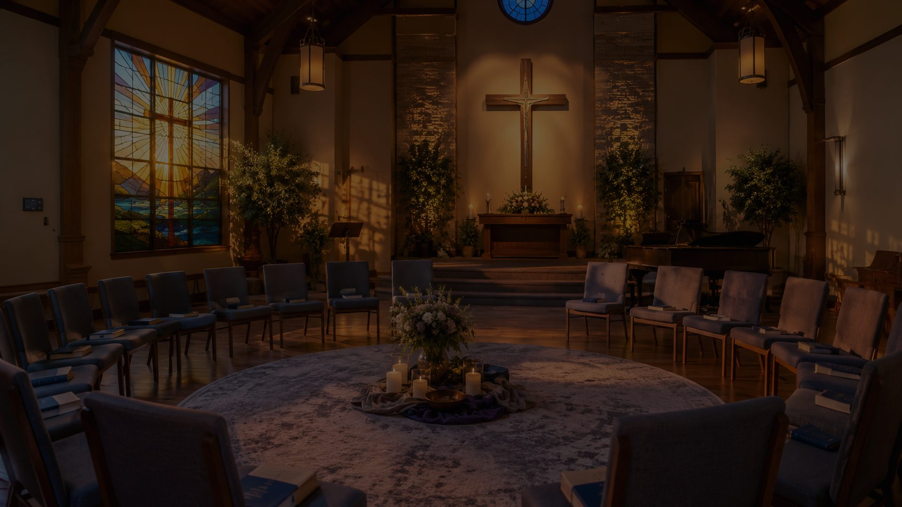
Why This Hymn Matters Today
Many churches gather often, but fellowship still needs tending.
Pastoral
It speaks honestly about belonging, grief, and parting.
Worship
It gives congregations a shared voice of love and prayer.
Teaching
It explains the church as one body in Christ.
From friendly attendance to prayerful, burden-bearing fellowship.
Prepared for teaching and small group use - hymninfo.com

Slide 7
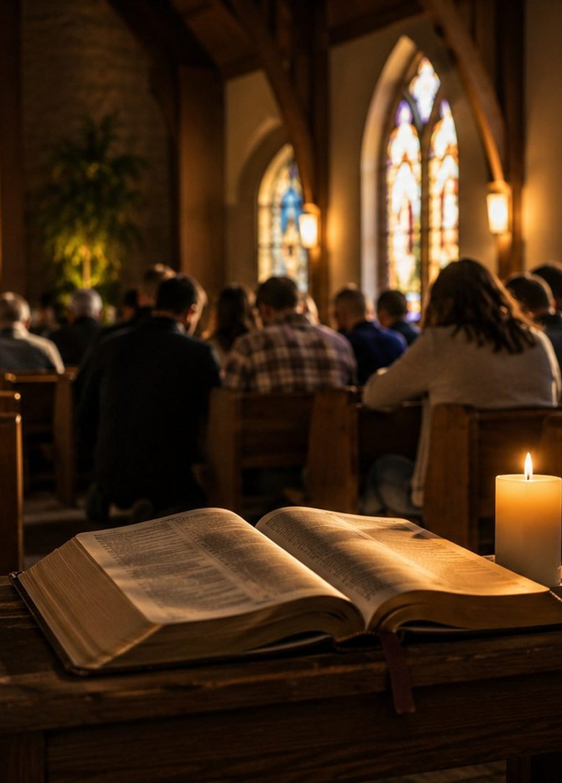
Biblical Foundation
Love is the bond, fellowship is the practice, hope is the horizon.
Colossians 3:14 — love is the bond of maturity and wholeness.
John 13:34-35 — love marks the disciples of Jesus.
Acts 2:42-44 — the church shares teaching, prayer, and common life.
Romans 12 and 1 Corinthians 12 — many members belong to one body.
Prepared for teaching and small group use - hymninfo.com

Slide 8

Stanza Study
From love, to prayer, to burdens, to hope.
Prepared for teaching and small group use - hymninfo.com

Slide 9
Stanza 1: The Bond of Love
Christian fellowship begins in Christlike love.
The opening image is a holy tie: hearts joined in Christian love.
This unity is deeper than preference, heritage, or convenience.
Teaching emphasis: the church is a spiritual family formed by grace.
Prepared for teaching and small group use - hymninfo.com

Slide 10
Stanza 2: Shared Prayer
The fellowship of the church gathers before the Father.
The hymn connects fellowship with common prayer.
Believers bring shared fears, hopes, comforts, and cares.
Teaching emphasis: prayer changes fellowship from social contact into spiritual communion.
Prepared for teaching and small group use - hymninfo.com

Slide 11
Stanza 3: Mutual Burdens
Christian love becomes visible in shared sorrow.
The hymn refuses shallow fellowship that only celebrates together.
The body of Christ shares grief, weakness, and practical need.
Teaching emphasis: compassion must take concrete form.
Prepared for teaching and small group use - hymninfo.com

Slide 12
Stanza 4: Parting and Pain
The hymn tells the truth about separation.
Farewells hurt because love is real.
Distance does not erase belonging in Christ.
Teaching emphasis: Christian hope names pain without surrendering to despair.
Prepared for teaching and small group use - hymninfo.com

Slide 13
Final Hope: Fellowship Completed
The communion of saints points beyond the present age.
The hymn looks toward freedom from sorrow, toil, pain, and sin.
Earthly fellowship becomes a foretaste of perfected love.
Teaching emphasis: Christian community is both present gift and future promise.
Prepared for teaching and small group use - hymninfo.com

Slide 14
Theological Themes
What does the hymn teach the church to believe?
Communion of Saints
Believers are joined to Christ and to one another.
Unity of the Spirit
Fellowship is a gift to guard with humility and patience.
Mutual Care
Love carries burdens, griefs, prayers, and responsibilities.
Christian Hope
The church lives toward a final fellowship where love is perfected.
Prepared for teaching and small group use - hymninfo.com

Slide 15
Literary Movement
The hymn follows the pastoral arc of congregational life.
Love binds hearts.
Prayer gathers the church before the Father.
Mutual care shares sorrow and need.
Parting brings pain, but hope looks toward reunion.
Final fellowship completes what earthly fellowship begins.
Prepared for teaching and small group use - hymninfo.com

Slide 16
Musical Observations
DENNIS supports quiet strength rather than sentimentality.
Short Meter: 6.6.8.6
Gentle contour and modest range make the tune congregationally accessible.
A moderate tempo allows the words to carry pastoral weight.
Useful for communion, farewell, covenant, church anniversary, and small-group gatherings.
Prepared for teaching and small group use - hymninfo.com

Slide 17
Pastoral and Worship Use
Where the hymn serves the church well.
Farewells
When members move, retire, or leave for ministry.
Communion
When the table calls the body to unity and love.
Covenant
When the church renews shared commitment.
Small Groups
Useful for teaching prayer, burden-bearing, reconciliation, and fellowship.
Prepared for teaching and small group use - hymninfo.com

Slide 18
Teaching and Choir Notes
Lead the hymn as prayerful fellowship, not nostalgia.
Invite singers to shape phrases warmly and clearly.
Avoid rushing; let the text sound like shared prayer.
Before singing, read John 13:34-35 or Colossians 3:14.
In rehearsal, ask how the sound should change when the text turns toward sorrow and hope.
Prepared for teaching and small group use - hymninfo.com

Slide 19
Teaching Questions
Move from observation to practice.
What makes Christian fellowship different from ordinary friendship?
How do prayer and burden-bearing deepen the life of a church?
Why does love make parting painful?
What helps a congregation guard unity without ignoring wounds?
What practice could strengthen fellowship this month?
Prepared for teaching and small group use - hymninfo.com

Slide 20

Application
The tie of love must be practiced.
Pray
Name specific people before the Father.
Bear
Share burdens with practical care.
Repair
Seek reconciliation where fellowship is strained.
Hope
Comfort one another with the promise of fellowship made complete in Christ.
Prepared for teaching and small group use - hymninfo.com

Slide 21
Suggested Lesson Flow
Two ways to teach the hymn.
30 Minutes
1. Read Colossians 3:14
2. Tell Fawcett background
3. Study the hymn movement
4. Discuss one application
5. Close in prayer
60 Minutes
1. Read John 13 and Colossians 3
2. Teach history and tune
3. Walk through each section
4. Discuss fellowship practices
5. Plan one concrete act of care
Prepared for teaching and small group use - hymninfo.com

Slide 22
Pastoral Cautions
Teach fellowship with honesty and hope.
Do not reduce Christian fellowship to friendliness.
Do not use unity language to silence grief, disagreement, or needed repentance.
Keep Christ at the center: he creates and sustains the church's bond.
Make application concrete: prayer, listening, meals, visits, forgiveness, and faithful presence.
Prepared for teaching and small group use - hymninfo.com

Slide 23
Closing Summary and Prayer
Bind us together in the love of Christ.
Christian fellowship is a grace to receive.
Mutual care is a calling to practice.
Final fellowship is a hope to cherish.
Prayer
Father, bind our hearts together in Christ. Teach us to pray, bear burdens, and keep the unity of the Spirit in the bond of peace. Amen.
Prepared for teaching and small group use - hymninfo.com

Slide 24
Usage Notice
© HymnInfo.com. Free for personal, church, classroom, and small-group teaching use.
Please do not sell, repost, or redistribute as downloadable files without permission.
Prepared for teaching and small group use - hymninfo.com

