Slide 1

Break Thou the Bread of Life
A hymn study on Scripture, illumination, and spiritual nourishment
First line: Break thou the bread of life, dear Lord, to me
Mary Artemisia Lathbury • William F. Sherwin • 1877
Primary Scriptures: John 6:35; Luke 24:30-32
Prepared for teaching and small group use - hymninfo.com

Slide 2
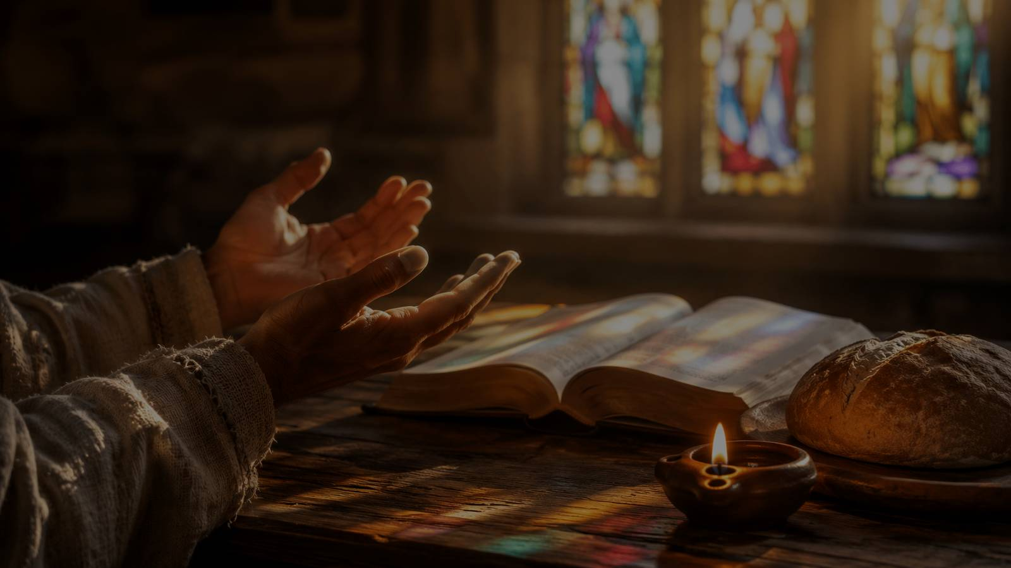
Teaching Aim
A lesson that moves from understanding to prayerful practice
Understand
Feel
Practice
Scripture is not merely material to analyze. It is a means through which Christ feeds, teaches, corrects, and comforts his people.
Hunger for God’s Word, reverence before Christ, and humble dependence on the Spirit’s illuminating grace.
Pray before reading, teaching, and hearing Scripture; receive the Word with faith, obedience, and gratitude.
▭
Word
✦
Prayer
●
Nourishment
Prepared for teaching and small group use - hymninfo.com

Slide 3

Hymn Identity
A Bible-study hymn shaped by prayer, teaching, and spiritual hunger
Title
Break Thou the Bread of Life
First line
Break thou the bread of life, dear Lord, to me
Author
Mary Artemisia Lathbury
Tune
BREAD OF LIFE by William Fisk Sherwin
Meter
6.4.6.4.D
Setting
Chautauqua Sunday School Assembly, 1877
Prepared for teaching and small group use - hymninfo.com

Slide 4
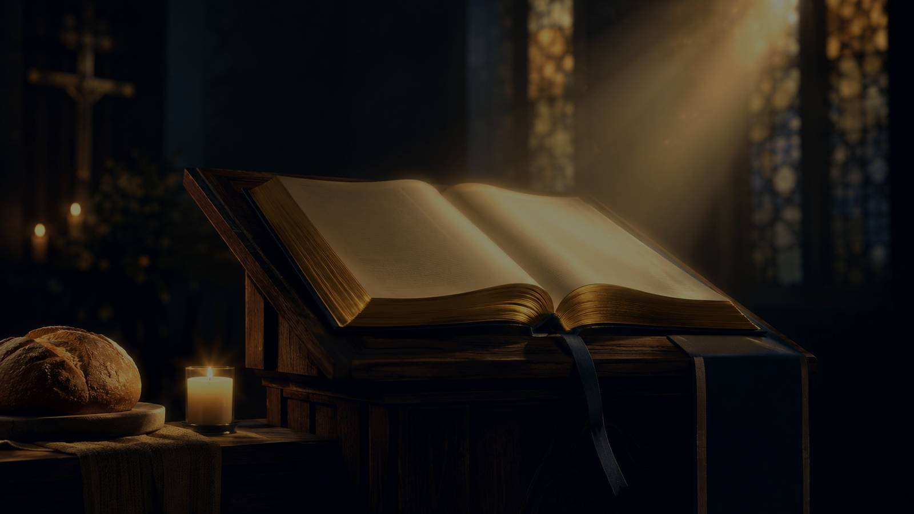
HISTORICAL AND DEVOTIONAL SETTING
The Word That Feeds
Prepared for teaching and small group use - hymninfo.com

Slide 5
Historical Background
Mary A. Lathbury
Chautauqua, 1877
American Methodist writer, artist, educator, and hymn writer. Her gifts served Christian teaching and devotional formation.
The hymn was written for Bible-study use among teacher-training classes at the Chautauqua Sunday School Assembly.
William F. Sherwin
Expanded Forms
Chautauqua music director and composer of BREAD OF LIFE, a quiet tune made for prayerful congregational singing.
Some hymnals include additional stanzas associated with Alexander Groves, broadening the prayer for truth and illumination.
Prepared for teaching and small group use - hymninfo.com

Slide 6
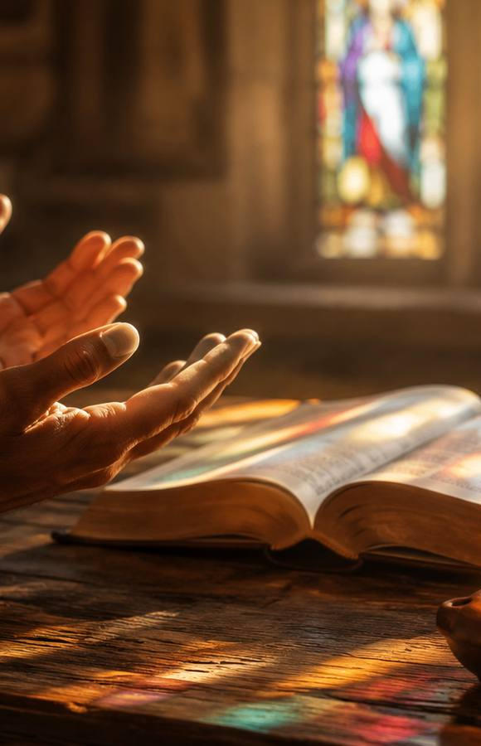
Why This Hymn Matters Today
It gives worshipers words to pray before Bible study, preaching, and teaching.
It protects Christian education from becoming mere information transfer.
It reminds the church that Scripture points us to the living Christ.
It teaches dependence on the Spirit’s work of opening eyes and hearts.
It helps families, classes, choirs, and congregations receive the Word with hunger.
Prepared for teaching and small group use - hymninfo.com

Slide 7
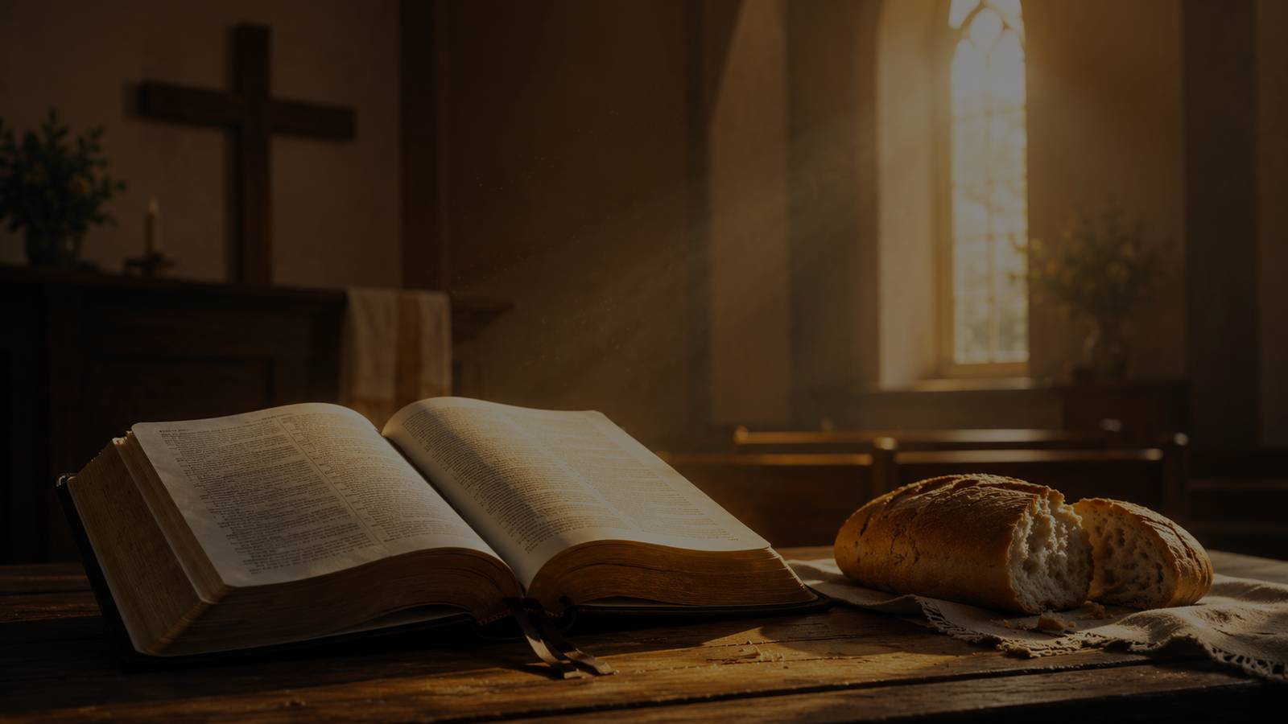
BREAD, WORD, AND OPENED EYES
Biblical Foundation
Prepared for teaching and small group use - hymninfo.com

Slide 8

Biblical Foundation
John 6:35
Luke 24:30-32
Christ is the Bread of Life who satisfies spiritual hunger.
The risen Lord is known as he opens Scripture and breaks bread.
Matthew 4:4
Psalm 119:18
Human life depends on every word that comes from God.
The faithful reader prays for opened eyes.
Acts 2:42
The church is formed by teaching, fellowship, prayer, and shared life.
Prepared for teaching and small group use - hymninfo.com

Slide 9

STANZA AND SECTION STUDY
The Hymn as Prayer
Prepared for teaching and small group use - hymninfo.com

Slide 10

Opening Prayer: Feed Us Through the Word
The opening movement asks the Lord to make Scripture nourishing. The bread image is not casual decoration; it names a deep hunger that only Christ can satisfy.
Key Image
Scripture Link
Bread received from Christ: spiritual nourishment through the Word.
John 6:35 and Matthew 4:4.
Teaching Emphasis
Ask learners to read Scripture as hungry people before a gracious Lord, not as detached observers.
Prepared for teaching and small group use - hymninfo.com

Slide 11
Blessed Truth: Freedom and Peace
The hymn asks that truth be blessed to the worshiper. God’s Word is meant to loosen bondage, expose false peace, and bring the soul to rest in Christ.
Key Image
Scripture Link
Truth that frees the bound heart.
John 8:31-32 may be paired with the study.
Teaching question: What would change if Bible study aimed at obedient freedom, not merely correct answers?
Prepared for teaching and small group use - hymninfo.com

Slide 12
Bread of Life and Illumination
Expanded stanza material widens the prayer from nourishment to sight.
Christ the Living Word
The Spirit Opens Eyes
The Bible nourishes because it bears witness to the Lord who gives life.
True understanding is more than technique; it is a gracious work of God.
Teaching Emphasis
Encourage students to hold together careful study and humble prayer. God often uses disciplined attention as the setting for gracious illumination.
Prepared for teaching and small group use - hymninfo.com

Slide 13
Theological Themes
Christ as Bread
Scripture as Gift
Illumination
The Lord himself satisfies the hungry soul.
God’s Word teaches, feeds, and corrects.
We pray for opened eyes and receptive hearts.
Spiritual Hunger
Teaching Ministry
Peace in Truth
The hymn honors longing as part of faithful discipleship.
Christian education becomes worship when centered on Christ.
Blessed truth leads to freedom and rest.
Prepared for teaching and small group use - hymninfo.com

Slide 14
Literary and Musical Observations
Movement of Thought
Imagery
Prayer moves from hunger, to truth, to freedom, to seeing Christ in the Word.
Bread, sacred page, truth, spiritual sight, and living Word are woven together.
Tune Character
Congregational Use
BREAD OF LIFE is quiet, balanced, and devotional, supporting reflective worship.
Best sung unhurriedly before Scripture reading, preaching, Bible study, or teaching.
The tune does not overpower the prayer. It gives the congregation room to ask, listen, and receive.
Prepared for teaching and small group use - hymninfo.com

Slide 15
Pastoral and Worship Use
Before Scripture reading or sermon preparation.
At the beginning of Sunday school or small group Bible study.
In services focused on the ministry of the Word.
For teacher commissioning, Christian education, and retreats.
In personal devotion when beginning a study of Scripture.
Use caution when selecting it for Communion: the bread imagery is rich, but the hymn’s primary purpose is prayer around Scripture.
Prepared for teaching and small group use - hymninfo.com

Slide 16
Teaching Questions
What does spiritual hunger look like in an ordinary church member?
How does Luke 24 shape our expectations for Scripture reading?
Why should we pray before studying or teaching the Bible?
When can Bible study become spiritually dry or merely academic?
How does Christ bring peace through truth?
What would a Word-centered small group look like in practice?
Prepared for teaching and small group use - hymninfo.com

Slide 17
Suggested Lesson Flow
30-Minute Teaching Plan
60-Minute Teaching Plan
1. Open with Psalm 119:18 prayer.
2. Briefly tell the Chautauqua setting.
3. Read John 6:35 and Luke 24:30-32.
4. Teach the hymn as prayer for nourishment.
5. End with one application question.
1. Opening reflection on spiritual hunger.
2. Background and tune notes.
3. Scripture study in pairs.
4. Section-by-section hymn study.
5. Group discussion on teaching and obedience.
6. Closing prayer for illumination.
Prepared for teaching and small group use - hymninfo.com

Slide 18
Closing Summary and Prayer
This hymn teaches the church to come to Scripture hungry, humble, and expectant. Christ is the Bread of Life, the living Word, and the Lord who opens our eyes.
Lord Jesus, feed us through your Word. Open our eyes, free us by your truth, and make us faithful hearers and doers. Amen.
© HymnInfo.com. Free for personal, church, classroom, and small-group teaching use. Please do not sell, repost, or redistribute as downloadable files without permission.
Prepared for teaching and small group use - hymninfo.com

