Slide 1

TRINITARIAN HYMN STUDY
Come Thou
Almighty King
Teaching Guide | Invocation, divine presence, and praise to the One in Three
Anonymous text, 1757 • Felice Giardini, ITALIAN HYMN, 1769
Come Thou Almighty King | Teaching Guide | 1
Notes:
Open by inviting participants to notice that the hymn begins with prayer for help. Worship is presented as God-enabled response, not self-generated religious energy.

Slide 2
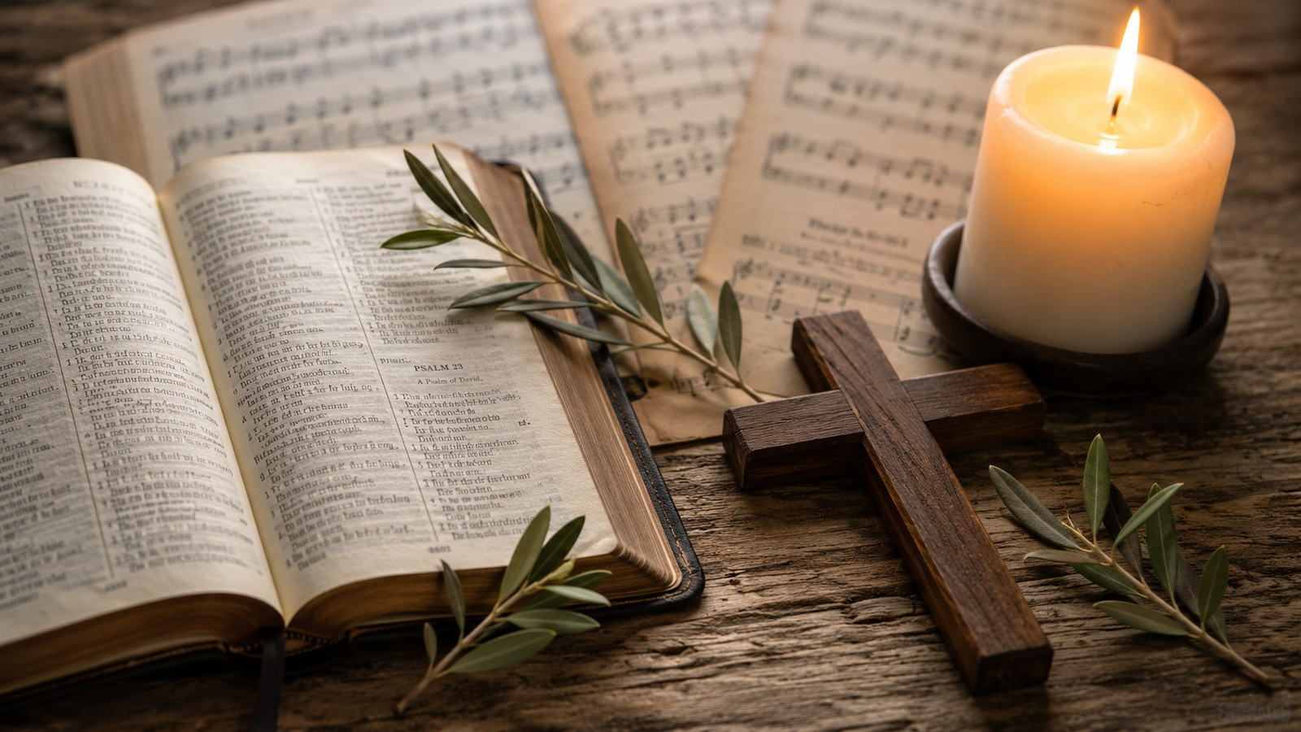
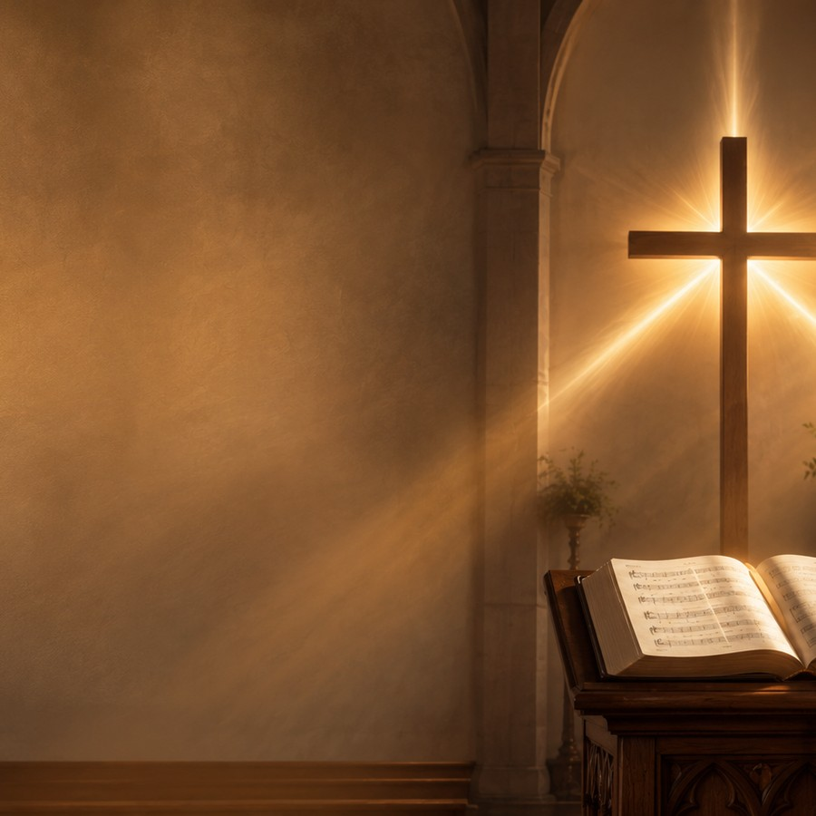
SLIDE 2
Teaching Roadmap
What learners should grasp and practice
Trace the hymn's movement: Father, Son, Spirit, then the great One in Three.
Connect the hymn to Scripture: Matthew 28:19, 2 Corinthians 13:14, Revelation 4:11, Isaiah 6:3.
Explain why the hymn is best suited for Trinity Sunday, invocation, and worship focused on God's presence.
Lead worshipers from doctrine to prayer: Help us praise, bless Your word, rule every heart.
Doctrine carried by prayer.
Come Thou Almighty King | Teaching Guide | 2
Notes:
Use this slide to name the intended outcomes. The lesson should not become only historical trivia; its aim is renewed, Trinitarian worship.

Slide 3
SLIDE 3
Hymn Identity
Core facts for teaching and worship planning
Title
Come Thou Almighty King
First line
Come thou Almighty King, help us thy name to sing
Author
Anonymous; first documented by 1757
Tune
ITALIAN HYMN by Felice Giardini, 1769
Meter
6.6.4.6.6.6.4
Primary use
Trinity Sunday, opening worship, ordination, invocation
Teaching caution: do not present Charles Wesley as the confirmed author. Modern sources treat his authorship as unproven.
Come Thou Almighty King | Teaching Guide | 3
Notes:
Emphasize the anonymous authorship. Wesley was once proposed, but that attribution is not secure.

Slide 4
The Hymn as Trinitarian Prayer
Its structure is its theology
Father
Son
Holy Spirit
One in Three
Almighty King
Incarnate Word
Comforter
Sovereign Majesty
Help us praise; reign over us
Attend our prayer; bless Your people; give Your word success
Bear witness; rule every heart; remain with us
Receive eternal love and adoration
Christian worship names God as He has revealed Himself.
Come Thou Almighty King | Teaching Guide | 4
Notes:
Avoid explaining the Trinity as a mere diagram. The hymn models Trinitarian prayer: address each person distinctly and adore the one God.

Slide 5
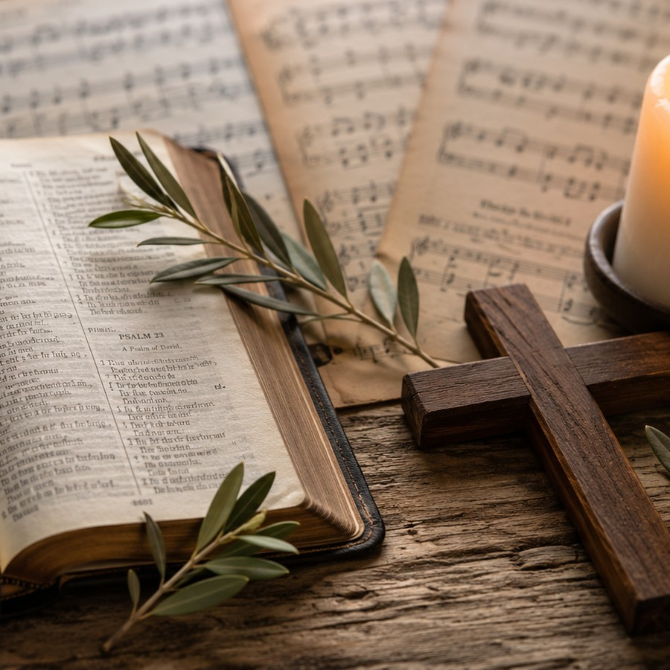
SLIDE 5
Historical Background
Anonymous leaflet, evangelical hymn collections, and a dedicated tune
The earliest securely documented appearance is an anonymous four-page leaflet bound into surviving copies of the sixth edition of George Whitefield's Collection of Hymns for Social Worship in 1757. The leaflet was titled An Hymn to the Trinity and contained five stanzas.
Felice Giardini later composed ITALIAN HYMN specifically for the text; it first appeared in Martin Madan's A Collection of Psalm and Hymn Tunes in 1769. The modern four-stanza form usually omits an early stanza beginning “Jesus, our Lord, arise.”
Teaching note: older books may include five stanzas; most modern hymnals use four.
Come Thou Almighty King | Teaching Guide | 5
Notes:
The historical point helps avoid two common errors: overconfident Wesley attribution and confusion over the omitted stanza.

Slide 6
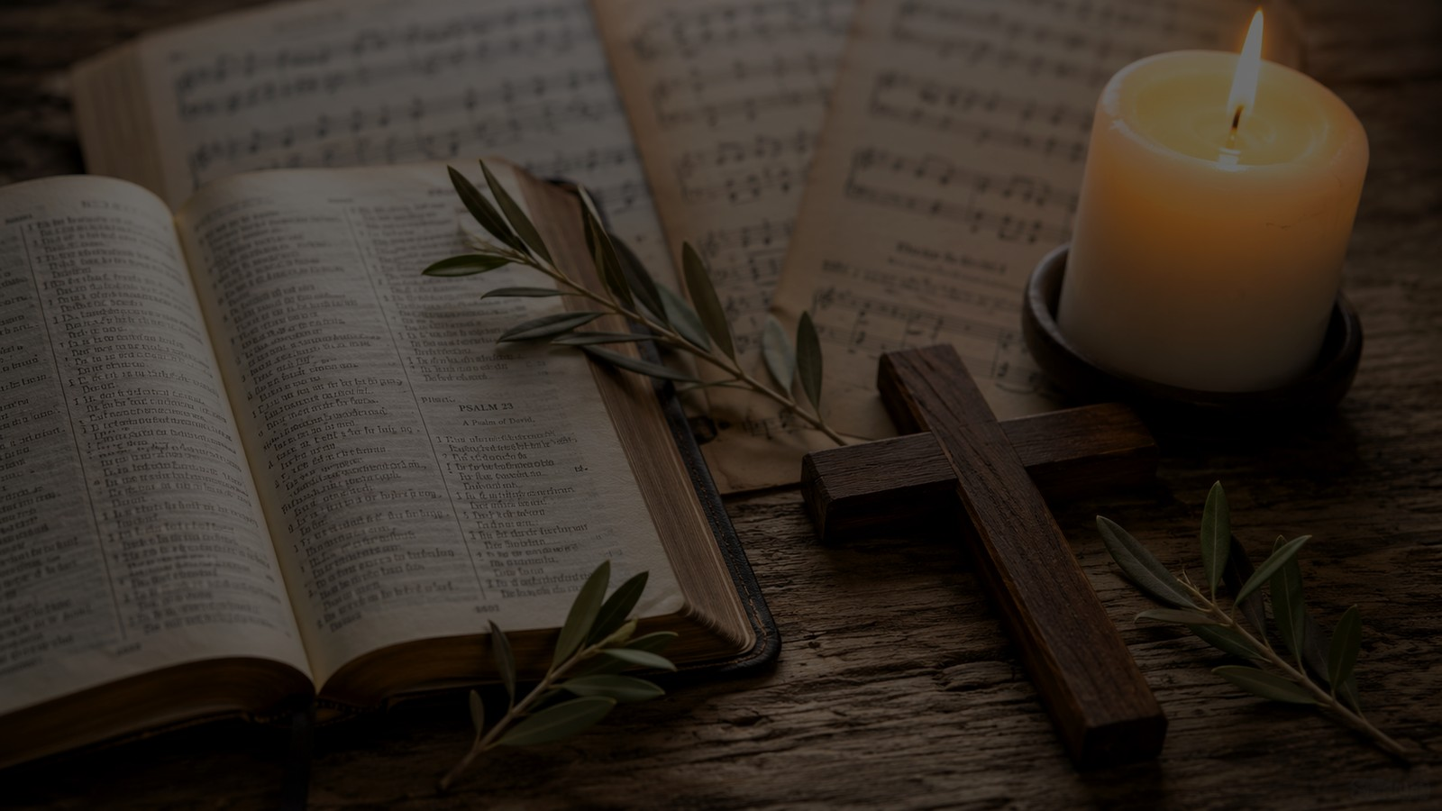
Biblical Foundations
The hymn gathers several strands of biblical worship
Revelation 4:11
Worthy are you, our Lord and God, to receive glory, honor, and power.
Matthew 28:19
The church names Father, Son, and Holy Spirit together.
2 Corinthians 13:14
Grace, love, and fellowship are received from the triune God.
Isaiah 6:3
Heavenly worship declares the holiness and glory of the Lord.
Come Thou Almighty King | Teaching Guide | 6
Notes:
Invite participants to read one or two passages aloud before singing. The text is especially close to Matthew 28 and 2 Corinthians 13 in its Trinitarian shape.

Slide 7
SLIDE 7
Stanza 1: The Father Reigns
“Come, Thou Almighty King...”
Help us Thy name to sing, help us to praise.
The stanza names God as Almighty King, all-glorious, victorious, and Ancient of Days.
Worship begins with dependence: the congregation needs God's help even to praise rightly.
“Come and reign over us” turns singing into surrender to divine kingship.
Come Thou Almighty King | Teaching Guide | 7
Notes:
This stanza is a good place to discuss the difference between praise as expression and praise as submission.

Slide 8
Stanza 2: The Son Blesses His Word
“Come, Thou Incarnate Word...”
Christ is invoked as the Incarnate Word - God made known among us.
The “mighty sword” is biblical imagery for the power of God's word and victory, not a summons to human violence.
The church asks Christ to attend prayer, bless the people, and give His word success.
Give Thy word success.
Come Thou Almighty King | Teaching Guide | 8
Notes:
Link the Incarnate Word to John 1. Emphasize that proclamation depends on Christ's blessing, not only on human technique.

Slide 9
SLIDE 9
Stanza 3: The Spirit Rules Every Heart
“Come, Holy Comforter...”
The third stanza explicitly invokes the Holy Comforter. The Spirit is not merely an influence but the divine person who bears witness, rules inwardly, remains with the congregation, and empowers worship.
Sacred witness: the Spirit confirms the truth of Christ.
Heart rule: worship moves from external form to inner transformation.
Abiding presence: the church prays, “ne'er from us depart.”
Come Thou Almighty King | Teaching Guide | 9
Notes:
The stanza is especially useful for Pentecost and renewal contexts, but the hymn overall is more naturally Trinitarian than only Pentecostal.

Slide 10
Stanza 4: The Great One in Three
From invocation to eternal adoration
To Thee, great One in Three, the highest praises be.
The final stanza preserves both distinction and unity: Father, Son, and Spirit - one God.
Present worship anticipates future glory: “Thy sovereign majesty may we in glory see.”
The hymn ends with love and adoration, not abstract explanation.
Come Thou Almighty King | Teaching Guide | 10
Notes:
Do not let the theological language remain abstract. The final movement is devotional: love and adore forever.

Slide 11
SLIDE 11
Theological Themes
What this hymn teaches the church to believe and pray
Invocation
Trinity
Worship asks God to come among His people.
The Father, Son, and Spirit are addressed distinctly and adored as one God.
Word and witness
Majesty and mercy
Christ blesses the word; the Spirit bears sacred witness.
God is sovereign, victorious, almighty, and graciously near.
Come Thou Almighty King | Teaching Guide | 11
Notes:
These are four anchors for a teaching session or sermon. Encourage learners to see how theology becomes prayer.

Slide 12
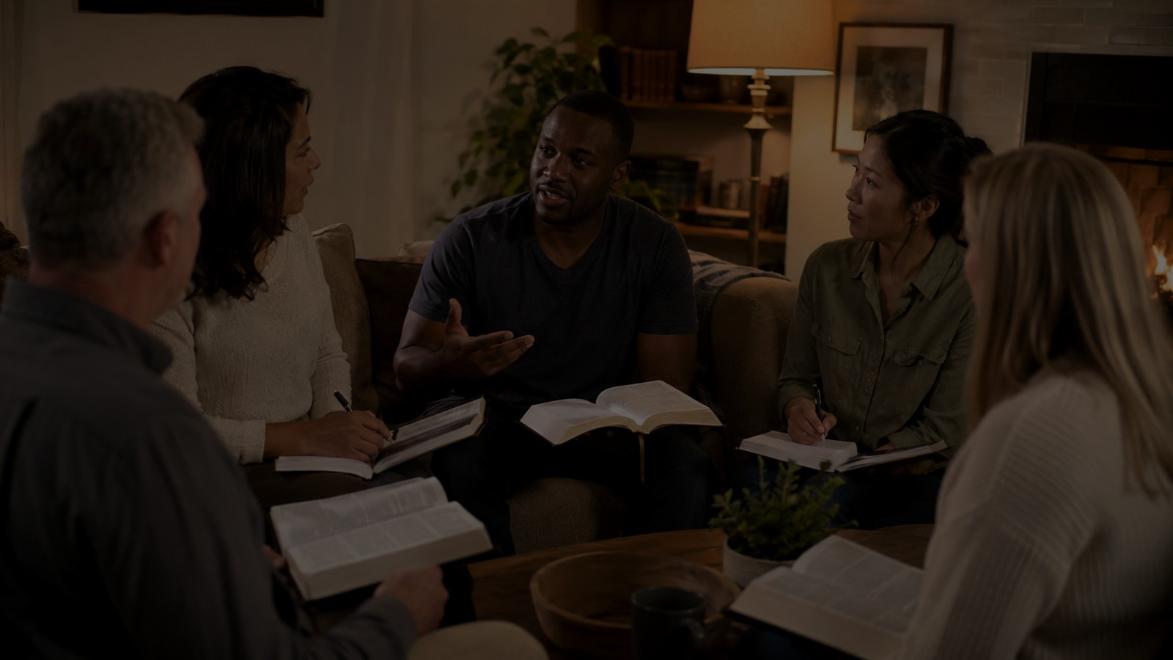
Worship & Teaching Use
Where the hymn serves the church well
Trinity Sunday: compact catechesis in praise.
Opening worship: a prayer for God-enabled praise and presence.
Ordination or commissioning: dependence on Christ's word and the Spirit's power.
Teaching series on the Trinity: accessible structure for doctrinal formation.
Not primarily an Easter hymn: the address to the Incarnate Word is Christ-centered, but the hymn's main focus is Trinitarian invocation.
Come Thou Almighty King | Teaching Guide | 12
Notes:
This slide helps categorize the hymn accurately in church planning or database tagging.

Slide 13
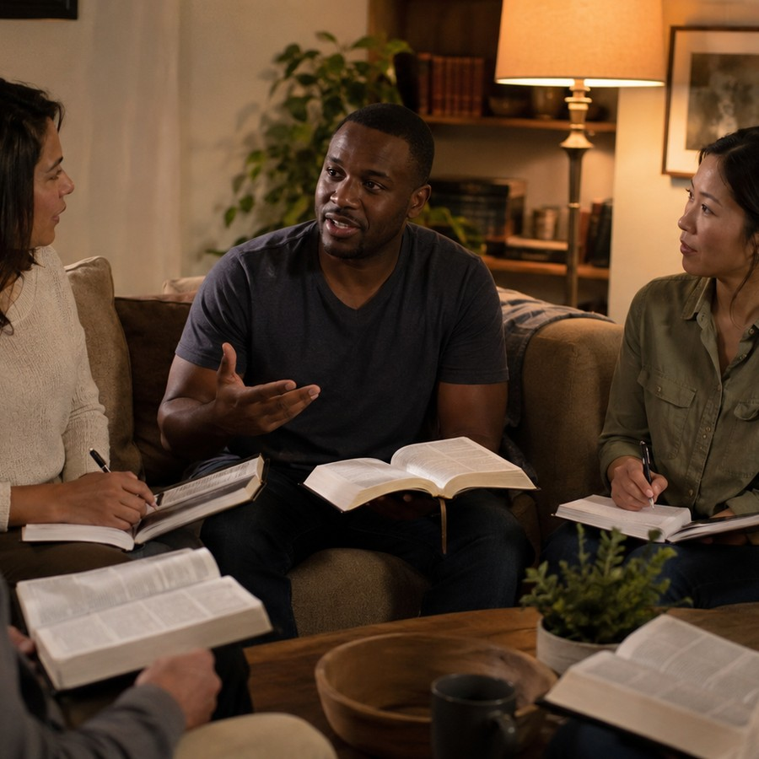
SLIDE 13
Small Group Discussion
Questions that move from text to life
What does the hymn ask each person of the Trinity to do?
Why does the congregation ask God for help even in praising God?
How does the final stanza preserve both divine threeness and unity?
What practices can make our worship more intentionally Trinitarian?
How might the prayer “rule in every heart” change our church life this week?
Come Thou Almighty King | Teaching Guide | 13
Notes:
Give the group a few minutes to answer question 2 personally before discussing corporately.

Slide 14
SLIDE 14
Suggested 45-Minute Teaching Flow
A practical guide for leaders
0-5 min
Opening prayer and singing
5-12 min
Historical background and authorship caution
12-22 min
Scripture readings: Matthew 28, 2 Corinthians 13, Revelation 4
22-34 min
Stanza-by-stanza Trinitarian reading
34-42 min
Discussion and application
42-45 min
Pray the hymn refrain-like petitions together
Come Thou Almighty King | Teaching Guide | 14
Notes:
Leaders can expand this into a 60-minute session by singing all stanzas, adding more time for Scripture, and assigning stanza groups.

Slide 15
CLOSING PRAYER
Come, Almighty King.
Come, Incarnate Word.
Come, Holy Comforter.
Reign over us, bless Your Word among us, rule every heart within us, and prepare us to love and adore You forever.
Amen.
Come Thou Almighty King | Teaching Guide | 15
Notes:
Close by praying this slide aloud together, then sing the hymn or one stanza again.

