Slide 1
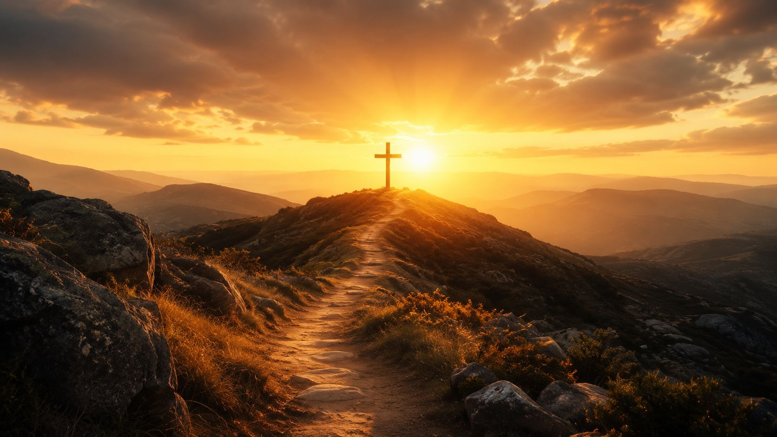
I Know Not Why God's Wondrous Grace
A hymn of assurance, grace, and Christ’s keeping power
Teaching Guide
Text
Tune
Tune Name
Primary Scripture
Daniel W. Whittle
James McGranahan
EL NATHAN
2 Timothy 1:12

Slide 2

Teaching Aim
What learners should understand, feel, and practice
Understand
Feel
Practice
Assurance rests in knowing Christ, not in solving every mystery.
Humble wonder before grace and settled confidence in the Savior.
Entrust fears, failures, and the future to Christ’s keeping power.
Prepared for teaching and small group use - hymninfo.com

Slide 3
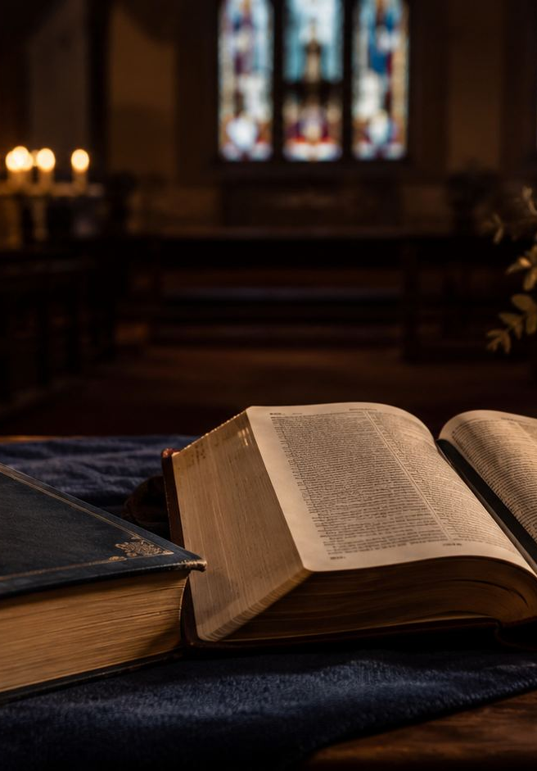
Hymn Identity
A gospel song of assurance in Christ
First line
I know not why God’s wondrous grace
Common title
I Know Whom I Have Believed
Text
Daniel Webster Whittle, often known as Major Whittle
Music
James McGranahan
Tune
EL NATHAN
Meter
Common meter with refrain, in many hymnals
Setting
American gospel-song and evangelistic hymn tradition
Prepared for teaching and small group use - hymninfo.com

Slide 4
Historical Background
Whittle, McGranahan, and the gospel-song tradition
Daniel Webster Whittle wrote the text and often used the name “El Nathan.”
James McGranahan composed the tune EL NATHAN for Whittle’s words.
The hymn belongs to the early 1880s revival and gospel-song stream.
It was securely in wide circulation by Gospel Hymns No. 5 in 1887.
Its witness has endured because it gives humble questions a strong Christ-centered confession.
Historical details about early publication are sometimes stated differently in hymnals. The safest teaching emphasis is the hymn’s clear authorship, tune, Scripture center, and evangelistic setting.
Prepared for teaching and small group use - hymninfo.com

Slide 5
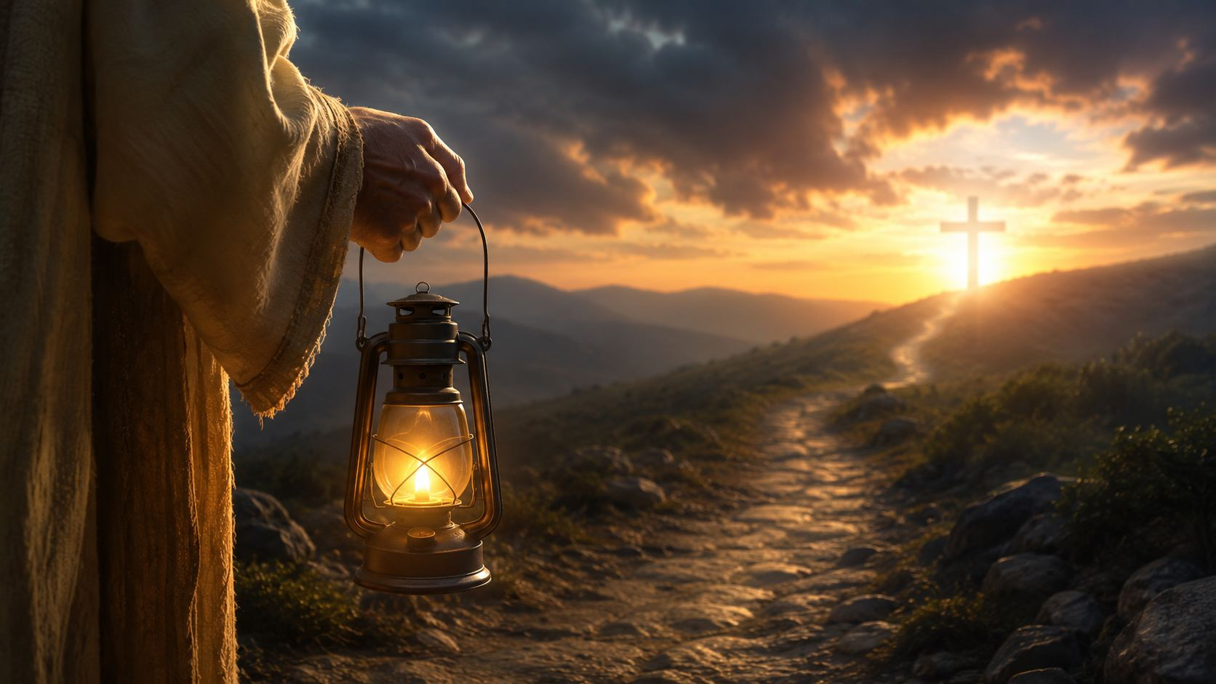
Why This Hymn Matters Today
Faithful confidence when life is not fully explained
The hymn lets believers be honest about mystery without surrendering assurance. It says, in effect, “I do not know every why, but I know Christ.”
For doubting believers who need patience and Scripture.
For grieving believers who need Christ’s keeping promise.
For new believers learning that faith rests on grace.
For the church’s witness: confident, humble, and Christ-centered.
Prepared for teaching and small group use - hymninfo.com

Slide 6
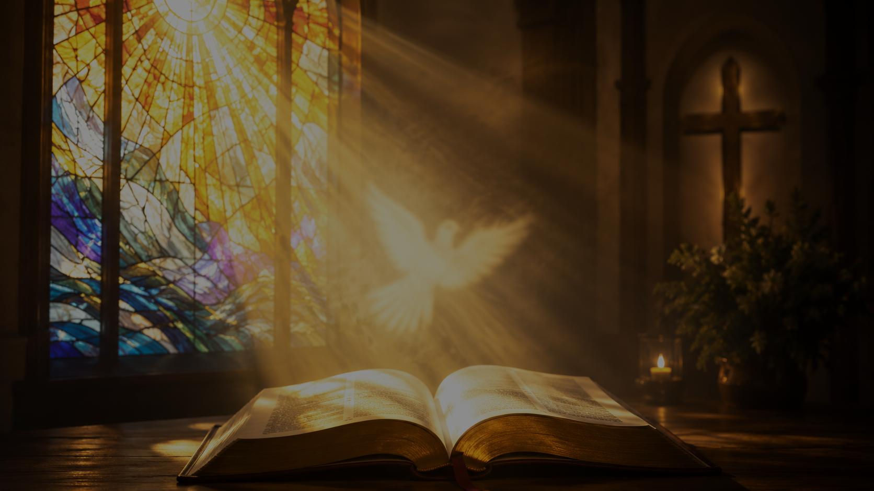
Biblical Foundation
The hymn’s central confession comes from 2 Timothy 1:12
Ephesians 2:8-9 — grace as gift
Romans 10:17 — faith through the Word
John 16:8 — the Spirit’s conviction
Romans 8:38-39 — inseparable love
Jude 24-25 — God’s keeping power
“I know him whom I have believed, and I am persuaded that he is able to guard that which I have committed to him against that day.”
2 Timothy 1:12
Prepared for teaching and small group use - hymninfo.com

Slide 7
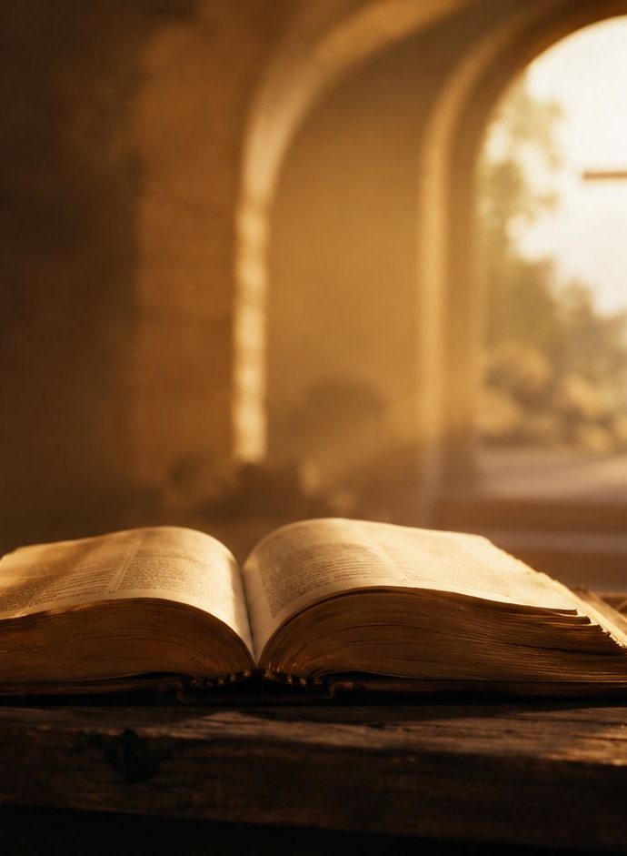
Hymn-Section Study 1
Grace beyond explanation
The hymn begins with wonder.
The believer cannot fully explain why God’s grace should reach him. Yet the answer to that wonder is not pride or despair, but thanksgiving. Ephesians 2 teaches that salvation is God’s gift, received by faith and not earned by works.
Teaching emphasis: grace creates humility and gratitude before God.
Prepared for teaching and small group use - hymninfo.com

Slide 8
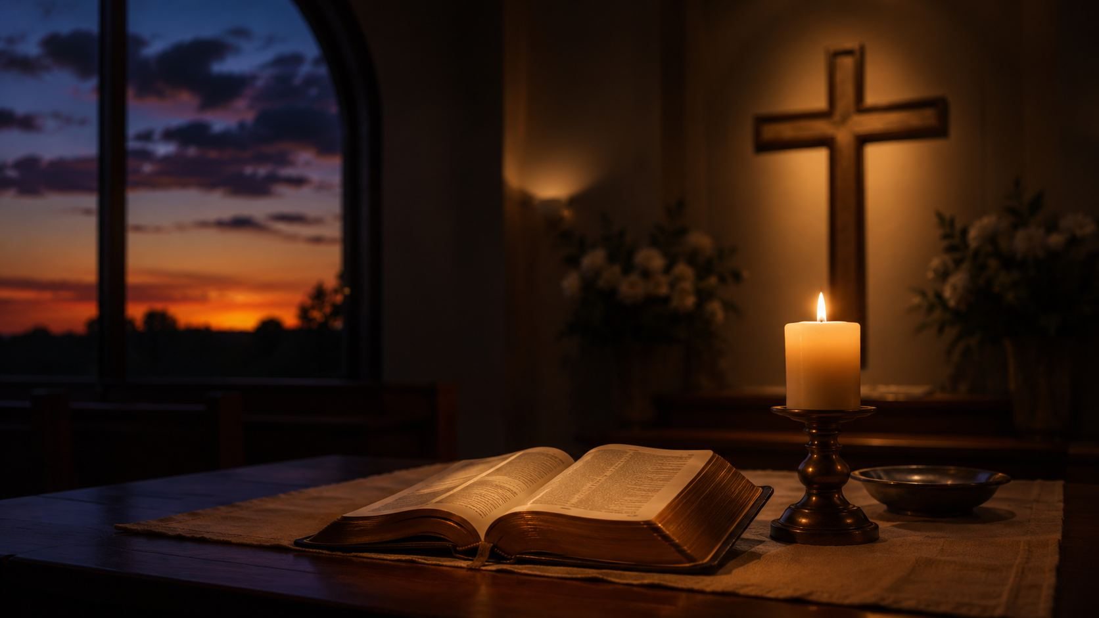
Hymn-Section Study 2
Faith awakened by the Word
The hymn’s questions do not end in vagueness. Faith comes through hearing God’s Word, and Christian confidence grows as Scripture directs us to Christ.
Romans 10:17
When feelings are uncertain, the church does not merely look inward. We listen again to the promise God has spoken.
Prepared for teaching and small group use - hymninfo.com

Slide 9
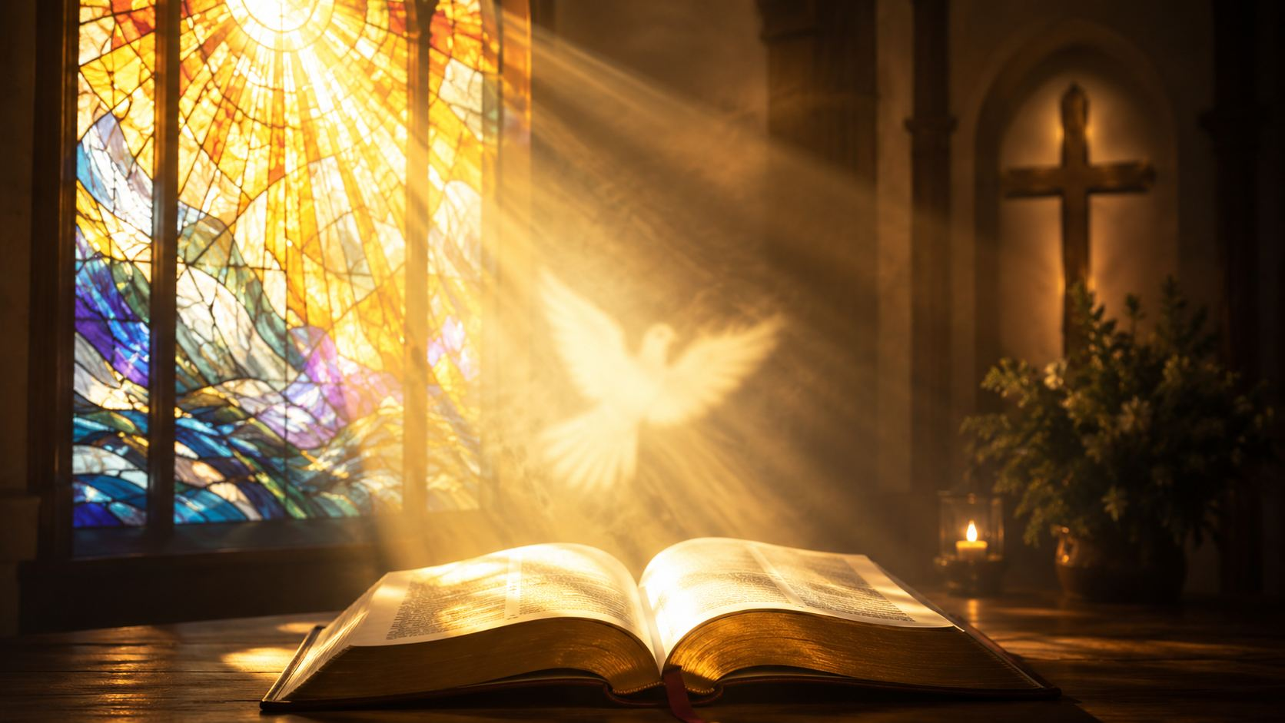
Hymn-Section Study 3
The Spirit’s hidden work
The inward work of the Spirit cannot be reduced to a formula. The hymn admits this mystery while still confessing that God truly convicts, awakens, and leads sinners toward Christ.
The Spirit convicts concerning sin, righteousness, and judgment.
Conviction is mercy, not mere accusation.
Spiritual life begins and continues by God’s gracious work.
Prepared for teaching and small group use - hymninfo.com

Slide 10
Hymn-Section Study 4
Christ guards what we entrust
The heart of the hymn is assurance: the believer commits himself to Christ, and Christ is able to guard what weak hands cannot keep.
Salvation rests in Christ’s faithfulness.
Assurance is stronger than changing emotions.
The future is placed in the hands of the Savior.
Prepared for teaching and small group use - hymninfo.com

Slide 11
Hymn-Section Study 5
Confidence until “that day”
The hymn looks beyond the present toward the final day. Its hope is not that believers will keep themselves, but that God is able to keep them and present them in joy.
Jude 24-25
Present uncertainty is not the final word. Christ’s keeping mercy is.
Prepared for teaching and small group use - hymninfo.com

Slide 12
Theological Themes
Six truths for teaching and worship
Grace
Faith
Holy Spirit
Salvation begins as God’s gift.
Trust is awakened by God’s Word.
God convicts and gives life.
Assurance
Perseverance
Christ’s Return
Christ keeps what we entrust.
Hope endures through mystery.
The final day belongs to Him.
Prepared for teaching and small group use - hymninfo.com

Slide 13
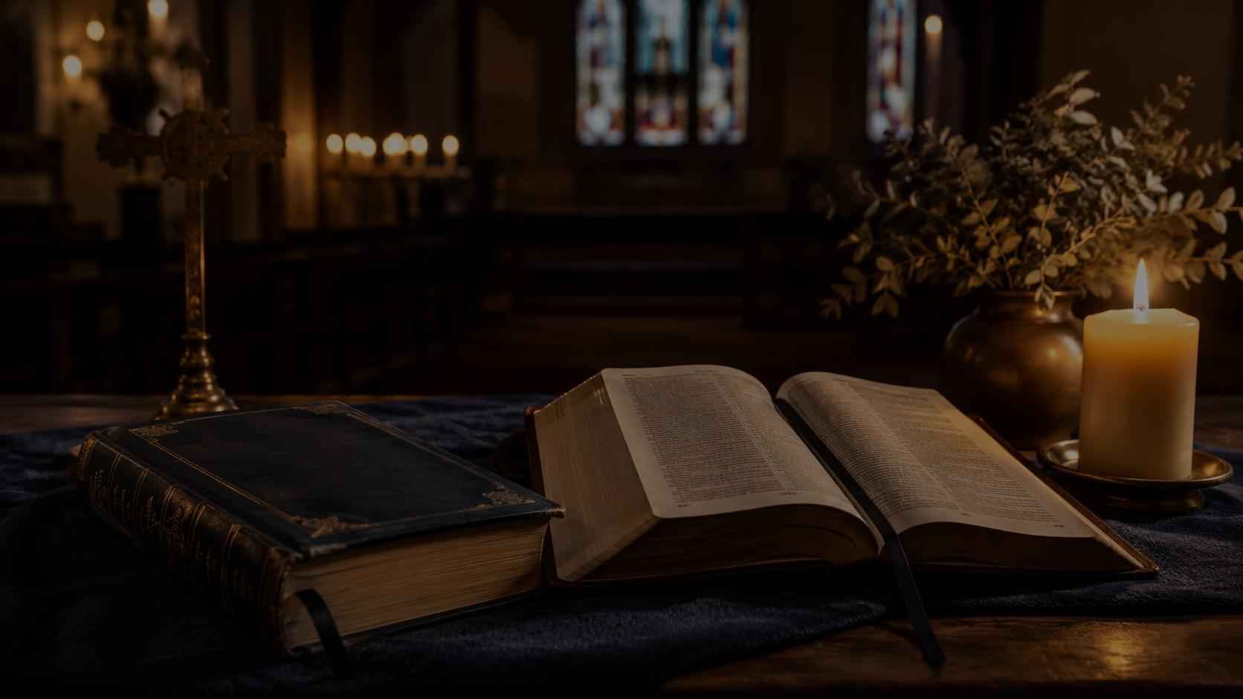
Literary and Musical Observations
How the hymn carries assurance
Repeated “I know not” language creates honest humility.
The refrain answers mystery with a firm confession of Christ.
The movement goes from grace, to faith, to Spirit, to final hope.
The tune EL NATHAN supports a strong gospel-song refrain.
Question → Scripture → Assurance
This is the hymn’s teaching rhythm.
Prepared for teaching and small group use - hymninfo.com

Slide 14
Pastoral and Worship Use
Where this hymn serves the church well
Assurance
after a sermon on salvation or perseverance
Testimony
when the church remembers God’s keeping grace
Discipleship
in classes about faith, Scripture, and doubt
Funerals
when hope is anchored in Christ’s final keeping
Evangelism
when calling hearers to entrust themselves to Christ
Prepared for teaching and small group use - hymninfo.com

Slide 15
Teaching Questions
Move from observation to response
What mysteries does the hymn acknowledge without trying to explain away?
Why does the hymn emphasize knowing Christ rather than knowing every answer?
How does 2 Timothy 1:12 define Christian assurance?
What is the difference between assurance and self-confidence?
How can unanswered questions become a path toward deeper trust?
What should a believer entrust to Christ this week?
Prepared for teaching and small group use - hymninfo.com

Slide 16
Application
Entrust yourself again to Christ
This week:
Pray 2 Timothy 1:12 each morning.
Name one burden you are trying to keep in your own hands.
Read Romans 8:31-39 and mark every promise of God’s keeping love.
Encourage one doubting believer with patience and Scripture.
Prepared for teaching and small group use - hymninfo.com

Slide 17
Suggested Lesson Flow
Two simple ways to teach the hymn
30-Minute Class
60-Minute Class
Read 2 Timothy 1:12
Introduce Whittle and McGranahan
Teach the “I know not / I know Him” pattern
Discuss one application question
Close with prayer
Opening reflection
Historical background
Scripture foundations
Five hymn-section movements
Group discussion
Practice for the week
Closing prayer
Prepared for teaching and small group use - hymninfo.com

Slide 18
Closing Summary and Prayer
We may not know every reason, mystery, or future detail. But the church can still confess with Scripture: we know Christ, and He is able to keep what we entrust to Him.
Lord Jesus, strengthen our faith, calm our fears, and teach us to entrust ourselves to Your faithful keeping until that day. Amen.
© HymnInfo.com. Free for personal, church, classroom, and small-group teaching use. Please do not sell, repost, or redistribute as downloadable files without permission.
Prepared for teaching and small group use - hymninfo.com

