Slide 1

✝
Shout to the Lord
Teaching Guide
Worshiping Christ with every breath, and joining creation’s praise.
Prepared for teaching and small group use - hymninfo.com

Slide 2

Teaching Aim
Know the song, hear Scripture, and lead a faithful response.
1
Understand
Place the hymn within Scripture and worship history.
Lesson Goal
Feel
Help worshipers see that this song joins personal devotion to Jesus with the Bible’s vision of creation-wide praise.
2
Let Christ’s majesty move the heart toward reverent joy.
3
Practice
Turn congregational praise into everyday trust and obedience.
Prepared for teaching and small group use - hymninfo.com

Slide 3

Hymn Identity
A contemporary song of adoration and creation praise
Writer and composer
Darlene Zschech
Year
1993
Tune
SHOUT TO THE LORD
Meter
Irregular
Worship setting
Contemporary congregational song
Teaching note: keep the focus on adoration, Christ’s lordship, and the Psalm-shaped call for the whole earth to praise.
Prepared for teaching and small group use - hymninfo.com

Slide 4

1
A Song of Adoration
Personal devotion opens into the praise of all creation.
Prepared for teaching and small group use - hymninfo.com

Slide 5
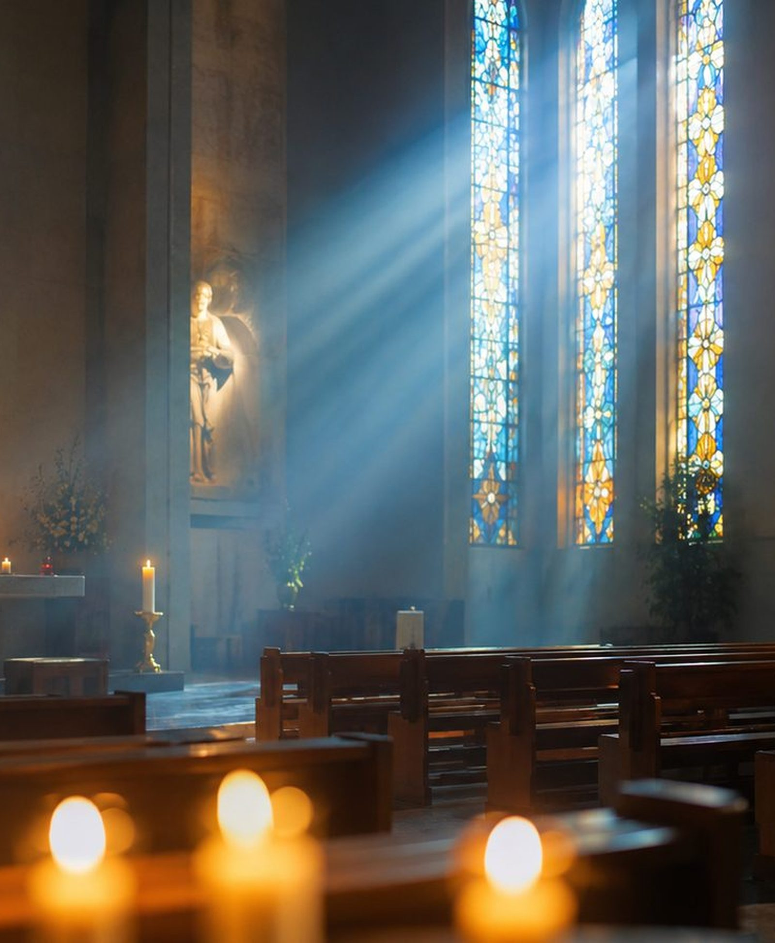
Historical Background
A modern worship song that became widely sung in the 1990s.
Written and composed by Darlene Zschech in 1993 while she served in the worship ministry of Hills Christian Life Centre in Sydney, later known as Hillsong Church.
Became widely known through Hillsong worship recordings in the mid-1990s, especially People Just Like Us.
Entered printed worship collections and hymnals, showing how contemporary songs can become part of broader congregational practice.
Best taught as a Psalm-shaped song of adoration: personal address to Christ, then a summons for the whole earth to praise.
Prepared for teaching and small group use - hymninfo.com

Slide 6

Biblical Foundation
Psalms of joyful praise and New Testament confession of Christ.
Psalm 98:4-9
Psalm 95:1-6
The earth is called to sing; sea, rivers, and mountains answer the Lord.
Joyful praise and humble bowing belong together before the Maker.
Philippians 2:9-11
Revelation 5:12-13
Every tongue will confess that Jesus Christ is Lord.
Every creature joins in blessing God and the Lamb.
Anchor text for the lesson: Psalm 98.
Prepared for teaching and small group use - hymninfo.com

Slide 7

Hymn Section: Personal Adoration
Worship begins by addressing Jesus as living Savior and Lord.
The song starts close to the heart: not abstract praise, but direct address to Christ.
Its devotion is anchored in the New Testament confession that Jesus is Lord.
Teach worshipers to connect emotion with truth: affection for Christ grows from knowing who He is.
Key Scripture: Philippians 2:9-11
Every knee bows before the name of Jesus; praise is the fitting response to His exalted lordship.
Prepared for teaching and small group use - hymninfo.com

Slide 8
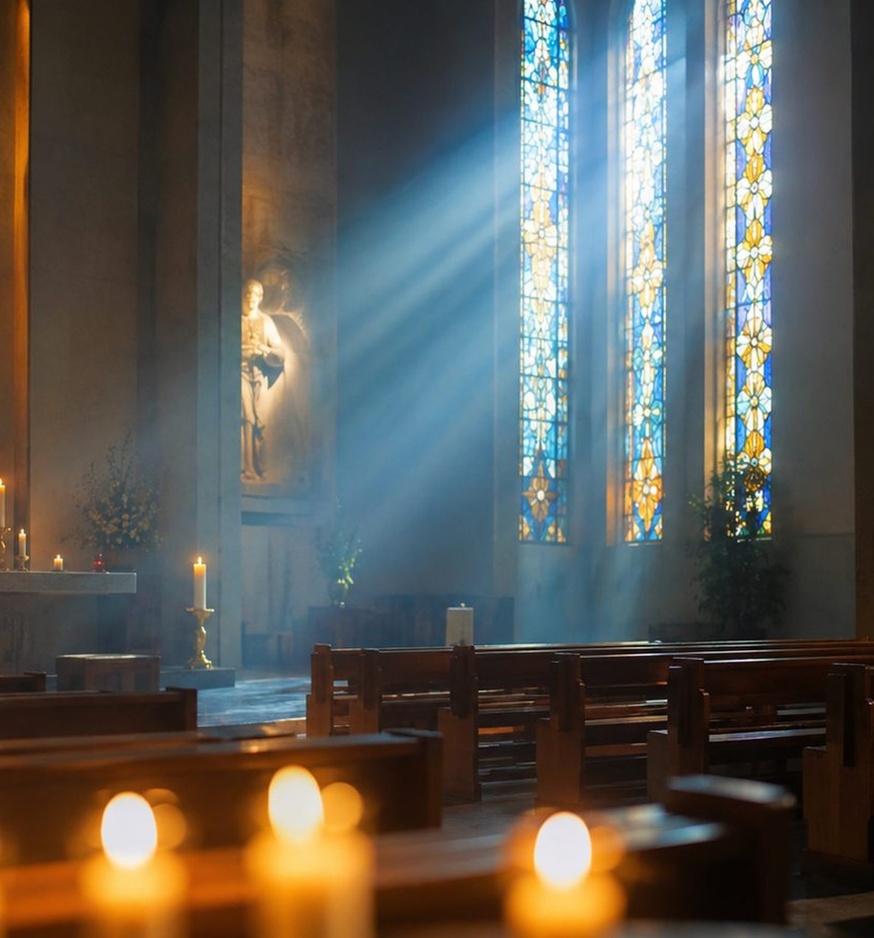
Hymn Section: Refuge and Strength
Praise gives language for trust in Christ amid weakness.
Pastoral Emphasis
The song does not treat worship as escape from need.
It teaches believers to bring fear, grief, and exhaustion to Christ.
Use related Psalms to show that refuge language is deeply biblical.
Related texts: Psalm 46:1; Psalm 18:2
Prepared for teaching and small group use - hymninfo.com

Slide 9

Central Declaration
All the earth is called to praise the King.
Psalm 98 gives the song its biblical air: the sea roars, the rivers clap, and the mountains sing before the Lord.
✝
Prepared for teaching and small group use - hymninfo.com

Slide 10

Theological Themes
Six truths to keep before the class.
Christ’s Lordship
Creation Praise
Whole-Life Worship
Praise names Jesus as the exalted Lord.
The earth witnesses to God’s majesty.
Every breath can become an offering.
Joyful Confession
Refuge and Strength
Eternal Worship
Singing says aloud what faith believes.
Christ receives the weak and fearful.
Earthly praise anticipates Revelation 5.
Prepared for teaching and small group use - hymninfo.com

Slide 11
2
From Creation to Congregation
The song teaches a people to join the worship already sounding through creation.
Prepared for teaching and small group use - hymninfo.com

Slide 12

Musical and Literary Observations
How the song carries its message.
Irregular meter fits the spoken, prayer-like flow of modern worship song.
The opening feels reflective; the central declaration expands in range, volume, and congregational energy.
Creation imagery gives the song scale: personal praise is set within cosmic praise.
The melody is often led with piano, guitar, or worship band, but the teaching point is the shared confession of the congregation.
Prepared for teaching and small group use - hymninfo.com

Slide 13

Teaching the Song Well
Move the class from familiarity to faithful worship.
1
Start with Psalm 98
Let Scripture supply the frame.
2
Name Christ clearly
Savior and Lord are not vague titles.
3
Guard reverence
Joyful praise can remain humble and holy.
4
Lead toward obedience
Singing should shape the week.
Prepared for teaching and small group use - hymninfo.com

Slide 14

Pastoral and Worship Use
Where this song can serve a congregation.
As a call to worship after a Scripture reading from the Psalms.
As a response to preaching on Christ’s lordship or God’s majesty in creation.
As a congregational declaration in a service of thanksgiving or renewal.
As a pastoral reminder that praise is possible even when believers need refuge and strength.
Choir or worship leader cue
Build gradually. Let awe, not volume alone, carry the refrain.
Prepared for teaching and small group use - hymninfo.com

Slide 15
Suggested Lesson Flow
A 45-minute teaching path.
1
2
3
4
5
6
Welcome
Scripture
Background
Hymn Study
Discussion
Prayer
Open with a creation-praise reflection.
Read Psalm 98 and Philippians 2.
Place the song in its worship setting.
Move from personal devotion to creation-wide praise.
Connect worship to trust and obedience.
Close by confessing Christ as Lord.
Prepared for teaching and small group use - hymninfo.com

Slide 16

3
Response: Praise with Every Breath
Let worship become trust, witness, gratitude, and obedience.
Prepared for teaching and small group use - hymninfo.com

Slide 17

Closing Summary
Jesus Christ is worthy of personal devotion and public confession.
The Psalms call the whole earth to joyful praise.
True worship becomes steady faith, grateful witness, and obedient love.
Prayer
Lord Jesus Christ, Savior and King, teach our hearts to praise You with joy and reverence. Let our singing become faithfulness, and let every breath honor Your name. Amen.
© HymnInfo.com. Free for personal, church, classroom, and small-group teaching use. Please do not sell, repost, or redistribute as downloadable files without permission.
Prepared for teaching and small group use - hymninfo.com

