Slide 1

We've a Story to Tell to the Nations
Mission, witness, and the kingdom of love and light
First line: We've a story to tell to the nations
Words and music: Henry Ernest Nichol (1896)
Tune: MESSAGE | Primary Scripture: Matthew 28:19-20
Prepared for teaching and small group use - hymninfo.com

Slide 2

Teaching Aim
What this lesson should form in the congregation
Understand
Feel
Practice
Mission begins with God’s saving work in Christ and the command of the risen Lord.
A sober joy that the gospel is good news for all nations and all peoples.
Humble witness through prayer, proclamation, service, and cross-cultural respect.
Teach the hymn as a sung missionary commitment.
Connect the refrain’s dawn imagery with biblical kingdom hope.
Correct triumphalism by grounding mission in love and humility.
Prepared for teaching and small group use - hymninfo.com

Slide 3

Hymn Identity
A mission hymn written for congregational sending
Title: We've a Story to Tell to the Nations
First line: We've a story to tell to the nations
Author and composer: Henry Ernest Nichol
Pseudonym sometimes printed: Colin Sterne
Tune: MESSAGE
Meter: 10.8.8.7.7 with refrain; often treated as irregular with refrain
First published: The Sunday School Hymnary, London, 1896
Teaching note
The hymn’s original mission language belongs to a nineteenth-century setting. Teach it today as a biblical call to witness that rejects pride and serves in Christlike love.
Prepared for teaching and small group use - hymninfo.com

Slide 4

Henry Ernest Nichol
Composer, writer, and church musician
Born in Hull, Yorkshire; later trained in music.
Earned a Bachelor of Music degree from Oxford in 1888.
Wrote Sunday school and church music, sometimes under the name Colin Sterne.
For this hymn, he supplied both words and the tune MESSAGE.
Responsible wording
When older sources differ on biographical details, focus on the securely useful hymn facts: author, tune, publication, and message.
Prepared for teaching and small group use - hymninfo.com

Slide 5
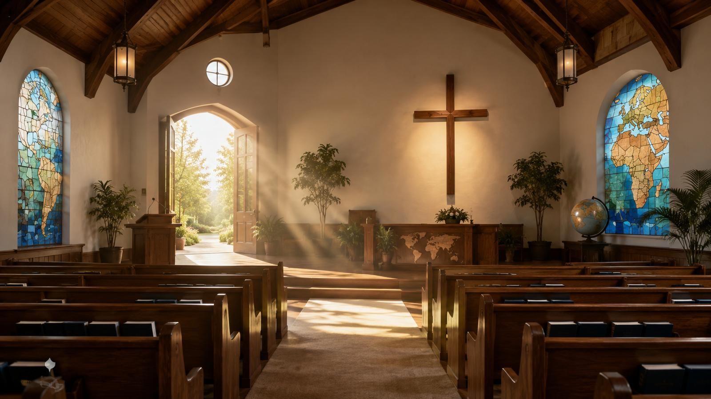
1896 Mission Setting
A hymn shaped by missionary zeal and Sunday school song
Late nineteenth-century Protestant churches often sang mission hymns to awaken prayer, giving, and sending.
Sunday school hymnody favored strong refrains, plain language, and memorable melodies.
The hymn’s language should be taught with biblical humility, not cultural superiority.
Its enduring value is its focus on Christ, gospel proclamation, peace, and kingdom hope.
Teaching emphasis
Mission is not church self-promotion; it is witness to the Savior whom God sent for the world.
Prepared for teaching and small group use - hymninfo.com

Slide 6
The Hymn’s Movement
Story → Song → Message → Savior → Kingdom
Story
Song
Message
Savior
Kingdom
truth and mercy
worship that witnesses
God’s love in Christ
Christ shown to the world
love and light
The hymn does not merely describe mission; it sings a congregation into it.
Every stanza widens attention from proclamation to the reign of Christ.
Prepared for teaching and small group use - hymninfo.com

Slide 7
Biblical Foundation: The Great Commission
Matthew 28:19-20
Matthew 28:19-20
Mission is grounded in the risen authority of Jesus.
The goal is discipleship, baptism, and obedience to Christ.
The church goes with Christ’s presence, not its own strength.
“Go and make disciples of all nations…” The command is joined to Christ’s promise: “I am with you always.”
Prepared for teaching and small group use - hymninfo.com

Slide 8
Biblical Foundation: Worship Among the Nations
Psalm 96:1-3
The church sings because God’s salvation is worth proclaiming.
Worship and witness belong together.
Mission is doxological: it aims at the glory of God.
Psalm 96:1-3
“Declare his glory among the nations, his marvelous works among all the peoples.”
Prepared for teaching and small group use - hymninfo.com

Slide 9

Biblical Foundation: Peace for the Nations
Isaiah 2:4
The hymn’s hope is not only personal conversion but the reign of Christ.
Gospel proclamation is joined with a longing for justice and peace.
Mission should be carried out in ways consistent with the kingdom it announces.
Isaiah 2:4
The prophetic hope points to a day when nations no longer learn war.
Prepared for teaching and small group use - hymninfo.com

Slide 10
Biblical Foundation: God Loved the World
John 3:16-17
John 3:16-17
The church’s message is not built on fear or superiority.
The gospel story is rooted in divine love and salvation.
Witness should sound like the heart of the Sender.
Mission begins in the sending love of God. The Son is given so the world may be saved through him.
Prepared for teaching and small group use - hymninfo.com

Slide 11
Stanza One: A Story to Tell
Truth, mercy, peace, and light
The first movement presents the gospel as a story worth telling.
Truth and mercy belong together; mission must not divide them.
Peace and light show that gospel witness seeks restoration, not domination.
Teaching emphasis: evangelism is truthful love, not religious pressure.
Prepared for teaching and small group use - hymninfo.com

Slide 12
Stanza Two: A Song to Be Sung
Worship as public witness
The second movement makes singing part of the church’s witness.
The gospel song stands against evil, violence, and despair.
A singing church practices hope before the world.
Teaching emphasis: the church’s worship should send believers into faithful action.
Prepared for teaching and small group use - hymninfo.com

Slide 13
Stanza Three: A Message to Give
God has shown his love in the Son
This movement names the heart of the message: God’s love shown in Christ.
Christian mission begins with the God who sends, saves, and loves.
The church announces good news; it does not manufacture it.
Teaching emphasis: the message shapes the messenger’s tone.
Prepared for teaching and small group use - hymninfo.com

Slide 14
Stanza Four: A Savior to Show
The witness points to Christ himself
The hymn ends by directing attention to the Savior, not to the missionary.
Christ walked the path of sorrow for the world.
The aim of witness is that people come to the truth of God in Christ.
Teaching emphasis: gospel mission is Christ-centered from beginning to end.
Prepared for teaching and small group use - hymninfo.com

Slide 15
Refrain: From Darkness to Dawning
Kingdom hope in repeated song
The image
The refrain gives the congregation an eschatological hope.
Mission is sustained by the promise of Christ’s reign.
The kingdom is marked by love, light, peace, and truth.
Darkness gives way to dawn, and dawn grows to noonday brightness.
The doctrine
Christ’s kingdom is the final horizon of mission.
Prepared for teaching and small group use - hymninfo.com

Slide 16
Theological Themes
What the hymn teaches
Mission
Kingdom
Peace
The church is sent to all nations with the gospel of Christ.
The final hope is Christ’s reign of love and light.
The gospel looks toward reconciliation and restored creation.
Witness
Humility
Believers speak and live as signs of God’s saving work.
Mission must mirror the servant way of Christ.
Prepared for teaching and small group use - hymninfo.com

Slide 17
Mission with Humility Today
A pastoral correction for responsible use
Appreciate the hymn’s biblical zeal for worldwide witness.
Acknowledge that mission history includes both faithful service and real failures.
Reject cultural pride; announce Christ with humility and respect.
Let acts of mercy, justice, and peacemaking support verbal witness.
Depend on the Spirit rather than technique or pressure.
Prepared for teaching and small group use - hymninfo.com

Slide 18
Literary Observations
How the text builds its message
Four repeated openings create a steady sending rhythm.
The nouns move from story to song to message to Savior.
The refrain turns the church’s work toward the promised kingdom.
Light imagery keeps the hymn hopeful without denying darkness.
The congregation becomes both singer and witness.
Prepared for teaching and small group use - hymninfo.com

Slide 19
Musical Observations: MESSAGE
A tune built for congregational confidence
The tune MESSAGE was composed by Henry Ernest Nichol for this hymn.
The refrain gives the congregation a memorable kingdom confession.
The melody is direct, sturdy, and suited to mission services or sending moments.
Keep the tempo energetic but not rushed; diction matters because the hymn teaches as it sings.
Choir note
Use the refrain to build congregational confidence. A choir can introduce the first stanza, then invite the assembly to join.
Prepared for teaching and small group use - hymninfo.com

Slide 20
Pastoral and Worship Use
Where the hymn fits well
Mission Sunday or global outreach emphasis
Commissioning missionaries, teachers, or lay workers
Sermons on Matthew 28, Psalm 96, or John 3
Services focused on evangelism, kingdom hope, or peacemaking
Sunday school lessons on the global church
Prayer gatherings for the nations
Pastoral use
Pair the hymn with prayers for named nations, local ministries, and the global body of Christ.
Prepared for teaching and small group use - hymninfo.com

Slide 21
Teaching Questions
For class discussion or choir reflection
What story does our congregation most clearly tell?
How can mission be both confident and humble?
Why does John 3 place love at the center of witness?
How does the refrain help the church hope beyond present darkness?
What is one practical way our worship can lead to witness this week?
Prepared for teaching and small group use - hymninfo.com

Slide 22
Suggested Lesson Flow
Two ways to teach the hymn
30-minute plan
60-minute plan
5 min - sing or read refrain
7 min - hymn background
8 min - Matthew 28 and John 3
5 min - stanza movement
5 min - prayer for witness
10 min - opening discussion
10 min - history and tune
15 min - Scripture study
15 min - stanza/refrain study
5 min - mission with humility
5 min - commitment prayer
Prepared for teaching and small group use - hymninfo.com

Slide 23
Closing Summary and Prayer
The church has a story, song, message, and Savior to bear witness to among the nations. We go not with pride, but with the love of God, the presence of Christ, and the hope of his kingdom.
Lord Jesus, make us faithful witnesses. Let our words carry truth and mercy, our worship become mission, and our hope rest in your coming kingdom of love and light. Amen.
© HymnInfo.com. Free for personal, church, classroom, and small-group teaching use. Please do not sell, repost, or redistribute as downloadable files without permission.
Prepared for teaching and small group use - hymninfo.com

