Slide 1
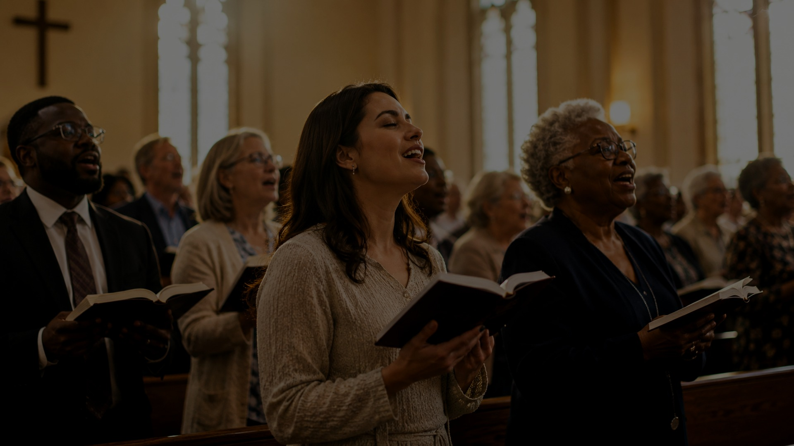
Come, Christians,
Join to Sing
A teaching guide for corporate worship, joyful praise, and eternal Alleluia.
Psalm 95:1
Revelation 5:12
Alleluia! Amen!
Christian Henry Bateman • MADRID

Slide 2

HYMN IDENTITY
At a Glance
Title: Come, Christians, Join to Sing
First line: Come, Christians, join to sing Alleluia! Amen!
Year: 1843
Original title: Come, Children, Join to Sing
Tune: MADRID / Spanish Hymn
Main themes: praise, joy, corporate worship, Christ’s exaltation
Source: attached JSON data

Slide 3
CORE MESSAGE
A Call to Joined Praise
Praise is shared by the church.
Praise is directed to Christ.
Praise ends in “Alleluia! Amen!”
“With heart and voice”
The hymn does not imagine worship as a private performance. It gathers the whole congregation into one joyful confession: Christ is King, worthy of praise, and the church’s song is already training us for eternity.
Teaching emphasis: corporate worship

Slide 4
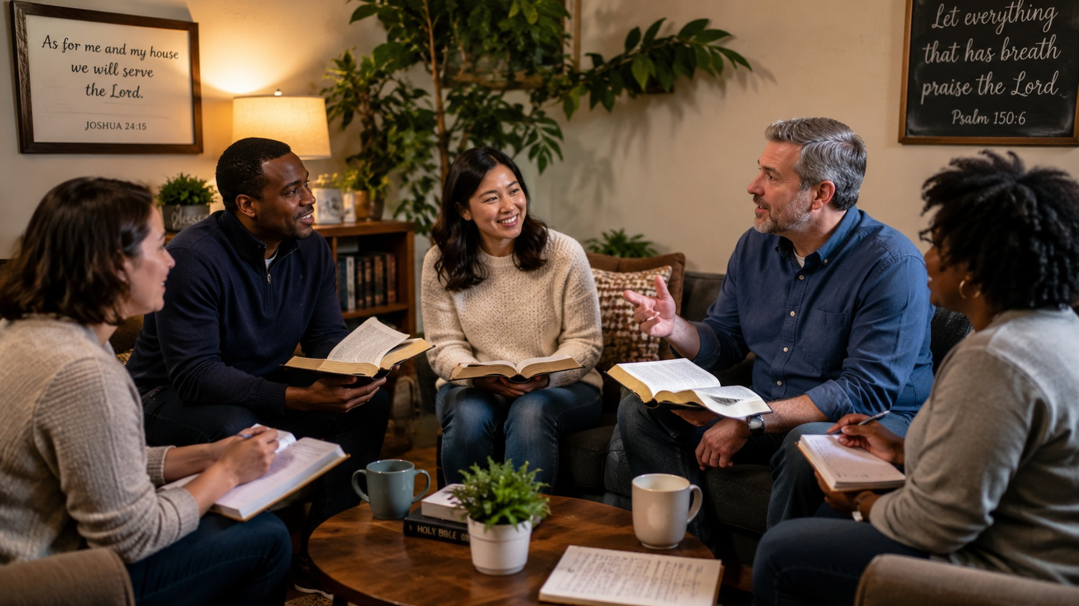
HISTORICAL BACKGROUND
From Children’s Song to Congregational Anthem
Published in Edinburgh in 1843 in Sacred Melodies for Children.
Original wording: “Come, Children, Join to Sing.”
Modern hymnals normally use three adapted stanzas.
The tune MADRID is a traditional melody of uncertain origin.
David Evans prepared a widely used 1927 harmonization.
Bateman • MADRID • Evans harmonization

Slide 5
SCRIPTURE FOUNDATIONS
The Bible Beneath the Song
Psalm 95:1
Psalm 147:1
Come, let us sing to the Lord.
Praise is good, pleasant, and fitting.
Revelation 5:12
1 Peter 1:8
Worthy is the Lamb.
Joy unspeakable and full of glory.
Scripture references from attached JSON

Slide 6
THEOLOGICAL MOVEMENT
Earthly Song, Heavenly Horizon
Now
Not Yet
The church hears the invitation to sing.
Worship forms a united people.
Joy is practiced even when life is heavy.
Alleluia anticipates heaven.
The final stanza looks beyond death.
Earthly praise joins the redeemed host.
Eschatological praise

Slide 7
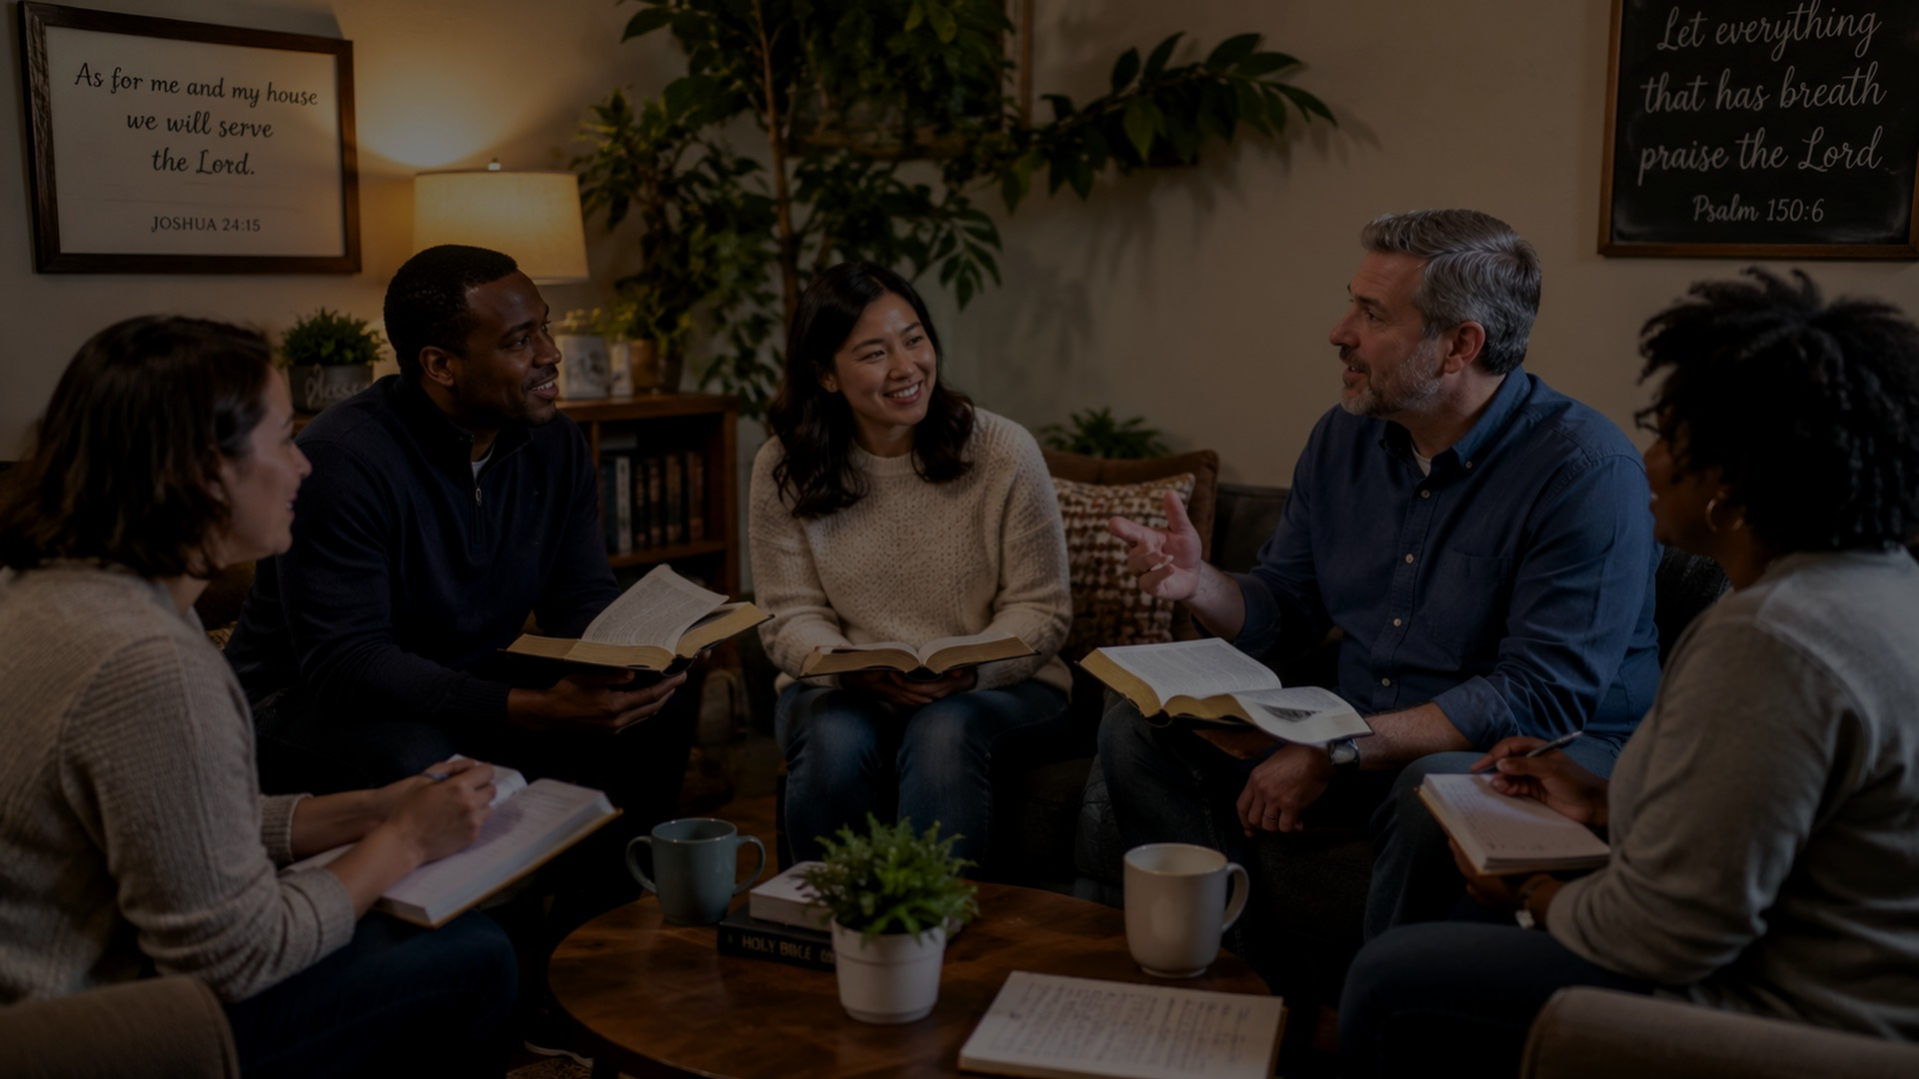
VERSE 1
Invitation: Come and Sing
The first verse calls the gathered church to praise Christ with both heart and voice. It is worship as participation: not watching, not merely listening, but joining.
Praise is a shared Christian vocation.
“Come” gathers the assembly.
Christ is the object of praise.
Heart and voice belong together.
“Amen” gives congregational assent.
Teaching point: gathered worship

Slide 8
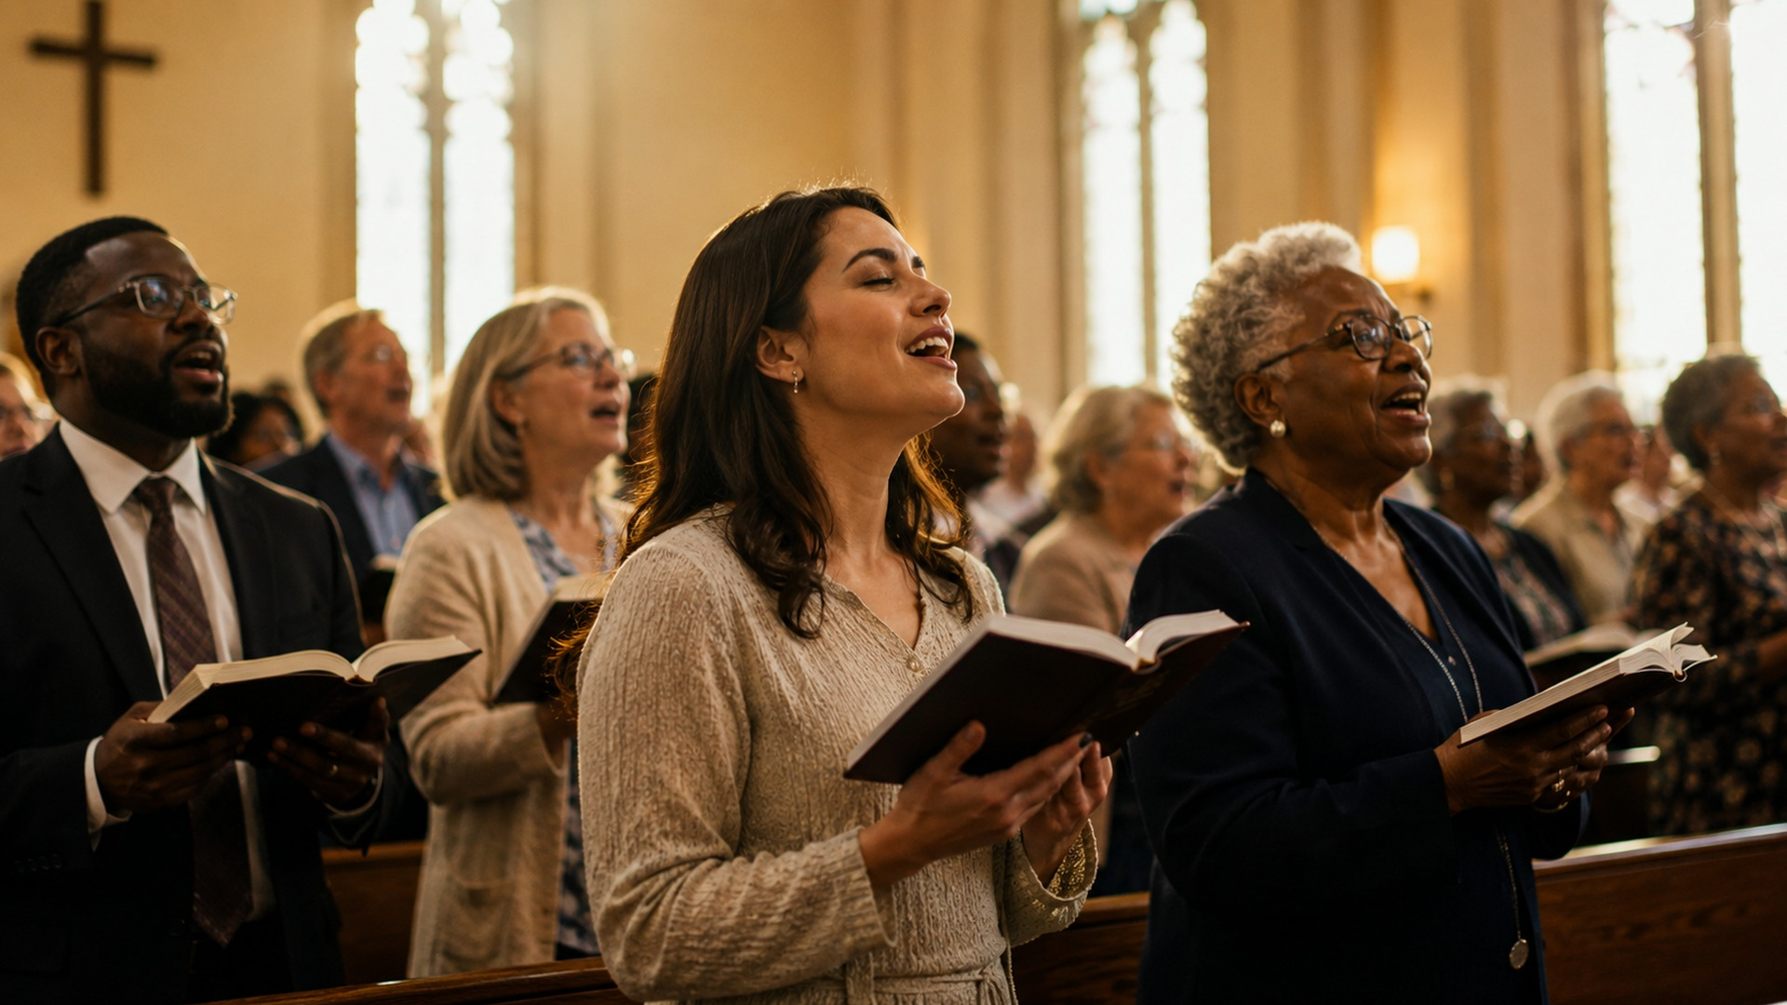
VERSE 2
Christ: King, Guide, and Friend
The hymn celebrates more than Christ’s power; it celebrates his character.
Christ is King: worthy of acclaim and obedience.
Christ is Guide: faithful through the journey of life.
Christ is Friend: near to the believer and gracious to the church.
Christological emphasis

Slide 9

VERSE 3
Praise That Outlives Death
The final stanza opens the horizon beyond present life. The hymn teaches worshipers to sing with eternity in view: what begins in the congregation continues before the throne.
Earthly praise is temporary practice.
Heavenly praise is lasting fulfillment.
Christian hope gives strength to sing now.
Alleluia becomes a bridge from present worship to eternal adoration.
Hope and eternal worship

Slide 10
MUSICAL NOTES
Why MADRID Carries the Text Well
Traditional melody commonly described as Spanish; exact origin uncertain.
Also known in some sources as SPANISH HYMN.
Meter: 6.6.6.6 double.
Bright duple pulse supports joyful “Alleluia.”
A brisk but controlled tempo preserves festivity without rushing the text.
Tune: MADRID

Slide 11
CHURCH IMPACT
A Song for Intergenerational Praise
Moved from a children’s hymn into adult congregational use.
Works well as an opening hymn, processional, school/camp song, or intergenerational praise.
Its joy is accessible without being shallow.
It shapes the church to praise Christ together with confidence.
Impact: broad Protestant use

Slide 12
TEACHING PLAN
A 45-Minute Teaching Flow
1
Gather
Read Psalm 95:1 aloud.
2
Locate
Explain 1843 children’s origin and adapted adult use.
3
Listen
Identify the repeated “Alleluia! Amen!” as praise and assent.
4
Reflect
Discuss Christ as King, Guide, and Friend.
5
Respond
Sing or pray the hymn with eternity in view.
Facilitator structure

Slide 13
SMALL GROUP USE
Questions That Open the Hymn
How does singing 'Alleluia! Amen!' together strengthen our sense of community as a local church?
Why is it important to address Christ as both 'King' and 'Friend' in the same hymn?
Does the 'loud acclaim' mentioned in the hymn challenge your typical approach to worship? Why or why not?
In what ways does this hymn help us prepare for the 'eternal' worship described in the final verse?
How can we 'join to sing' even when we do not feel joyful or when life feels like a 'toil'?
Question to close with: “How can we join to sing when we do not feel joyful?”
Use with the handout

Slide 14
APPLICATION
Practicing Alleluia This Week
Name one reason to praise Christ each morning.
Sing with the congregation, not merely near the congregation.
Remember Christ as both King and Friend in trial.
Let “Amen” become a daily yes to God’s goodness.
Encourage one weary believer through shared praise.
Personal and congregational practice

Slide 15
CLOSING
Alleluia! Amen!
Come, Christians, Join to Sing teaches the church that praise is not an accessory to faith. Praise is the gathered people’s response to Christ the King, their companion in the present, and their eternal hope.
Suggested closing: sing the hymn, then read Revelation 5:12 as a congregational response.
Earthly worship is rehearsal for eternal praise.
End with praise

