Slide 1

When Morning Gilds the Skies
First line: When morning gilds the skies
Anonymous German text • Edward Caswall, translator • Joseph Barnby, LAUDES DOMINI • Hebrews 13:15
A hymn study on continual, Christ-centered praise
Prepared for teaching and small group use - hymninfo.com

Slide 2
Teaching Aim
U
F
P
Understand
Feel
Practice
How this hymn gathers the whole day into praise of Christ.
The gladness and steadiness of worship rooted in Jesus.
Begin, continue, and end the day with Christ-centered praise.
Prepared for teaching and small group use - hymninfo.com

Slide 3

Hymn Identity
A hymn of praise from dawn to eternity
Text: anonymous German devotional hymn, translated into English by Edward Caswall.
Later hymnals sometimes include revisions or a stanza associated with Robert Bridges.
Tune: LAUDES DOMINI by Joseph Barnby, a bright congregational tune written for this text.
Meter: usually printed as 6.6.6.6.6.6, with some hymnal variation.
Prepared for teaching and small group use - hymninfo.com

Slide 4

Historical Background
German devotion, English translation, and Victorian congregational song
The German text is associated with the early nineteenth century and printed in a Catholic hymnal in Würzburg in 1828.
Caswall’s English translation carried the hymn into English-language congregational worship.
Barnby’s LAUDES DOMINI appeared with the text in the 1868 Appendix to Hymns Ancient and Modern.
Different hymnals select and arrange stanzas in slightly different ways, but the central praise remains clear.
Prepared for teaching and small group use - hymninfo.com

Slide 5

Why This Hymn Matters Today
A sturdy song for daily worship
It teaches the church to begin the day by turning attention to Christ.
It gives believers a short, memorable pattern of praise for work, prayer, hardship, and worship.
It reminds congregations that earthly praise joins the worship of heaven.
It helps worship leaders place Christ at the center of morning praise and opening worship.
Prepared for teaching and small group use - hymninfo.com

Slide 6

Scripture Foundations
Continual praise through Christ, from the rising of the sun to heavenly worship
Prepared for teaching and small group use - hymninfo.com

Slide 7
Primary Biblical Foundation
Praise is not only a moment in worship; it is a life offered through Christ.
Hebrews 13:15 calls believers to offer a continual sacrifice of praise through Christ.
Psalm 34:1 gives the voice of daily devotion: God’s praise is to be always in the mouth of his people.
Psalm 113:3 connects the hymn’s morning image with praise from sunrise to sunset.
Ephesians 5:19-20 connects congregational singing with thanksgiving in the name of Christ.
Prepared for teaching and small group use - hymninfo.com

Slide 8
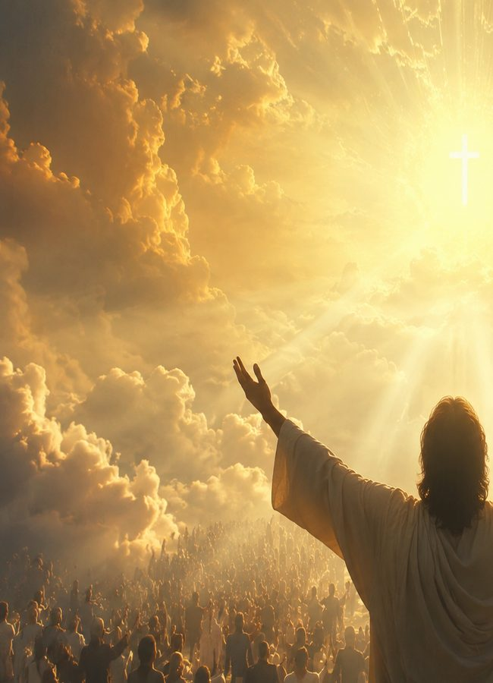
The Heavenly Horizon
The hymn looks beyond the day to eternal praise
Revelation 5 shows the Lamb receiving honor, glory, and blessing from all creation.
The hymn moves from morning praise toward the worship of heaven.
Every ordinary act of praise is joined to the larger story of God’s kingdom.
The church sings now in anticipation of the day when every creature gives glory to God and the Lamb.
Prepared for teaching and small group use - hymninfo.com

Slide 9

Teaching the Hymn
Trace the movement from morning devotion to whole-life praise
Prepared for teaching and small group use - hymninfo.com

Slide 10

Opening Movement: Praise at Dawn
Dawn becomes a call to worship
The hymn begins with the morning sky as an image of renewed mercy and fresh devotion.
The first act of the day is not anxiety, hurry, or self-direction, but praise of Christ.
Teaching emphasis: morning worship sets the heart’s direction before the day’s work begins.
Scripture connection: Psalm 113:3 and Psalm 34:1.
Prepared for teaching and small group use - hymninfo.com

Slide 11
Daily Movement: Praise in Work and Prayer
Worship follows the believer into ordinary life
The hymn’s praise is not confined to a church service.
It extends into labor, conversation, prayer, struggle, and the ordinary duties of the day.
Teaching emphasis: praise disciplines the heart to remember Christ in every setting.
Scripture connection: Ephesians 5:19-20 and Hebrews 13:15.
Prepared for teaching and small group use - hymninfo.com

Slide 12

Hardship Movement: Praise When Life Is Heavy
Continual praise can become costly, honest, and sustaining
The hymn does not reserve praise only for easy seasons.
Its repeated acclamation trains worshipers to confess Christ’s worth even when circumstances are difficult.
Teaching emphasis: praise is not denial of pain; it is trust directed toward the living Lord.
Scripture connection: the “sacrifice of praise” in Hebrews 13:15.
Prepared for teaching and small group use - hymninfo.com

Slide 13
Final Movement: Praise in Heaven
The song stretches from sunrise to everlasting worship
The hymn lifts the congregation from present worship toward the praise of eternity.
Its vision is not private spirituality alone, but the church joining the praise of heaven.
Teaching emphasis: worship now is practice for the kingdom that is coming in fullness.
Scripture connection: Revelation 5:12-13.
Prepared for teaching and small group use - hymninfo.com

Slide 14
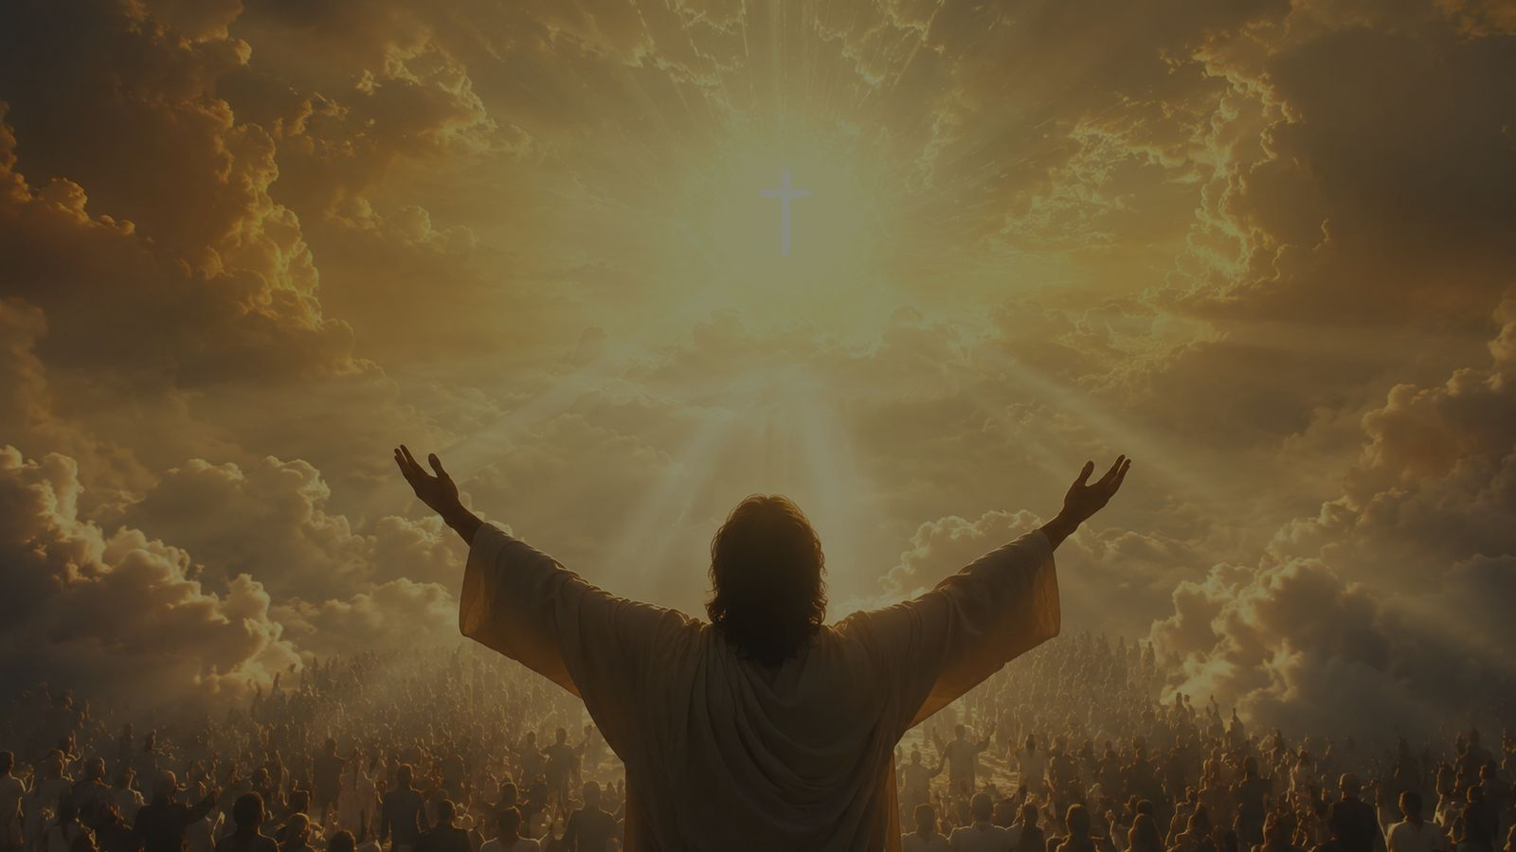
Theology and Music
A doxological hymn shaped by Christ-centered repetition and bright congregational melody
Prepared for teaching and small group use - hymninfo.com

Slide 15
Theological Themes
Five themes for teaching and worship planning
Christ-centered worship: the hymn continually directs praise toward Jesus Christ.
Daily devotion: the whole day is gathered into worship.
Persevering praise: faith keeps singing through change and trouble.
Heavenly hope: earthly song anticipates the worship of the Lamb.
Congregational witness: a church that praises Christ together teaches the gospel by its song.
Prepared for teaching and small group use - hymninfo.com

Slide 16
Literary and Musical Observations
The music gives lift to the text’s constant praise
The repeated acclamation functions like a sung doxology, easy to remember and hard to forget.
The hymn moves outward: morning, daily life, all creation, and heavenly praise.
LAUDES DOMINI has a clear, bright contour that supports joyful congregational singing.
The tune works well as an opening hymn, morning hymn, or hymn of general praise.
Prepared for teaching and small group use - hymninfo.com

Slide 17
Pastoral and Worship Use
Where this hymn can serve the church
Morning worship or an opening hymn of praise.
Eastertide and services focused on the lordship of Christ.
Choir or congregation teaching on daily devotion.
Thanksgiving, testimony, or prayer services that call the church to continual praise.
Pastoral care for believers learning to praise God in ordinary and difficult days.
Prepared for teaching and small group use - hymninfo.com

Slide 18
Teaching Questions
Use these prompts for class discussion
What does the hymn teach about the first movement of the heart each day?
How does praise change the way Christians enter work, prayer, and hardship?
Why does the hymn keep returning to Christ rather than to general optimism?
How do Hebrews 13:15 and Revelation 5 deepen the hymn’s meaning?
What habits could help a congregation practice continual praise?
Prepared for teaching and small group use - hymninfo.com

Slide 19
Practice: A Week of Continual Praise
Moving from lesson to habit
Morning: begin with a sentence of praise before checking messages or starting tasks.
Workday: pause once to name Christ’s faithfulness in the middle of ordinary duty.
Hardship: turn one anxious thought into a short prayer of trust.
Evening: close the day by thanking Christ for one evidence of grace.
Sunday: sing with the congregation as a rehearsal for heavenly worship.
Prepared for teaching and small group use - hymninfo.com

Slide 20
Suggested Lesson Flow
Flexible teaching plans for different settings
30 minutes: open with Psalm 113:3; teach hymn identity; discuss daily praise; close with prayer.
60 minutes: add historical background, Scripture comparison, hymn movement, musical notes, and group application.
Choir rehearsal: teach the text’s movement first, then sing LAUDES DOMINI with clear energy and reverence.
Worship planning: pair the hymn with a call to worship, morning prayer, or Revelation 5 reading.
Prepared for teaching and small group use - hymninfo.com

Slide 21

Closing Summary and Prayer
Let morning praise become whole-life worship, and let earthly song anticipate heaven
Prepared for teaching and small group use - hymninfo.com

Slide 22
Closing Summary
From dawn to eternity
This hymn teaches the church to praise Christ at the beginning of the day and through every hour that follows.
Its repeated center is not mood, culture, or circumstance, but the worthiness of Jesus Christ.
The congregation that sings it learns to join daily devotion with the endless praise of heaven.
Prayer: Lord Jesus Christ, receive our praise in the morning, sustain it through the day, and bring it to fullness in your kingdom. Amen.
Prepared for teaching and small group use - hymninfo.com

Slide 23

For Church Teaching Use
© HymnInfo.com. Free for personal, church, classroom, and small-group teaching use. Please do not sell, repost, or redistribute as downloadable files without permission.
Prepared for teaching and small group use - hymninfo.com

