Slide 1

For the Beauty of the Earth
First line: For the beauty of the earth
Folliott Sandford Pierpoint • Conrad Kocher • 1864
A hymn of creation, thanksgiving, and worshipful gratitude.
Prepared for teaching and small group use - hymninfo.com

Slide 2
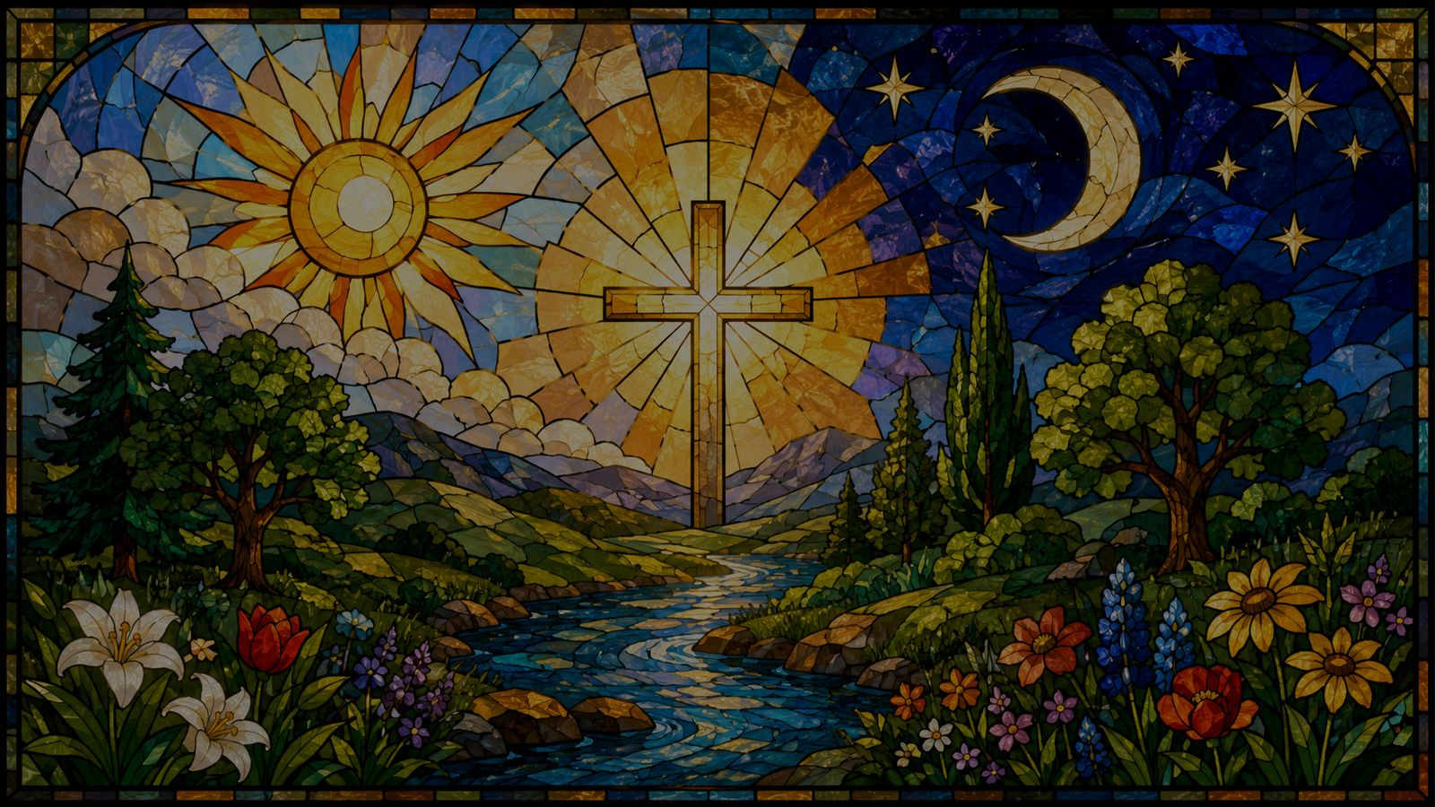
Teaching Aim
1
2
3
Understand
Feel
Practice
Creation is a gift that points to God.
Gratitude for beauty, love, and grace.
Turn daily blessings into praise.
Prepared for teaching and small group use - hymninfo.com

Slide 3

Hymn Identity
Title
For the Beauty of the Earth
First line
For the beauty of the earth
Text
Folliott Sandford Pierpoint, 1864
Tune
DIX, adapted from Conrad Kocher
Meter
7.7.7.7.7.7
Core theme
Thanksgiving for creation and every good gift
Prepared for teaching and small group use - hymninfo.com

Slide 4
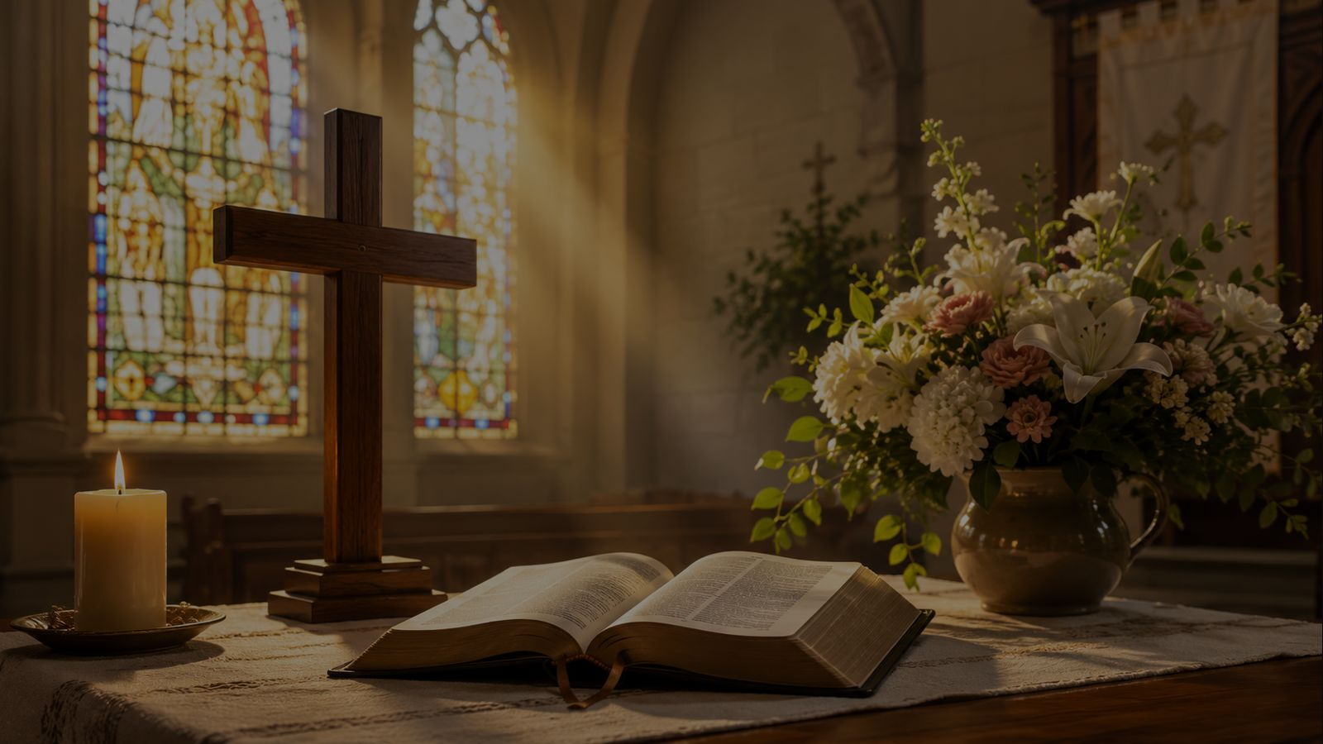
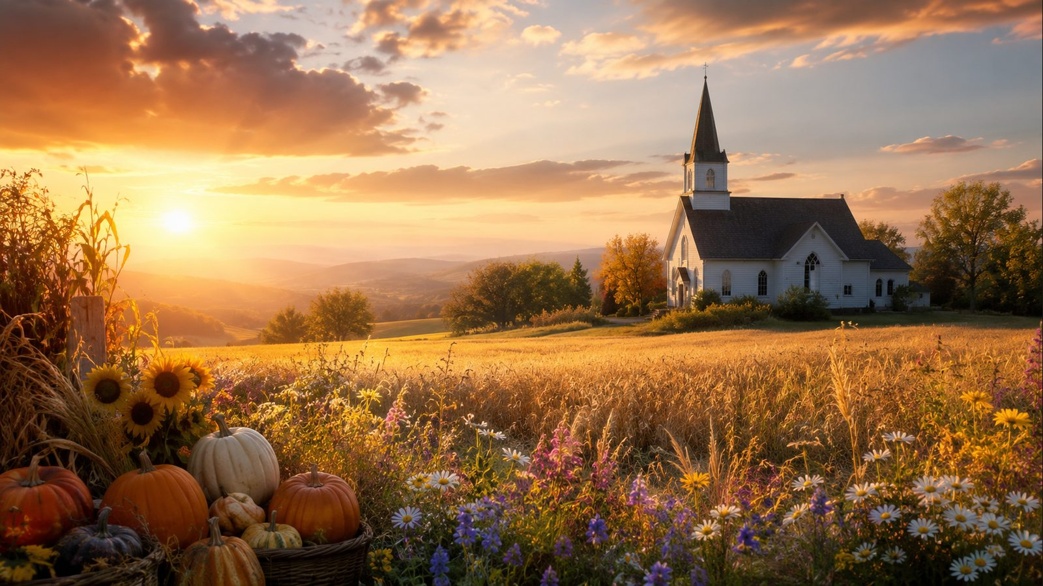
Historical Background
• Folliott Sandford Pierpoint wrote the text in 1864 while living in Bath, England.
• The hymn first appeared in Lyra Eucharistica, a collection connected with Holy Communion.
• Over time it became widely used as a hymn of thanksgiving and general praise.
• DIX, associated with Conrad Kocher, gives the text a graceful and memorable congregational setting.
Prepared for teaching and small group use - hymninfo.com

Slide 5

Why This Hymn Matters Today
A grateful imagination
It trains worshipers to name God’s gifts rather than rush past them.
A whole-life praise
It joins earth, sky, love, friendship, senses, and worship into thanksgiving.
A pastoral corrective
It helps anxious or distracted hearts recover wonder before God.
Prepared for teaching and small group use - hymninfo.com

Slide 6
Biblical Foundation
• Genesis 1:31 — creation is declared very good.
• Psalm 19:1 — the heavens declare God’s glory.
• Psalm 104:24 — the earth is full of God’s riches.
• James 1:17 — every good and perfect gift comes from above.
• Colossians 1:16 — all things were created through Christ and for Christ.
Teaching emphasis
The hymn does not worship nature. It receives nature as a gift and returns praise to the Lord of all.
Prepared for teaching and small group use - hymninfo.com

Slide 7

Stanza Study: Beauty that Becomes Praise
The opening movement names earth, sky, and surrounding love as gifts. The proper response is not possession but gratitude.
Scripture connection
Psalm 19:1; Genesis 1:31
Teaching emphasis
Beauty is not an escape from God; it is a doorway into praise.
Prepared for teaching and small group use - hymninfo.com

Slide 8
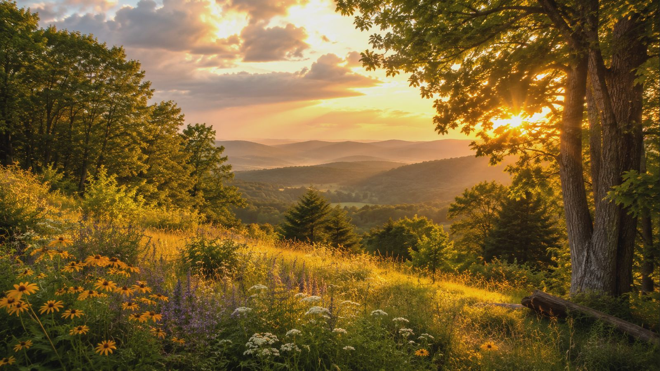
Stanza Study: Each Hour as a Gift
Day and night, hill and valley, tree and flower all become reminders that time and place are held in God’s care.
The stanza helps a group slow down and notice: God’s generosity is not rare; it is woven into ordinary hours.
Prepared for teaching and small group use - hymninfo.com

Slide 9

Stanza Study: Senses, Sound, and Sight
Pierpoint gives thanks not only for objects of beauty, but for the human ability to receive them: ear, eye, heart, and mind.
Teaching emphasis
Our senses can become instruments of worship when they awaken thanksgiving instead of entitlement.
Prepared for teaching and small group use - hymninfo.com

Slide 10
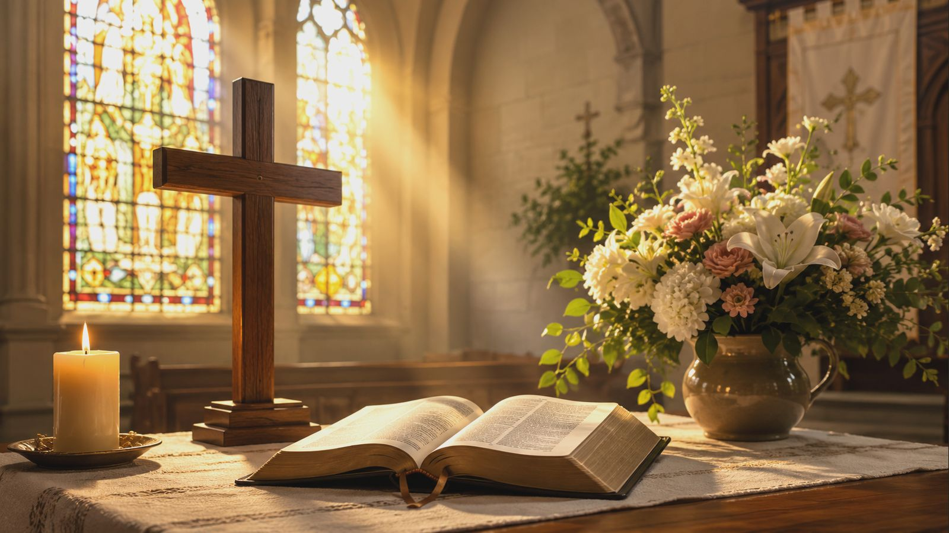
Stanza Study: Human Love as a Gift
The hymn moves from creation to community. Family, friendship, and gentle affections are received as gifts from God.
Pastoral angle
Thanksgiving should become tenderness. Gratitude for people leads to patience, forgiveness, and generous love.
Prepared for teaching and small group use - hymninfo.com

Slide 11
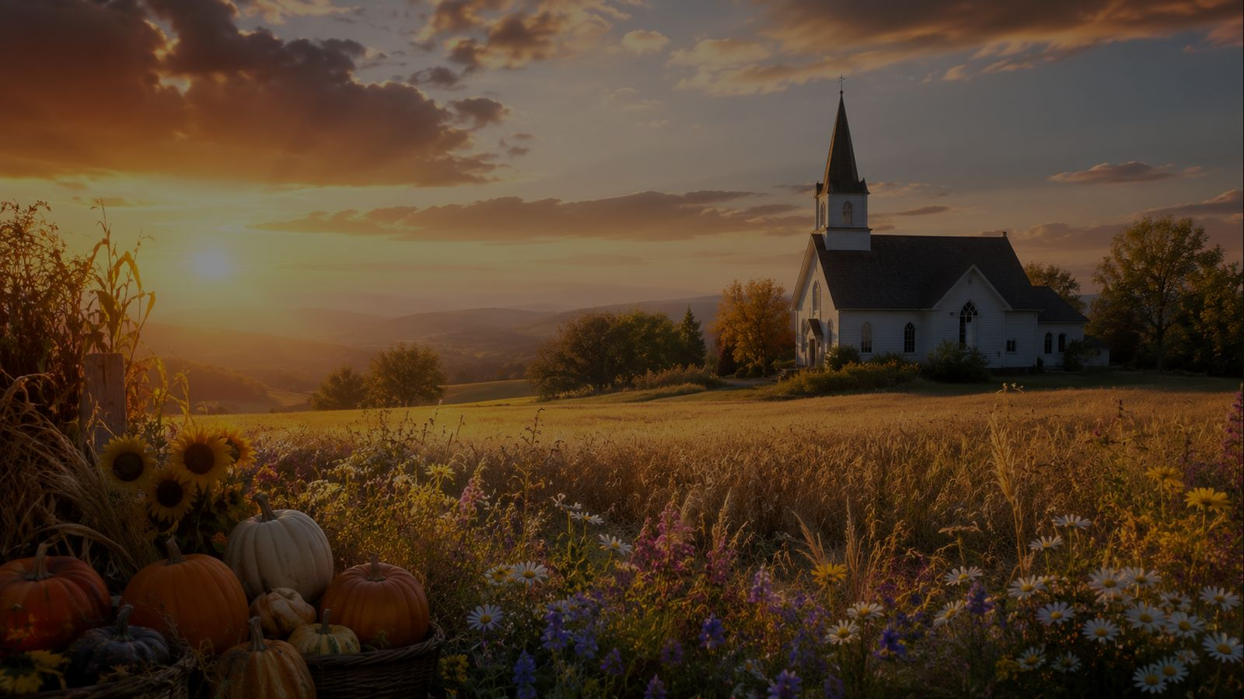
Gathering the Gifts into Praise
The repeated response turns each blessing back toward God: “Lord of all.” Thanksgiving becomes worship.
The hymn finally gathers “every perfect gift” and teaches the church to receive both human and divine graces with humble joy.
Prepared for teaching and small group use - hymninfo.com

Slide 12
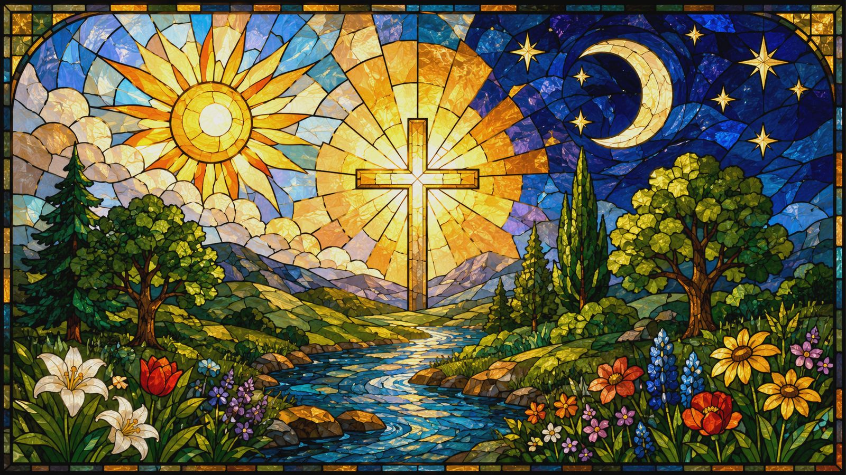
Theological Themes
Creation
The world is made good by God.
Providence
Life is sustained by divine care.
Thanksgiving
Gratitude is worship in daily form.
Community
Human love is a holy gift.
Christ
All things exist through and for him.
Stewardship
Received gifts call for faithful care.
Prepared for teaching and small group use - hymninfo.com

Slide 13
Literary and Musical Observations
• The text moves outward and inward: earth and sky, then senses, relationships, and worship.
• The repeated closing line gives the congregation a simple doxological anchor.
• DIX has a balanced, flowing shape that supports joyful gratitude without rushing.
• A moderate tempo lets the words remain clear and prayerful.
Choir note
Shape each stanza with warmth, leaving space for the repeated response to feel like a true offering.
Prepared for teaching and small group use - hymninfo.com

Slide 14
Pastoral and Worship Use
Suitable occasions
Thanksgiving • Harvest • Creation care • Family services • General praise • Communion services that emphasize gratitude
• What gifts of God do you most often overlook?
• How can beauty lead to worship rather than distraction?
• How might gratitude change the way a church cares for people and creation?
Prepared for teaching and small group use - hymninfo.com

Slide 15
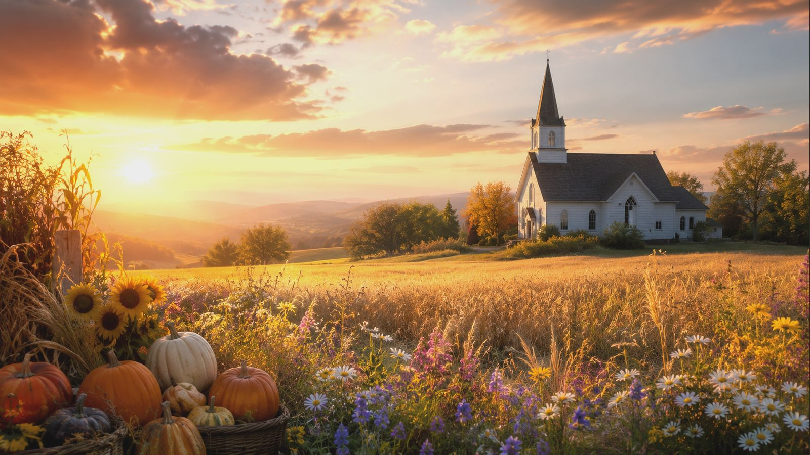
Suggested Lesson Flow
30 minutes
1. Read Psalm 19:1 and James 1:17
2. Brief hymn background
3. Stanza walk-through
4. One gratitude practice for the week
60 minutes
1. Opening reflection on beauty
2. Creation and providence in Scripture
3. Stanza-by-stanza discussion
4. Worship-planning conversation
5. Closing prayer of thanksgiving
Prepared for teaching and small group use - hymninfo.com

Slide 16
Closing Summary and Prayer
Summary
God’s gifts surround us: creation, time, senses, relationships, and grace. The hymn teaches the church to receive them with wonder and return them as praise.
Prayer
Lord of all, open our eyes to your goodness. Teach us to notice your gifts, cherish your creation, love our neighbors, and raise our lives as grateful praise through Jesus Christ. Amen.
Prepared for teaching and small group use - hymninfo.com

Slide 17
For Teaching Use
© HymnInfo.com. Free for personal, church, classroom, and small-group teaching use. Please do not sell, repost, or redistribute as downloadable files without permission.
Prepared for teaching and small group use - hymninfo.com

