Slide 1

Are You Washed in the Blood?
Have you been to Jesus for the cleansing power
Elisha A. Hoffman • 1878 • WASHED IN THE BLOOD
Primary Scripture: Revelation 7:14
A teaching guide on cleansing, redemption, assurance, and gospel invitation.
Prepared for teaching and small group use - hymninfo.com

Slide 2
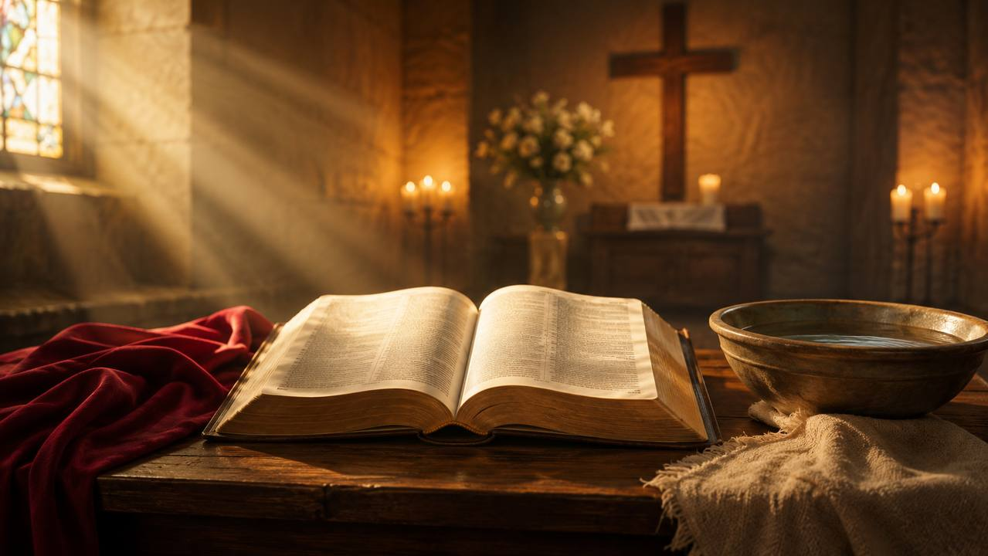
Teaching Aim
Understand, feel, and practice the gospel message of cleansing through Christ.
1
Biblical image
See how Revelation 7:14 and 1 John 1:7 use washing, blood, and the Lamb to describe salvation.
Understand
2
Pastoral weight
Receive the searching question as a gracious invitation, not as fear-based pressure.
Feel
3
Faithful response
Trust Christ, walk in the light, and serve God with a cleansed conscience.
Practice
Prepared for teaching and small group use - hymninfo.com

Slide 3
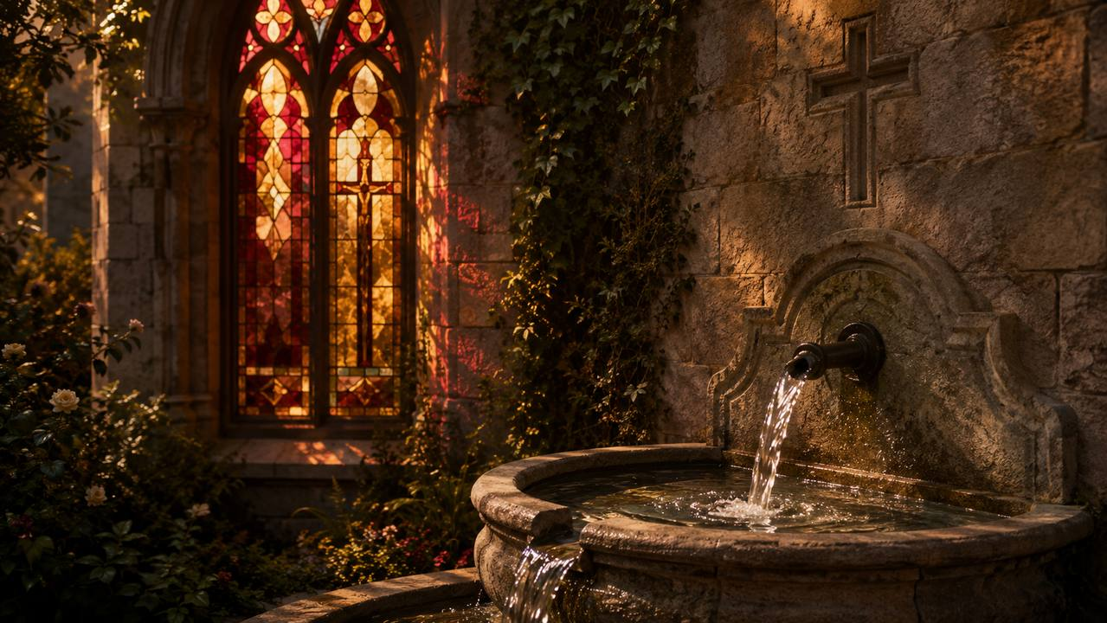
Hymn Identity
A classic American gospel song of invitation and assurance.
Title
First line
Are You Washed in the Blood?
Have you been to Jesus for the cleansing power
Writer and composer
Year
Elisha Albright Hoffman
1878
Tune
Meter
WASHED IN THE BLOOD
11.9.11.9 with refrain
Prepared for teaching and small group use - hymninfo.com

Slide 4

Hoffman
1878
American minister, editor, and gospel hymn writer who wrote both text and music.
Historical Background
First publication
Printed in Spiritual Songs for Gospel Meetings and the Sunday School.
A revival-era gospel song shaped for Sunday schools, testimony, and evangelistic response.
Church setting
Direct questions and a memorable refrain served revival and invitation worship.
Prepared for teaching and small group use - hymninfo.com

Slide 5

Why This Hymn Matters Today
It teaches gospel clarity without losing pastoral care.
Pastoral value
Teaching value
Names guilt honestly
Points to Christ directly
Offers assurance beyond feeling
Explains biblical cleansing
Connects Lamb and sacrifice
Links forgiveness and holy living
Worship value
Devotional value
Strong congregational refrain
Useful for response and testimony
Clear focus on the cross
Encourages self-examination
Leads to confession
Strengthens gratitude
Prepared for teaching and small group use - hymninfo.com

Slide 6
Key passages
SCRIPTURE
Revelation 7:14 - robes washed in the Lamb’s blood
1 John 1:7 - cleansed from all sin
Hebrews 9:14 - conscience purified for service
Isaiah 1:18 - scarlet sins made white
1 Peter 1:18-19 - redeemed by Christ
Biblical Foundation
Washed robes, the Lamb’s blood, cleansed conscience, and sins made white as snow.
Prepared for teaching and small group use - hymninfo.com

Slide 7

Hymn-Section Study: The Opening Question
The hymn begins where pastoral evangelism often begins: honest examination before Christ.
Theme
Teaching emphasis
A direct question about coming to Jesus for cleansing.
The question is not meant to shame, but to turn the hearer toward mercy.
Scripture connection
Isaiah 1:18 and 1 John 1:7 show both the seriousness of sin and the promise of cleansing grace. The gospel names the wound in order to bring healing.
Prepared for teaching and small group use - hymninfo.com

Slide 8
Hymn-Section Study: Daily Fellowship
The hymn connects cleansing with walking in grace.
What to teach
Pastoral note
Christ cleanses from sin.
Forgiveness leads to fellowship.
Grace produces holy living.
The believer walks in the light, not hiding in darkness.
Do not separate assurance from discipleship. The hymn’s questions press hearers to trust Christ and to live honestly before God.
Prepared for teaching and small group use - hymninfo.com

Slide 9
Function
REFRAIN
It turns doctrine into congregational response.
Refrain Study
Theology
The Lamb’s sacrifice is the ground of forgiveness and purity.
The refrain returns again and again to the Lamb, the blood, and the cleansing question.
Pastoral use
Sing it as both confession of faith and invitation to trust Christ.
Prepared for teaching and small group use - hymninfo.com

Slide 10

Hymn-Section Study: Readiness Before God
The hymn asks whether the heart is prepared to stand before the Lord.
Assurance
Warning
Christian readiness is not confidence in our perfection. It is confidence in Christ’s saving work.
The hymn’s questions should awaken response without becoming manipulation.
Teaching direction
Lead hearers to examine themselves, then lead them beyond themselves to the Lamb who redeems and cleanses.
Prepared for teaching and small group use - hymninfo.com

Slide 11
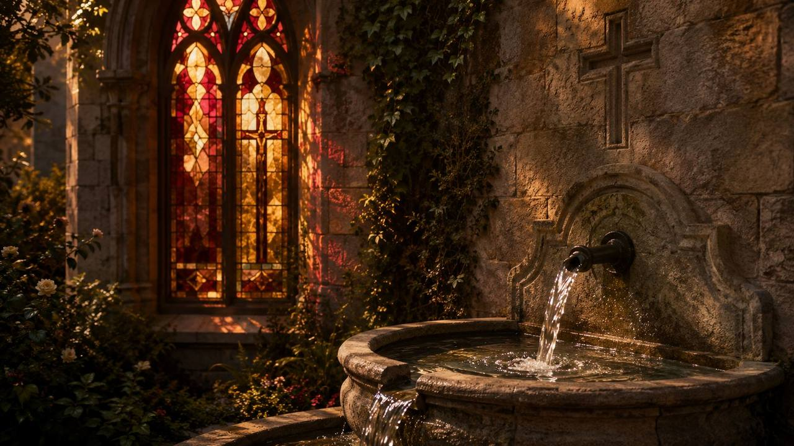
Hymn-Section Study: Garments Made Clean
White garments point to forgiveness, purity, and the hope of standing among the redeemed.
Revelation imagery
Pastoral emphasis
The Bible speaks of robes washed and made white in the Lamb’s blood. The image is paradoxical, but its meaning is clear: Christ makes sinners clean.
A stained conscience is not healed by pretending. The hymn points the wounded heart to Christ’s cleansing grace.
✓
✦
→
Cleansed
Redeemed
Ready
Prepared for teaching and small group use - hymninfo.com

Slide 12
Theological Themes
Themes genuinely present in the hymn and its biblical foundation.
Atonement
Cleansing
Redemption
Christ gives himself for sinners.
Sin is washed away by grace.
The Lamb purchases freedom.
Invitation
Assurance
Holy living
The gospel calls for response.
Confidence rests in Christ.
Forgiven people walk in the light.
Prepared for teaching and small group use - hymninfo.com

Slide 13
Literary and Musical Observations
The hymn’s structure supports clear gospel teaching.
Text
Music
Built around searching questions
Uses biblical images of Lamb, blood, washing, and garments
Moves from invitation to readiness and assurance
Late nineteenth-century gospel-song style
Clear phrases and memorable refrain
Moderate tempo keeps the questions clear and strong
Prepared for teaching and small group use - hymninfo.com

Slide 14
Pastoral and Worship Use
Use the hymn where gospel invitation and assurance are central.
Best settings
Use with care
Evangelistic services
Baptismal reflection
Testimony gatherings
Teaching on the cross
Explain blood imagery biblically
Avoid pressure tactics
Point anxious hearts to Christ
Worship planning note
The hymn can serve as a response after preaching, but it should be framed with Scripture and sung with reverence rather than haste.
Prepared for teaching and small group use - hymninfo.com

Slide 15
Teaching Questions
Questions for Sunday school, choir rehearsal, or worship planning.
For discussion
Why does the hymn ask questions instead of only making declarations?
How does Revelation 7:14 explain the image of being washed?
What does Hebrews 9:14 teach about conscience and service?
How can a church invite people to Christ without manipulation?
What does assurance look like when someone feels unworthy?
Prepared for teaching and small group use - hymninfo.com

Slide 16
Application
How believers can respond faithfully this week.
Trust
Confess
Come to Christ for cleansing rather than hiding guilt.
Walk in the light through honest repentance and faith.
Serve
Invite
Let a cleansed conscience become joyful service to God.
Speak the gospel with clarity, humility, and compassion.
Prepared for teaching and small group use - hymninfo.com

Slide 17
Suggested Lesson Flow
Two options for leading the study.
30-minute plan
60-minute plan
Read Revelation 7:14 • Explain the hymn background • Discuss the refrain • Close with prayer.
Add 1 John 1:7, Hebrews 9:14, and a fuller discussion of assurance and gospel invitation.
1
2
3
4
1
2
3
4
5
Read
Teach
Discuss
Pray
Scripture
History
Themes
Music
Practice
Prepared for teaching and small group use - hymninfo.com

Slide 18
Closing Summary and Prayer
Christ the Lamb cleanses sinners, gives assurance, and calls his people to walk in the light.
Lord Jesus Christ, cleanse our hearts, quiet every fear, and teach us to trust your saving work with grateful obedience. Amen.
© HymnInfo.com. Free for personal, church, classroom, and small-group teaching use. Please do not sell, repost, or redistribute as downloadable files without permission.
Prepared for teaching and small group use - hymninfo.com

