Slide 1
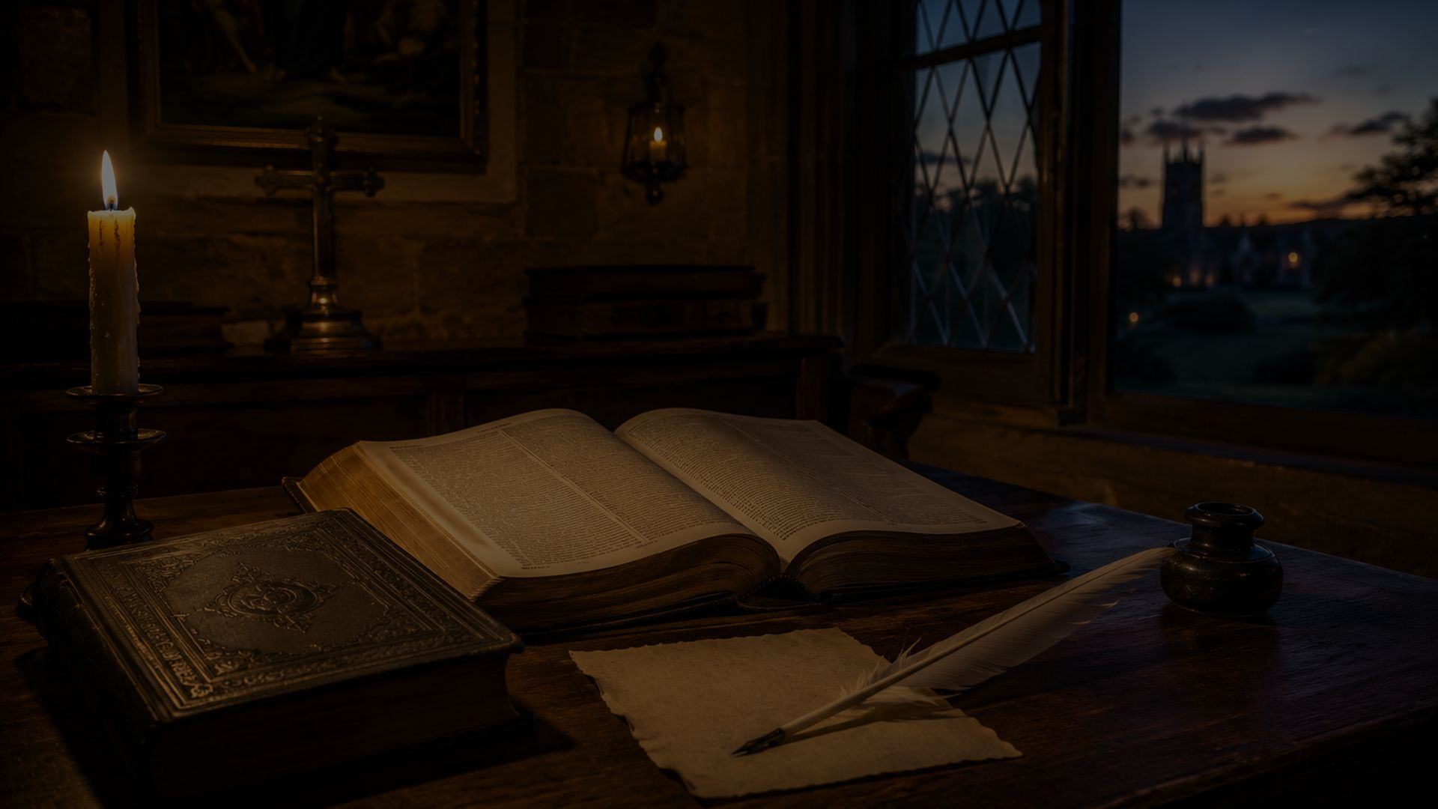
All Praise to Thee, My God, This Night
An evening hymn of praise, repentance, and trust
First line: All praise to thee, my God, this night
Text: Thomas Ken • first known 1692
Tune: TALLIS' CANON / TALLIS' EVENING HYMN
Primary Scripture: Psalm 4:8
Prepared for teaching and small group use - hymninfo.com

Slide 2

Teaching Aim
What learners should understand, feel, and practice
Understand the hymn as a pattern for ending the day before God.
Feel the comfort of God’s protecting care through the night.
Practice gratitude, repentance, trust, and praise as daily devotion.
Prepared for teaching and small group use - hymninfo.com

Slide 3
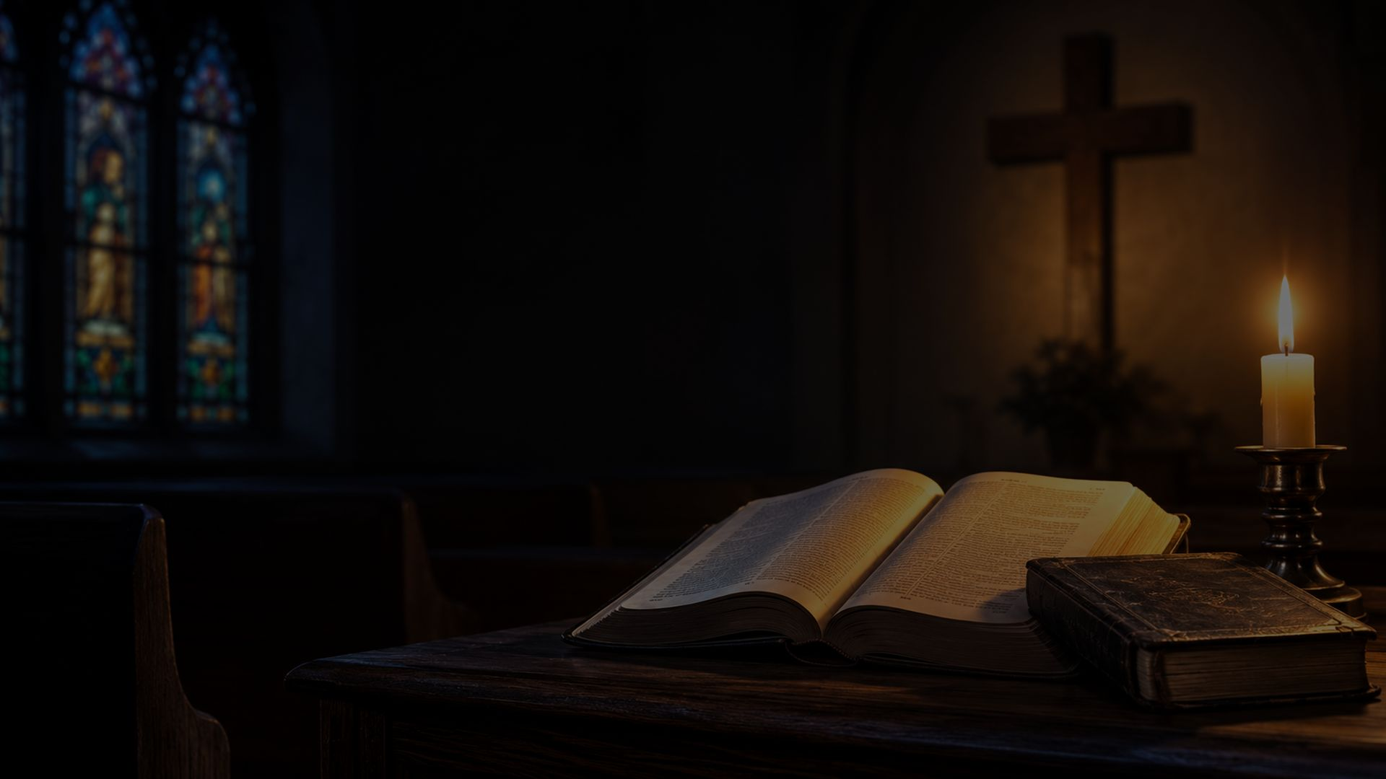
Hymn Identity
A classic evening prayer in English-language hymnody
Title
All Praise to Thee, My God, This Night
First line
All praise to thee, my God, this night
Author
Thomas Ken (1637–1711)
Tune
TALLIS' CANON / TALLIS' EVENING HYMN
Composer source
Thomas Tallis (c.1505–1585)
Meter
Long Meter (8.8.8.8)
Prepared for teaching and small group use - hymninfo.com

Slide 4

Historical Background
Thomas Ken and the rhythm of daily devotion
Ken’s morning, evening, and midnight hymns were connected with devotional instruction for students at Winchester College.
The evening hymn is first known from a 1692 printing and later appeared in authorized forms in the 1690s.
Both “All praise to thee” and “Glory to thee” openings have continued in use.
Prepared for teaching and small group use - hymninfo.com

Slide 5
Thomas Ken
Pastor, bishop, hymn writer, teacher of prayer
An Anglican bishop whose hymns helped shape early English congregational hymnody.
His devotional hymns framed the day with prayer, praise, and moral seriousness.
The doxology associated with his hymns became one of the church’s most familiar acts of praise.
Prepared for teaching and small group use - hymninfo.com

Slide 6
Tallis and the Tune
A dignified long-meter melody for evening prayer
TALLIS’ CANON derives from a melody associated with Thomas Tallis and Psalm 67 in Parker’s Psalter.
Its long-meter form fits the common hymnal shape of Ken’s evening hymn.
The canon can be sung in rounds, giving a simple melody a rich devotional texture.
Prepared for teaching and small group use - hymninfo.com

Slide 7
Why This Hymn Matters Today
A prayer pattern for weary believers
It gives Christians words for ending the day with God rather than with anxiety.
It joins gratitude and repentance without losing the assurance of God’s care.
It teaches families, students, and congregations to recover daily prayer rhythms.
Prepared for teaching and small group use - hymninfo.com

Slide 8
Biblical Foundation
Night prayer, divine protection, and praise
Psalm 4:8 - the Lord alone gives peaceful safety.
Psalm 121:4–5 - the Keeper of Israel neither slumbers nor sleeps.
Psalm 91:1–2 - the faithful dwell in the shelter of the Most High.
Psalm 134:1–2 - the servants of the Lord bless him by night.
Matthew 6:13 - believers ask for deliverance from the evil one.
Prepared for teaching and small group use - hymninfo.com

Slide 9
Psalm 4:8
Peace because God gives safety
“In peace I will both lay myself down and sleep, for you, Yahweh alone, make me live in safety.”
The hymn teaches rest as an act of trust. Sleep becomes a confession that the Lord’s keeping care is stronger than our unfinished concerns.
Prepared for teaching and small group use - hymninfo.com

Slide 10
Psalm 121
The Keeper who does not sleep
Human strength is limited; God’s watchful care is not.
The hymn’s nighttime petitions rest on the truth that the Lord keeps his people continually.
Evening prayer is not denial of danger but trust in God’s faithful presence.
Prepared for teaching and small group use - hymninfo.com

Slide 11
Stanza Movement
Thanksgiving • Repentance • Protection • Doxology
Prepared for teaching and small group use - hymninfo.com

Slide 12
Thanksgiving
A public-facing stanza study in original prose
The hymn begins by praising God for mercies received throughout the day. It trains believers to remember the day through providence rather than anxiety.
Prepared for teaching and small group use - hymninfo.com

Slide 13
Repentance
A public-facing stanza study in original prose
Evening prayer includes honest review. The believer can confess failure because God’s mercy is greater than the sins of the day.
Prepared for teaching and small group use - hymninfo.com

Slide 14
Protection
A public-facing stanza study in original prose
The hymn asks God to guard the believer through the night against danger, temptation, fear, and evil.
Prepared for teaching and small group use - hymninfo.com

Slide 15
Doxology
A public-facing stanza study in original prose
The closing praise lifts private devotion into the worship of Father, Son, and Holy Spirit.
Prepared for teaching and small group use - hymninfo.com

Slide 16
Theological Themes
What the hymn teaches
Providence: every day and night are held in God’s care.
Repentance: the day ends with honest confession and renewed grace.
Assurance: the believer can rest because God remains awake and faithful.
Praise: personal devotion culminates in doxology.
Prepared for teaching and small group use - hymninfo.com

Slide 17
Literary and Musical Observations
Gentle structure, serious devotion
The text moves from memory of the day to prayer for the night.
Its language is simple enough for daily devotion and strong enough for corporate worship.
TALLIS’ CANON supports quiet reverence and can also be sung in a round.
A moderate tempo preserves the hymn’s prayerful character.
Prepared for teaching and small group use - hymninfo.com

Slide 18
Pastoral and Worship Use
Where this hymn serves the church
Evening prayer, compline, and devotional gatherings.
Family worship and school chapel settings.
Services emphasizing gratitude, repentance, protection, or trust.
Choir rehearsal as a canon or reflective congregational hymn.
Prepared for teaching and small group use - hymninfo.com

Slide 19
Teaching Questions
For class or small group discussion
How does gratitude change the way we remember a difficult day?
Why does evening prayer need both repentance and assurance?
What does Psalm 121 teach us about rest?
How does the doxology connect private prayer to the worship of the church?
Prepared for teaching and small group use - hymninfo.com

Slide 20
Application
A simple evening prayer pattern
Name one mercy received today.
Confess one sin, failure, or anxious burden honestly before God.
Entrust one person or concern to God’s keeping care.
Close with praise: all blessings flow from God.
Prepared for teaching and small group use - hymninfo.com

Slide 21
Suggested Lesson Flow
Two practical teaching plans
30-Minute Plan
60-Minute Plan
Read Psalm 4:8
Introduce Ken and Tallis
Study the hymn’s four movements
Pray the evening prayer pattern
Read Psalm 4, 121, and 134
Explore historical background
Discuss each stanza movement
Sing or listen prayerfully
Plan a weekly evening devotion
Prepared for teaching and small group use - hymninfo.com

Slide 22
Closing Summary and Prayer
Resting under God’s faithful care
The hymn teaches believers to end the day with thanksgiving, confession, trust, and praise.
Lord, keeper of your people, receive our praise for today’s mercies. Forgive our sins, quiet our fears, and guard us through the night. Teach us to rest in your faithful care and rise again to glorify you. Amen.
Prepared for teaching and small group use - hymninfo.com

Slide 23
Usage Notice
© HymnInfo.com. Free for personal, church, classroom, and small-group teaching use. Please do not sell, repost, or redistribute as downloadable files without permission.
Prepared for teaching and small group use - hymninfo.com
Prepared for teaching and small group use - hymninfo.com

