Slide 1
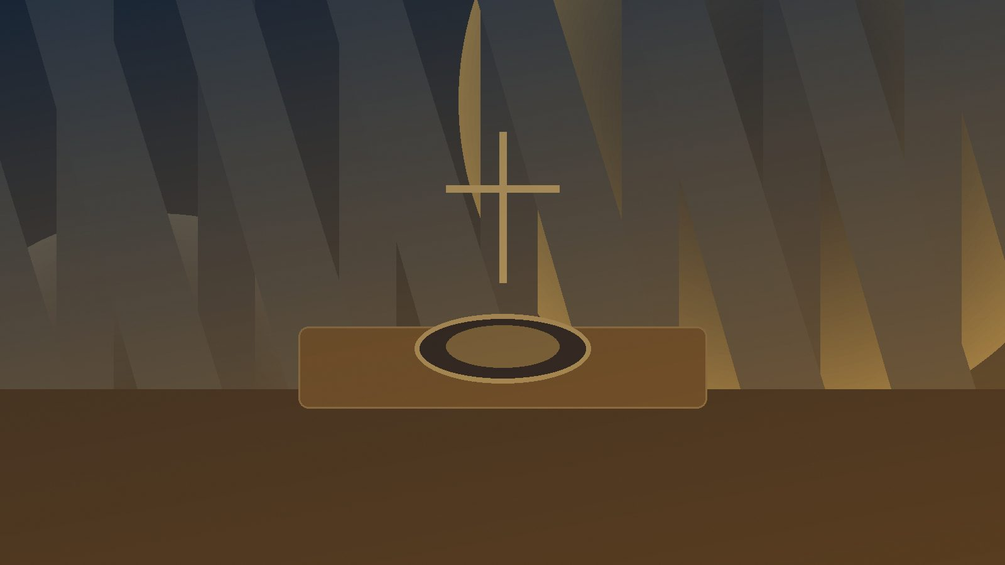
All Things Come of Thee
A hymn study resource on stewardship, offering, and gratitude
First line: “All things come of thee, O Lord”
Primary Scripture: 1 Chronicles 29:14
For pastors, teachers, worship planners, and small groups
Prepared for teaching and small group use - hymninfo.com

Slide 2
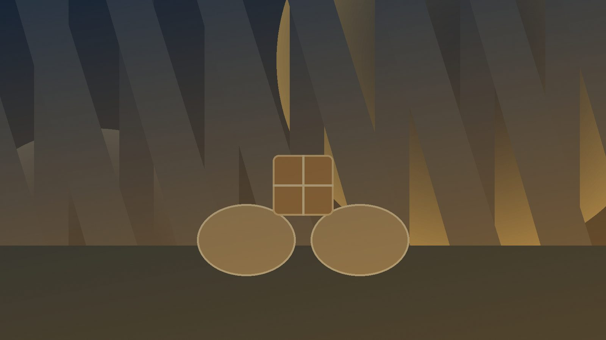
Teaching Aim
What learners should understand, feel, and practice
1
2
3
Understand
Feel
Practice
All generosity begins in God’s prior giving.
Gratitude, humility, and freedom from possessiveness.
Offering life and gifts back to God in worship.
Prepared for teaching and small group use - hymninfo.com

Slide 3

Hymn Identity
A Scripture sentence used as service music
Detail | Teaching Note
Title | All Things Come of Thee
First line | All things come of thee, O Lord
Biblical text | 1 Chronicles 29:14
Musical use | Offertory response or sung sentence
Tune name | OFFERING in some hymnals
Meter | Irregular
Music | Anonymous or traditional liturgical settings
This is best taught as worship language for the offering: brief, biblical, memorable, and deeply theological.
Prepared for teaching and small group use - hymninfo.com

Slide 4

Historical Background
From David’s prayer to the church’s offertory
The words come from David’s prayer after gifts were gathered for the temple.
David refuses to treat generosity as human achievement; he confesses God’s prior giving.
Christian liturgical traditions adopted the sentence for the presentation of gifts.
Modern hymnals often classify it as service music, a response, or a short musical sentence.
Receive • Return • Rejoice
Prepared for teaching and small group use - hymninfo.com

Slide 5

Why This Matters Today
The offertory is not a pause in worship
It teaches that giving is worship, not merely church administration.
It forms humility: the church gives only because God has already provided.
It guards against both pride and reluctance in stewardship.
It turns money, time, labor, and gifts toward God’s glory.
Receive • Return • Rejoice
Prepared for teaching and small group use - hymninfo.com

Slide 6
Biblical Foundations
The gifts of God returned in gratitude
Prepared for teaching and small group use - hymninfo.com

Slide 7
Primary Scripture
1 Chronicles 29:14
The verse holds together two truths: the people give willingly, and every gift has already come from God.
“But who am I, and what is my people, that we should be able to offer so willingly as this? For all things come from you, and we have given you of your own.”
Prepared for teaching and small group use - hymninfo.com

Slide 8
Supporting Scriptures
A biblical theology of stewardship
James 1:17
Psalm 24:1
Every good gift comes from above.
The earth belongs to the Lord.
Romans 11:36
2 Corinthians 9:7
All things are from, through, and to God.
God loves cheerful giving.
Prepared for teaching and small group use - hymninfo.com

Slide 9
Sentence Study
The movement of the offertory response
God gives first: every gift begins in divine generosity.
The church returns: offering is gratitude made visible.
Pride is humbled: even willing gifts are possible because God supplies them.
Discipleship is widened: all of life can be offered back to God.
Receive • Return • Rejoice
Prepared for teaching and small group use - hymninfo.com

Slide 10

How It Functions in Worship
A short sentence with a large confession
It interprets the act of giving while the congregation is already participating in it.
It keeps the offertory connected to Scripture and prayer.
It reminds worshipers that stewardship belongs inside praise.
It can be spoken, chanted, sung by choir, or sung by the whole congregation.
Receive • Return • Rejoice
Prepared for teaching and small group use - hymninfo.com

Slide 11
Theological Themes
Stewardship, gratitude, providence, generosity
Prepared for teaching and small group use - hymninfo.com

Slide 12
Theological Themes
What this short sentence teaches
Providence
Stewardship
Gratitude
God supplies what his people offer.
We are caretakers, not absolute owners.
Giving answers the gifts already received.
Humility
Worship
Generosity
The offering is not grounds for boasting.
Generosity belongs inside praise.
Grace frees the heart to give willingly.
Prepared for teaching and small group use - hymninfo.com

Slide 13
Literary and Musical Observations
Service music that teaches theology simply
The language is brief enough to be remembered and repeated by the congregation.
Its irregular meter allows simple spoken, chanted, or harmonized settings.
A restrained musical setting keeps the biblical confession clear.
The sentence works best when it supports, rather than overwhelms, the presentation of gifts.
Receive • Return • Rejoice
Prepared for teaching and small group use - hymninfo.com

Slide 14
Pastoral and Worship Use
Where this response serves the church well
Offertory and presentation of gifts
Stewardship teaching and annual commitment services
Thanksgiving, harvest, dedication, and mission emphasis
Services that connect worship with generosity and daily discipleship
Receive • Return • Rejoice
Prepared for teaching and small group use - hymninfo.com

Slide 15
Teaching Questions
Move from observation to practice
How does 1 Chronicles 29:14 reshape the meaning of the offering?
What is the difference between cheerful giving and pressured giving?
How can churches teach stewardship without reducing worship to fundraising?
What gifts besides money can be returned to God in faithful service?
Receive • Return • Rejoice
Prepared for teaching and small group use - hymninfo.com

Slide 16
Suggested Lesson Flow
Two teaching options
30-Minute Plan
60-Minute Plan
1. Read 1 Chronicles 29:14
1. Open with reflection questions
2. Teach the biblical context
2. Study David’s prayer and supporting Scriptures
3. Discuss worship and offering
3. Discuss the study table
4. Close with a gratitude prayer
4. Plan one act of generosity
5. Pray the offertory sentence together
Prepared for teaching and small group use - hymninfo.com

Slide 17
Closing Summary and Prayer
All things come from you, O Lord. Teach us to receive with gratitude, give with humility, and offer our lives for your glory. Make our worship generous and our generosity worshipful. Amen.
Receive gratefully • Return humbly • Live generously
Prepared for teaching and small group use - hymninfo.com

Slide 18
Prepared for Church Teaching
© HymnInfo.com. Free for personal, church, classroom, and small-group teaching use. Please do not sell, repost, or redistribute as downloadable files without permission.
hymninfo.com
Prepared for teaching and small group use - hymninfo.com

