Slide 1

Christmas Carol Study
Angels We Have Heard on High
First line: “Angels we have heard on high”
French carol tradition • English version associated with James Chadwick, 1862
Tune: GLORIA • Primary Scripture: Luke 2:8-20
Glory to God in the highest
Prepared for teaching and small group use - hymninfo.com
1

Slide 2
Teaching Aim
Understand
Feel
Practice
The carol retells Luke 2 as a movement from angelic announcement to human adoration. Learners should see how Christmas praise is rooted in revealed good news.
Invite wonder, joy, reverence, and humility before the mystery of the Word made flesh.
Respond like the shepherds: hear the message, seek Christ, worship him, and bear witness with joy.
Prepared for teaching and small group use - hymninfo.com
2

Slide 3
Hymn Identity
• Title: Angels We Have Heard on High.
• First line: “Angels we have heard on high.”
• French carol roots: Les Anges dans nos campagnes.
• English version commonly associated with Bishop James Chadwick, 1862.
• Tune: GLORIA, a traditional French melody; later harmonizations helped shape modern congregational use.
• Meter: 7.7.7.7 with extended refrain.
Prepared for teaching and small group use - hymninfo.com
3

Slide 4
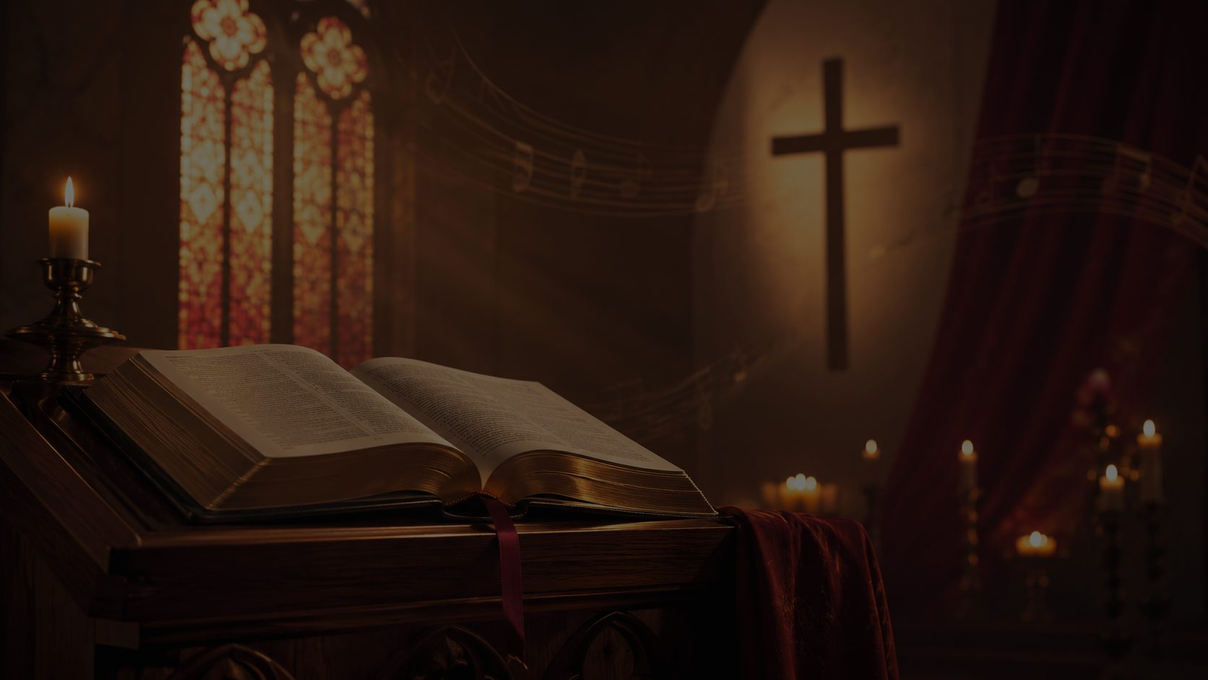
HISTORICAL BACKGROUND
From French Carol to Congregational Praise
The carol grew from French noel traditions and entered English-language worship through a translation that preserved the Latin Gloria refrain.
Prepared for teaching and small group use - hymninfo.com
4

Slide 5
Historical Setting
• The carol belongs to the wider European Christmas carol tradition, where biblical narrative, folk melody, and liturgical praise meet.
• The retained Latin refrain connects local song to the historic worship of the church.
• The English text made the carol accessible for congregational Christmas worship while preserving its joyful and reverent character.
• The tune GLORIA has become one of the most recognizable melodies of the Christmas season.
Prepared for teaching and small group use - hymninfo.com
5

Slide 6
Why This Carol Matters Today
Pastoral Value
Worship Value
It speaks good news into fear, darkness, and ordinary life.
It trains the church to answer revelation with praise.
Teaching Value
Devotional Value
It gives a clear path through Luke 2: hearing, seeking, seeing, telling.
It helps believers move from seasonal familiarity to adoration of Christ.
Prepared for teaching and small group use - hymninfo.com
6

Slide 7
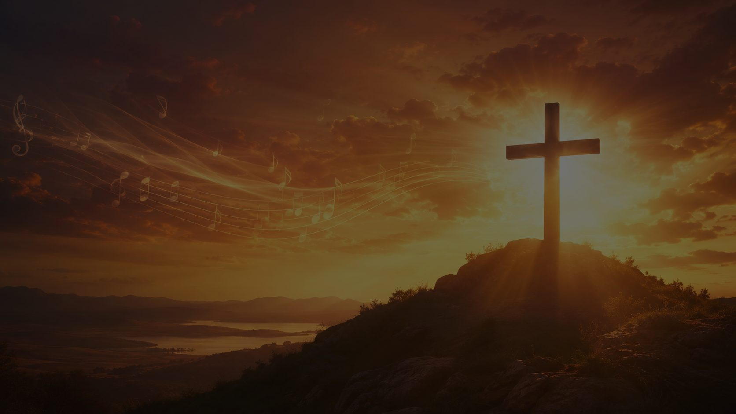
BIBLICAL FOUNDATION
Luke 2:8-20
The carol follows the angelic announcement, the shepherds’ response, and the return of worshipers who glorify and praise God.
Prepared for teaching and small group use - hymninfo.com
7

Slide 8
Scripture Connections
• Luke 2:8-14: the angel appears, the glory of the Lord shines, and heaven announces good news of great joy.
• Luke 2:15-20: the shepherds go to Bethlehem, find the child, tell what they heard, and return praising God.
• John 1:14: the Word became flesh and lived among us, revealing glory full of grace and truth.
• Philippians 2:9-11: the humbled and exalted Christ receives universal confession to the glory of God the Father.
Prepared for teaching and small group use - hymninfo.com
8

Slide 9
The Carol’s Movement
1. Hearing
2. Wondering
3. Adoring
The shepherds hear heavenly praise over the fields. The story begins with God speaking into ordinary life.
The carol asks about the cause of the shepherds’ joy and draws worshipers into the mystery.
The invitation is clear: come, see, and kneel before Christ the Lord, the newborn King.
Prepared for teaching and small group use - hymninfo.com
9

Slide 10
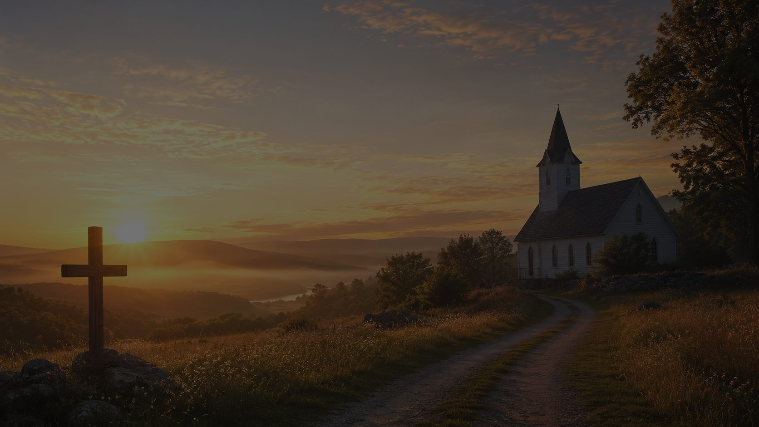
Stanza 1: Heaven over the Fields
• The opening scene contrasts ordinary shepherd life with heavenly song.
• The mountains echo the joy, suggesting that creation itself becomes a witness to praise.
• Teaching emphasis: God’s good news comes to humble hearers and ordinary places.
Prepared for teaching and small group use - hymninfo.com
10

Slide 11

The Refrain: Gloria
“Gloria in excelsis Deo”
• The refrain is not a pause from the story; it is the worshiping response to the story.
• The long musical line stretches the congregation’s praise, allowing joy to become embodied in song.
• Teaching emphasis: Christmas doctrine should lead to doxology.
Prepared for teaching and small group use - hymninfo.com
11

Slide 12
Stanza 2: The Shepherds’ Wonder
• The carol asks why the shepherds are rejoicing.
• Their joy is not vague seasonal cheer; it is grounded in a message from heaven.
• This stanza helps teachers ask: What has Christ’s birth changed that makes joy possible?
• Teaching emphasis: true Christian joy is a response to the gospel.
Prepared for teaching and small group use - hymninfo.com
12

Slide 13
Stanza 3: Come to Bethlehem
• The carol moves from description to invitation.
• Worshipers are called to behold Christ, not merely to admire the angels’ song.
• The newborn King is approached with reverence, humility, and adoration.
• Teaching emphasis: hearing the gospel calls for personal and congregational response.
Prepared for teaching and small group use - hymninfo.com
13

Slide 14
Theological Theme: Incarnation
• The carol holds together majesty and humility: heavenly glory announces a child in a manger.
• John 1:14 helps interpret the scene: the eternal Word truly comes among us.
• The newborn King is not a symbol of vague peace; he is Christ the Lord.
• The manger reveals the humility of God’s saving love.
Prepared for teaching and small group use - hymninfo.com
14

Slide 15
Theological Theme: Glory and Worship
• The refrain keeps the center of Christmas on God’s glory.
• The carol does not leave worship as private sentiment; it gathers heaven, earth, congregation, and creation into praise.
• The Latin refrain links modern worshipers with the historic song of the church.
• Christmas worship becomes a foretaste of every tongue confessing Jesus Christ as Lord.
Prepared for teaching and small group use - hymninfo.com
15

Slide 16
Literary Observations
Contrast
Questions
Invitation
Heavenly angels and earthly shepherds stand side by side, showing the surprising reach of grace.
The carol asks the shepherds about their joy, drawing singers into reflection rather than passive listening.
The final movement urges the congregation to come, behold, and adore.
Prepared for teaching and small group use - hymninfo.com
16

Slide 17
Musical Observations
• Tune: GLORIA, a traditional French melody with a memorable extended refrain.
• The verse is direct and singable; the refrain opens into long, joyful melisma.
• The Gloria requires clear breath planning and a steady pulse from choir and congregation.
• Effective settings can range from a cappella singing to organ, brass, or full congregational accompaniment.
Prepared for teaching and small group use - hymninfo.com
17

Slide 18
Choir and Congregational Use
• Teach the refrain slowly first, marking breathing points before singing at full tempo.
• Encourage singers to shape the long Gloria as one joyful line rather than detached syllables.
• Keep the verses clear and narrative so the congregation understands the story being sung.
• Consider alternating choir and congregation on verses, with all joining on the refrain.
Prepared for teaching and small group use - hymninfo.com
18

Slide 19
Pastoral and Worship Use
• Christmas Eve and Christmas Day worship.
• Lessons and Carols services with Luke 2 as the reading.
• Children’s or intergenerational teaching on the shepherds.
• Choir rehearsal focused on breath, phrasing, and theological expression.
• Sermons on incarnation, joy, humble witness, and doxology.
Prepared for teaching and small group use - hymninfo.com
19

Slide 20
Teaching Questions
• Why do you think shepherds were among the first to hear the announcement?
• What does the Gloria refrain teach about the goal of Christmas worship?
• How does the carol move singers from observers to participants?
• What keeps Christmas worship from becoming only sentiment or tradition?
• How can a congregation imitate the shepherds’ movement from hearing to witness?
Prepared for teaching and small group use - hymninfo.com
20

Slide 21
Application
Hear
Go
Receive the good news of Christ as God’s announcement, not merely a seasonal memory.
Move from hearing to seeking. Bring the message of Christ into daily decisions and relationships.
Adore
Tell
Let worship center on the glory of God revealed in Jesus.
Like the shepherds, make known the good news you have heard and seen.
Prepared for teaching and small group use - hymninfo.com
21

Slide 22
Suggested Lesson Flow
30-Minute Plan
60-Minute Plan
1. Read Luke 2:8-20
2. Introduce the carol’s French roots and Chadwick translation
3. Study the narrative movement: hearing, wondering, adoring
4. Discuss two application questions
5. Close with the Gloria as prayerful praise
1. Opening reflection and Scripture reading
2. Historical and musical background
3. Stanza and refrain study
4. Theology of incarnation and glory
5. Small-group discussion
6. Worship planning or choir application
7. Closing prayer
Prepared for teaching and small group use - hymninfo.com
22

Slide 23
Closing Summary and Prayer
Summary
The carol invites the church to hear the angelic announcement, follow the shepherds to Christ, and join heaven’s praise with joyful adoration.
Prayer
Lord Jesus Christ, newborn King and Savior, give us ears to hear your good news, hearts to adore your glory, and lives that witness to your peace. Amen.
© HymnInfo.com. Free for personal, church, classroom, and small-group teaching use. Please do not sell, repost, or redistribute as downloadable files without permission.
Prepared for teaching and small group use - hymninfo.com
23

