Slide 1
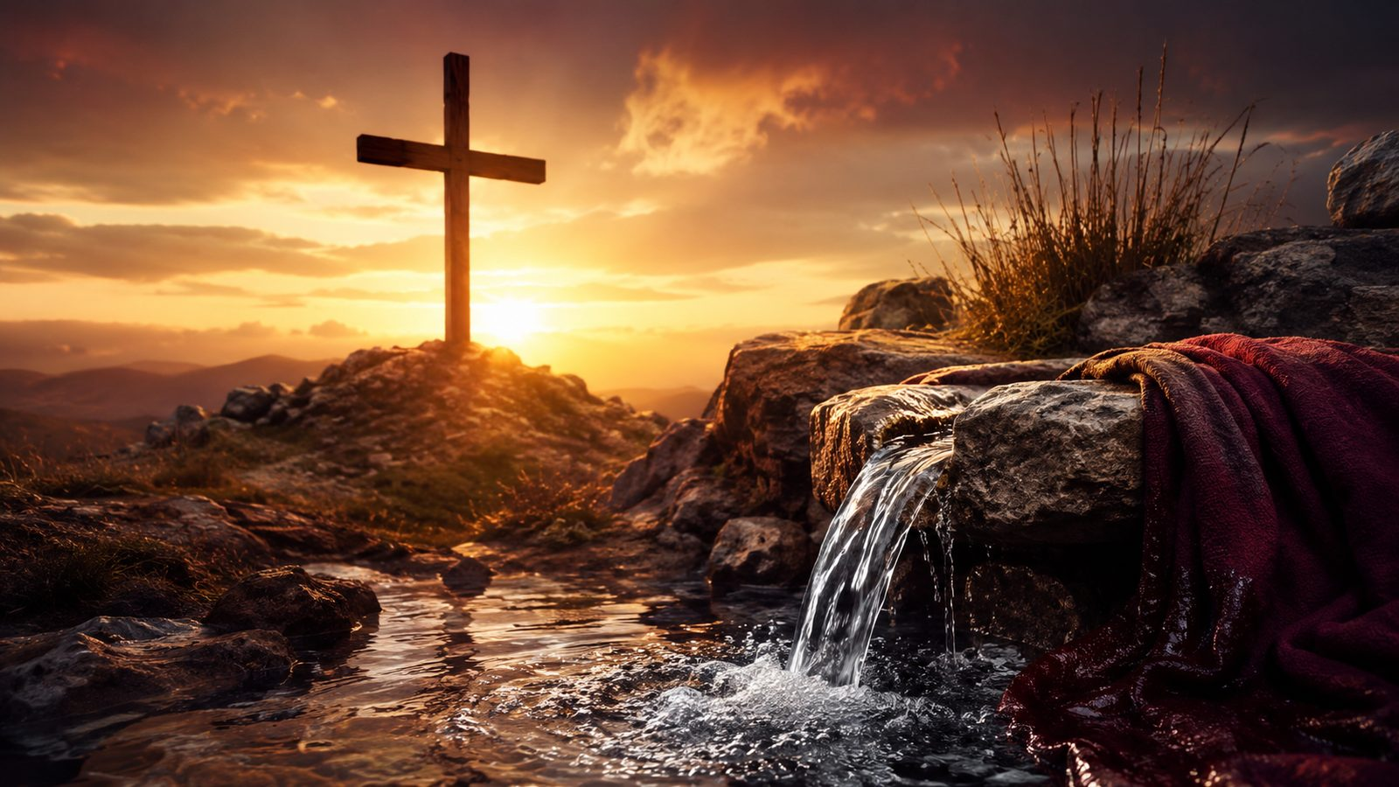
Are Ye Able
A hymn study on Christ’s call to costly discipleship
Mark 10:38-39
Luke 9:23
Earl Bowman Marlatt • Harry Silvernale Mason • 1926
Prepared for teaching and small group use - hymninfo.com

Slide 2
Teaching Aim
The lesson moves from Christ’s question to a grace-shaped answer.
Understand
Feel
Practice
Jesus’ question asks more than enthusiasm; it searches the heart of discipleship.
The hymn carries holy seriousness, courage, and humble dependence.
Respond with faithful service, not self-reliant bravado.
Prepared for teaching and small group use - hymninfo.com

Slide 3

Hymn Identity
A consecration hymn formed by a Gospel question.
Title
Are Ye Able
First line
Are ye able, said the Master
Lyricist
Earl Bowman Marlatt
Composer
Harry Silvernale Mason
Tune
BEACON HILL
Meter
8.7.8.7 with refrain
Date
1926
Primary text
Mark 10:38-39
Prepared for teaching and small group use - hymninfo.com

Slide 4
The Gospel Question
Christ asks not for quick confidence, but for a life ready to follow him.
Prepared for teaching and small group use - hymninfo.com

Slide 5
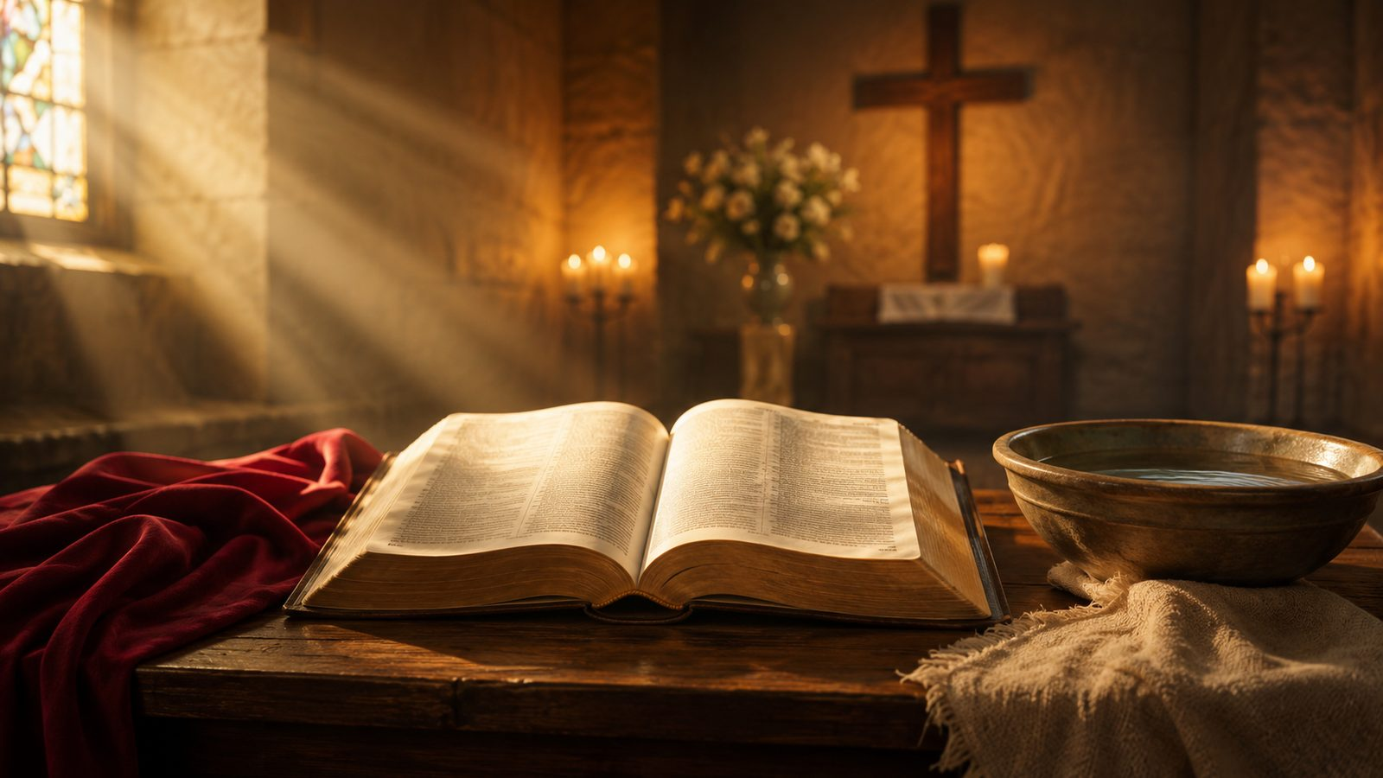
Historical Background
A hymn born in a setting of consecrated Christian service.
Earl Bowman Marlatt wrote the hymn in 1926 for a Boston University consecration service.
Its early title was Challenge, fitting its call to serious discipleship.
Five stanzas appeared in The American Student Hymnal in 1928.
Harry Silvernale Mason’s BEACON HILL gives the text a firm, processional character.
Prepared for teaching and small group use - hymninfo.com

Slide 6
Why This Hymn Matters Today
It asks the church to sing commitment with humility and courage.
Pastoral value
Worship value
It names the cost of following Christ without romanticizing suffering.
It can gather a congregation around consecration, mission, and renewed obedience.
Teaching value
Devotional value
It opens a clear path from Mark 10 to ordinary Christian vocation.
It turns a bold answer into a prayer for Christ to make us faithful.
Prepared for teaching and small group use - hymninfo.com

Slide 7
Biblical Foundation
Scripture keeps the hymn honest: discipleship is costly, grace-filled, and Christ-centered.
Mark 10:38-39
Jesus asks whether his disciples are able to share his cup and baptism.
Luke 9:23
Following Christ means self-denial and taking up the cross.
Romans 12:1
The believer’s life becomes a living offering to God.
Philippians 3:10
Christian courage is shaped by fellowship with the crucified and risen Christ.
Prepared for teaching and small group use - hymninfo.com

Slide 8
Hymn Study: The Question
Christ’s question is not casual. It exposes shallow ambition and calls for honest surrender.
The hymn begins with the Master’s searching challenge.
In Mark 10, the disciples want glory before they understand the cup.
Teaching emphasis: true discipleship begins by listening carefully to Jesus.
Ask before you answer
Prepared for teaching and small group use - hymninfo.com

Slide 9
Hymn Study: The Cross
The call to follow Christ is inseparable from the cross.
The hymn’s imagery points toward sacrifice, endurance, and costly faithfulness.
Luke 9:23 helps interpret the call: deny self, take up the cross, follow.
The cross is not a symbol of personal strength; it is the path of Christ-shaped obedience.
Prepared for teaching and small group use - hymninfo.com

Slide 10

Hymn Study: Consecrated Service
The hymn was shaped for dedication, mission, and Christian vocation.
Mission
Vocation
Perseverance
Service is not private admiration of Christ but public obedience.
Students, teachers, workers, parents, leaders, and neighbors all answer Christ in daily life.
Faithfulness continues when the cost becomes visible.
Prepared for teaching and small group use - hymninfo.com

Slide 11
Hymn Study: The Answer
The congregation’s answer is best sung as prayer, not as self-confidence.
A wise pastoral reading
The hymn’s confidence needs the support of grace.
“We are able” can become a prayer: Lord, make us able.
Christ does not call disciples and then leave them to themselves.
Prepared for teaching and small group use - hymninfo.com

Slide 12

The Refrain as Congregational Prayer
The repeated response gathers the church around courage, loyalty, and dependence on Christ.
Sing it as a pledge shaped by grace.
The refrain should not sound like spiritual bravado. It is a prayer that the Lord who calls will also strengthen, teach, and sustain his people.
Prepared for teaching and small group use - hymninfo.com

Slide 13
Theological Themes
Major ideas for teaching and worship planning.
Discipleship
Cross
Consecration
Following Jesus has a cost.
The path of Christ shapes the church.
Life is offered to God.
Mission
Humility
Perseverance
Faith moves into service.
Courage depends on grace.
Faithfulness continues through trial.
Prepared for teaching and small group use - hymninfo.com

Slide 14

Literary and Musical Observations
BEACON HILL gives the hymn its sturdy, public character.
The text moves from Christ’s question to the church’s answer.
The refrain broadens the hymn into a memorable congregational response.
BEACON HILL has a firm, processional feel suited to dedication and mission.
A steady tempo keeps the hymn strong without becoming heavy.
Prepared for teaching and small group use - hymninfo.com

Slide 15
Pastoral and Worship Use
Best used where the church is invited into serious, hopeful dedication.
Ordination or commissioning services
Mission Sundays and vocation emphasis
Youth or student dedication
Congregational renewal services
Sermons on Mark 10 or Luke 9
Choir or class study on discipleship
Prepared for teaching and small group use - hymninfo.com

Slide 16
Teaching Questions
Use these to move from observation to response.
1
What does Jesus’ question mean in Mark 10?
2
Where does the hymn challenge shallow discipleship?
3
Why should the answer be sung as prayer rather than boast?
4
How can ordinary service become cross-shaped obedience?
5
What comfort does Christ give to those who feel unable?
Prepared for teaching and small group use - hymninfo.com

Slide 17
Suggested Lesson Flow
Two teaching plans for different settings.
30-minute plan
60-minute plan
Read Mark 10:35-40 (5 min)
Tell the hymn story (5 min)
Teach three key themes (10 min)
Discuss the refrain as prayer (5 min)
Close with personal response (5 min)
Open with Luke 9:23 (5 min)
Background and tune (8 min)
Stanza-section study (20 min)
Scripture table discussion (15 min)
Applications and prayer (12 min)
Prepared for teaching and small group use - hymninfo.com

Slide 18
Closing Summary and Prayer
Christ asks a question that no disciple can answer honestly apart from grace. The hymn teaches the church to answer with humble courage: Lord, make us able to follow you.
Lord Jesus Christ, form in us the courage to follow where you lead. Free us from shallow confidence and fearful hesitation. Teach us to serve with humility, bear the cross with hope, and answer your call by the power of your grace. Amen.
© HymnInfo.com. Free for personal, church, classroom, and small-group teaching use. Please do not sell, repost, or redistribute as downloadable files without permission.
Prepared for teaching and small group use - hymninfo.com

