Slide 1
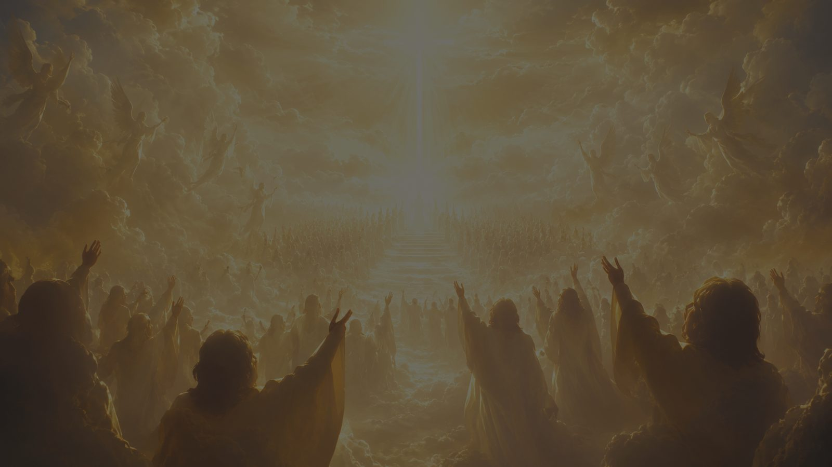
At the Name of Jesus
First line: At the name of Jesus every knee shall bow
Caroline Maria Noel, 1870
Tune: KING'S WESTON - Ralph Vaughan Williams
Primary Scripture: Philippians 2:9-11
Prepared for teaching and small group use - hymninfo.com

Slide 2

Teaching Aim
What this hymn helps the church see, feel, and practice
Understand how the hymn follows the movement of Philippians 2: humility, exaltation, and universal confession.
Feel reverent awe before the name and lordship of Jesus Christ.
Practice worship that bows before Christ in praise, obedience, and hope.
Prepared for teaching and small group use - hymninfo.com

Slide 3
Hymn Identity
Text, tune, meter, and biblical center
Title: At the Name of Jesus
First line: At the name of Jesus every knee shall bow
Author: Caroline Maria Noel (1817-1877)
Year: 1870; published in The Name of Jesus, and Other Verses for the Sick and Lonely
Tune: KING'S WESTON; Ralph Vaughan Williams; meter 6.5.6.5 D
Primary theme: the exalted lordship of Christ.
Prepared for teaching and small group use - hymninfo.com

Slide 4
Historical Background
A devotional hymn shaped by Philippians 2
Caroline Maria Noel was an English Anglican poet and hymn writer.
Her years of illness gave a pastoral and devotional tone to much of her writing.
This hymn appeared in 1870 in a collection written for those who were sick and lonely.
Its strongest feature is not personal sentiment but a clear, biblical confession of Christ.
Prepared for teaching and small group use - hymninfo.com

Slide 5
Why This Hymn Matters Today
A congregation learns to praise Christ with biblical substance
Pastoral value
Worship value
Gives suffering believers a strong confession to sing.
Centers hope in the enthroned Christ rather than changing circumstances.
Teaches reverence for the name of Jesus without vague sentiment.
Works well for Holy Name, Epiphany, Ascension, and Christ the King.
Unites doctrine, adoration, and congregational strength.
Calls the church to confess Christ as Lord now, before the final day.
Prepared for teaching and small group use - hymninfo.com

Slide 6

Biblical Foundation
Philippians 2:9-11
God highly exalted him... that at the name of Jesus every knee should bow... and every tongue should confess that Jesus Christ is Lord.
Philippians 2:9-11
The hymn is an extended meditation on Christ's exaltation and universal lordship.
The church's present worship anticipates the day when all creation acknowledges him.
Prepared for teaching and small group use - hymninfo.com

Slide 7
The Name Above Every Name
What the hymn means by honoring Jesus
The name of Jesus
The church’s response
Represents the person, authority, saving work, and royal dignity of Christ.
Is the name by which salvation is proclaimed (Acts 4:12).
Calls for trust, worship, prayer, and obedience.
Bow in reverence, not empty ritual.
Confess Christ openly, not privately only.
Live under his lordship in ordinary decisions and relationships.
Prepared for teaching and small group use - hymninfo.com

Slide 8

Humility Before Exaltation
The path of Christ’s saving obedience
The hymn does not treat Christ's majesty as detached from his suffering love.
Philippians 2 moves from self-giving obedience to God's exaltation of the Son.
Christian worship should honor both the cross-shaped humility and the enthroned glory of Christ.
The church learns that true greatness is revealed in obedient love.
Prepared for teaching and small group use - hymninfo.com

Slide 9
Exaltation and Universal Confession
Every knee, every tongue, every realm
The hymn's vision is cosmic: heaven, earth, and all powers are brought under Christ's lordship.
This is not a vague hope that goodness will prevail; it is confidence in the risen and exalted Lord.
The church's praise is a preview of the worship described in Revelation 5.
Mission flows from this conviction: Jesus is Lord, and his name is to be made known.
Prepared for teaching and small group use - hymninfo.com

Slide 10
Scripture Connections
A biblical web around the hymn
Philippians 2:9-11 - the central confession: Jesus Christ is Lord.
Acts 4:12 - salvation is found in no other name.
Ephesians 1:20-22 - Christ is seated above every rule, authority, power, and dominion.
Hebrews 1:3-4 - the Son purifies sins and sits at the right hand of Majesty.
Revelation 5:12-13 - heaven and earth worship the Lamb.
Prepared for teaching and small group use - hymninfo.com

Slide 11
The Hymn’s Movement
From confession to final worship
Opening movement: the name of Jesus becomes the focus of universal homage.
Middle movement: Christ's humility and obedience reveal the path of saving love.
Heavenly movement: angels, the church, and creation join in recognition of his reign.
Final movement: present believers are invited to confess now what all creation will one day acknowledge.
Prepared for teaching and small group use - hymninfo.com

Slide 12
Stanza Focus 1
Universal homage
The hymn begins with the language of bowing and confession.
Its opening vision is not merely personal devotion but the worship of all creation.
Teaching emphasis: Christ is worthy of honor because God has exalted him.
Prepared for teaching and small group use - hymninfo.com

Slide 13
Stanza Focus 2
Humility and obedience
The hymn looks back to the incarnate Son who took the path of lowliness.
Christ's glory is inseparable from the self-giving love by which he saves.
Teaching emphasis: Christian worship is shaped by the humility of Christ.
Prepared for teaching and small group use - hymninfo.com

Slide 14
Stanza Focus 3
Heavenly worship
The hymn gathers angels, saints, and creation into praise of the exalted Lord.
Revelation 5 helps the church imagine worship around the Lamb who was slain.
Teaching emphasis: Sunday worship participates in a larger heavenly reality.
Prepared for teaching and small group use - hymninfo.com

Slide 15
Stanza Focus 4
Present allegiance
The final emphasis presses the confession into the life of the church today.
Believers do not wait until the final day to honor Christ's name.
Teaching emphasis: confession becomes obedience, witness, reverence, and hope.
Prepared for teaching and small group use - hymninfo.com

Slide 16
Theological Themes
Doctrines the hymn helps teach
Christology
Worship and hope
The humiliation and exaltation of Christ.
The name, authority, and lordship of Jesus.
The ascended Christ above all powers.
The church's present confession of Jesus as Lord.
Universal worship at the fulfillment of God's kingdom.
Reverent allegiance in daily life.
Prepared for teaching and small group use - hymninfo.com

Slide 17
Literary and Musical Observations
How text and tune strengthen one another
Text
Tune
Strong biblical progression rather than loose devotional imagery.
Repeated focus on the name, the knee, the tongue, and confession.
Movement from earthly worship to heavenly and universal recognition.
KING'S WESTON has a bold, processional character.
Meter: 6.5.6.5 D; broad phrases support the grandeur of the text.
A firm tempo helps the hymn feel confident without becoming heavy.
Prepared for teaching and small group use - hymninfo.com

Slide 18
Pastoral and Worship Use
Where this hymn serves the church well
Holy Name of Jesus, Epiphany, Ascension, and Christ the King.
Calls to worship and festivals centered on Christ's lordship.
Choir or congregational teaching on Philippians 2.
Services of comfort where suffering believers need to confess Christ's reign.
Mission emphasis: every tongue will confess Jesus as Lord.
Prepared for teaching and small group use - hymninfo.com

Slide 19
Teaching Questions
For Sunday school, small groups, or choir rehearsal
How does Philippians 2 shape the hymn's picture of Jesus?
Why does the hymn connect Christ's humility with his exaltation?
What does it mean to honor the name of Jesus beyond singing?
How should the coming universal confession of Christ affect Christian mission?
How does the tune KING'S WESTON help carry the hymn's message?
Prepared for teaching and small group use - hymninfo.com

Slide 20
Suggested Lesson Flow
Two practical teaching options
30-minute plan
60-minute plan
Read Philippians 2:5-11 aloud.
Introduce Noel, the hymn, and its worship setting.
Trace the hymn's movement in four themes.
Close with one question about allegiance to Christ.
Begin with prayer and opening reflection.
Study Philippians 2 with supporting texts.
Discuss stanza themes and musical character.
Apply the hymn to worship, witness, and perseverance.
Close with prayer and congregational singing if appropriate.
Prepared for teaching and small group use - hymninfo.com

Slide 21
Closing Summary and Prayer
Confess now what all creation will one day proclaim
At the Name of Jesus teaches the church to worship the humbled, exalted, and reigning Christ.
The hymn invites believers to bow in reverence, confess with courage, and live under Christ's lordship.
Lord Jesus Christ, teach us to honor your name with worship, trust, obedience, and hope. Amen.
© HymnInfo.com. Free for personal, church, classroom, and small-group teaching use. Please do not sell, repost, or redistribute as downloadable files without permission.
Prepared for teaching and small group use - hymninfo.com

