Slide 1

Canticle of Praise to God (Venite Exultemus)
“O come, let us sing unto the Lord”
Psalm 95 as a call to joyful, reverent worship
Chant associated with William Boyce (1711-1779) • Primary Scripture: Psalm 95:1-7
Prepared for teaching and small group use - hymninfo.com

Slide 2

Teaching Aim
A worship lesson shaped by Psalm 95
✓
♥
↗
Understand
Feel
Practice
Understand
Feel
Practice
Psalm 95 calls the whole congregation to praise the Lord as Creator, King, Maker, and Shepherd.
Joy and reverence belong together when the church stands before the living God.
Singing should lead to thanksgiving, humility, and readiness to hear God’s voice.
Prepared for teaching and small group use - hymninfo.com

Slide 3
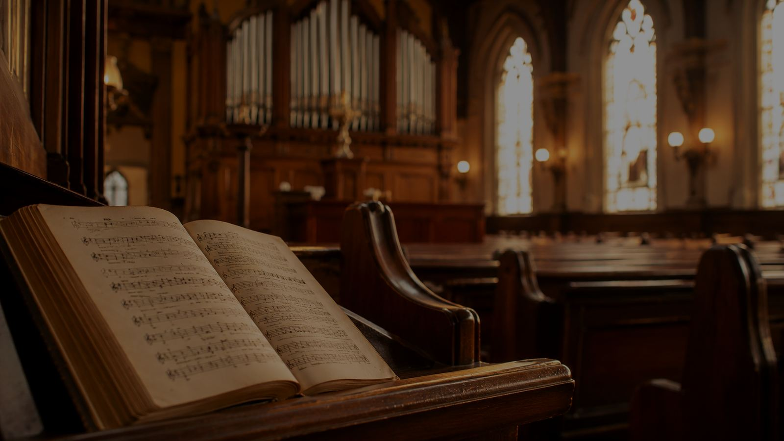
Hymn Identity
A biblical canticle sung as prayer and proclamation
Title
First line
Canticle of Praise to God (Venite Exultemus)
O come, let us sing unto the Lord
Biblical text
Tune / chant
Psalm 95:1-7, traditionally known by its Latin opening “Venite, exultemus Domino.”
Anglican chant associated with William Boyce; often listed simply as CHANT.
Musical form
Worship setting
Prose psalm chant rather than regular metrical hymn stanzas.
Especially fitting at the beginning of worship, Morning Prayer, and services centered on praise.
Prepared for teaching and small group use - hymninfo.com

Slide 4

Joyful Worship Begins with God
“Oh come, let’s sing to Yahweh.”
Prepared for teaching and small group use - hymninfo.com

Slide 5
Historical Background
A scriptural song with a long place in Christian prayer
• The Venite is drawn from Psalm 95 and has been used for centuries as an invitatory psalm in Western Christian daily prayer.
• In Anglican worship it is closely associated with Morning Prayer in the Book of Common Prayer.
• The United Methodist Hymnal includes this canticle with an eighteenth-century chant associated with William Boyce.
• The chant form lets Scripture remain at the center while giving the congregation a dignified way to sing prose text.
Teaching emphasis
This is not a private devotional poem. It is Scripture placed on the lips of the gathered church, calling the people of God to sing, bow, and listen together.
Prepared for teaching and small group use - hymninfo.com

Slide 6

Biblical Foundation
Psalm 95 gathers praise, reverence, creation, and shepherd care
Primary text
Supporting witness
Christian hearing
Psalm 95:1-7 calls worshipers to sing, give thanks, confess God as great King, bow before the Maker, and hear the Shepherd’s voice.
Psalm 100:1-2 joins glad service and singing. Revelation 4:11 names God worthy because all things exist by divine will.
Hebrews 3 presses the urgency of “Today.” John 10 shows the Shepherd’s care fulfilled in Christ, who knows and lays down his life for his sheep.
Prepared for teaching and small group use - hymninfo.com

Slide 7
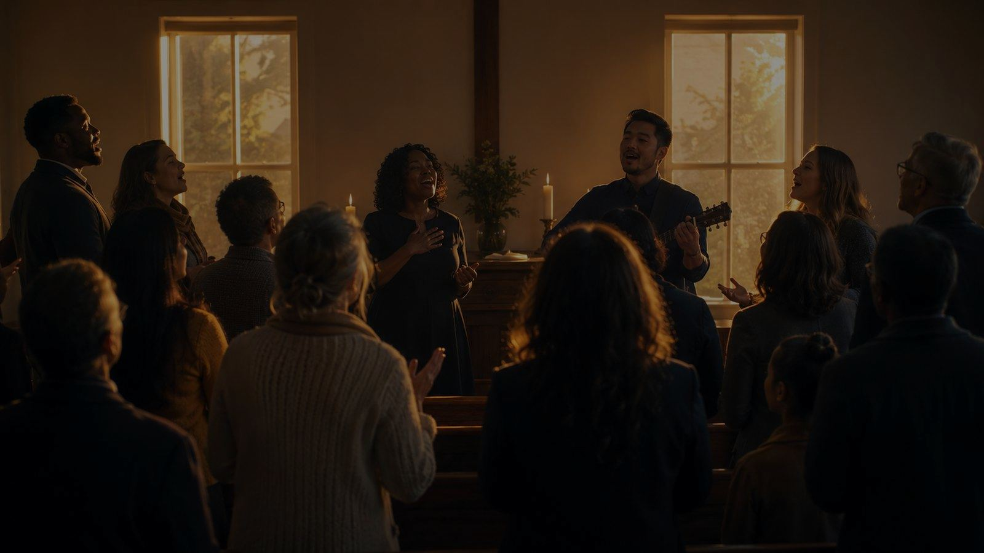
Movement 1: Come and Sing
Psalm 95:1-2
• The canticle begins with a communal summons, not a solo performance.
• Thanksgiving is the doorway: worship remembers who God is and what God has done.
• Joyful praise is a fitting response to “the rock of our salvation.”
For teachers
Ask the group to notice the repeated “let us.” The first lesson of the canticle is that praise gathers us into one worshiping people.
Prepared for teaching and small group use - hymninfo.com

Slide 8
Movement 2: Creator and King
Psalm 95:3-5
• The Lord is not one power among many; he is “a great King above all.”
• Depths, heights, sea, and dry land all belong to the Maker.
• Creation praise gives worshipers a larger vision than their own concerns.
Prepared for teaching and small group use - hymninfo.com

Slide 9
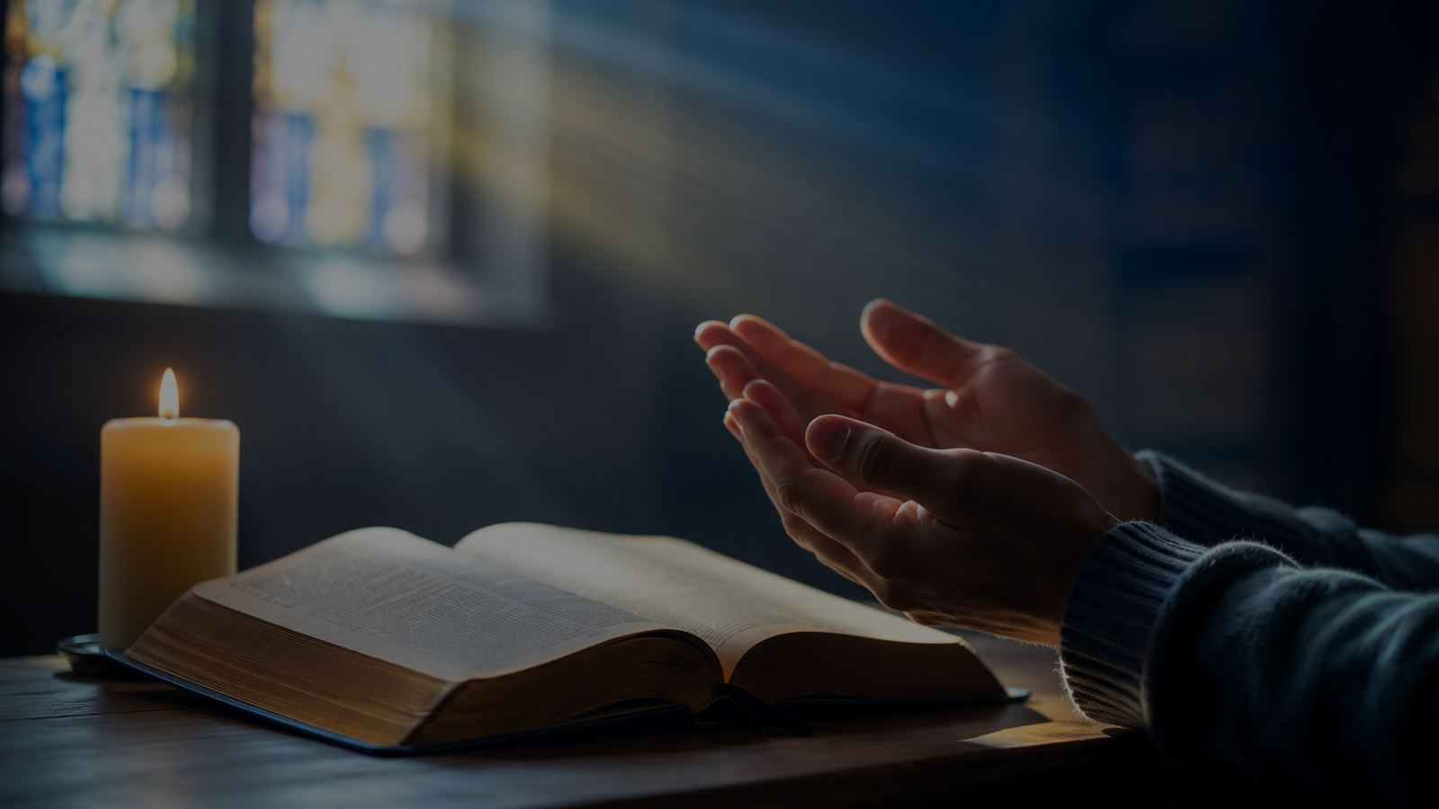
Movement 3: Bow and Kneel
Psalm 95:6
• Joyful singing leads to humble posture.
• The body participates in worship: voices sing, knees bend, hearts yield.
• Reverence protects praise from becoming casual self-expression.
Prepared for teaching and small group use - hymninfo.com

Slide 10

Movement 4: Shepherd and People
Psalm 95:7
• The Creator is also the Shepherd who knows and keeps his people.
• The congregation belongs to God as “the people of his pasture.”
• The New Testament deepens this image in Christ, the good shepherd.
Prepared for teaching and small group use - hymninfo.com

Slide 11
Praise Must Lead to Listening
The final word of Psalm 95:1-7 turns worshipers toward obedience
Today
Voice
Response
The canticle refuses to let worship remain in the past. The congregation is addressed now, in this moment of hearing and response.
God is not only praised from a distance; God speaks to the people he gathers, guides, and shepherds.
Sung praise prepares the heart to receive Scripture, repent where needed, and walk in faithfulness.
Prepared for teaching and small group use - hymninfo.com

Slide 12
Theological Themes
What the canticle teaches the church to confess
Praise
Thanksgiving
Creation
God is worthy of joyful song.
Worship remembers grace received.
Sea, land, depths, and heights belong to God.
Kingship
Reverence
Shepherd care
The Lord reigns above every rival power.
Kneeling and bowing express holy awe.
God gathers and keeps his people.
Prepared for teaching and small group use - hymninfo.com

Slide 13
Literary and Musical Observations
Prose Scripture carried by chant
• The movement is simple and strong: sing, give thanks, behold the Creator, bow before the Maker, hear the Shepherd.
• Unlike a regular metrical hymn, Anglican chant supports prose psalm lines and natural speech rhythm.
• Clear text delivery matters. The congregation should understand the biblical words as they sing.
• The musical dignity of the chant serves Scripture rather than drawing attention away from it.
Choir note
If a choir leads the canticle, shape the chant as prayer. Avoid rushing the words; let the phrases breathe.
Prepared for teaching and small group use - hymninfo.com

Slide 14

Pastoral and Worship Use
Where the canticle serves the church well
• Call to worship or opening Scripture song
• Morning Prayer, daily office, or devotional gatherings
• Services of thanksgiving, creation praise, or reverent adoration
• Choir rehearsal teaching on psalm chant and text declamation
• Bible study on Psalm 95, Psalm 100, John 10, or Hebrews 3
Worship planning
Place the canticle where it can do its work: gathering the people, giving language to praise, and preparing hearts to listen.
Prepared for teaching and small group use - hymninfo.com

Slide 15
Teaching Questions
For Sunday school, choir, or worship planning
1. What does Psalm 95 teach us to do before God?
2. How do joy and reverence strengthen one another?
3. Why does the canticle mention creation before shepherd care?
4. What changes when worshipers hear “today” as a personal summons?
5. How might singing Scripture shape a congregation over time?
Prepared for teaching and small group use - hymninfo.com

Slide 16
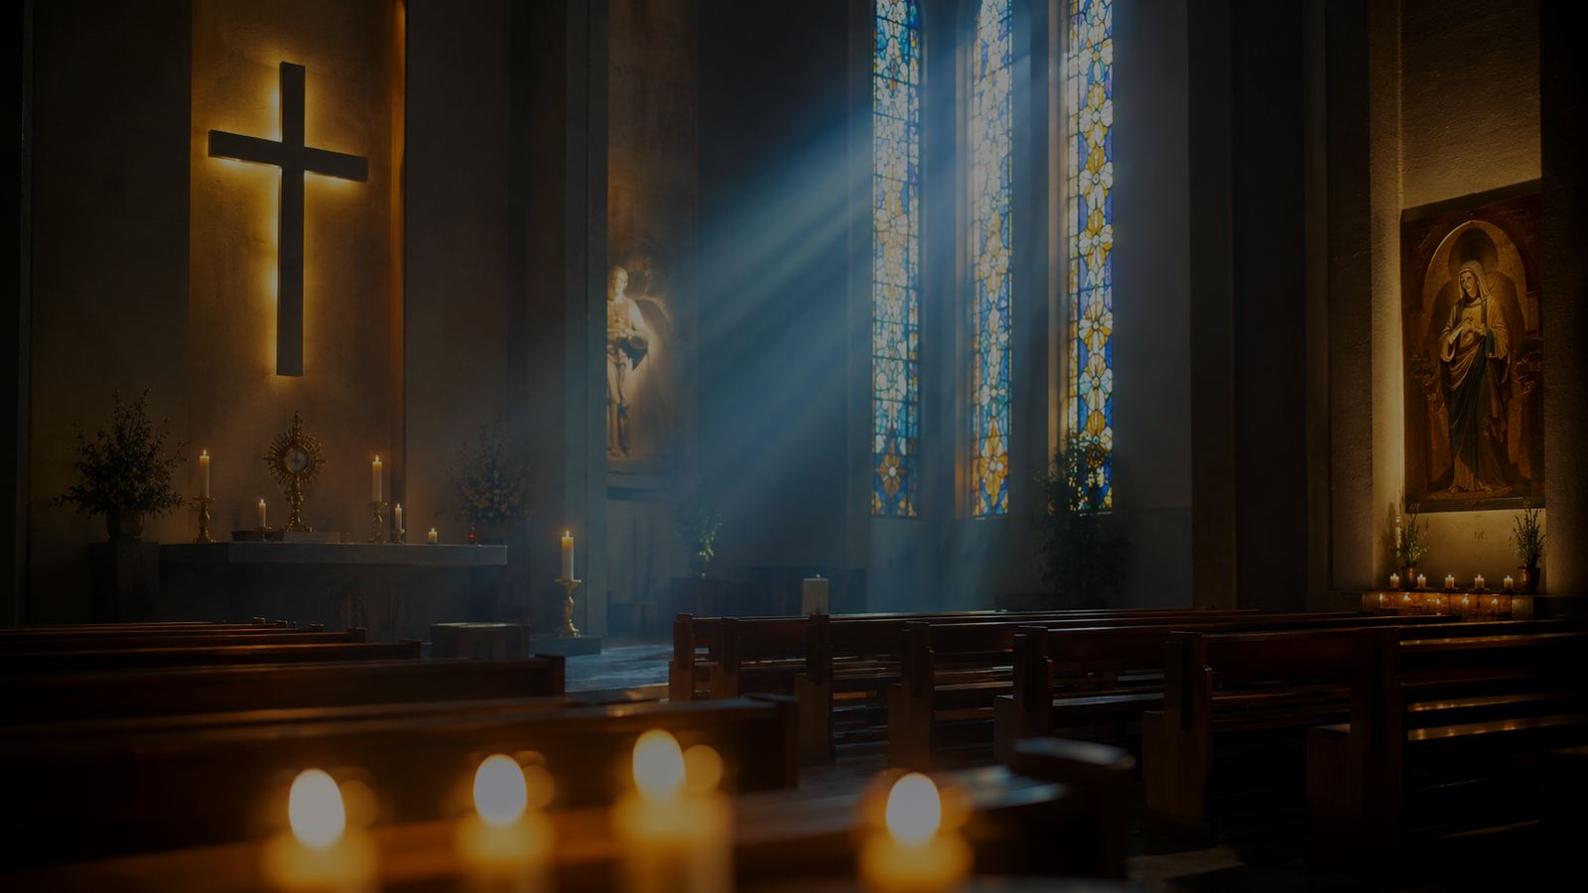
Application: Let Worship Form Us
From singing to listening
Start with praise
Practice thanksgiving
Name God’s greatness before bringing requests.
Remember mercy already received.
Bow inwardly
Listen today
Let reverence quiet pride and hurry.
Receive Scripture as the living voice of God.
Follow the Shepherd
Leave worship ready to obey with trust.
Prepared for teaching and small group use - hymninfo.com

Slide 17
Suggested Lesson Flow
Flexible plans for 30 or 60 minutes
30-minute teaching plan
60-minute teaching plan
1. Read Psalm 95:1-7.
2. Name the four central images: singing, creation, kneeling, shepherd care.
3. Teach the background of the Venite and Boyce chant.
4. Discuss one application: praise leading to listening.
5. Close with prayer.
1. Opening reflection and Scripture reading.
2. Historical and musical context.
3. Four-part study of Psalm 95.
4. Small-group discussion questions.
5. Worship planning or choir application.
6. Closing prayer and commitment to hear God today.
Prepared for teaching and small group use - hymninfo.com

Slide 18
Closing Summary and Prayer
The Venite gathers the church with Scripture’s own voice: sing with joy, give thanks, behold the Creator, bow before the Maker, and hear the Shepherd today.
Lord our God, make us a people who sing with gladness, kneel with reverence, and listen with obedient hearts. Gather us as the sheep of your pasture, and teach us to follow your voice through Jesus Christ our Lord. Amen.
© HymnInfo.com. Free for personal, church, classroom, and small-group teaching use. Please do not sell, repost, or redistribute as downloadable files without permission.
Prepared for teaching and small group use - hymninfo.com

