Slide 1

Children of the Heavenly Father
A powerful teaching guide on comfort, assurance, providence, and the Father’s faithful care
“No one is able to snatch them out of my Father’s hand.” — John 10:29
Children of the Heavenly Father • Hymn Teaching Guide • 1

Slide 2
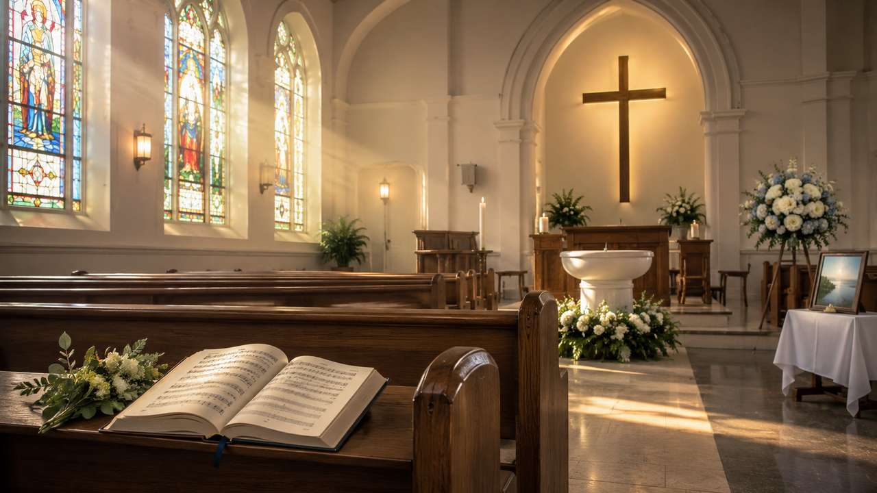
Teaching Aim
What this session should accomplish
Receive the hymn as a pastoral confession of God’s fatherly care.
Explain the historical setting without overstating the drowning story.
Connect the hymn to Scripture’s promises of refuge and assurance.
Equip believers to comfort the anxious and grieving.
Children of the Heavenly Father • Hymn Teaching Guide • 2

Slide 3
Hymn Identity
Title taken directly from the JSON metadata
Title: Children of the Heavenly Father
First line: Children of the heavenly Father
Year written: 1855
Swedish title: Tryggare kan ingen vara
Translator: Ernst W. Olson, 1925
Tune: Traditional Swedish melody
Children of the Heavenly Father • Hymn Teaching Guide • 3

Slide 4
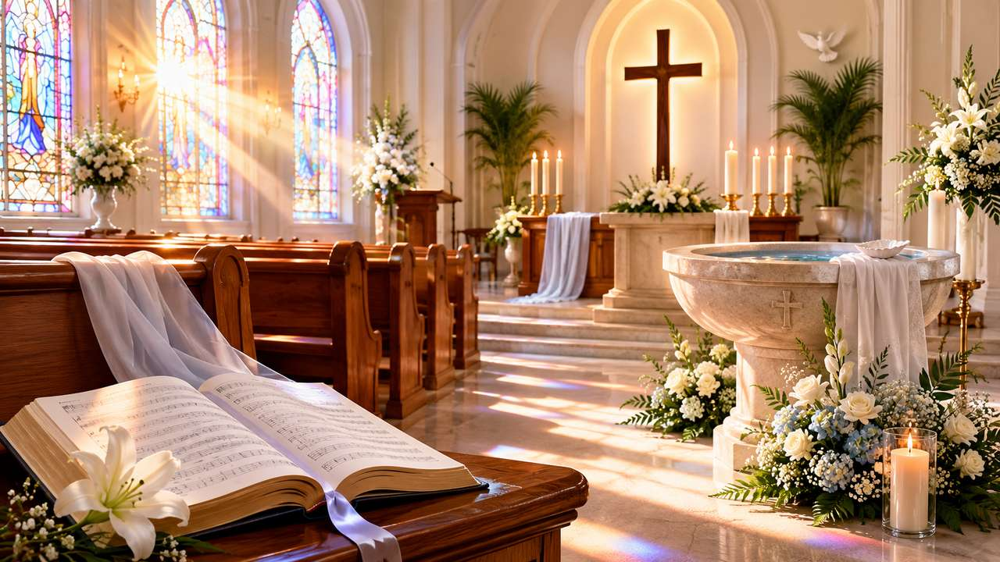
Historical Background
Lina Sandell, Swedish Lutheran hymnody, and careful chronology
Karolina Wilhelmina Sandell-Berg, widely known as Lina Sandell, wrote the Swedish text Tryggare kan ingen vara.
Hymnal evidence commonly identifies the text with Andeliga daggdroppar, published in 1855, where it appeared anonymously.
The origin story requires care.
Some later accounts connect the hymn to the tragic drowning of Sandell’s father, which she witnessed in 1858, and that tragedy certainly shaped her life and the reception of many of her hymns.
Children of the Heavenly Father • Hymn Teaching Guide • 4

Slide 5
Why This Hymn Matters
A simple hymn with deep pastoral power
Sung by children, mourners, and mature believers with equal truth.
Confesses protection without denying grief, anxiety, or death.
Helps the church speak assurance without shallow sentimentality.
Especially useful in baptism, funeral, memorial, and comfort settings.
Children of the Heavenly Father • Hymn Teaching Guide • 5

Slide 6
Biblical Foundation: Fatherly Care
Matthew 6, Psalm 103, Isaiah 49
Matthew 6: the Father feeds the birds and values His children.
Psalm 103: the Lord has compassion and remembers our frailty.
Isaiah 49: God will not forget His people.
The hymn’s comfort begins with God’s character, not our circumstances.
Children of the Heavenly Father • Hymn Teaching Guide • 6

Slide 7
Biblical Foundation: Kept in Love
John 10 and Romans 8
John 10: Christ’s sheep are held by the Father’s hand.
Romans 8: nothing can separate believers from God’s love in Christ.
Psalm 91: God is refuge, fortress, shield, and shelter.
Assurance is stronger than fear because God’s keeping is stronger than death.
Children of the Heavenly Father • Hymn Teaching Guide • 7

Slide 8
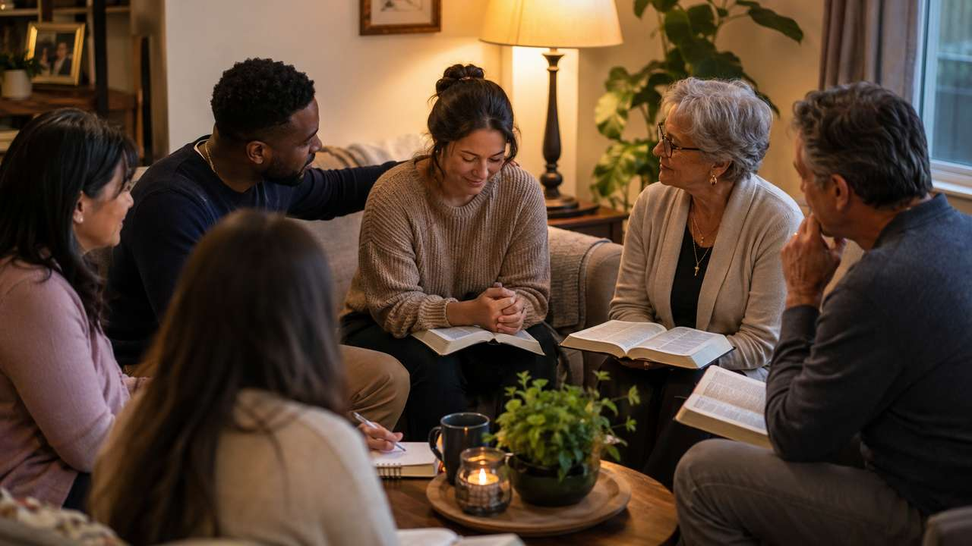
Stanza 1
Gathered safely into the Father’s care
The opening image is family and refuge: children gathered by a heavenly Father.
The hymn teaches belonging before it teaches endurance.
Pastoral use: speak identity before instruction to those who are afraid.
Children of the Heavenly Father • Hymn Teaching Guide • 8

Slide 9
Stanza 2
Nourished and protected by mighty arms
God does not leave His children to defend themselves.
The hymn’s protection language is tender, not triumphalist.
Use this stanza to lead people from self-reliance into prayerful trust.
Children of the Heavenly Father • Hymn Teaching Guide • 9

Slide 10
Stanza 3
Neither life nor death can separate us
The hymn faces death without surrendering to despair.
Its assurance echoes Romans 8: nothing can finally remove God’s children from His love.
This is why the hymn has become treasured at funerals and memorials.
Children of the Heavenly Father • Hymn Teaching Guide • 10

Slide 11
Stanza 4
God gives, takes away, and never forsakes
The hardest stanza teaches trust inside the mystery of providence.
It is not fatalism: it is confidence that the Father’s love remains faithful.
Preach this stanza gently; grief needs presence, not explanation alone.
Children of the Heavenly Father • Hymn Teaching Guide • 11

Slide 12
Theological Themes
What the hymn teaches the church
Providence as personal fatherly care
Assurance rooted in God’s faithfulness
Comfort that does not deny sorrow
Adoption: believers belong to God
Pastoral hope for children, mourners, and the anxious
Children of the Heavenly Father • Hymn Teaching Guide • 12

Slide 13
Musical Notes
TRYGGARE KAN INGEN VARA
Traditional Swedish melody; precise composer unknown.
Often listed as 8.8.8.8 or Long Meter with a gentle trochaic character.
Sing tenderly but not too slowly; the text needs quiet confidence.
Simple contour supports children, families, and grieving congregations.
Children of the Heavenly Father • Hymn Teaching Guide • 13

Slide 14
Worship and Pastoral Use
Where this hymn serves especially well
Baptisms and services emphasizing adoption and belonging.
Funerals and memorials where assurance must be spoken gently.
Services of comfort, anxiety, illness, or family devotion.
Children’s ministry when teaching God’s fatherly care.
Children of the Heavenly Father • Hymn Teaching Guide • 14

Slide 15
Discussion Questions
Move from doctrine to pastoral practice
How does the hymn describe the security of God’s children?
Why is it important not to make the father’s drowning story the certain origin of the hymn?
How does the hymn comfort without denying suffering or death?
What biblical passages best support the hymn’s assurance?
How can congregations use this hymn with children, mourners, and those facing anxiety?
Children of the Heavenly Father • Hymn Teaching Guide • 15

Slide 16
Life Application
How to live this hymn this week
Bring anxiety to God in prayer, remembering that the heavenly Father cares for his children.
Use the hymn to comfort those grieving without denying the reality of loss.
Teach children and adults that Christian assurance rests in God’s faithfulness, not in changing circumstances.
Remember that God’s fatherly care includes protection, compassion, discipline, and preservation in faith.
At funerals and memorials, let the hymn point beyond sentimentality to the promise that nothing can separate believers from God’s love.
Children of the Heavenly Father • Hymn Teaching Guide • 16

Slide 17
Sermon Movement
A powerful preaching path
Belong: God gathers His children.
Shelter: God protects without denying suffering.
Assure: Christ holds what the Father has given.
Comfort: the church becomes a refuge for the anxious and grieving.
Hope: nothing can separate us from God’s love.
Children of the Heavenly Father • Hymn Teaching Guide • 17

Slide 18
Conclusion
Safe in the Father’s faithful keeping
Children of the Heavenly Father teaches the church to rest in God’s care, grieve with hope, and offer comfort grounded in the promises of Scripture.
Use it not as sentiment, but as sung theology: the Father knows, shelters, preserves, and never abandons His children.
Children of the Heavenly Father • Hymn Teaching Guide • 18

