Slide 1
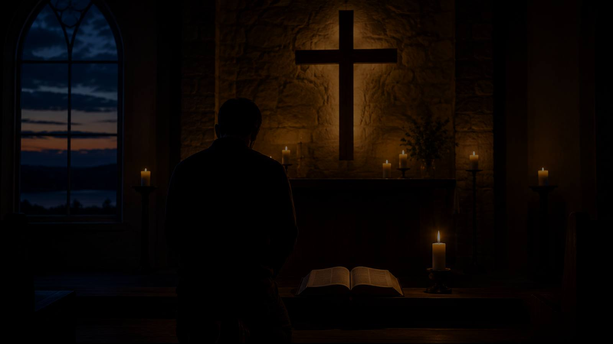
God of Grace and God of Glory
First line: God of grace and God of glory
Words: Harry Emerson Fosdick (1930)
Tune commonly used: CWM RHONDDA by John Hughes (1907)
Primary Scripture: James 1:5; 2 Timothy 1:7
Prepared for teaching and small group use - hymninfo.com

Slide 2
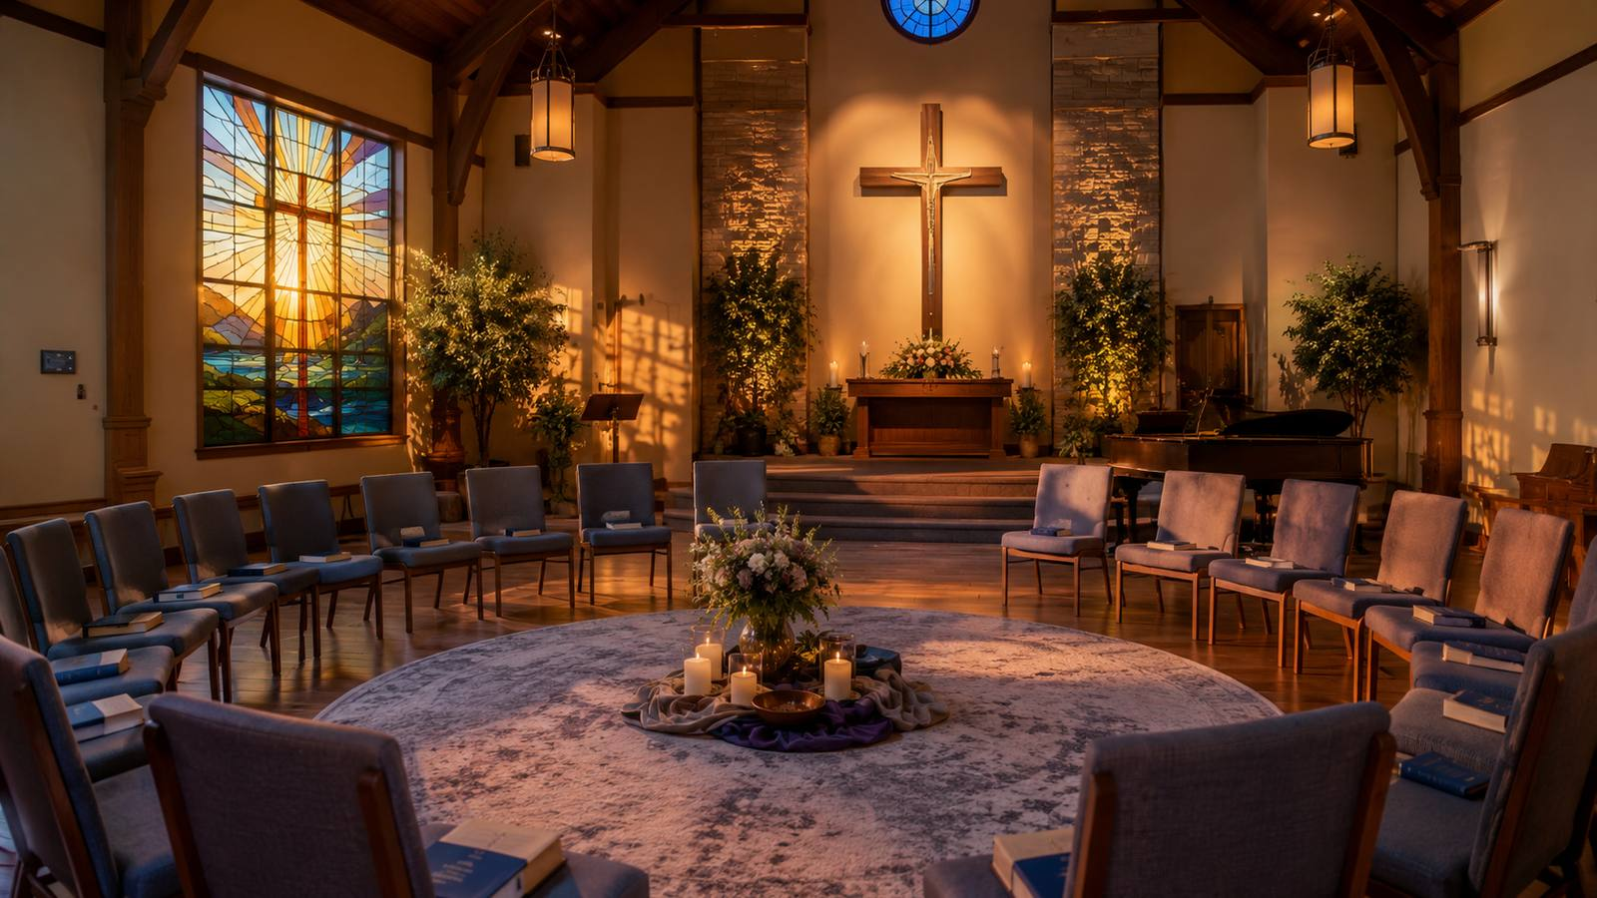
Teaching Aim
Understand the hymn as a prayer for wisdom, courage, and faithful witness.
Feel the weight of the church’s calling in difficult days without despair.
Practice honest prayer, moral courage, and Christ-shaped service.
Prepared for teaching and small group use - hymninfo.com

Slide 3

Hymn Identity
Title: God of Grace and God of Glory
First line: God of grace and God of glory
Words: Harry Emerson Fosdick, written in 1930
Common tune: CWM RHONDDA by John Hughes, 1907
Meter often printed as 8.7.8.7.8.7.7
Prepared for teaching and small group use - hymninfo.com

Slide 4
Historical Background
Harry Emerson Fosdick wrote the hymn for the dedication of Riverside Church in New York City.
The text was written amid social anxiety, economic uncertainty, and questions about the church’s witness.
The hymn asks not for comfort alone, but for a church made wise, brave, humble, and useful.
Prepared for teaching and small group use - hymninfo.com

Slide 5

Biblical Grounding
Wisdom, courage, justice, and Spirit-formed witness
Prepared for teaching and small group use - hymninfo.com

Slide 6

Primary Scripture Connections
James 1:5
Believers are told to ask God for wisdom, trusting his generous provision.
2 Timothy 1:7
God gives not fear, but power, love, and self-control.
Micah 6:8
The life God requires joins justice, mercy, and humble walking with him.
Luke 4:18-19
Christ’s mission shapes the church’s call to serve the wounded and captive.
Prepared for teaching and small group use - hymninfo.com

Slide 7

Stanza Study
From grace received to courage lived
Prepared for teaching and small group use - hymninfo.com

Slide 8
Stanza 1: Grace for the Church
The hymn begins by addressing God as the giver of grace and glory.
It asks God to renew the church’s story so that present faithfulness may become fruitful witness.
The repeated prayer for wisdom and courage sets the spiritual rhythm of the whole hymn.
Prepared for teaching and small group use - hymninfo.com

Slide 9
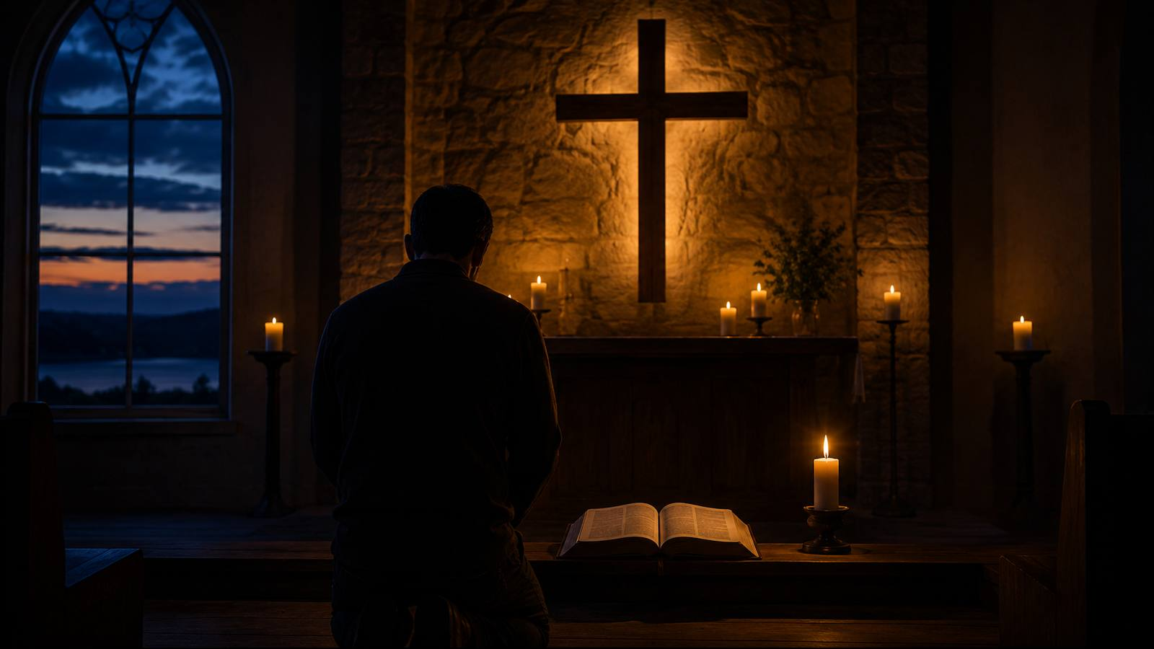
Stanza 2: Freedom from Fear
The hymn names hostile powers and the fears that bind God’s people.
Faithful witness begins with hearts released from fear into faith and praise.
This stanza pairs well with 2 Timothy 1:7: power, love, and disciplined courage.
Prepared for teaching and small group use - hymninfo.com

Slide 10

Stanza 3: Pride Brought Low
The hymn asks God to cure warring madness and bend pride to divine control.
It warns against a life rich in possessions but poor in soul.
The stanza calls the church to repent of comfort that ignores righteousness.
Prepared for teaching and small group use - hymninfo.com

Slide 11

Stanza 4: Christlike Graces
The prayer turns from correction to formation.
The church asks to be strengthened with Christlike graces for liberating service.
Luke 4 helps frame this stanza as mission under the Spirit of the Lord.
Prepared for teaching and small group use - hymninfo.com

Slide 12

Stanza 5: Against Weak Resignation
The final stanza refuses passive acceptance of evils the church deplores.
It asks that the search for God’s salvation become the church’s lasting glory.
Worship ends in service to the God the church adores.
Prepared for teaching and small group use - hymninfo.com

Slide 13
Central Petition
“Grant us wisdom, grant us courage” is more than a repeated line.
Wisdom keeps courage from becoming recklessness.
Courage keeps wisdom from becoming caution without obedience.
Together they form a prayer for faithful discipleship in the present hour.
Prepared for teaching and small group use - hymninfo.com

Slide 14
Theological Themes
A hymn-shaped prayer for the church
Grace that empowers
Wisdom for decisions
Courage over fear
God renews the church for more than comfort.
Faithful action begins with discernment.
The Spirit forms holy boldness.
Holiness with justice
Mission under Christ
Prayerful dependence
The hymn names pride, violence, and apathy.
Grace sends the church into costly service.
The church cannot serve well in its own strength.
Prepared for teaching and small group use - hymninfo.com

Slide 15
Literary Movement
The hymn moves from praise to confession to renewed commitment.
Its language is corporate: the church prays as one body.
The text names concrete dangers: fear, pride, selfishness, violence, and resignation.
The repeated closing petition makes each stanza a direct prayer.
Prepared for teaching and small group use - hymninfo.com

Slide 16
Musical Observations
CWM RHONDDA gives the text a strong, public, congregational character.
The tune’s broad arches support the hymn’s urgent petitions.
Because the tune is widely known with another text, announce the first line clearly.
A sturdy tempo helps the congregation sing with conviction rather than haste.
Prepared for teaching and small group use - hymninfo.com

Slide 17
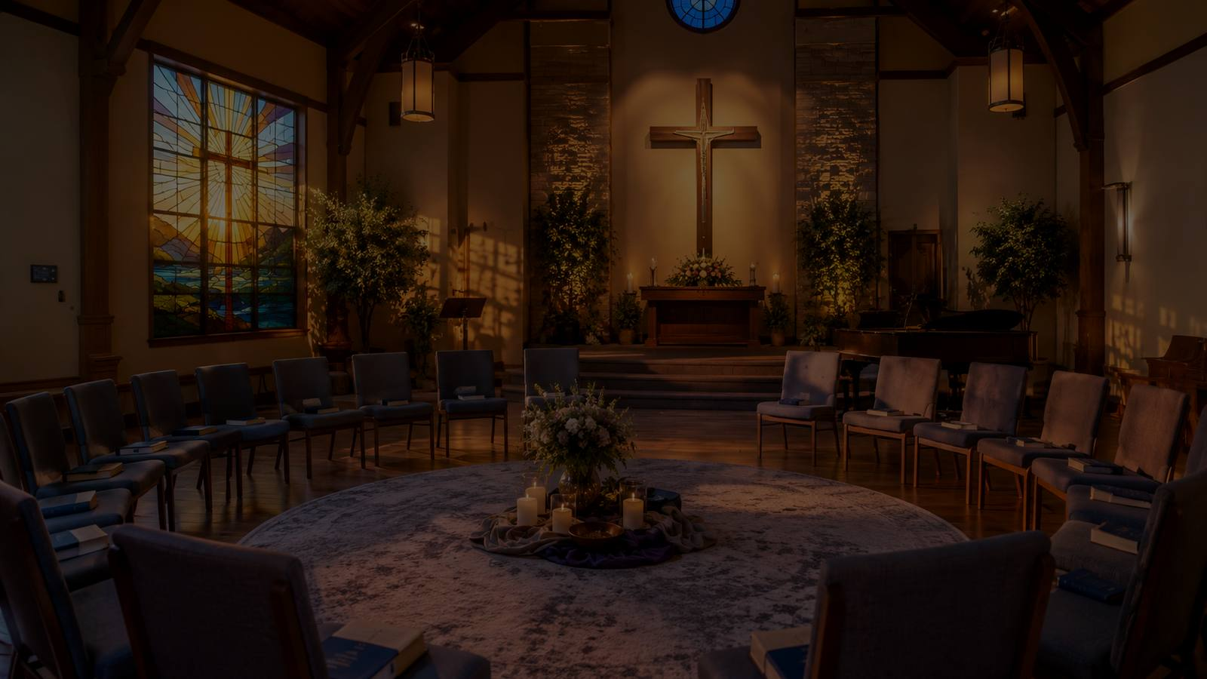
Pastoral Use
When the church needs courage for the hour
Prepared for teaching and small group use - hymninfo.com

Slide 18
Worship and Ministry Settings
Church dedication, anniversary, or renewal services
Ordination, commissioning, or leadership installation
Mission emphasis, justice, and congregational discernment
Services after crisis, conflict, or hard communal decisions
Teaching on sanctification, vocation, and Christian witness
Prepared for teaching and small group use - hymninfo.com

Slide 19
Teaching Questions
Why does the hymn ask for both wisdom and courage?
What fears can bind a congregation today?
Where might pride or comfort weaken the church’s witness?
How does Micah 6:8 clarify faithful action?
What is one courageous step our church can take prayerfully?
Prepared for teaching and small group use - hymninfo.com

Slide 20
Application for Believers
Pray before acting, but do not use prayer to avoid obedience.
Ask God to reveal the fears that shape your decisions.
Practice humility when convictions are strong.
Look for one concrete act of Christlike service this week.
Join courage to love, and conviction to mercy.
Prepared for teaching and small group use - hymninfo.com

Slide 21
Suggested Lesson Flow
Two ways to teach the hymn faithfully
30 minutes
Read James 1:5
Tell the setting
Sing one stanza
Discuss wisdom and courage
Pray for the church
60 minutes
Open with 2 Timothy 1:7
Walk through the stanzas
Connect Micah 6:8
Name present obstacles
Plan one response
Prepared for teaching and small group use - hymninfo.com

Slide 22
Closing Summary
Grace renews the church for faithful witness
Prepared for teaching and small group use - hymninfo.com

Slide 23
Key Takeaways
The hymn is a prayer for the church, not a celebration of human strength.
Grace empowers wisdom, courage, humility, and service.
The church’s witness must resist fear, pride, selfishness, and resignation.
God’s people are called to serve Christ with courageous love.
Prepared for teaching and small group use - hymninfo.com

Slide 24
Closing Prayer
God of grace and glory, give your church wisdom for the decisions before us, courage for the witness you require, and humble love for the people you call us to serve. Cure our pride, strengthen our hearts, and make us faithful to Christ. Amen.
© HymnInfo.com. Free for personal, church, classroom, and small-group teaching use. Please do not sell, repost, or redistribute as downloadable files without permission.
Prepared for teaching and small group use - hymninfo.com

