Slide 1

Come, My Way, My Truth, My Life
A hymn study on Christ as the Way, the Truth, and the Life
First line: Come, my Way, my Truth, my Life
Text: George Herbert, 1633 • Tune: THE CALL, Ralph Vaughan Williams
Primary Scripture: John 14:6
Teaching Guide
Prepared for teaching and small group use - hymninfo.com

Slide 2

Teaching Aim
This lesson helps the church pray Herbert’s hymn with mind, heart, and obedience.
W
T
L
UNDERSTAND
FEEL
PRACTICE
Christ is not merely a guide; he is the Way, the Truth, and the Life.
Desire Christ himself, not only answers, comfort, or direction.
Turn the hymn into a daily prayer of discipleship and communion.
Prepared for teaching and small group use - hymninfo.com

Slide 3

Hymn Identity
Title: Come, My Way, My Truth, My Life
Tune: THE CALL
First line: Come, my Way, my Truth, my Life
Tune composer: Ralph Vaughan Williams
Text: George Herbert, from “The Call”
Congregational adaptation: E. Harold Geer
Publication: The Temple, 1633
Meter often listed: 7.7.7.7
The hymn is a brief, concentrated prayer addressed to Christ. It is best taught as devotion shaped by Scripture, not as a long doctrinal lecture.
Prepared for teaching and small group use - hymninfo.com

Slide 4
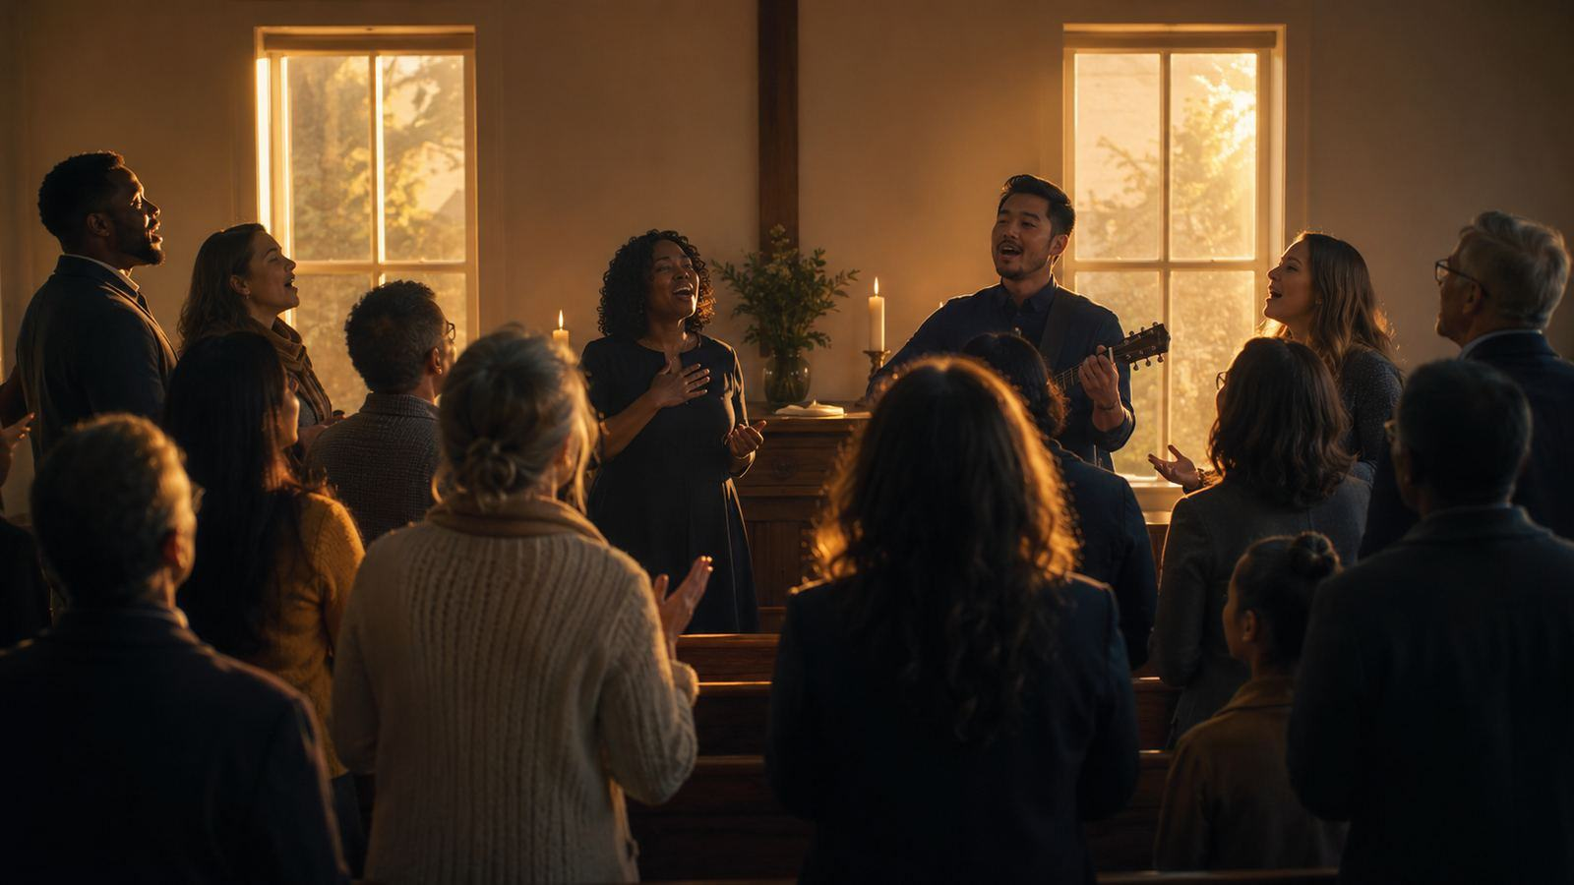
The Poem and the Tune
A seventeenth-century prayer carried by a twentieth-century English melody.
Prepared for teaching and small group use - hymninfo.com

Slide 5
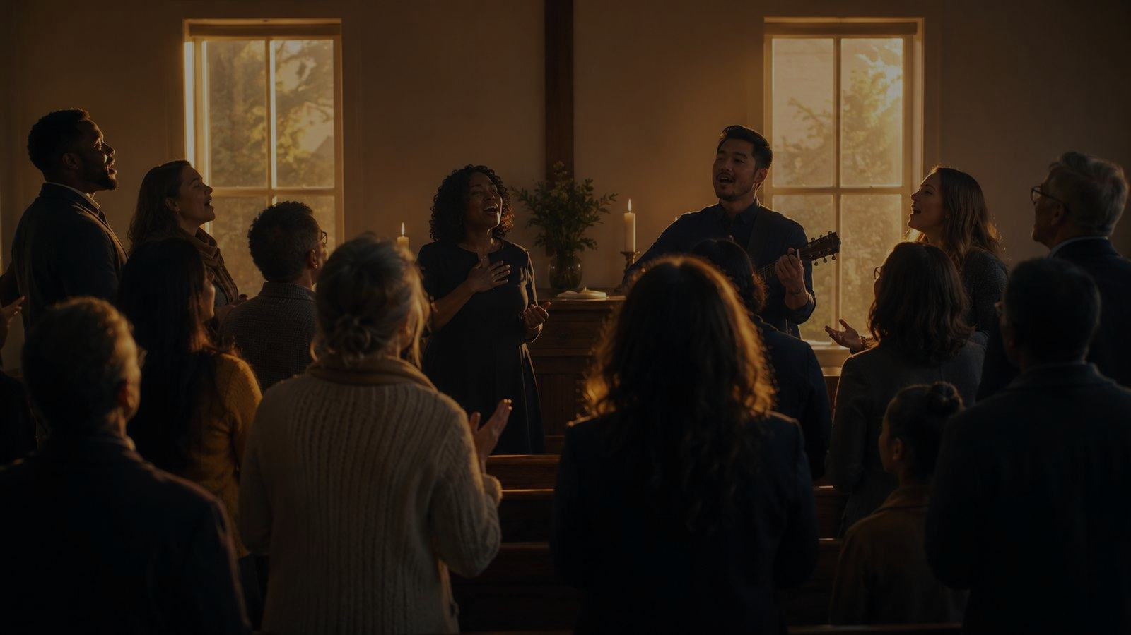
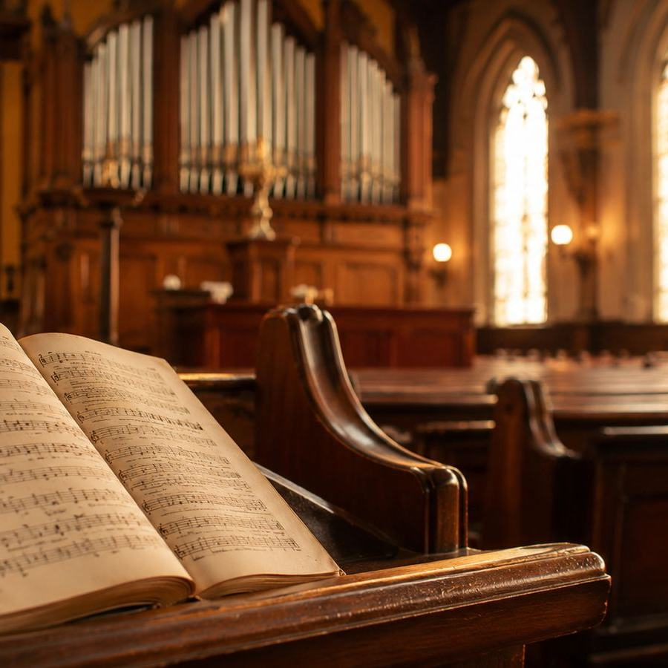
Historical Background
George Herbert was an Anglican priest and devotional poet whose work joins biblical doctrine with personal prayer.
“The Call” appeared in The Temple, published after Herbert’s death in 1633.
Ralph Vaughan Williams set the poem in Five Mystical Songs in 1911.
E. Harold Geer later adapted THE CALL for congregational hymn singing.
From poetic prayer to congregational song
Prepared for teaching and small group use - hymninfo.com

Slide 6

Why This Hymn Matters Today
In a distracted age, the hymn teaches the church to want Christ himself.
Pastoral value
Worship value
It gives simple words for people who need guidance, clarity, and inner strength.
It works well as a sung prayer before Scripture, communion, or a time of response.
Devotional value
Teaching value
Its short phrases can be carried into the week as personal prayer.
It opens John 14:6 without reducing Christ to an idea or a slogan.
Prepared for teaching and small group use - hymninfo.com

Slide 7

Biblical Foundation
John 14:6 gives the hymn its center: Christ himself.
Prepared for teaching and small group use - hymninfo.com

Slide 8

Biblical Foundation
John 14:6
Jesus identifies himself as the way to the Father, the truth that reveals God, and the life that gives communion with God.
John 14:6
Christ names himself the way, the truth, and the life.
John 1:4-5
Christ is life and light, shining where darkness cannot overcome him.
John 6:35
Christ satisfies the deep hunger of the soul.
Psalm 16:11
God shows the path of life and fullness of joy in his presence.
Ephesians 3:16-19
Christ strengthens the inner person and roots believers in love.
Prepared for teaching and small group use - hymninfo.com

Slide 9
Christ as the Way
Herbert’s prayer begins with a heart asking Christ to lead not only the feet, but the whole life.
• The way is personal: Christ leads us to the Father.
• The way is relational: discipleship is life with him.
• The way is practical: prayer becomes obedience.
Teaching emphasis: guidance begins with belonging to Christ.
Prepared for teaching and small group use - hymninfo.com

Slide 10
Christ as the Truth
The hymn’s truth is not an abstract principle. It is Christ, who reveals God and orders the heart.
• Truth steadies faith when feelings shift.
• Truth exposes false hopes and heals distorted loves.
• Truth becomes prayer when the church turns to Christ.
Prepared for teaching and small group use - hymninfo.com

Slide 11

Christ as the Life
The hymn moves from direction and truth toward the living communion that gives strength, joy, love, and the heart’s true home.
Strength
Christ sustains weak disciples.
Joy
Christ gives gladness deeper than circumstance.
Love
Christ roots the heart in God’s own life.
Prepared for teaching and small group use - hymninfo.com

Slide 12
A Sung Prayer, Not a Lecture
Herbert’s poetic craft is compact, but the spiritual movement is expansive: every phrase asks Christ to be more deeply known and loved.
Address
Naming
Desire
Response
The soul speaks directly to Christ.
→
Christ is named through biblical images.
→
The singer asks not for things first, but for Christ.
→
Prayer becomes faith, worship, and discipleship.
Teaching emphasis: let the class hear the hymn as prayer before analyzing it as poetry.
Prepared for teaching and small group use - hymninfo.com

Slide 13

Theological Themes
Christ-centered faith
Guidance
Revelation
All spiritual life begins and ends in Christ.
The path of discipleship is communion with him.
Truth is made known in the person of Christ.
Spiritual vitality
Prayer
Indwelling grace
Christ gives strength, joy, and love.
Doctrine becomes desire before God.
Christ forms the inner life of the believer.
Prepared for teaching and small group use - hymninfo.com

Slide 14
Literary and Musical Observations
Poetic form
Short petitions carry deep theological weight.
Biblical compression
John 14:6 is unfolded through a sequence of prayerful images.
T
Musical character
THE CALL is lyrical, restrained, and well suited to reflection.
W
L
Congregational use
Sing gently enough for the words to be heard and prayed.
The melody should carry the prayer, not overshadow it.
Prepared for teaching and small group use - hymninfo.com

Slide 15

Pastoral and Worship Use
• Before Scripture readings centered on Christ
• During communion or quiet response
• In classes on prayer, discipleship, or John 14
• For choir meditation with careful text delivery
• In personal prayer or retreat settings
Pastoral note: the hymn can serve anxious, weary, or searching believers by drawing them to the person of Christ.
Prepared for teaching and small group use - hymninfo.com

Slide 16
Teaching Questions
1. How does John 14:6 shape the whole hymn?
2. Why does Herbert address Christ directly rather than merely describe him?
3. Which image of Christ do you most need to pray this week: way, truth, life, light, strength, joy, love, or heart?
4. How can a short hymn form deep habits of prayer?
5. What does this hymn teach a congregation about desiring Christ himself?
Prepared for teaching and small group use - hymninfo.com

Slide 17

Suggested Lesson Flow
30 minutes
60 minutes
1. Read John 14:6
1. Add Scripture cross-references
2. Introduce Herbert and THE CALL
2. Discuss poetic prayer
3. Teach Christ as Way, Truth, and Life
3. Practice singing or reading reflectively
4. Close with prayerful response
4. Work through applications for the week
Application: choose one phrase from the hymn’s pattern of prayer and turn it into a daily prayer to Christ this week.
Prepared for teaching and small group use - hymninfo.com

Slide 18
Closing Summary and Prayer
Christ is the path we walk, the truth we trust, and the life we receive. The hymn teaches us to bring our whole heart to him.
Lord Jesus Christ, be our way when we are uncertain, our truth when we are confused, and our life when we are weary. Root us in your love, strengthen us by your Spirit, and teach us to follow you with a quiet and faithful heart. Amen.
© HymnInfo.com. Free for personal, church, classroom, and small-group teaching use. Please do not sell, repost, or redistribute as downloadable files without permission.
Prepared for teaching and small group use - hymninfo.com

