Slide 1

Do, Lord, Remember Me
First line: Do, Lord, do, Lord, do, Lord, remember me
A hymn study on grace, remembrance, assurance, and hope
African American spiritual • Tune commonly identified as DITMUS • Primary Scripture: Luke 23:42-43
Prepared for teaching and small group use - hymninfo.com

Slide 2

Teaching Aim
Understand how the hymn’s simple prayer carries a deep biblical theology of divine remembrance.
Feel the comfort of Christ’s mercy toward sinners, the forgotten, and the weary.
Practice humble prayer, communal worship, and compassionate remembrance of others.
Prepared for teaching and small group use - hymninfo.com

Slide 3
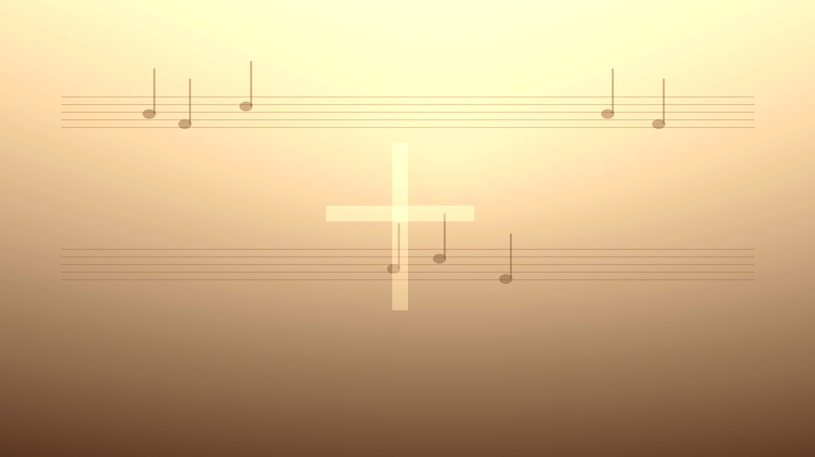
Hymn Identity
Hymn facts
Title: Do, Lord, Remember Me
First line: “Do, Lord, do, Lord, do, Lord, remember me”
Tradition: African American spiritual
Exact writing date: not firmly documented
Modern tune name: often DITMUS
Teaching focus
Prayer for mercy
Grace and salvation
Assurance and comfort
Joyful communal singing
Hope that God does not forget his people
Prepared for teaching and small group use - hymninfo.com

Slide 4
Historical Background
A song shaped by Scripture, suffering, communal memory, and hope
Prepared for teaching and small group use - hymninfo.com

Slide 5
The Spirituals Tradition
African American spirituals developed through communal singing, oral transmission, and worshipful testimony.
They often unite biblical faith with lived hardship, hope, and the longing for deliverance.
Call and response, repetition, and shared participation are not ornaments; they are part of the song’s meaning.
This hymn should be taught with gratitude, humility, and reverence for the community that carried the tradition.
Prepared for teaching and small group use - hymninfo.com

Slide 6
Hymn Background
No single original author is known with confidence, which is common among traditional spirituals.
Modern hymnals often associate the melody with the name DITMUS.
William Farley Smith prepared a later arrangement/adaptation for congregational worship collections.
The song has been especially useful in churches, revivals, camps, children’s ministries, and informal worship.
Prepared for teaching and small group use - hymninfo.com

Slide 7

Biblical Foundation
When God remembers, he acts in mercy, covenant faithfulness, and salvation
Prepared for teaching and small group use - hymninfo.com

Slide 8
Primary Scripture: Luke 23:42-43
The plea
A guilty man turns to Jesus near death.
His request is simple: “remember me.”
He brings no merit, only need and trust.
The prayer is humble, urgent, and Christ-centered.
The promise
Jesus answers with assurance, not hesitation.
Paradise is promised by grace.
The Lord’s remembrance becomes saving mercy.
The hymn echoes this gospel-shaped cry.
Prepared for teaching and small group use - hymninfo.com

Slide 9
Supporting Scriptures
Psalm 25:6-7 asks God to remember mercy and loving kindness rather than sin.
Psalm 106:4-5 asks to be remembered with the favor God shows his people.
Isaiah 49:15-16 declares that God does not forget his people.
Hebrews 6:10 comforts faithful servants: God does not overlook labor done in his name.
Prepared for teaching and small group use - hymninfo.com

Slide 10
Hymn Study
The repeated prayer becomes a doorway into grace, assurance, and hope
Prepared for teaching and small group use - hymninfo.com

Slide 11
The Central Plea
“Remember me” is not a fear that God has poor memory.
It is a plea for God’s merciful attention and saving action.
The repetition gives the congregation time to pray, confess, and trust.
The hymn can be sung as both personal prayer and shared testimony.
Prepared for teaching and small group use - hymninfo.com

Slide 12
Prayer and Humility
The singer stands before the Lord without bargaining or boasting.
The repeated line teaches dependence on grace.
This makes the hymn especially suitable for invitations, prayer meetings, and testimony settings.
A simple prayer can carry mature theology when it is rooted in Scripture.
Prepared for teaching and small group use - hymninfo.com

Slide 13
Grace and Salvation
Luke 23 shows that Christ’s mercy reaches the helpless and repentant.
The hymn asks to be remembered by the Lord who saves.
Grace is received, not earned.
The song’s joy comes from confidence in the mercy of Christ.
Prepared for teaching and small group use - hymninfo.com

Slide 14

Assurance and Comfort
For the anxious: the Lord does not forget his people.
For the grieving: Christ’s promise reaches beyond death.
For the weary servant: God sees labor done in his name.
For the overlooked: God’s remembrance is personal, faithful, and compassionate.
Prepared for teaching and small group use - hymninfo.com

Slide 15
Musical and Literary Observations
Repetition invites participation and meditation.
The melody’s accessible pattern allows all ages to join quickly.
Call and response can help a congregation experience the communal character of the song.
The tone is lively, but the theology is serious: mercy, remembrance, and hope.
Prepared for teaching and small group use - hymninfo.com

Slide 16
Pastoral and Worship Use
Prayer meetings and testimony services
Services emphasizing grace, salvation, hope, or assurance
Children’s ministry, camps, revival gatherings, and intergenerational worship
Teaching moments on spirituals, Luke 23, and the biblical meaning of divine remembrance
Prepared for teaching and small group use - hymninfo.com

Slide 17
Teaching Questions
What does it mean in Scripture for God to remember someone?
How does Luke 23:42-43 shape the hymn’s meaning?
Why can repetition make a prayer stronger rather than weaker?
How can a joyful spiritual carry honest suffering and deep hope?
Who around us needs to be reminded that God has not forgotten them?
Prepared for teaching and small group use - hymninfo.com

Slide 18
Application: Remembered People Remember Others
Pray simply and honestly before the Lord.
Rest in Christ’s mercy instead of personal merit.
Encourage someone who feels unseen or forgotten.
Let worship form compassion, testimony, and joyful trust.
Honor the spirituals tradition by singing with reverence and gratitude.
Prepared for teaching and small group use - hymninfo.com

Slide 19
Suggested Lesson Flow
30-minute plan
5 min - Sing or listen reflectively
7 min - Read Luke 23:42-43
8 min - Teach divine remembrance
7 min - Discuss assurance and hope
3 min - Closing prayer
60-minute plan
8 min - Opening reflection
10 min - Spirituals background
15 min - Scripture study
12 min - Hymn theme discussion
10 min - Application and testimony
5 min - Prayer and singing
Prepared for teaching and small group use - hymninfo.com

Slide 20
Closing Summary
The Lord remembers with mercy, saves by grace, and comforts his people with hope
Prepared for teaching and small group use - hymninfo.com

Slide 21
Closing Prayer
Lord Jesus, remember us according to your mercy.
Teach us to pray with humility and sing with hope.
Comfort those who feel forgotten, strengthen those who serve quietly, and make us a people who remember others in love.
Amen.
Prepared for teaching and small group use - hymninfo.com

Slide 22
Usage Notice
© HymnInfo.com. Free for personal, church, classroom, and small-group teaching use. Please do not sell, repost, or redistribute as downloadable files without permission.
Prepared for teaching and small group use - hymninfo.com

