Slide 1

Every Time I Feel the Spirit
A hymn study on the Holy Spirit, prayer, and joyful witness
Acts 2:1-4
Romans 8:14-16
Traditional African American Spiritual
Prepared for teaching and small group use - hymninfo.com

Slide 2
Teaching Aim
Help learners receive the song as testimony, prayer, and worship.
Understand
Feel
Practice
The song joins the Spirit’s inward witness with prayer and praise.
Its joy is resilient faith, not shallow optimism.
Let the Spirit’s movement lead to prayer, obedience, and witness.
Prepared for teaching and small group use - hymninfo.com

Slide 3

Hymn Identity
A communal spiritual shaped by Scripture, prayer, and sung testimony.
Title
Every Time I Feel the Spirit
First line
Upon the mountain, my Lord spoke
Tradition
African American spiritual
Authorship
Communal oral tradition
Tune
Traditional spiritual melody
Meter
Varies by arrangement
Primary Scripture
Acts 2:1-4
Key Themes
Holy Spirit, prayer, joy, faith
Prepared for teaching and small group use - hymninfo.com

Slide 4
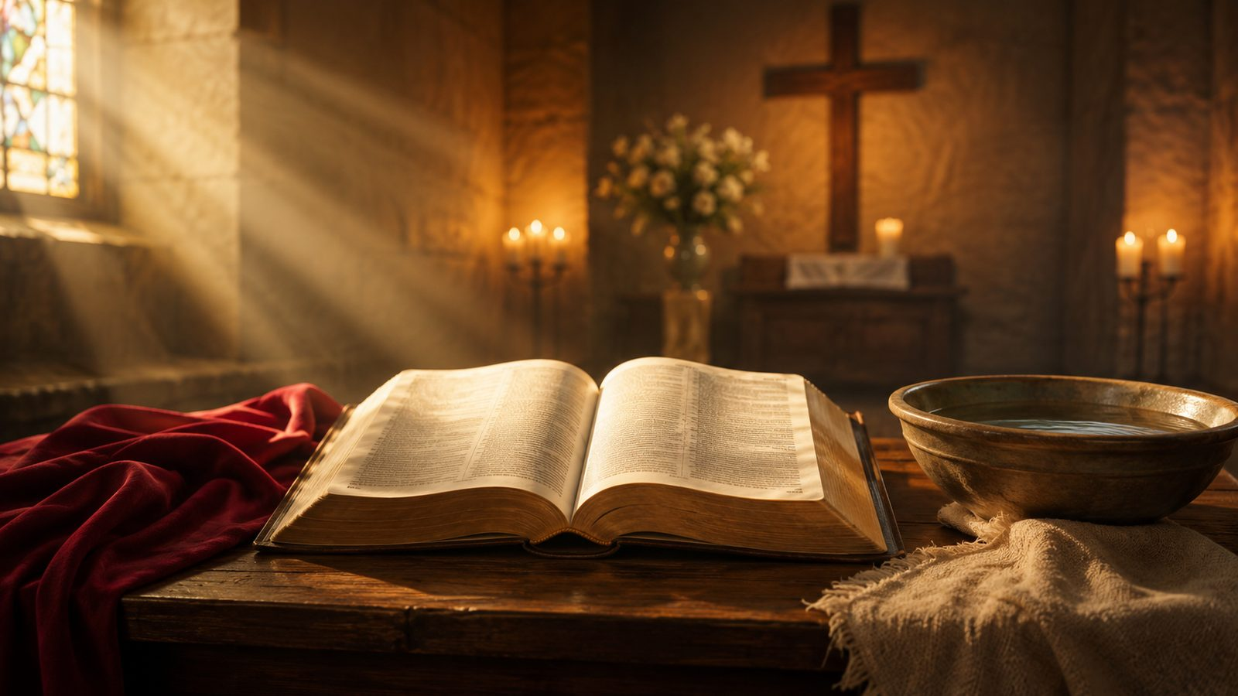
Spirit, Prayer, and Joy
A spiritual that moves from divine presence to prayerful response.
Prepared for teaching and small group use - hymninfo.com

Slide 5

Historical Background
A song carried by community, faith, and oral tradition.
The song belongs to the African American spiritual tradition, where biblical faith was sung through communal memory and worship.
Its first singers shaped the song through oral transmission rather than through a single named composer.
The mountain image echoes biblical scenes of divine speech and revelation.
Modern hymnals and choirs use varied arrangements, but the spiritual’s heart remains prayerful testimony.
Prepared for teaching and small group use - hymninfo.com

Slide 6
Why This Hymn Matters Today
It teaches the church to sing the Spirit’s presence with body, memory, and hope.
Worship
Formation
The refrain gives the whole congregation an immediate prayer response.
It connects Spirit-filled experience with daily walking by the Spirit.
Cultural care
Pastoral strength
It reminds churches to honor spirituals as gifts from African American Christian communities.
Its joy can sustain believers under pressure and hardship.
Prepared for teaching and small group use - hymninfo.com

Slide 7

Biblical Foundation
The song stands near Scripture’s language of fire, mountain, prayer, and Spirit-led life.
Acts 2:1-4
The Spirit fills the gathered church with power at Pentecost.
Exodus 19:16-20
God speaks from the mountain with awe, fire, sound, and holy presence.
Romans 8:14-16
The Spirit bears witness that believers belong to God.
Romans 8:26
The Spirit helps the weakness of prayer.
Galatians 5:25
Life in the Spirit becomes a walk of obedience.
Prepared for teaching and small group use - hymninfo.com

Slide 8
Hymn Movement Study
From mountain revelation to prayerful witness
Prepared for teaching and small group use - hymninfo.com

Slide 9
Movement 1: The mountain of divine speech
The spiritual remembers a God who speaks and moves among his people.
Teaching emphasis
The mountain points to biblical scenes where God reveals his presence with power.
The song treats God’s speech as living memory, not distant history.
Teach this image with Exodus 19 and Acts 2 side by side: holy presence, sound, and divine action.
Prepared for teaching and small group use - hymninfo.com

Slide 10
Movement 2: Spirit and prayer
When the Spirit moves, the faithful answer in prayer.
Prayer is not merely duty.
Romans 8 teaches that the Spirit bears witness within God’s children and helps them when they do not know how to pray. The song turns that doctrine into congregational testimony.
Prepared for teaching and small group use - hymninfo.com

Slide 11
Movement 3: Joy with spiritual weight
The song’s energy carries testimony, not entertainment alone.
Embodied praise
Resilient faith
Communal witness
Rhythm and repetition help the congregation sing with the whole self.
Spiritual joy often rises within hardship, pressure, and longing.
The song is strongest when sung as shared testimony, not private feeling only.
Prepared for teaching and small group use - hymninfo.com

Slide 12

Theological Themes
Six truths carried by a brief spiritual.
Holy Spirit
Prayer
Revelation
God’s living presence moves the heart.
Spirit-given life turns toward God.
The mountain image remembers divine speech.
Adoption
Joy
Witness
The Spirit witnesses that we belong to God.
Praise becomes strength for the journey.
The church sings what God has done.
Prepared for teaching and small group use - hymninfo.com

Slide 13
Literary and Musical Observations
Repetition, rhythm, and response make the song teachable and singable.
Text movement
Musical character
The song moves between biblical image and personal testimony.
The refrain gathers the central response: the Spirit’s movement turns the heart toward prayer.
Its simplicity makes room for congregational energy and memory.
Strong rhythmic motion supports joyful singing.
Verse and refrain can be led with call-and-response where it fits the community.
Choirs should preserve vitality without turning the song into mere display.
Prepared for teaching and small group use - hymninfo.com

Slide 14
Pastoral and Worship Use
A strong choice where the church prays for Spirit-filled life.
Pentecost
Pair with Acts 2 and prayers for renewed witness.
Prayer services
Use as a sung response after intercession or testimony.
Choir and congregation
Let a choir lead vitality while the people join the refrain.
Teaching settings
Discuss spirituals as biblical, communal, and culturally rooted worship.
Youth and children
Its repetition helps younger singers learn faith by singing.
Mission emphasis
Connect Spirit-filled prayer with faithful public witness.
Prepared for teaching and small group use - hymninfo.com

Slide 15
Teaching Questions
Guide a thoughtful class conversation.
1
What does the song teach about the Holy Spirit’s work in prayer and worship?
2
How does the mountain image connect with biblical revelation?
3
How can joy become a form of resilient faith?
4
What responsibilities come with teaching and singing African American spirituals?
5
How can Spirit-filled worship lead to obedience during the week?
Prepared for teaching and small group use - hymninfo.com

Slide 16
Application
Four practices for the week.
Pray
Listen
Sing
Walk
Begin each day asking the Spirit to guide speech, choices, and love.
Read Acts 2 or Romans 8 slowly and notice what the Spirit gives.
Use the refrain as a short prayer when strength is low.
Choose one act of obedience that turns worship into witness.
Prepared for teaching and small group use - hymninfo.com

Slide 17
Suggested Lesson Flow
Two options for teaching.
30-minute class
60-minute class
5 min - Opening prayer and Acts 2:1-4
7 min - Hymn identity and background
8 min - Scripture: Acts 2 and Romans 8
7 min - Discussion questions
3 min - Closing prayer
8 min - Sing or listen to a respectful setting
10 min - History of spirituals and cultural care
15 min - Biblical study: Acts, Exodus, Romans
15 min - Movement study and applications
7 min - Practice for the week
5 min - Prayer
Prepared for teaching and small group use - hymninfo.com

Slide 18
Closing Summary and Prayer
The spiritual teaches the church to recognize the Spirit’s movement and answer with prayer, praise, and faithful witness.
Living God, by your Spirit awaken prayer in us. Give us joy that endures, worship that bears witness, and obedience that walks in your way. Amen.
© HymnInfo.com. Free for personal, church, classroom, and small-group teaching use. Please do not sell, repost, or redistribute as downloadable files without permission.
Prepared for teaching and small group use - hymninfo.com

