Slide 1

HYMN STUDY TEACHING GUIDE
Fill My Cup, Lord
Like the woman at the well I was seeking
Words and music: Richard Eugene Blanchard Sr.
Tune: FILL MY CUP • 1959
Primary Scripture: John 4:14
Prepared for teaching and small group use - hymninfo.com

Slide 2

What this hymn teaches
TEACHING AIM
• Understand how the song draws from Jesus’ promise of living water.
• Recognize spiritual thirst as a summons to Christ, not as a problem to hide.
• Practice honest prayer for renewal, salvation, and daily dependence on grace.
Prepared for teaching and small group use - hymninfo.com

Slide 3
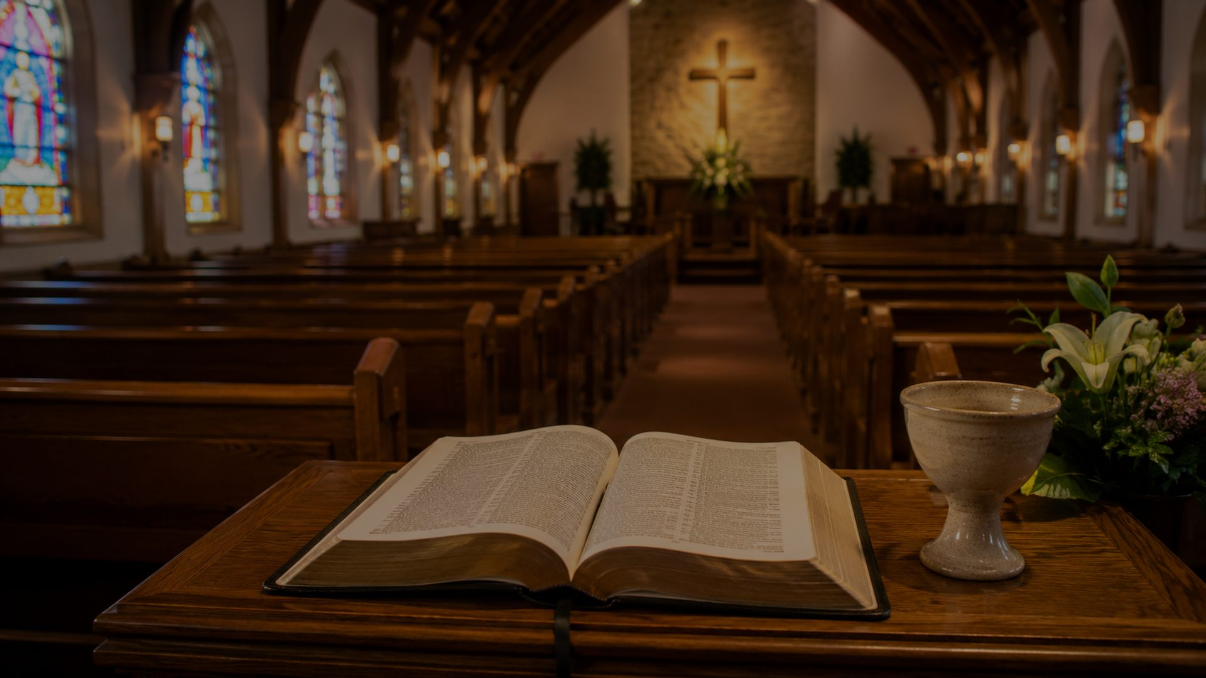
Hymn Identity
Title
First line
Fill My Cup, Lord
Like the woman at the well I was seeking
Text & Tune
Tune name
Richard Eugene Blanchard Sr.
FILL MY CUP
Date
Meter
1959
Irregular; often printed with refrain
Prepared for teaching and small group use - hymninfo.com

Slide 4

A mid-century gospel prayer
HISTORICAL BACKGROUND
• Richard Eugene Blanchard Sr., a Methodist minister and songwriter, wrote both words and music.
• Hymnal records commonly date the tune FILL MY CUP to 1959.
• Some later hymnals identify Eugene Clark as arranger for particular settings.
• The song became familiar as a devotional, invitation, and response song in many churches.
Prepared for teaching and small group use - hymninfo.com

Slide 5

Why This Hymn Matters Today
Pastoral value
Worship value
Teaching value
It gives words to people who know they are spiritually empty and need Christ to renew them.
It works well as a quiet response after Scripture, prayer, confession, or gospel invitation.
It opens a clear path from John 4 to the larger biblical language of thirst, bread, and salvation.
Devotional value
Congregational value
It teaches believers to bring hunger, thirst, and longing to Christ rather than to lesser wells.
Its direct, prayerful language allows a congregation to respond together in humble dependence.
Prepared for teaching and small group use - hymninfo.com

Slide 6
BIBLICAL FOUNDATION
Living water for thirsty souls
“Whoever drinks of the water that I will give him will never thirst again.”
John 4:14
Prepared for teaching and small group use - hymninfo.com

Slide 7
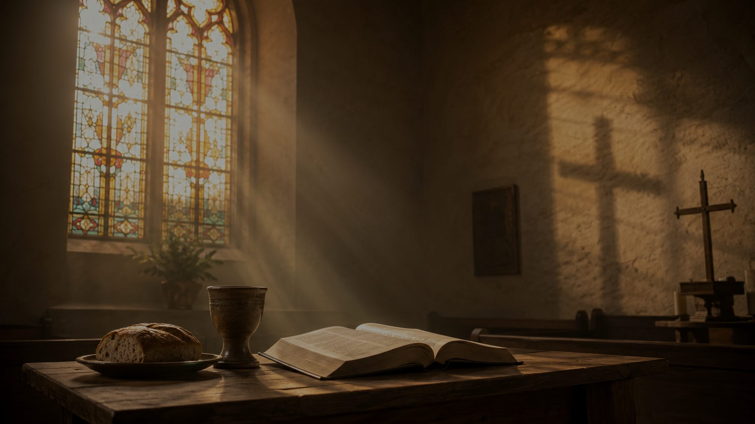
Scripture Connections
John 4:14
John 6:35
Christ gives living water that becomes a spring of eternal life.
Christ satisfies hunger and thirst as the bread of life.
Psalm 116:13
Matthew 5:6
The cup of salvation is received with prayer and praise.
Those who hunger and thirst for righteousness are filled.
Isaiah 55:1
God freely calls the thirsty to come and receive.
Prepared for teaching and small group use - hymninfo.com

Slide 8
The seeker at the well
HYMN SECTION STUDY
• The opening image draws the class toward John 4 and the Samaritan woman’s encounter with Jesus.
• Spiritual thirst is presented as a human condition that Christ alone can answer.
• Teaching emphasis: Jesus meets real need with grace, truth, and invitation.
Prepared for teaching and small group use - hymninfo.com

Slide 9
The prayer of an empty cup
HYMN SECTION STUDY
• The central prayer asks the Lord to fill what human effort cannot satisfy.
• The cup image joins longing, salvation, and daily renewal.
• Teaching emphasis: faith receives; it does not pretend to be self-sufficient.
Prepared for teaching and small group use - hymninfo.com

Slide 10
Christ satisfies the soul
HYMN SECTION STUDY
• The hymn moves from need to the sufficiency of Christ.
• Water and bread imagery points to spiritual life, nourishment, and grace.
• Teaching emphasis: the gospel is not mere information; it is Christ giving himself to thirsty people.
Prepared for teaching and small group use - hymninfo.com

Slide 11
Central Prayer and Response
How the refrain works
Why repetition matters
The refrain functions as a congregational prayer. It turns biblical teaching into direct address to Christ.
The repeated petition gives worshipers time to own the prayer rather than merely hear about spiritual thirst.
Teaching caution
Use brief references to the text in teaching, but focus the lesson on Scripture, themes, and application.
Prepared for teaching and small group use - hymninfo.com

Slide 12
Spiritual thirst
THEOLOGICAL THEMES
• The Bible treats thirst as more than emotion: it is a sign of need before God.
• False wells may distract for a time, but they cannot give eternal life.
• Christian teaching should name this thirst honestly and point directly to Christ.
Prepared for teaching and small group use - hymninfo.com

Slide 13
Grace, Salvation, and Renewal
Grace
Salvation
Renewal
The thirsty are invited to come freely. The song is a prayer of reception, not a claim of merit.
The cup of salvation is received by calling on the Lord and trusting his provision.
The believer’s ongoing need is met by the same Christ who first gives living water.
Pastoral thread
The hymn is useful when worshipers need to confess emptiness without despair and receive Christ’s mercy with faith.
Prepared for teaching and small group use - hymninfo.com

Slide 14
A gospel song shaped for response
MUSICAL OBSERVATIONS
• FILL MY CUP has the accessible phrasing of mid-twentieth-century gospel song.
• Its melodic shape supports personal prayer and congregational response.
• A gentle tempo helps the song function as a prayer rather than a performance.
• Solo, choir, and congregation can each serve the text when the mood stays reverent.
Prepared for teaching and small group use - hymninfo.com

Slide 15
Pastoral and Worship Use
Invitation
Prayer response
Small group
After a gospel message on Christ’s mercy and sufficiency.
Following Scripture, confession, or teaching on renewal.
As a discussion doorway into spiritual thirst and desire.
Choir rehearsal
Personal devotion
Pastoral care
To shape tone, phrasing, and prayerful delivery.
For morning or evening prayer when asking Christ to restore the soul.
With those who feel dry, weary, or spiritually restless.
Prepared for teaching and small group use - hymninfo.com

Slide 16
Teaching Questions
• What kinds of “thirst” do people bring into worship?
• How does John 4 move from ordinary water to eternal life?
• What does it mean to pray as an empty cup before God?
• How do John 6 and Psalm 116 deepen the song’s imagery?
• How can a church offer invitation without emotional manipulation?
Prepared for teaching and small group use - hymninfo.com

Slide 17
Practices for the week
APPLICATION
• Pray John 4:14 slowly each morning and name one place of thirst before Christ.
• Fast from one lesser comfort for a day and turn that desire into prayer.
• Encourage someone who feels spiritually dry with Scripture rather than clichés.
• End each day by thanking Christ for one evidence of sustaining grace.
Prepared for teaching and small group use - hymninfo.com

Slide 18
Suggested Lesson Flow
30-minute plan
60-minute plan
5 min opening question
8 min John 4:14 and John 6:35
8 min hymn theme study
6 min discussion
3 min closing prayer
8 min opening reflection
12 min biblical foundation
15 min section-by-section study
12 min theological themes
8 min application
5 min prayer and response
Prepared for teaching and small group use - hymninfo.com

Slide 19
Christ fills the thirsty soul
CLOSING SUMMARY
• This hymn teaches believers to bring spiritual hunger and thirst honestly to Christ.
• The living water promised in John 4 is not a mood but the gift of eternal life.
• A church sings this prayer best when it points all longing toward the Savior.
Prepared for teaching and small group use - hymninfo.com

Slide 20
Closing Prayer
Lord Jesus Christ, giver of living water, meet us in our need. Turn our restless desires toward your grace, fill our emptiness with your mercy, and make us a people who seek our satisfaction in you. Amen.
© HymnInfo.com. Free for personal, church, classroom, and small-group teaching use. Please do not sell, repost, or redistribute as downloadable files without permission.
Prepared for teaching and small group use - hymninfo.com

