Slide 1
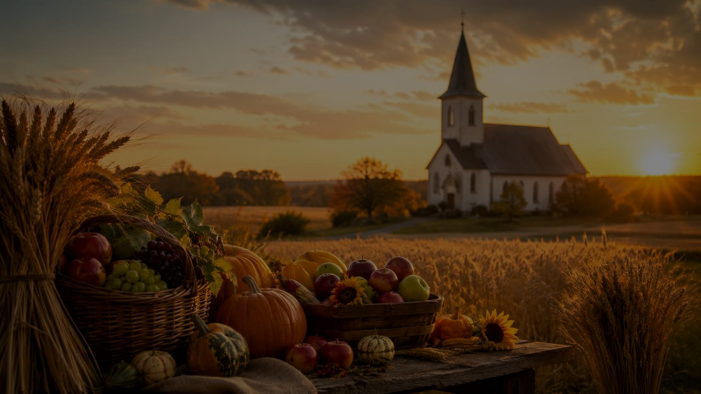
For the Fruits of This Creation
A hymn study on gratitude, stewardship, and the gifts of God
Frederick Pratt Green • 1970 • EAST ACKLAM / AR HYD Y NOS
Primary Scripture: Psalm 65:9-13
Prepared for teaching and small group use - hymninfo.com

Slide 2

Teaching Aim
Move from thanksgiving to faithful responsibility
Understand
God gives the fruits of creation as gifts to be received with reverence, not consumed carelessly.
Feel
Grateful wonder before God’s generosity, joined with sober concern for neighbors in need.
Practice
Let worship become generosity, fair dealing, and stewardship of creation’s abundance.
✓
✚
→
Receive
Share
Serve
Prepared for teaching and small group use - hymninfo.com

Slide 3

Hymn Identity
A modern harvest hymn with a moral center
Text
Frederick Pratt Green, 1970. First printed in the Methodist Recorder and later included in Green’s 26 Hymns.
Tunes
Often sung to EAST ACKLAM by Francis Alan Jackson or to the Welsh tune AR HYD Y NOS.
Meter
Commonly listed as 8.4.8.4.8.8.8.4, matching the hymn’s compact thanksgiving refrain.
Themes
Thanksgiving, providence, creation, harvest, stewardship, generosity, service, and justice.
Teaching Value
The hymn helps a congregation confess gratitude and then ask what faithful gratitude requires.
Prepared for teaching and small group use - hymninfo.com

Slide 4
Historical Background
Frederick Pratt Green and a renewed harvest song
Green was an English Methodist minister and poet whose later hymns gave congregations clear language for modern Christian discipleship.
Written in 1970, this text reframes harvest thanksgiving for a world aware of hunger, labor, stewardship, and social responsibility.
Francis Alan Jackson’s EAST ACKLAM became one of the principal tunes, while AR HYD Y NOS remains a familiar alternate setting.
Teaching Caution
Present the hymn as gratitude that matures into action, not as a nostalgic harvest song only.
Prepared for teaching and small group use - hymninfo.com

Slide 5

Gratitude Receives God’s Gifts
Creation is not self-made abundance; it is mercy in visible form.
Prepared for teaching and small group use - hymninfo.com

Slide 6
Biblical Foundation
Thanksgiving that becomes faithful action
Genesis 1:29-31
Creation’s fruitfulness is part of God’s good gift.
Psalm 65:9-13
God waters the earth and crowns the year with bounty.
2 Corinthians 9:6-15
Generosity is a harvest of righteousness and thanksgiving.
Matthew 25:35-40
Care for hungry neighbors is service to Christ.
James 1:17
Every good and perfect gift comes from above.
Prepared for teaching and small group use - hymninfo.com

Slide 7
Hymn-Section Study: Creation’s Gifts
First movement of the hymn
The hymn begins with gratitude for the visible gifts of creation: food, harvest, growth, and provision.
Teaching emphasis: name ordinary gifts as gifts from God before talking about how to use them.
Scripture connection: Psalm 65 praises the God who waters, enriches, and fills the earth with grain.
Prepared for teaching and small group use - hymninfo.com

Slide 8
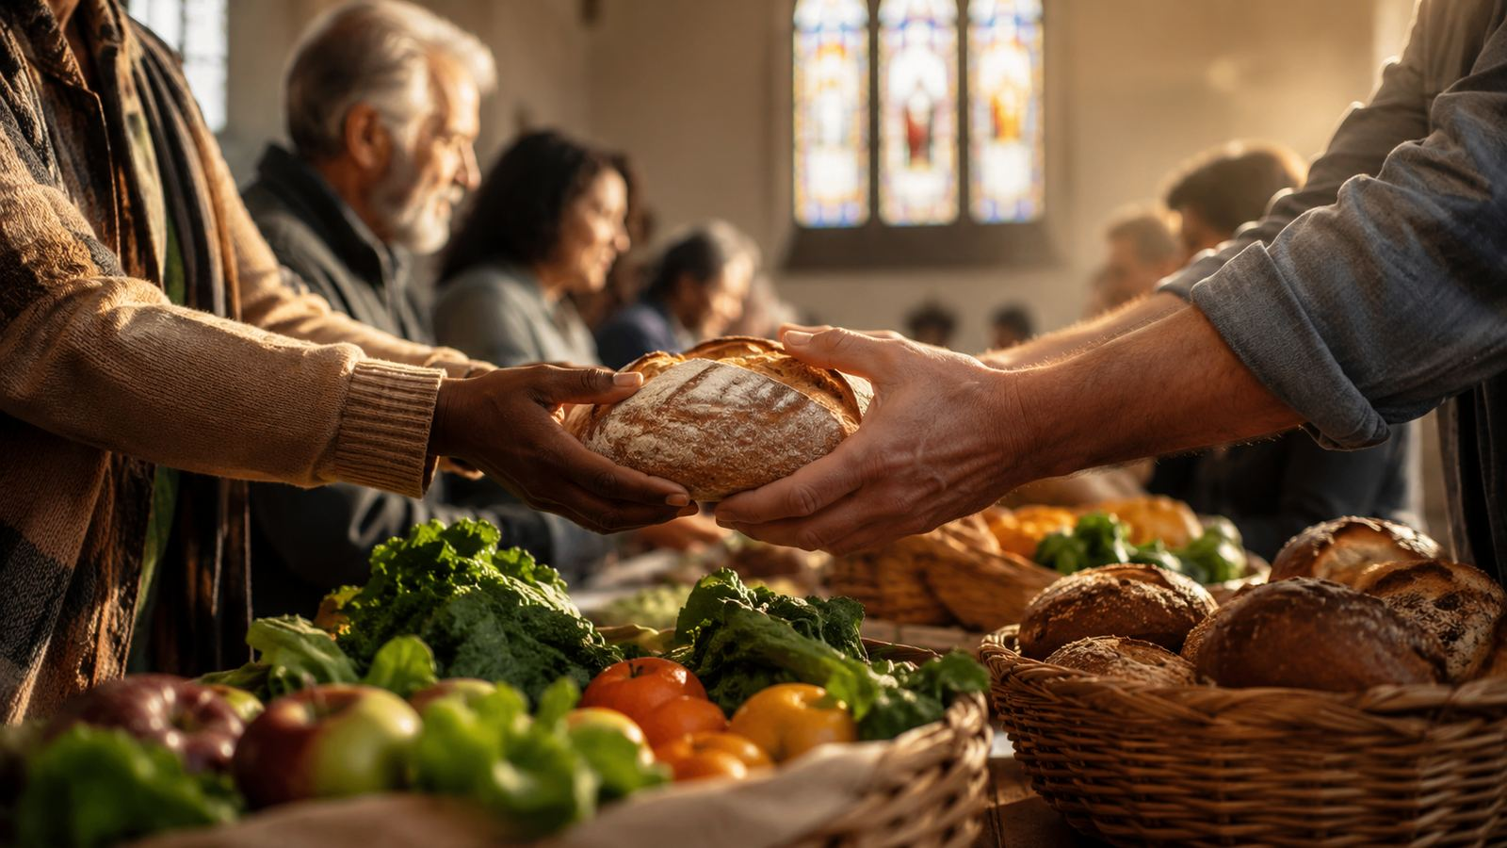
Hymn-Section Study: Shared Labor and Care
The hymn moves from “thank you” to “what now?” It joins labor, neighborly care, and justice with worship.
God’s gifts are entrusted, not hoarded. A harvest kept only for oneself has not yet become Christian thanksgiving.
Scripture connection: Matthew 25 and 2 Corinthians 9 press gratitude toward practical mercy.
◆
•
✚
Food
Labor
Neighbor
Prepared for teaching and small group use - hymninfo.com

Slide 9
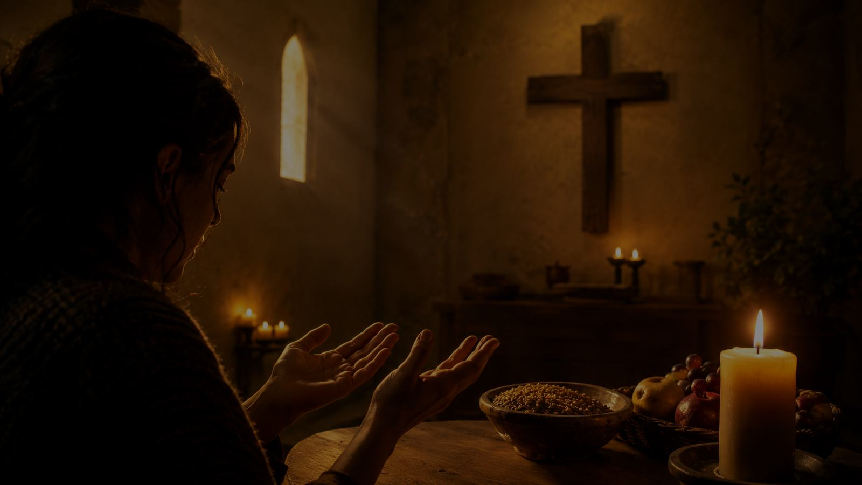
Hymn-Section Study: The Spirit’s Harvest
Final movement of the hymn
The closing movement broadens harvest beyond food and fields.
God’s grace grows a deeper harvest: goodness, love, mercy, and the fruit of a life turned toward Christ.
Teaching emphasis: thanksgiving matures into spiritual formation and communal witness.
Prepared for teaching and small group use - hymninfo.com

Slide 10
Theological Themes
The hymn’s central convictions
Providence
God gives what sustains life.
Creation
The earth’s fruitfulness bears witness to God.
Thanksgiving
Praise begins with receiving gifts rightly.
Justice
Gratitude cannot ignore hungry neighbors.
Stewardship
The harvest is entrusted for faithful use.
Service
Love becomes visible in practical care.
Prepared for teaching and small group use - hymninfo.com

Slide 11
Literary and Musical Observations
A compact text with a steady moral movement
Text Movement
The hymn begins with gifts, turns to human responsibility, and ends with the harvest of the Spirit.
Tune Options
EAST ACKLAM gives a dignified, reflective setting. AR HYD Y NOS may help congregations sing with ease.
Leadership
Use a moderate tempo. Let the repeated thanksgiving phrase sound grateful rather than rushed.
Prepared for teaching and small group use - hymninfo.com

Slide 12

Pastoral and Worship Use
Where this hymn serves the church
Thanksgiving Day or harvest festival
Creation care and stewardship services
Mission offerings and food-pantry Sundays
Sermons on generosity, labor, and mercy
Choir or congregational teaching on Christian gratitude
Pastoral Angle
Use the hymn to show that worship is not finished when the song ends. Thanksgiving continues in the way God’s gifts are shared.
Prepared for teaching and small group use - hymninfo.com

Slide 13
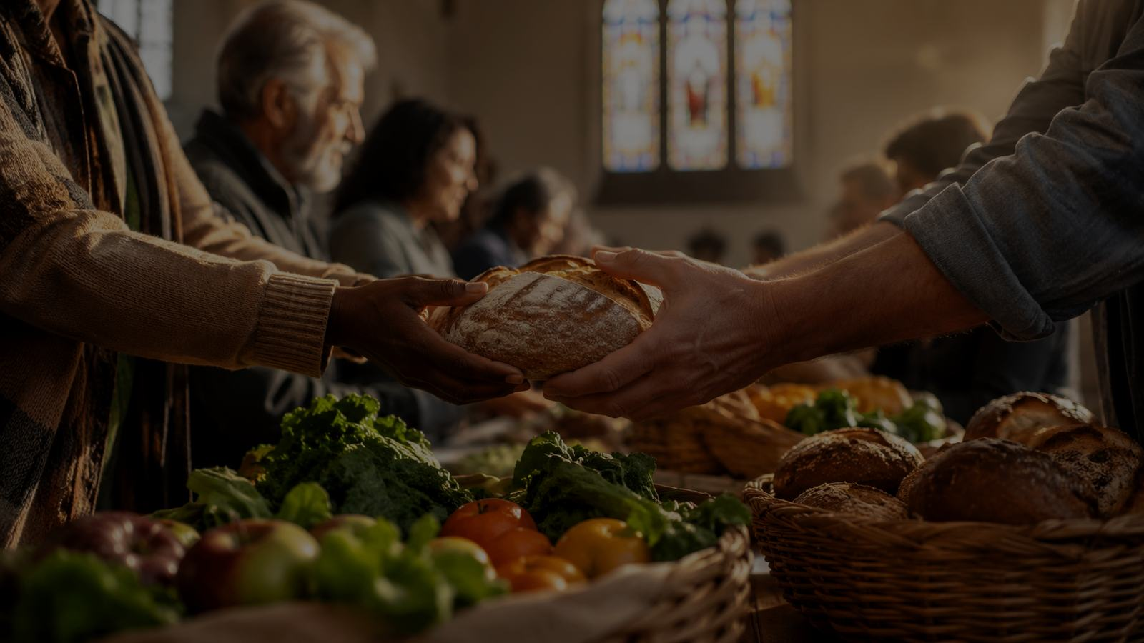
Thanksgiving Becomes Justice
The table of gratitude becomes a table of responsibility.
Prepared for teaching and small group use - hymninfo.com

Slide 14
Teaching Questions
For Sunday school, choir rehearsal, or worship planning
What gifts of creation do we receive without noticing?
How does Psalm 65 help us worship the Giver, not merely enjoy the gifts?
Where does gratitude need to become generosity in our congregation?
What forms of hunger or despair are near enough for us to address?
How can this hymn shape a stewardship emphasis without sounding merely financial?
Prepared for teaching and small group use - hymninfo.com

Slide 15
Practice the Hymn This Week
Simple responses for individuals and congregations
Name gifts
Write down five ordinary provisions and thank God for each.
Share food
Give to a food pantry, community meal, or neighbor in need.
Examine habits
Ask whether your buying, working, and consuming honor God and neighbor.
Pray Psalm 65
Let creation’s abundance become language for worship.
Serve quietly
Choose one act of mercy that does not seek attention.
Prepared for teaching and small group use - hymninfo.com

Slide 16
Suggested Lesson Flow
Two ways to teach the hymn
30-Minute Plan
1. Read Psalm 65:9-13.
2. Introduce Green and the hymn’s harvest setting.
3. Walk through the three hymn movements.
4. Discuss one question: Where should thanksgiving become action?
5. Close with prayer for generosity.
60-Minute Plan
1. Open with Genesis 1 or Psalm 65.
2. Teach the historical setting.
3. Compare Psalm 65, 2 Corinthians 9, and Matthew 25.
4. Discuss stewardship, hunger, and labor.
5. Plan one concrete congregational response.
6. Sing or pray the hymn themes.
Prepared for teaching and small group use - hymninfo.com

Slide 17
Closing Summary and Prayer
Receive. Give thanks. Share.
This hymn teaches the church to receive creation’s gifts with wonder, to give thanks with sincerity, and to answer God’s generosity with mercy and justice.
Prayer: Lord of the harvest, teach us to receive your gifts with humble gratitude. Make our thanksgiving generous, our stewardship faithful, and our service a witness to your love in Jesus Christ. Amen.
Prepared for teaching and small group use - hymninfo.com

Slide 18
For the Fruits of This Creation
May gratitude become worship, and worship become faithful love.
© HymnInfo.com. Free for personal, church, classroom, and small-group teaching use. Please do not sell, repost, or redistribute as downloadable files without permission.
Prepared for teaching and small group use - hymninfo.com

