Slide 1

Blessed Assurance
First line: “Blessed assurance, Jesus is mine”
Fanny J. Crosby, 1873 • Tune: ASSURANCE by Phoebe P. Knapp
Primary text: Hebrews 10:19–23
Prepared for teaching and small group use - hymninfo.com

Slide 2

Teaching Aim
1
2
3
Understand
Feel
Practice
Understand assurance as confidence rooted in Christ’s finished work, not spiritual self-confidence.
Feel the joy of belonging to Jesus and being sealed by the Holy Spirit.
Practice praise, testimony, and steady hope when doubts or trials come.
Prepared for teaching and small group use - hymninfo.com

Slide 3

Hymn Identity
Title: Blessed Assurance
Author: Fanny Jane Crosby
Composer: Phoebe Palmer Knapp
Year: 1873
Tune: ASSURANCE
Themes: assurance, testimony, Spirit, joy, heavenly hope
Prepared for teaching and small group use - hymninfo.com

Slide 4
Historical Background
A gospel hymn born from friendship, melody, and testimony.
Prepared for teaching and small group use - hymninfo.com

Slide 5

Crosby, Knapp, and Gospel Song
Fanny Crosby’s hymns often unite biblical confidence with personal testimony.
Phoebe Knapp’s melody carries the buoyant shape of nineteenth-century gospel song.
The hymn entered revival and church use because it gives simple, singable language to deep assurance.
Prepared for teaching and small group use - hymninfo.com

Slide 6
Biblical Foundation
Draw near. Hold fast. He who promised is faithful.
Prepared for teaching and small group use - hymninfo.com

Slide 7

Scripture That Grounds Assurance
Hebrews 10:19–23 — bold access to God through Jesus’ blood and priesthood.
Romans 8:15–17 — the Spirit bears witness that believers are God’s children.
Ephesians 1:13–14 — the Spirit is the pledge of our inheritance.
1 Peter 1:3–5 — a living hope guarded by God’s power.
Revelation 21:1–4 — assurance looks forward to God dwelling with his people.
Prepared for teaching and small group use - hymninfo.com

Slide 8
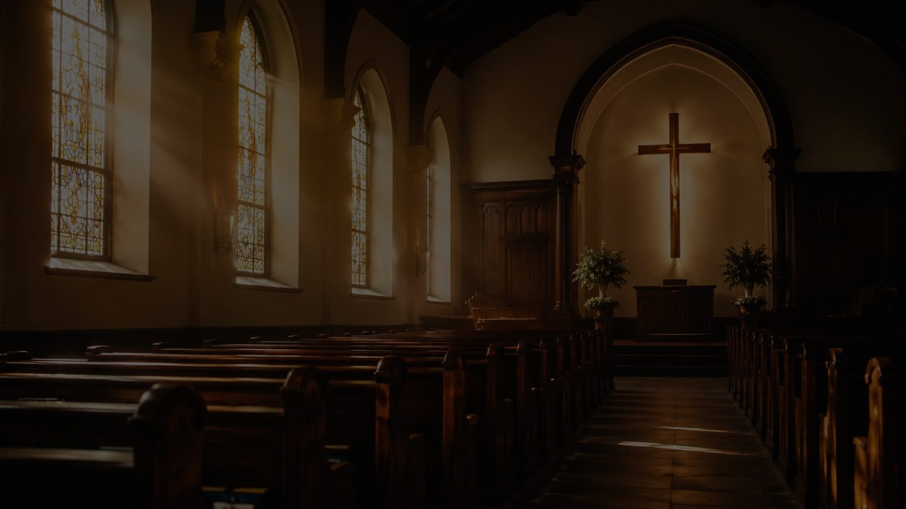
Why This Hymn Matters Today
It gives anxious believers a gospel-shaped confidence.
It teaches praise as testimony: the saved life has a story and a song.
It joins present rest with future glory.
It keeps assurance tied to Christ, Scripture, and the Spirit’s witness.
Prepared for teaching and small group use - hymninfo.com

Slide 9

Stanza 1: Belonging to Christ
The hymn begins with personal assurance: the believer belongs to Jesus.
Salvation is described as inheritance, redemption, new birth by the Spirit, and cleansing through Christ.
Teaching emphasis: assurance begins with what God has done, not with how strongly we feel.
Prepared for teaching and small group use - hymninfo.com

Slide 10
Refrain: A Story and a Song
The refrain turns doctrine into testimony.
Praise becomes the repeated rhythm of a life held by Christ.
A congregation singing together learns to confess the gospel with joy.
Prepared for teaching and small group use - hymninfo.com

Slide 11
Stanza 2: Surrender and Delight
The second movement links assurance with surrender.
The believer’s delight is not escape from obedience, but joy within yielded trust.
Images of mercy and love point to God’s nearness and the Spirit’s comfort.
Prepared for teaching and small group use - hymninfo.com

Slide 12

Stanza 3: Rest, Waiting, and Hope
The final movement is calm rather than frantic.
Assurance produces watchful patience: resting in Christ while looking above.
The hymn ends with love, goodness, and the hope of glory.
Prepared for teaching and small group use - hymninfo.com

Slide 13
Theological Themes
1
2
3
Assurance
Adoption
Spirit’s Witness
4
5
6
Testimony
Sanctification
Heavenly Hope
Prepared for teaching and small group use - hymninfo.com

Slide 14
Literary and Musical Observations
Gospel-song form: stanzas build toward a repeated refrain.
The tune is accessible, warm, and shaped for congregational confidence.
The language moves from assurance to surrender to expectant rest.
A moderate tempo keeps the hymn joyful without becoming rushed.
Prepared for teaching and small group use - hymninfo.com

Slide 15
Pastoral and Worship Use
Use in services on salvation, baptism, testimony, confirmation, and Christian hope.
Useful after sermons on Romans 8, Hebrews 10, or the Spirit’s witness.
Choirs can help the congregation sing the refrain as joyful testimony.
Pastorally, it speaks to doubting, weary, joyful, and hopeful believers.
Prepared for teaching and small group use - hymninfo.com

Slide 16

Teaching Questions
What makes assurance Christian rather than merely optimistic?
How does Romans 8 explain the Spirit’s witness in the believer?
How does the refrain turn personal faith into public testimony?
Why does true assurance lead to praise and obedience?
Where do anxious believers need to hear “he who promised is faithful”?
Prepared for teaching and small group use - hymninfo.com

Slide 17
Practice Assurance This Week
Read Hebrews 10:19–23 and pray it back to God.
Write a three-sentence testimony of Christ’s faithfulness.
When doubt rises, answer it with a promise of Scripture.
Encourage one believer with the hope of Romans 8.
Prepared for teaching and small group use - hymninfo.com

Slide 18
Suggested Lesson Flow
30 minutes
Read Hebrews 10:19–23
Teach hymn background
Discuss assurance and testimony
Close with prayer
60 minutes
Add Romans 8:15–17
Study each hymn movement
Sing or listen together
Invite written testimonies
Pray for doubting believers
Prepared for teaching and small group use - hymninfo.com

Slide 19
Closing Summary and Prayer
Blessed Assurance teaches believers to rest in Christ, rejoice in the Spirit’s witness, and live with a story of grace.
Lord Jesus, steady our hearts in your finished work. Let our confidence become worship, our testimony become encouragement, and our hope remain fixed on you. Amen.
Prepared for teaching and small group use - hymninfo.com

Slide 20
For Teaching Use
© HymnInfo.com. Free for personal, church, classroom, and small-group teaching use. Please do not sell, repost, or redistribute as downloadable files without permission.
Prepared for teaching and small group use - hymninfo.com

