Slide 1

A Mighty Fortress Is Our God
First line: A mighty fortress is our God
Martin Luther • translated by Frederic Henry Hedge
Tune: EIN FESTE BURG • first known in print by 1529
Primary Scripture: Psalm 46:1
Prepared for teaching and small group use - hymninfo.com
01

Slide 2

AIM
Teaching Aim
• Understand how Psalm 46 shapes the hymn's language of refuge, strength, and courage.
• Feel the sober confidence of the church standing in God rather than in itself.
• Practice answering fear and spiritual conflict with trust in Christ and his enduring Word.
Prepared for teaching and small group use - hymninfo.com
02

Slide 3
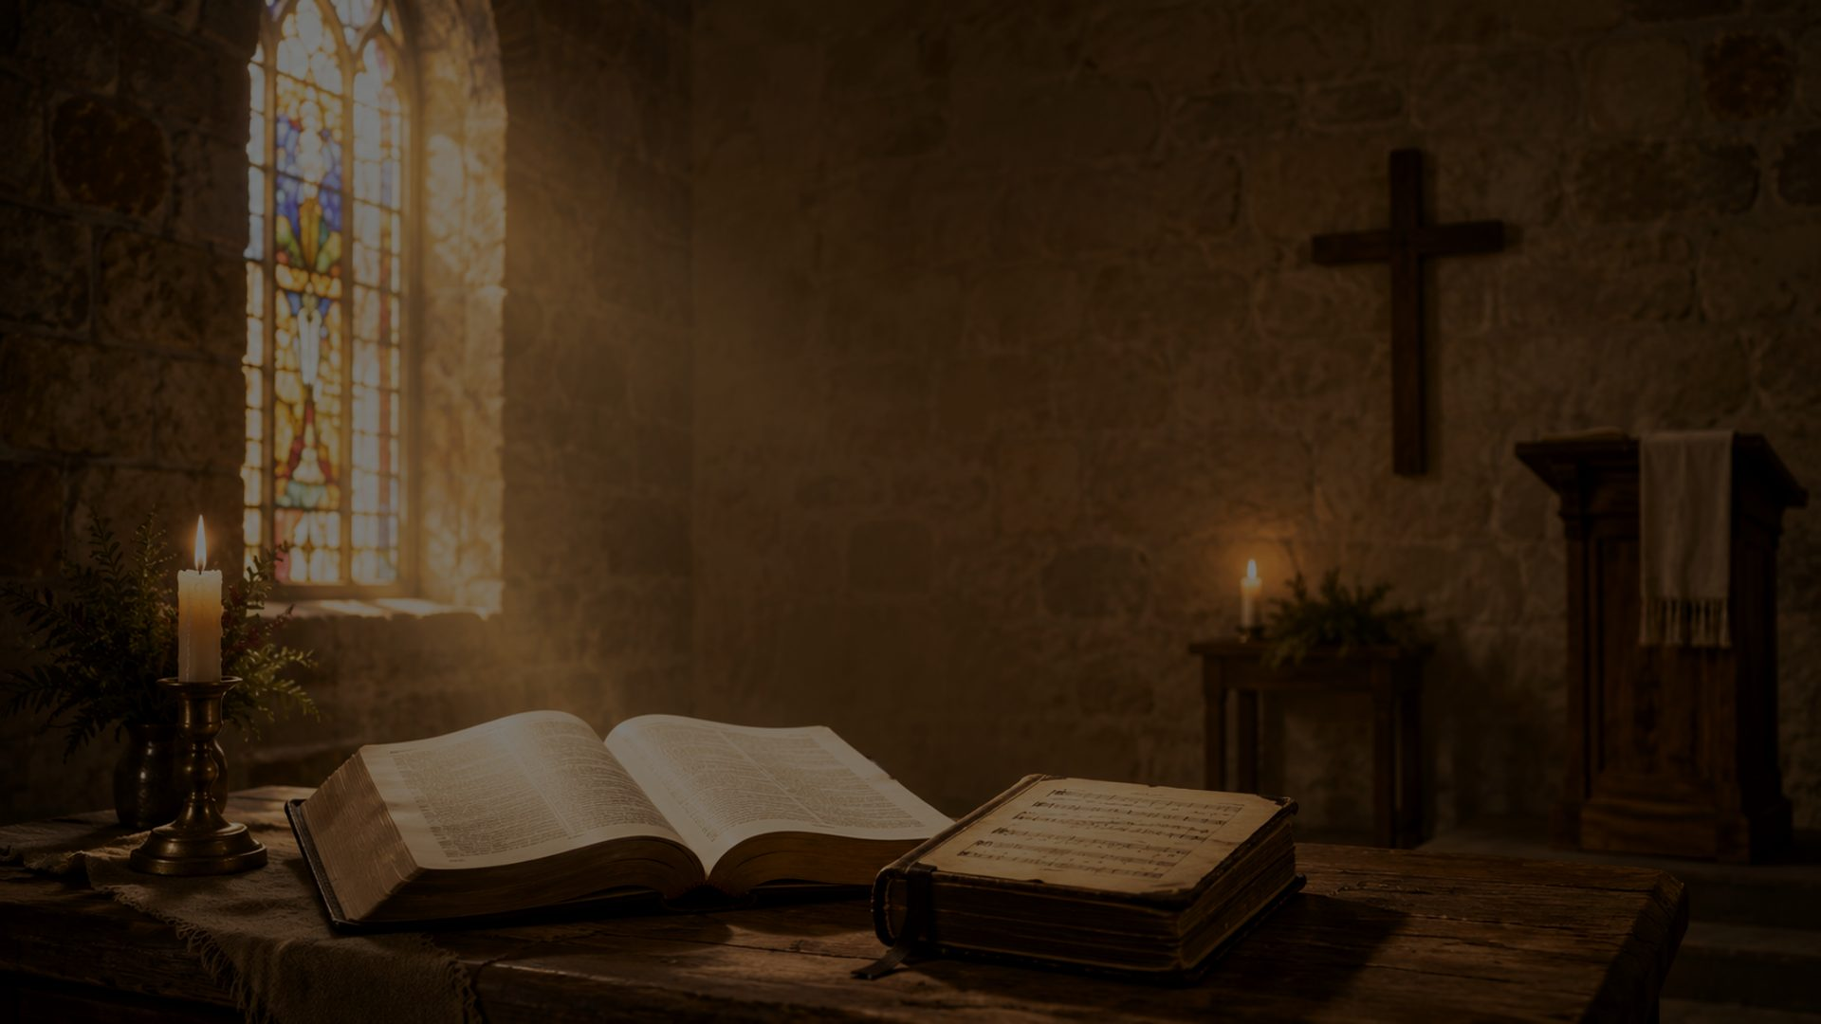
HYMN IDENTITY
Hymn Identity
Essential details
Worship setting
• Title: A Mighty Fortress Is Our God
• German title: Ein feste Burg ist unser Gott
• Author and tune: Martin Luther
• English translation: Frederic Henry Hedge
• Tune: EIN FESTE BURG
• Meter: 8.7.8.7.6.6.6.6.7
• Biblical foundation: Psalm 46
• First known in print by 1529
• Associated with Reformation worship
• Used widely across Protestant traditions
• Best sung with strength, clarity, and reverent confidence
Prepared for teaching and small group use - hymninfo.com
03

Slide 4
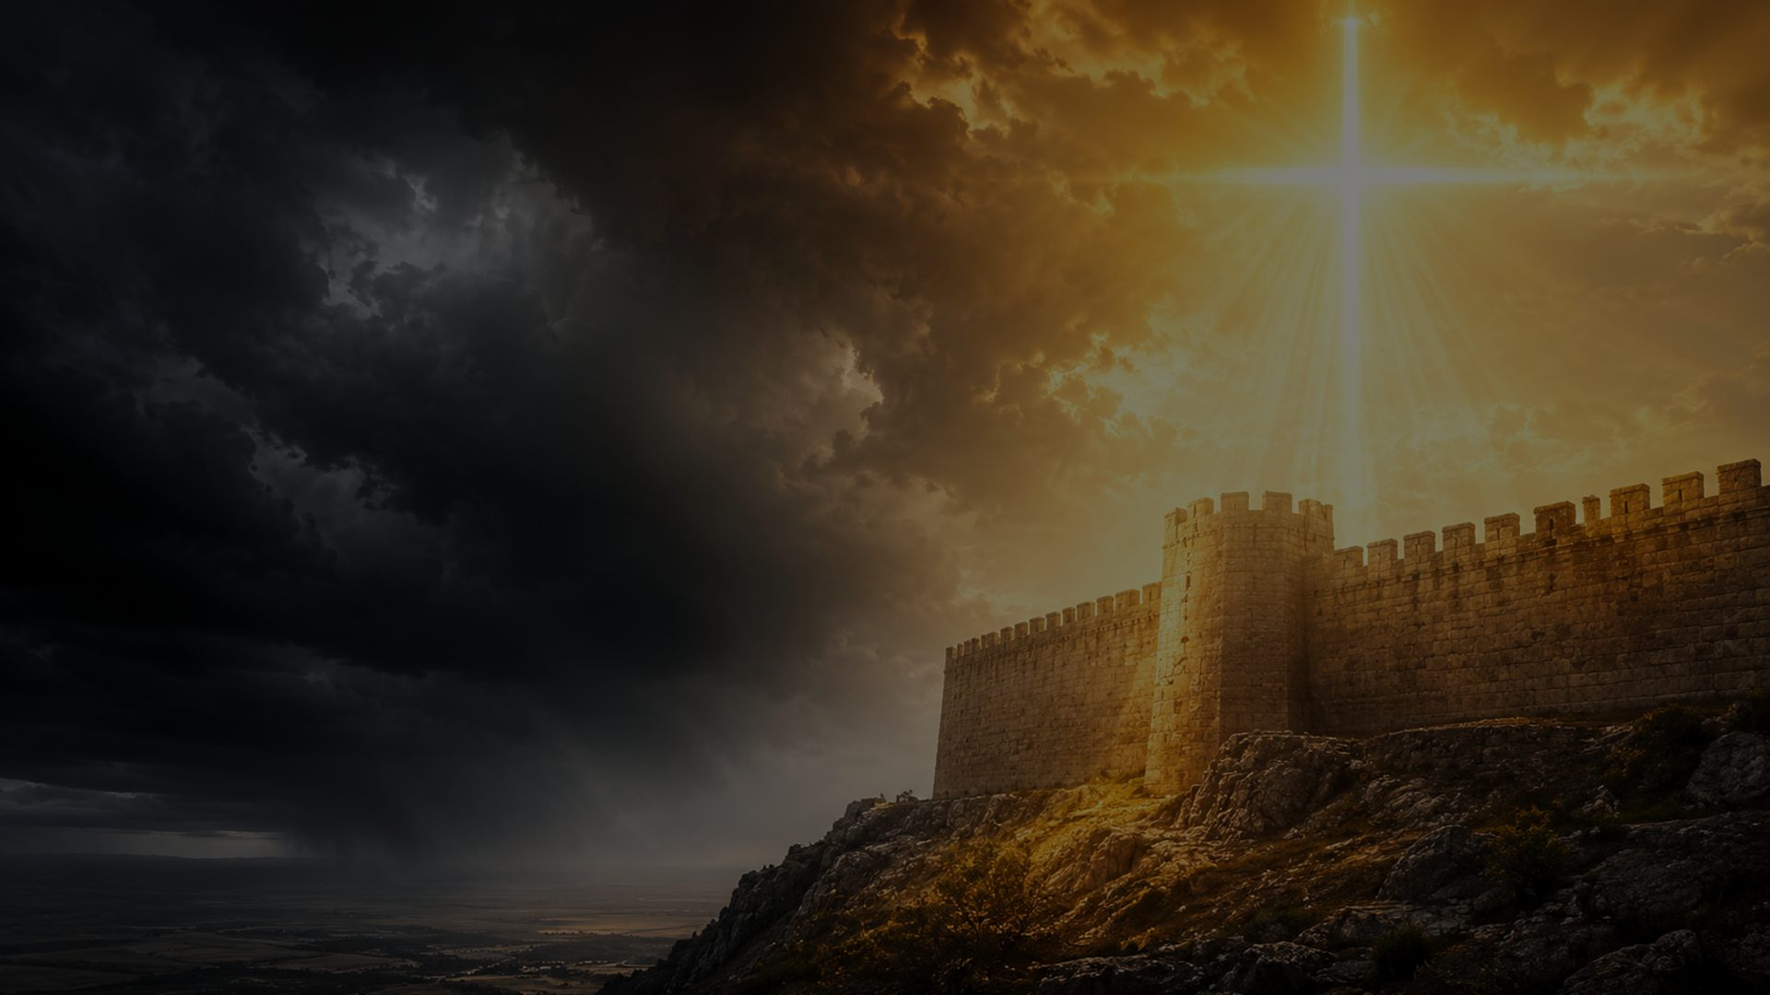
HISTORY
Historical Background
• Martin Luther wrote the German hymn Ein feste Burg ist unser Gott, and the hymn appeared in print by 1529.
• The hymn is chiefly connected with Psalm 46 and with the turbulent years of the early Reformation.
• The exact occasion of composition is not firmly documented, so teaching should avoid attaching it to one unverified event.
• Luther valued congregational song as a way to teach Scripture, strengthen faith, and give the church a shared voice.
Prepared for teaching and small group use - hymninfo.com
04

Slide 5
HISTORY
A Reformation Chorale
• The hymn helped establish congregational singing as a force for biblical teaching and corporate courage.
• Its strong melody carries doctrine in a form ordinary worshipers can remember and sing together.
• Frederic Henry Hedge's translation became one of the most influential English versions.
• The hymn still speaks because every age knows fear, conflict, weakness, and the need for a stronger refuge.
Prepared for teaching and small group use - hymninfo.com
05

Slide 6
PASTORAL VALUE
Why This Hymn Matters Today
• It gives anxious believers a biblical confession: God is present help in trouble.
• It teaches the church to stand in Christ rather than in personal strength or cultural confidence.
• It names spiritual conflict honestly without allowing fear to become the final word.
• It lifts worshipers from present turmoil toward the enduring kingdom of God.
Prepared for teaching and small group use - hymninfo.com
06

Slide 7
BIBLICAL FOUNDATION
Psalm 46: God Our Refuge
God is our refuge and strength, a very present help in trouble.
• Psalm 46 does not deny shaking earth, roaring waters, nations in turmoil, or human fear.
• It answers upheaval with the Lord's presence, strength, and reign.
Psalm 46:1
Prepared for teaching and small group use - hymninfo.com
07

Slide 8
SCRIPTURE
Supporting Scriptures
• Psalm 46:7 - The Lord of Armies is with us; the God of Jacob is our refuge.
• Ephesians 6:10-11 - Be strong in the Lord and stand against the works of evil.
• Romans 8:31 - If God is for us, who can be against us?
• John 16:33 - Christ has overcome the world.
• 2 Thessalonians 3:3 - The Lord is faithful and guards his people.
Prepared for teaching and small group use - hymninfo.com
08

Slide 9
STANZA STUDY
Stanza Study 1: Refuge
• The opening movement declares God as the church's secure refuge and defender.
• The teaching emphasis is not the absence of danger but the presence and strength of God.
• In worship, this stanza helps believers begin with God's character before describing the crisis.
• Scripture connection: Psalm 46:1 and Psalm 46:7.
Prepared for teaching and small group use - hymninfo.com
09

Slide 10
STANZA STUDY
Stanza Study 2: Conflict and Weakness
• The hymn acknowledges real spiritual opposition and human weakness.
• Its confidence is not self-confidence. It is reliance on the Lord who equips, guards, and sustains.
• Teaching emphasis: weakness is not denied; it is brought beneath the strength of God.
• Scripture connection: Ephesians 6:10-11 and 2 Thessalonians 3:3.
Prepared for teaching and small group use - hymninfo.com
10

Slide 11
STANZA STUDY
Stanza Study 3: Christ Our Champion
• The hymn directs worshipers to the one who fights for the people of God.
• Christian courage rests in Christ's victory, not in visible strength, numbers, or influence.
• Teaching emphasis: the church stands because Christ has overcome the world.
• Scripture connection: John 16:33 and Romans 8:31.
Prepared for teaching and small group use - hymninfo.com
11

Slide 12
STANZA STUDY
Stanza Study 4: The Enduring Kingdom
• The final movement does not minimize loss, suffering, or opposition.
• It places every earthly threat beneath the lasting reign of God and the reliability of his Word.
• Teaching emphasis: believers may lose much, but the kingdom of God cannot be taken away.
• Scripture connection: Psalm 46:10-11 and Romans 8:31.
Prepared for teaching and small group use - hymninfo.com
12

Slide 13
THEOLOGY
Theological Themes
Core doctrines
Pastoral emphases
• God as refuge and strength
• Divine sovereignty amid turmoil
• Christ's victory over evil
• The authority and endurance of God's Word
• The kingdom that outlasts earthly loss
• Courage without denial
• Faith during fear
• Dependence rather than self-reliance
• Hope during upheaval
• Corporate singing as mutual encouragement
Prepared for teaching and small group use - hymninfo.com
13

Slide 14
THEME FOCUS
Divine Refuge Is Personal
• The hymn is not merely about a safe idea; it is about the living God who is with his people.
• Psalm 46 joins refuge and presence: the Lord of Armies is with us.
• Teaching emphasis: biblical comfort is more than escape. It is God himself drawing near in trouble.
Prepared for teaching and small group use - hymninfo.com
14

Slide 15
THEME FOCUS
Spiritual Warfare with Confidence
• The hymn takes evil seriously, but it does not make evil ultimate.
• Believers are called to stand in the Lord and in the strength of his might.
• This is a needed corrective to both panic and pride: the battle is real, and Christ is greater.
Prepared for teaching and small group use - hymninfo.com
15

Slide 16
THEME FOCUS
The Word and the Kingdom Endure
• The hymn moves from conflict to confidence because God's truth does not collapse when circumstances shake.
• The church can lose earthly security and still belong to the kingdom that cannot be taken away.
• Teaching emphasis: Christian hope is anchored in God's reign, not in favorable conditions.
Prepared for teaching and small group use - hymninfo.com
16

Slide 17
FORM
Literary Observations
• The hymn uses strong images: fortress, shield, weapon, battle, enemy, and kingdom.
• The movement of thought is from refuge, to conflict, to Christ's victory, to final confidence.
• The emotional tone is sober, bold, and corporate rather than sentimental.
• The hymn functions as proclamation: the church sings what it needs to remember.
Prepared for teaching and small group use - hymninfo.com
17

Slide 18
MUSIC
Musical Observations
• EIN FESTE BURG is the chorale associated with Luther's German text.
• The tune has appeared in vigorous rhythmic forms and later regularized hymnbook forms.
• Its strong melodic profile supports corporate singing with clarity and courage.
• For worship, sing with strength rather than haste. Let the words proclaim.
Prepared for teaching and small group use - hymninfo.com
18

Slide 19
WORSHIP USE
Pastoral and Worship Use
• Reformation Sunday and services focused on Scripture, courage, or Christ's victory.
• Times of congregational uncertainty, discouragement, opposition, or grief.
• Teaching on Psalm 46, spiritual warfare, or the endurance of God's kingdom.
• Choir or congregational settings where strong text clarity will serve the message.
Prepared for teaching and small group use - hymninfo.com
19

Slide 20
WORSHIP USE
Choir and Congregational Leadership
• Teach the congregation to sing the hymn as shared confession rather than performance.
• Use a steady tempo that allows weight, clarity, and strength.
• Emphasize the corporate voice: this is the church declaring confidence together.
• Let the final stanza land as hope, not mere volume.
Prepared for teaching and small group use - hymninfo.com
20

Slide 21
DISCUSSION
Teaching Questions
• How does Psalm 46 shape the central images of this hymn?
• What does the hymn teach about human weakness and divine strength?
• Why is spiritual warfare presented with confidence rather than fear?
• How does the hymn reflect the worship concerns of the Reformation?
• How can a church sing this hymn faithfully in times of uncertainty or discouragement?
Prepared for teaching and small group use - hymninfo.com
21

Slide 22
APPLICATION
Application
• Name the storm honestly, but do not give it final authority.
• Pray Psalm 46 when fear makes God seem distant.
• Stand in the strength of Christ, not in personal control.
• Encourage the church with promises that are stronger than circumstances.
• Let worship train the heart to trust the God who reigns.
Prepared for teaching and small group use - hymninfo.com
22

Slide 23
LESSON PLANNING
Suggested Lesson Flow
30-minute plan
60-minute plan
• 5 min - Read Psalm 46 aloud
• 7 min - Hymn identity and Reformation context
• 10 min - Stanza movements and Scripture connections
• 5 min - Group discussion
• 3 min - Closing prayer
• 10 min - Psalm 46 and historical setting
• 20 min - Stanza-by-stanza teaching
• 10 min - Musical and worship observations
• 15 min - Discussion and application
• 5 min - Prayer and singing
Prepared for teaching and small group use - hymninfo.com
23

Slide 24
CLOSING
Closing Summary and Prayer
God is our refuge. Christ is our champion. His Word stands. His kingdom endures. Therefore the church may sing with courage even when the world shakes.
Lord God, our refuge and strength, teach us to stand in Christ. Guard your church from fear, strengthen weak hearts, and keep our hope fixed on your enduring kingdom. Amen.
© HymnInfo.com. Free for personal, church, classroom, and small-group teaching use. Please do not sell, repost, or redistribute as downloadable files without permission.
Prepared for teaching and small group use - hymninfo.com
24

