Slide 1

Happy the Home
When God Is There
A hymn study on household discipleship, prayer, Scripture, love, and peace in Christ.
Teaching Guide
HymnInfo.com

Slide 2
Teaching Aim
Help learners receive the hymn as a prayer for Christ-centered homes and church family.
1
2
3
Understand
Feel
Practice
God builds the home through his presence and Word.
A pastoral longing for peace, belonging, and healing.
Simple household rhythms of prayer, Scripture, and love.
By the end, participants should be able to teach the hymn responsibly, connect it to Scripture, and apply it tenderly to many kinds of homes and families.

Slide 3

Hymn Identity
A compact hymn of family worship and household grace.
Text
Tune
Widely associated with Henry Ware Jr.
Earliest secure printing: 1846
ST. AGNES by John Bacchus Dykes
Common Meter, 8.6.8.6
First Line
Use
“Happy the home when God is there”
A vision of grace-shaped domestic faith.
Christian home, family worship, marriage and family, child dedication, pastoral care.
Teach the attribution with care: the hymn is widely linked to Ware, while the earliest secure publication appeared after his death.

Slide 4
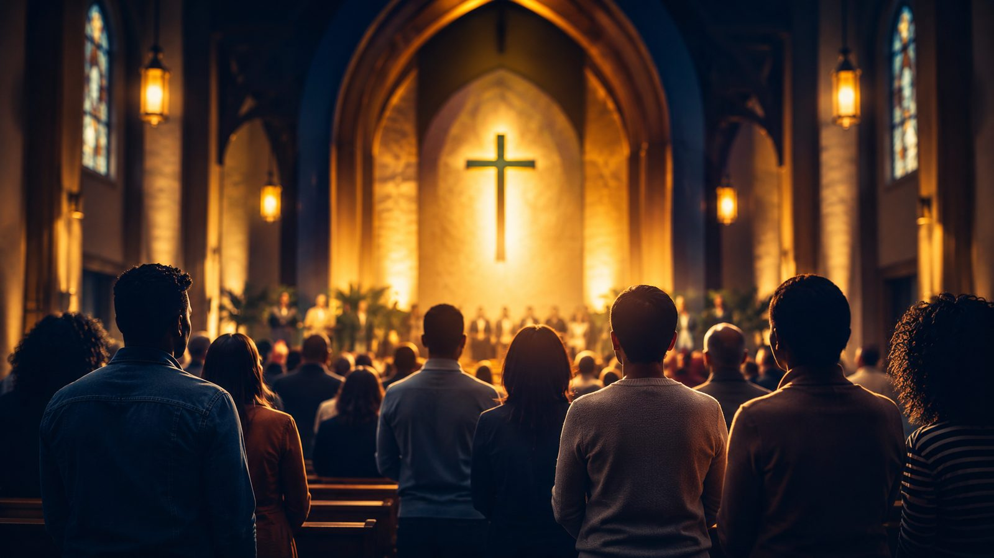
SECTION ONE
The Christian Home as Prayerful Vision
“Unless Yahweh builds the house…” - Psalm 127:1

Slide 5

Historical Background
Handle the hymn’s origin with clarity and modesty.
Earliest Secure Printing
Family Worship Context
The hymn appeared in an 1846 collection for infants, juvenile schools, and families, under the title “The Happy Home.”
The hymn belongs naturally to home devotion, Christian education, marriage and family, and pastoral teaching.
Common Attribution
Pastoral Use
Many hymnals associate the text with Henry Ware Jr.; the first known signature leaves room for caution.
Present it as a vision of grace and healing, not as a test of whether a family measures up.

Slide 6
Biblical Foundation
Psalm 127:1
Joshua 24:15
The Lord must build the house; blessing begins in dependence, not control.
A household’s life is shaped by the one it chooses to serve.
Deuteronomy 6:6-7
Psalm 128:1-4
Faith is spoken and practiced in ordinary household rhythms.
Reverence for the Lord orders the home toward blessing and peace.
Colossians 3:16-17
1 Corinthians 13:4-7
Scripture, song, gratitude, and daily action belong under Christ.
Love in the home is patient, truthful, humble, and enduring.

Slide 7
Stanza 1: God at the Center
A happy home is not a flawless home; it is a home being built by God.
Key Teaching
The hymn begins by placing God’s presence before every other mark of household blessing.
GOD
Scripture Connection
Psalm 127:1 teaches that human effort is vain unless the Lord builds and guards.
Pastoral Question
What would change if our homes were built first on dependence rather than control?

Slide 8
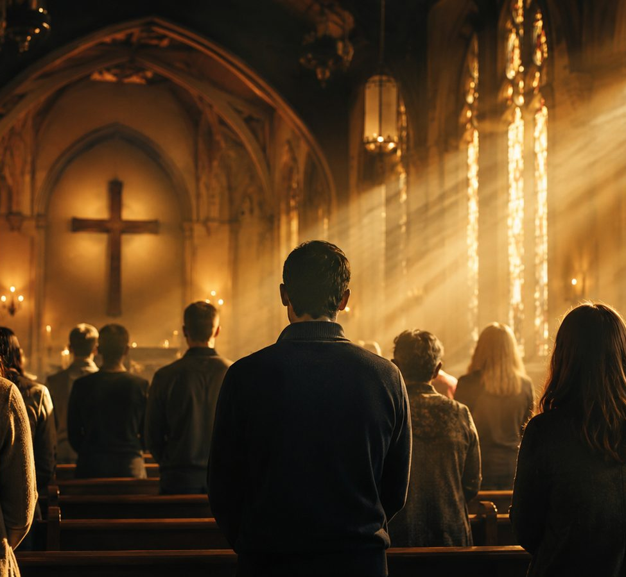
Stanza 2: The Name of Jesus in the Home
Faith is learned through affection, repetition, and example.
The hymn imagines a household where the name of Jesus is honored across generations.
Children are formed by what is loved, not only by what is explained.
Parents and elders teach by speech, prayer, repentance, and example.
Deuteronomy 6 makes faith part of ordinary daily conversation.
Teaching caution: avoid pressuring families to perform; point them toward small, honest faithfulness.

Slide 9
Stanza 3: Prayer, Praise, and the Word
The home becomes a small school of worship.
Prayer Is Heard
Simple prayers give ordinary rooms a sacred rhythm.
Praise Rises
Song and thanksgiving train the household to notice God’s mercy.
Scripture Is Prized
The Word of Christ dwells richly when it shapes speech, choices, and forgiveness.
Colossians 3:16-17 joins Scripture, song, gratitude, and everyday action under the name of the Lord Jesus.

Slide 10
Stanza 4: United Hearts
The hymn ends as prayer: Lord, unite our love for you and our love for others.
Love for God
Love toward all
Christian peace is not merely calm; it is hearts turned together toward God and then toward neighbor.

Slide 11
SECTION TWO
Household Discipleship
Faith is practiced where life is actually lived.

Slide 12
Theological Themes
The hymn’s theology is quiet, practical, and deeply pastoral.
Presence
Love
Formation
The Lord makes the home truly blessed.
Hearts are joined in love for God and neighbor.
Children and adults are shaped through daily faith.
Prayer
Scripture
Church Family
Ordinary rooms become places of dependence.
The sacred Word trains wisdom and gratitude.
The household of faith welcomes those without family support.

Slide 13
Literary and Musical Notes
A gentle common-meter hymn suited to prayerful teaching.
Meter
Common Meter, 8.6.8.6
Tune
ST. AGNES by John Bacchus Dykes is a common setting.
Do not rush the hymn. Let the tune sound like a household prayer rather than a performance.
Musical Character
Gentle, balanced, devotional, and suitable for congregational singing.

Slide 14
Pastoral and Worship Use
Use the hymn tenderly, especially where family language carries pain.
Good Settings
Marriage and family services, child dedication, Christian education, household prayer, pastoral care.
Pastoral Care
Make room for singles, widows, childless couples, blended families, estranged children, and wounded households.
Church Family
Broaden the application: the church is a household of faith where the lonely are welcomed.
The hymn should become a prayer for grace, healing, and faithful habits—not a sentimental picture that ignores suffering.

Slide 15
Lesson Flow
A simple teaching path for Sunday school, choir rehearsal, or small group.
1
2
3
4
5
Name the Vision
Read Scripture
Study the Hymn
Apply Pastorally
Pray and Practice
God-centered household grace
Psalm 127 and Deuteronomy 6
Presence, Jesus, prayer, Scripture, love
Homes, wounds, and church family
One faithful rhythm this week
Keep the lesson warm, Scripture-rooted, and honest about real family pain.

Slide 16
Practice and Application
Small rhythms can carry deep grace.
Pray Briefly
Attach prayer to a daily moment: waking, meals, travel, bedtime.
Read Simply
Choose one short passage and speak about one concrete response.
Love First Nearby
Practice patience and forgiveness with the people closest to you.
Welcome Widely
Let the church be family for someone who feels alone.

Slide 17
Closing Summary and Prayer
The hymn asks God to build homes and church family through his presence, Word, prayer, and love.
Lord, build what our strength cannot build. Let the name of Jesus be loved among us, let Scripture dwell richly, and let your peace rule our homes and your church. Amen.
© HymnInfo.com. Free for personal, church, classroom, and small-group teaching use. Please do not sell, repost, or redistribute as downloadable files without permission.

