Slide 1

How Great Thou Art
A hymn study in creation, redemption, and hope
First line: O Lord my God when I in awesome wonder
Author: Carl Boberg | English adapter: Stuart K. Hine
Tune: HOW GREAT THOU ART / O STORE GUD
Primary Scripture: Psalm 19:1-4
Teaching Guide
Prepared for teaching and small group use - hymninfo.com

Slide 2
Teaching Aim
What this lesson should form in the learner
Understand
Feel
Practice
The hymn moves from wonder at creation to worship at the cross and hope in Christ's return.
Reverent awe: God is great not only in power, but in mercy and covenant love.
Turn observation, memory, and expectation into personal and congregational praise.
Prepared for teaching and small group use - hymninfo.com

Slide 3
Hymn Identity
Key hymnological information for teachers and leaders
• Title: How Great Thou Art
• Alternative title: O Store Gud
• First line: O Lord my God when I in awesome wonder
• Original author: Carl Boberg, Swedish Lutheran poet
• English adapter: Stuart K. Hine, British missionary and hymn writer
• Tune: HOW GREAT THOU ART / O STORE GUD
• Melody: rooted in a Swedish folk tune
• Meter: 11.10.11.10 with refrain
• Original poem: 1885; early publication in 1886
• Common English use grew widely in the twentieth century
Prepared for teaching and small group use - hymninfo.com

Slide 4
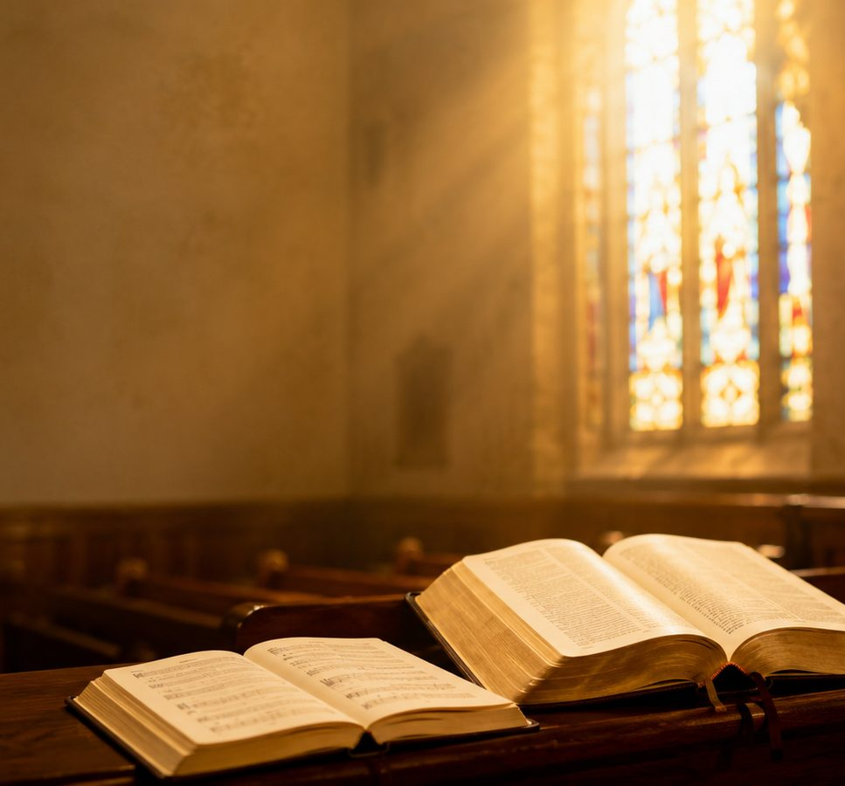
Historical Background
A hymn shaped across languages and mission contexts
• Carl Boberg wrote the Swedish poem O Store Gud in 1885 after reflecting on God's majesty in creation.
• The traditional account connects the poem with a sudden storm near Mönsterås, Sweden, followed by calm beauty.
• The hymn passed through later translation and adaptation before becoming widely sung in English.
• Stuart K. Hine's English version helped give the hymn its familiar evangelical form.
Prepared for teaching and small group use - hymninfo.com

Slide 5
Author and Adapter
Carl Boberg and Stuart K. Hine
Carl Boberg (1859-1940)
Stuart K. Hine (1899-1989)
• Swedish poet, editor, churchman, and public servant.
• His poem expressed awe before God's greatness as witnessed in creation.
• The original Swedish title, O Store Gud, means “O Great God.”
• British missionary, translator, and hymn writer.
• Encountered the hymn through Eastern European mission work.
• His English paraphrase and adaptation became the best-known English form.
Prepared for teaching and small group use - hymninfo.com

Slide 6
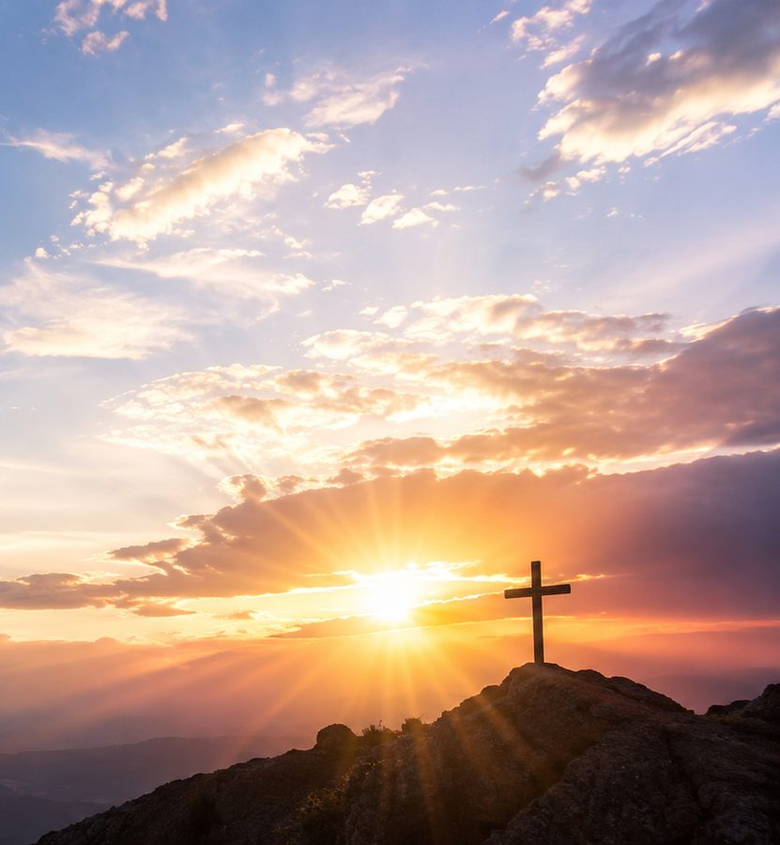
Why This Hymn Matters Today
A pastoral hymn for awe, gospel memory, and hope
• It teaches believers to read creation as a witness to the Creator.
• It moves beyond natural beauty to the love of God revealed in Christ.
• It gives a clear path from wonder to worship: behold, remember, hope, adore.
• Its refrain invites the whole congregation to answer theology with praise.
Prepared for teaching and small group use - hymninfo.com

Slide 7
Biblical Foundations
Creation, redemption, and consummation in Scripture
Prepared for teaching and small group use - hymninfo.com

Slide 8
Creation: The Heavens Declare
Psalm 19:1-4 and Psalm 8:1-9
Central claim
Teaching emphasis
Creation speaks before the believer sings. Mountains, stars, storms, and skies become teachers of divine majesty.
• Psalm 19 frames creation as testimony.
• Psalm 8 joins majesty with humility.
• The hymn helps worshipers receive wonder as a call to praise.
Prepared for teaching and small group use - hymninfo.com

Slide 9
Redemption: God Did Not Spare His Son
Romans 5:8; Romans 8:32; 1 Peter 2:24
• The hymn turns from God's power in creation to God's love at the cross.
• Romans 8:32 gives the language of divine generosity: God did not spare his own Son.
• 1 Peter 2:24 grounds praise in substitution, forgiveness, and restored life.
• The worshiper's awe deepens because greatness is now seen as self-giving grace.
Prepared for teaching and small group use - hymninfo.com

Slide 10
Hope: Christ Will Come
1 Thessalonians 4:16-17 and Revelation 15:3-4
The hymn ends with expectation.
Revelation's worship scene reminds the church that praise on earth anticipates the song of the redeemed before God.
• Christ's return gives worship an eternal horizon.
• The believer's future is not escape, but joyful presence with the Lord.
• Final adoration completes the hymn's movement.
Prepared for teaching and small group use - hymninfo.com

Slide 11
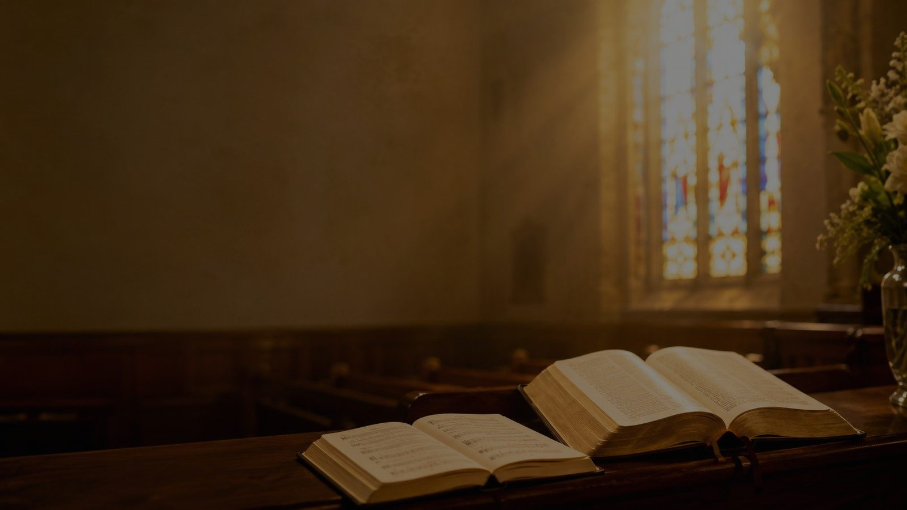
Stanza-by-Stanza Study
A guided movement from wonder to adoration
Prepared for teaching and small group use - hymninfo.com

Slide 12

Stanza 1: Wonder at Creation
Visible beauty becomes a summons to worship
• The singer stands in “awesome wonder” before the works of God's hand.
• The imagery moves from careful consideration to cosmic vastness and thunderous power.
• Scripture connection: Psalm 19 and Psalm 8 teach that creation declares God's majesty.
• Teaching emphasis: awe should become attention, gratitude, and praise.
Prepared for teaching and small group use - hymninfo.com

Slide 13
Additional Creation Imagery
Forest, birdsong, and ordinary beauty
Some hymnals preserve additional stanza material that expands the creation imagery through woods, forest glades, and birdsong. This deepens the hymn's invitation: God's greatness is not only seen in the vast sky and storm, but also heard in quiet, living details.
• Teaching emphasis: notice God's glory in both grandeur and quietness.
• Pastoral connection: people often meet awe in ordinary moments, not only dramatic ones.
• Scripture connection: creation continually “pours forth speech” without needing human words.
Prepared for teaching and small group use - hymninfo.com

Slide 14
Stanza 2: Wonder at the Cross
Divine greatness revealed as redeeming love
• The hymn turns from what God has made to what God has given.
• The cross evokes holy astonishment: the mind struggles to measure such mercy.
• Scripture connection: Romans 5:8; Romans 8:32; Colossians 1:15-20.
• Teaching emphasis: Christian praise is deepest when creation wonder is joined to gospel wonder.
Prepared for teaching and small group use - hymninfo.com

Slide 15
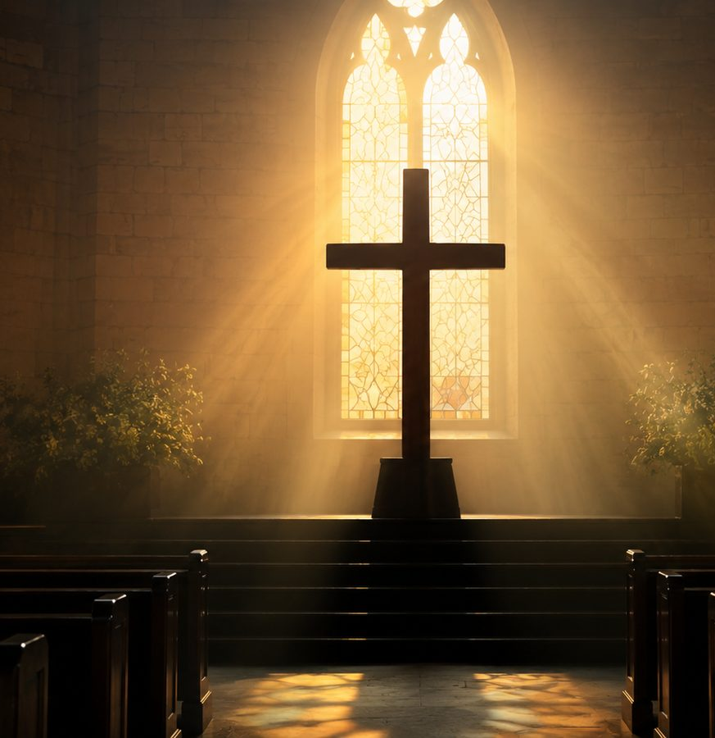
Stanza 3: Hope and Final Adoration
The return of Christ turns praise toward eternity
• The believer looks toward Christ's coming with joyful expectation.
• The promised future does not diminish present worship; it strengthens it.
• The final posture is humble adoration before God.
• Teaching emphasis: Christian hope is personal, embodied, and worshipful.
Prepared for teaching and small group use - hymninfo.com

Slide 16
Refrain Study
The congregation answers every theme with praise
The refrain functions like a repeated confession. After creation, cross, and future hope, the soul answers: God is great, and worship is the fitting response.
• Personal: praise rises from “my soul,” not only from the lips.
• Christ-centered: the address to the Savior keeps the hymn anchored in redemption.
• Congregational: repetition helps the whole church participate with confidence.
• Musical: the refrain expands emotionally, matching the breadth of the theology.
Prepared for teaching and small group use - hymninfo.com

Slide 17
Theological Themes
What the hymn teaches the church to confess
Creation
Redemption
Hope
• God is Creator
• Nature witnesses to divine majesty
• Awe begins with attention
• The cross reveals divine love
• Christ bears sin
• Grace turns wonder into gratitude
• Christ will return
• Joy will be complete
• Worship anticipates eternity
Prepared for teaching and small group use - hymninfo.com

Slide 18
Literary Observations
Movement, imagery, and tone
• Flow of thought: creation → cross → Christ's return → adoration.
• Imagery: stars, thunder, woods, birdsong, burden, cross, homecoming, humble worship.
• Tone: awe-struck, personal, reverent, confident, and doxological.
• Repeated refrain: gathers every stanza into a single act of praise.
• Pastoral insight: the hymn teaches believers how to move from experience to theology to worship.
Prepared for teaching and small group use - hymninfo.com

Slide 19
Musical Observations
Why the tune serves the text well
• The broad melodic shape supports expansive praise.
• The refrain provides a memorable emotional and theological climax.
• The meter is commonly given as 11.10.11.10 with refrain.
• The tune is accessible for congregational singing when led with steady tempo and clear phrasing.
• For choir: shape the verses gently and reserve full strength for the refrain.
• For congregation: allow a brief breath before the refrain so the response feels deliberate.
• For teaching: sing one stanza, study it, then sing it again with renewed understanding.
Prepared for teaching and small group use - hymninfo.com

Slide 20
Pastoral and Worship Use
Where the hymn fits in church life
• Opening praise when the service emphasizes God's majesty.
• After a Scripture reading from Psalm 19, Psalm 8, Romans 8, or Revelation 15.
• Before or after a sermon on creation, the cross, assurance, or Christ's return.
• In funerals and memorial services where Christian hope needs a clear voice.
• In choir rehearsal as a lesson in restrained verses and full congregational refrain.
• In small groups when connecting daily experience to worship.
Prepared for teaching and small group use - hymninfo.com

Slide 21
Teaching Questions
Discussion prompts for class or choir rehearsal
• What parts of creation most often stir awe in you, and why?
• How does the hymn move from natural wonder to gospel worship?
• Why does the cross deepen our understanding of God's greatness?
• How does hope in Christ's return reshape suffering, grief, or anxiety?
• What happens when a congregation sings the refrain with understanding?
• How might this hymn help someone whose faith feels dry or distracted?
Prepared for teaching and small group use - hymninfo.com

Slide 22
Application: Practice Awe This Week
From singing to spiritual formation
• Take a quiet walk and name three gifts in creation that point you to God.
• Read Psalm 19 aloud and turn each line into prayer.
• Thank Christ specifically for bearing sin and giving hope.
• Encourage one weary believer with a reminder of God's greatness and nearness.
• Sing the refrain slowly as a personal act of worship.
Prepared for teaching and small group use - hymninfo.com

Slide 23
Suggested Lesson Flow
Flexible plans for 30 or 60 minutes
30-Minute Plan
60-Minute Plan
• 5 min - read Psalm 19:1-4 and introduce the hymn
• 8 min - historical background and hymn identity
• 10 min - creation, cross, and hope movement
• 5 min - discussion and application
• 2 min - closing prayer
• 10 min - opening reflection and Scripture
• 10 min - background and musical notes
• 20 min - stanza-by-stanza study
• 10 min - discussion questions
• 7 min - worship-use planning
• 3 min - closing prayer
Prepared for teaching and small group use - hymninfo.com

Slide 24
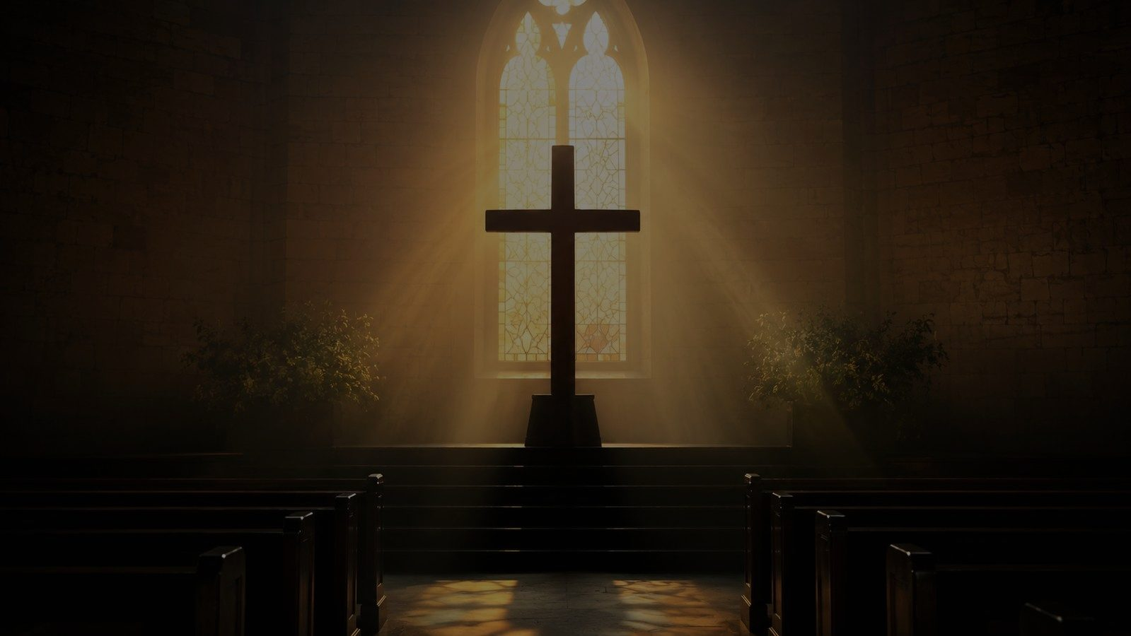
Closing Summary and Prayer
Behold the Creator. Remember the cross. Await the King. Sing with the soul.
Suggested prayer: Lord God, open our eyes to your glory in creation, our hearts to your mercy in Christ, and our lives to faithful hope until the day we worship before you with unclouded joy. Amen.
Prepared for teaching and small group use - hymninfo.com

