Slide 1

HYMN TEACHING GUIDE
Here I Am, Lord
Divine compassion, vocation, and the worshiper’s humble response
Daniel L. Schutte • 1979 • Published 1981
HymnInfo.com | Here I Am, Lord
01
Notes:
Open by inviting the class to listen for the two voices in the hymn: God calls; the congregation responds.

Slide 2
The heart of the hymn
A sung dialogue of call and response
1
God hears
2
God asks
3
God’s people answer
The Lord of sea, sky, wind, and flame notices human suffering and need.
The biblical question comes through the hymn: “Whom shall I send?”
The refrain becomes a prayer of humble willingness: “Is it I, Lord?”
“Here I am. Send me!”
Isaiah 6:8
HymnInfo.com | Here I Am, Lord
02

Slide 3
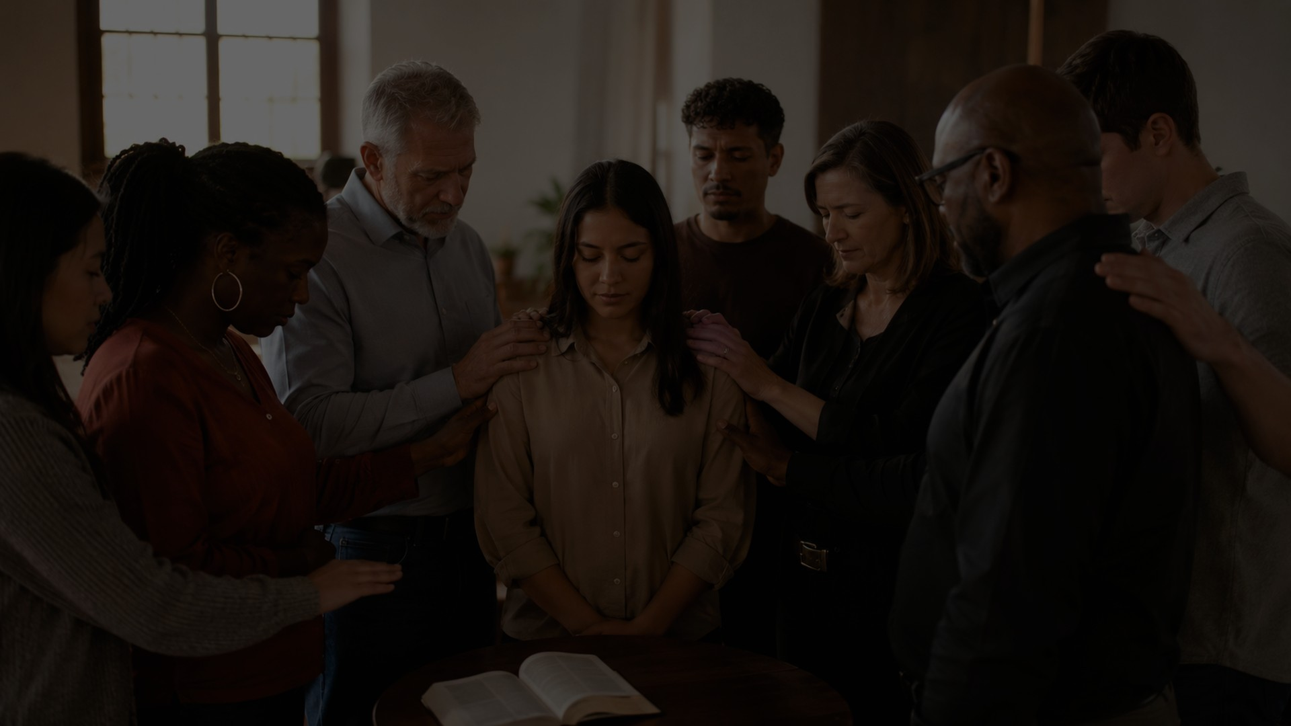
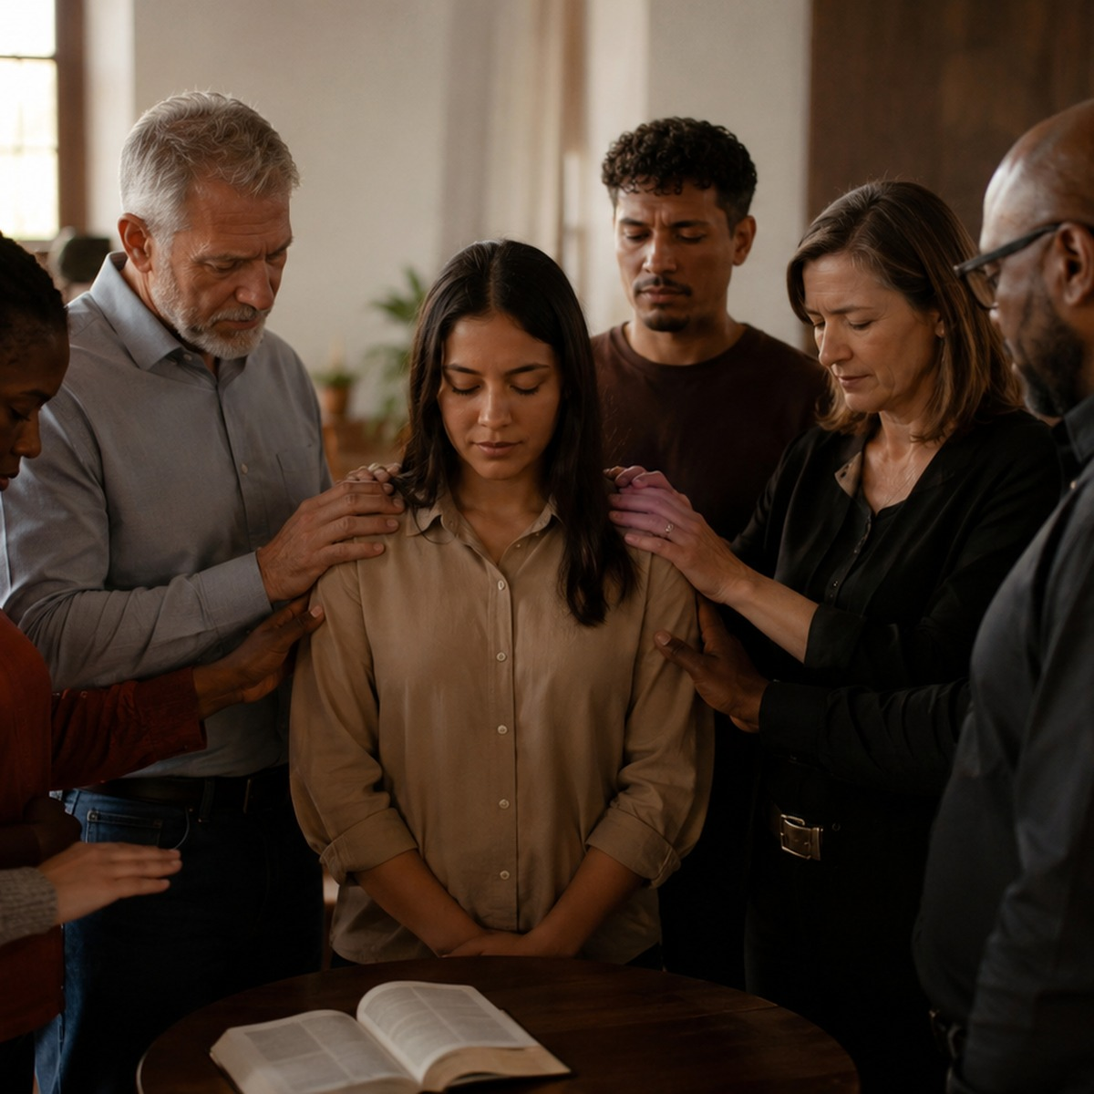
A song born for ordination
1979, Berkeley, California
Written by Daniel Schutte while studying theology at the Jesuit School of Theology.
Requested only days before a diaconate ordination service.
Based especially on Isaiah 6, with echoes of Samuel and the prophetic call tradition.
First published in Lord of Light in 1981.
HymnInfo.com | Here I Am, Lord
03

Slide 4

Daniel L. Schutte and the St. Louis Jesuits
A modern hymn from Catholic liturgical renewal
American Roman Catholic composer, pianist, and liturgical musician.
Associated with the St. Louis Jesuits, influential in post-Vatican II worship music.
Wrote both the words and original music of “Here I Am, Lord.”
Later hymnal names such as Carlton R. Young, John Weissrock, or Michael Pope usually identify arrangers/harmonizers, not the original composer.
“The song is a prayerful response to a God who first sees, hears, and sends.”
Teaching focus
HymnInfo.com | Here I Am, Lord
04

Slide 5
Biblical foundations
The hymn weaves together several call stories
Isaiah 6:8
“Here I am. Send me!”
1 Samuel 3:9-10
“Speak; for your servant hears.”
Exodus 3:7-10
God hears affliction and sends Moses.
Ezekiel 36:26-27
God gives a heart of flesh.
John 21:15-17
Love for Christ becomes care for his sheep.
HymnInfo.com | Here I Am, Lord
05

Slide 6
The dialogue matters
Stanzas: God’s voice • Refrain: the church’s answer
STANZAS
REFRAIN
God speaks in biblical imagery: Creator, deliverer, healer, and provider. The “I” of the verses is best treated as divine speech.
The congregation answers with humble readiness: not “I am enough,” but “Lord, is this my call? I will go if you lead.”
Teaching cue: use a soloist or choir for the stanzas and the congregation for the refrain.
HymnInfo.com | Here I Am, Lord
06

Slide 7
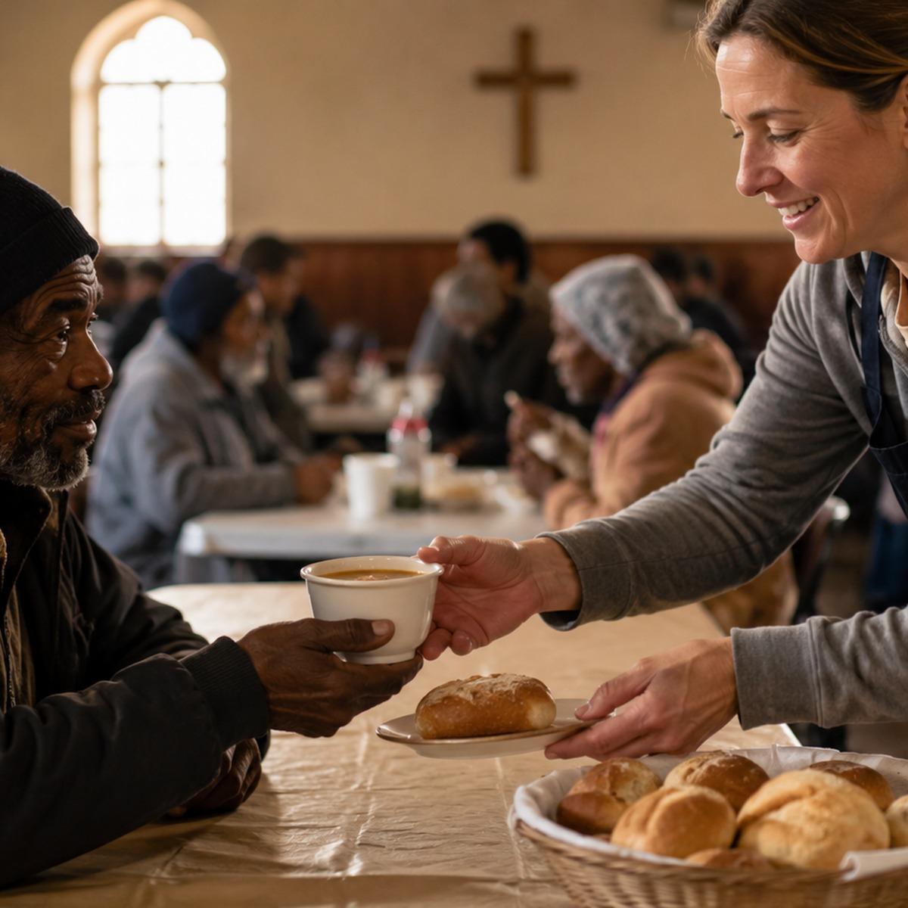
Three movements in the text
Creation → transformation → service
1
Sea and sky
God creates and hears those crying in darkness; the call is to carry light.
2
Snow and rain
God bears pain, transforms stony hearts, and asks who will speak the word.
3
Wind and flame
God sees the poor and hungry, provides nourishment, and sends servants of compassion.
HymnInfo.com | Here I Am, Lord
07

Slide 8
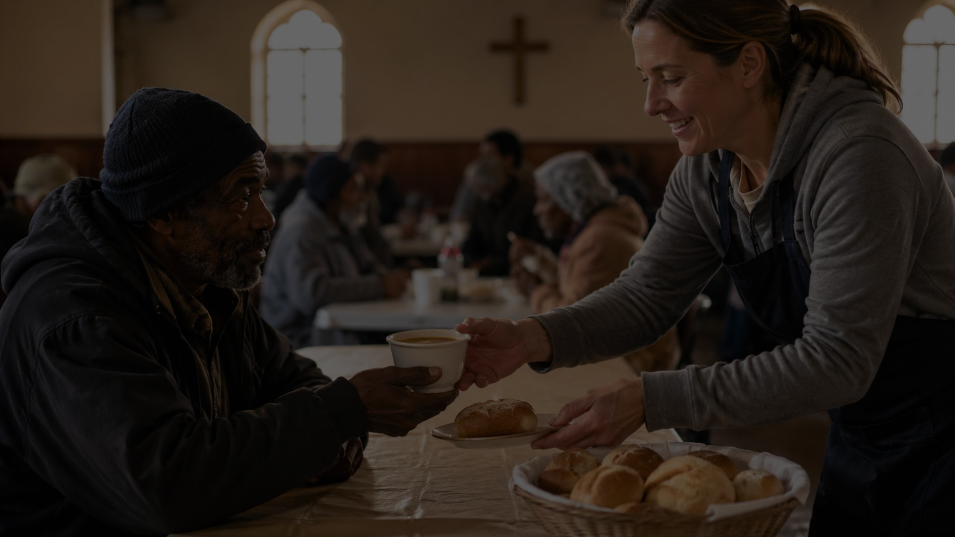
Vocation begins in God’s compassion
The call is not career ambition; it is participation in God’s care.
God sees and hears human suffering before anyone volunteers.
The divine call directs attention outward: to darkness, hardened hearts, the poor, and the hungry.
Christian ministry is service flowing from God’s compassion, not status or self-display.
The refrain places our availability under God’s initiative.
HymnInfo.com | Here I Am, Lord
08

Slide 9
A theology of humble response
“Is it I, Lord?” is a faithful question
“Speak; for your servant hears.”
Humility does not weaken obedience. It purifies it. Biblical servants listen before they go, receive before they give, and depend on God while they serve.
1 Samuel 3:10
“Come now therefore, and I will send you.”
Exodus 3:10
“Pray that the Lord of the harvest will send out laborers.”
Matthew 9:38
Teaching emphasis: vocation is discerning obedience, not impulsive self-confidence.
HymnInfo.com | Here I Am, Lord
09

Slide 10
Musical and liturgical notes
How to teach or lead the hymn well
Tune title: HERE I AM, LORD; words and original music by Daniel Schutte.
Meter often listed as 7.7.7.4 D with refrain, though some hymnals call it irregular.
Dramatic structure: solo/cantor/choir for God’s speech, congregation for the response.
Best sung with flexible text delivery in the stanzas and a clear, steady congregational pulse in the refrain.
Use authorized hymnals/licenses because the hymn remains under copyright.
HymnInfo.com | Here I Am, Lord
10

Slide 11
Church impact
Why this modern hymn became widely loved
One of the most recognizable modern hymns of late twentieth-century Christian worship.
Moved from Roman Catholic renewal music into Methodist, Presbyterian, Lutheran, Anglican, Baptist, Moravian, and other traditions.
Commonly used for ordination, commissioning, confirmation, installations, funerals, and mission services.
Endures because it connects worship with concrete compassion and response.
HymnInfo.com | Here I Am, Lord
11

Slide 12
Pastoral cautions
Teach the hymn with clarity and care
Voice of God
Not self-heroism
Copyright
Some worshipers are uneasy singing words as if they are God. The cantor/congregation division helps make the dialogue clear.
The refrain is not a boast of adequacy. It is a willing, dependent answer to God’s initiative.
Use only licensed text and music. Teaching materials may describe themes without reproducing the copyrighted lyrics.
HymnInfo.com | Here I Am, Lord
12

Slide 13
Teaching plan
Suggested 60-minute session
0–5
Opening prayer and brief listening exercise
5–15
Historical setting: Schutte, ordination, 1979/1981
15–30
Scripture study: Isaiah 6, 1 Samuel 3, Exodus 3
30–42
Theology: God’s compassion and human vocation
42–52
Discussion: where is God sending us?
52–60
Sing/reflect with commissioning prayer
HymnInfo.com | Here I Am, Lord
13

Slide 14
Discussion and application
Move from hymn study to faithful response
Where do you hear God’s call most clearly: Scripture, prayer, community, or human need?
What forms of suffering does the hymn place before the church?
What is the difference between vocation and ambition?
How can our congregation carry light, healing, nourishment, or hope this month?
Practice this week
Choose one concrete act of compassionate service and offer it as your response to God’s call.
HymnInfo.com | Here I Am, Lord
14

Slide 15
Send us, Lord.
Let worship become listening, listening become obedience, and obedience become compassion.
“Whom shall I send, and who will go for us?”
Isaiah 6:8
HymnInfo.com | Here I Am, Lord
15

