Slide 1

Rock of Ages, Cleft for Me
Christ our refuge • Grace our only hope
First line: Rock of Ages, cleft for me
Text: Augustus Montague Toplady
Tune: TOPLADY by Thomas Hastings
Publication: 1776 • Primary Scripture: Romans 3:23-26
Prepared for teaching and small group use - hymninfo.com

Slide 2

Teaching Aim
By the end of the lesson, learners should...
Understand how the hymn joins biblical rock imagery with grace and atonement.
Feel the weight of sin and the relief of Christ as refuge.
Practice confession that leads to assurance rather than despair.
☞
♥
✚
Understand
Feel
Practice
Prepared for teaching and small group use - hymninfo.com

Slide 3

Hymn Identity
Title
Author
Rock of Ages, Cleft for Me
Augustus Montague Toplady
Publication
Common U.S. Tune
Full hymn published in 1776
TOPLADY by Thomas Hastings
Meter
Primary Theme
7.7.7.7.7.7
Christ as refuge for sinners
Prepared for teaching and small group use - hymninfo.com

Slide 4
Historical Background
Toplady first printed related lines in 1775; the full hymn appeared in 1776.
The hymn came from an evangelical Anglican setting marked by strong teaching on grace.
Later hymnals shaped the wording many congregations know today.
The popular Burrington Combe storm story is beloved, but should be handled with caution.
Prepared for teaching and small group use - hymninfo.com

Slide 5

Biblical Foundations
Rock • Refuge • Cleansing • Grace
Prepared for teaching and small group use - hymninfo.com

Slide 6

The Rock as Refuge
Exodus 33:22
God himself places Moses in a cleft of the rock. The image is not self-made safety, but God-given shelter before divine glory.
1 Corinthians 10:4
The wilderness rock is read through Christ. The hymn’s refuge is ultimately the Savior himself.
Prepared for teaching and small group use - hymninfo.com

Slide 7
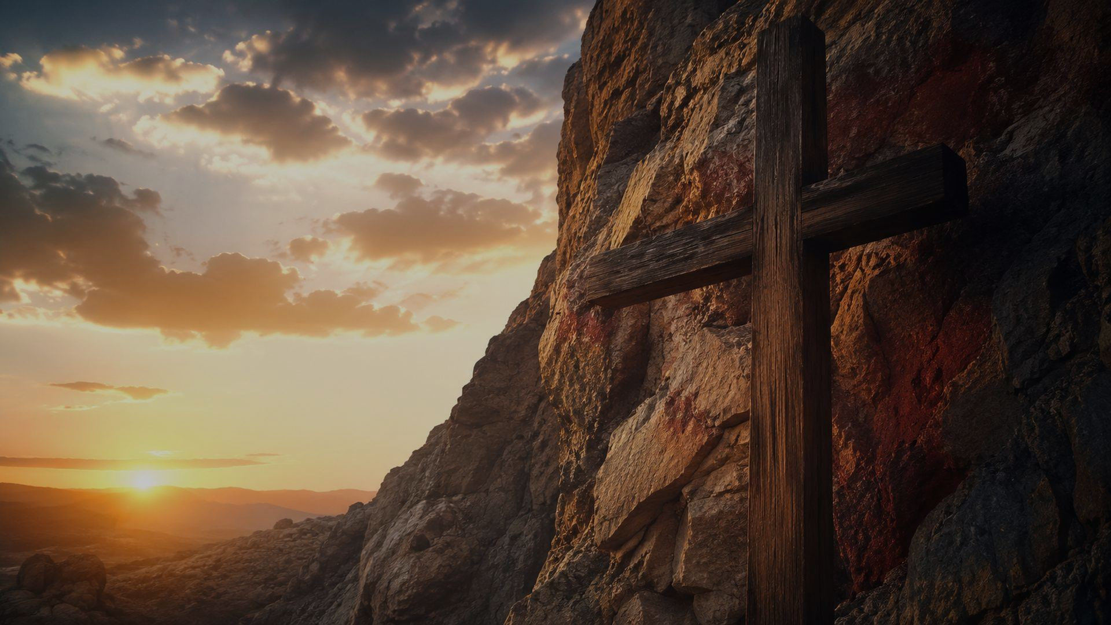
The Cross and Cleansing
John 19:34 gives the image of blood and water from Christ’s pierced side.
Hebrews 9:22 connects cleansing and remission with the shedding of blood.
The hymn teaches cleansing as a gift flowing from Christ, not an achievement produced by human effort.
Prepared for teaching and small group use - hymninfo.com

Slide 8

Hymn-Section Study
From refuge to final hope
Prepared for teaching and small group use - hymninfo.com

Slide 9
Movement 1: Hide Me in Christ
The hymn begins as direct prayer to Christ.
The singer seeks shelter in the Savior rather than explanation, status, or self-defense.
Teaching emphasis: Christian assurance begins with refuge in Christ, not confidence in the self.
Prepared for teaching and small group use - hymninfo.com

Slide 10
Movement 2: No Work Can Atone
The hymn refuses to turn labor, zeal, or tears into payment for sin.
Repentance is real, but repentance is not the Savior.
Scripture anchor: Ephesians 2:8-9 excludes boasting because salvation is gift.
Works matter as fruit,
not as foundation.
Prepared for teaching and small group use - hymninfo.com

Slide 11

Movement 3: Empty Hands Receive Grace
The hymn’s middle movement is honest about helplessness.
Faith comes without bargaining chips. It clings to Christ because Christ is sufficient.
Teaching emphasis: grace is not earned by neediness, but it is received by humble faith.
Prepared for teaching and small group use - hymninfo.com

Slide 12

Movement 4: Hope at the End
The hymn carries the believer to death and final judgment.
The refuge is the same at the end as at the beginning: Christ alone.
Pastoral emphasis: assurance is not pride; it is confidence in the Savior’s finished work.
Prepared for teaching and small group use - hymninfo.com

Slide 13
Theological Themes
✚
Christ the Rock
✚
Atonement
✚
Justification by Grace
Rooted in Scripture, sung as prayer.
Rooted in Scripture, sung as prayer.
Rooted in Scripture, sung as prayer.
✚
Human Need
✚
Assurance
✚
Final Hope
Rooted in Scripture, sung as prayer.
Rooted in Scripture, sung as prayer.
Rooted in Scripture, sung as prayer.
Prepared for teaching and small group use - hymninfo.com

Slide 14

Literary and Musical Observations
The text moves from image to doctrine to personal plea.
Repeated first-person prayer makes the hymn immediate and penitential.
TOPLADY’s regular meter and solemn contour support congregational singing.
British hymnals may use PETRA or REDHEAD 76.
Prepared for teaching and small group use - hymninfo.com

Slide 15

Pastoral and Worship Use
Confession and assurance of pardon
Lent and Good Friday
Teaching on grace and salvation
Pastoral care for guilt or fear
Funerals and services of Christian hope
Prepared for teaching and small group use - hymninfo.com

Slide 16
Teach with Care
Do not make the Burrington Combe story the main point; treat it as tradition, not firm history.
Explain grace clearly: good works follow salvation, but they do not purchase it.
Let the hymn’s penitence lead to assurance, not to vague religious guilt.
Clarify textual variations gently when needed; keep the class focused on the gospel message.
Prepared for teaching and small group use - hymninfo.com

Slide 17

Teaching Questions
What does Christ as Rock communicate about holiness and mercy?
Why are human effort, zeal, and tears unable to atone?
How does Romans 3:23-26 explain the hymn’s confidence?
What pastoral comfort does this hymn give to a troubled conscience?
How can a congregation sing confession with assurance?
Prepared for teaching and small group use - hymninfo.com

Slide 18
Application: Singing with Empty Hands
Confess honestly
Receive grace
Name sin without hiding or bargaining.
Rest in Christ rather than in spiritual performance.
Encourage others
Prepare for hope
Point the guilty and fearful toward the Rock.
Let the hymn train the church for life and death.
Prepared for teaching and small group use - hymninfo.com

Slide 19
Suggested Lesson Flow
30 Minutes
60 Minutes
Read Romans 3:23-26
Tell the brief hymn story
Teach the four movements
Discuss one pastoral application
Add Exodus 33 and 1 Corinthians 10
Compare grace and works carefully
Sing or listen prayerfully
Close with guided confession and assurance
Prepared for teaching and small group use - hymninfo.com

Slide 20
Choir and Worship Leader Notes
Choose a tempo that lets the congregation pray, not merely recite.
Shape phrases toward the hymn’s movement from guilt to refuge.
Use simple accompaniment when teaching the text for the first time.
Identify which textual version and tune your hymnal uses.
Prepared for teaching and small group use - hymninfo.com

Slide 21
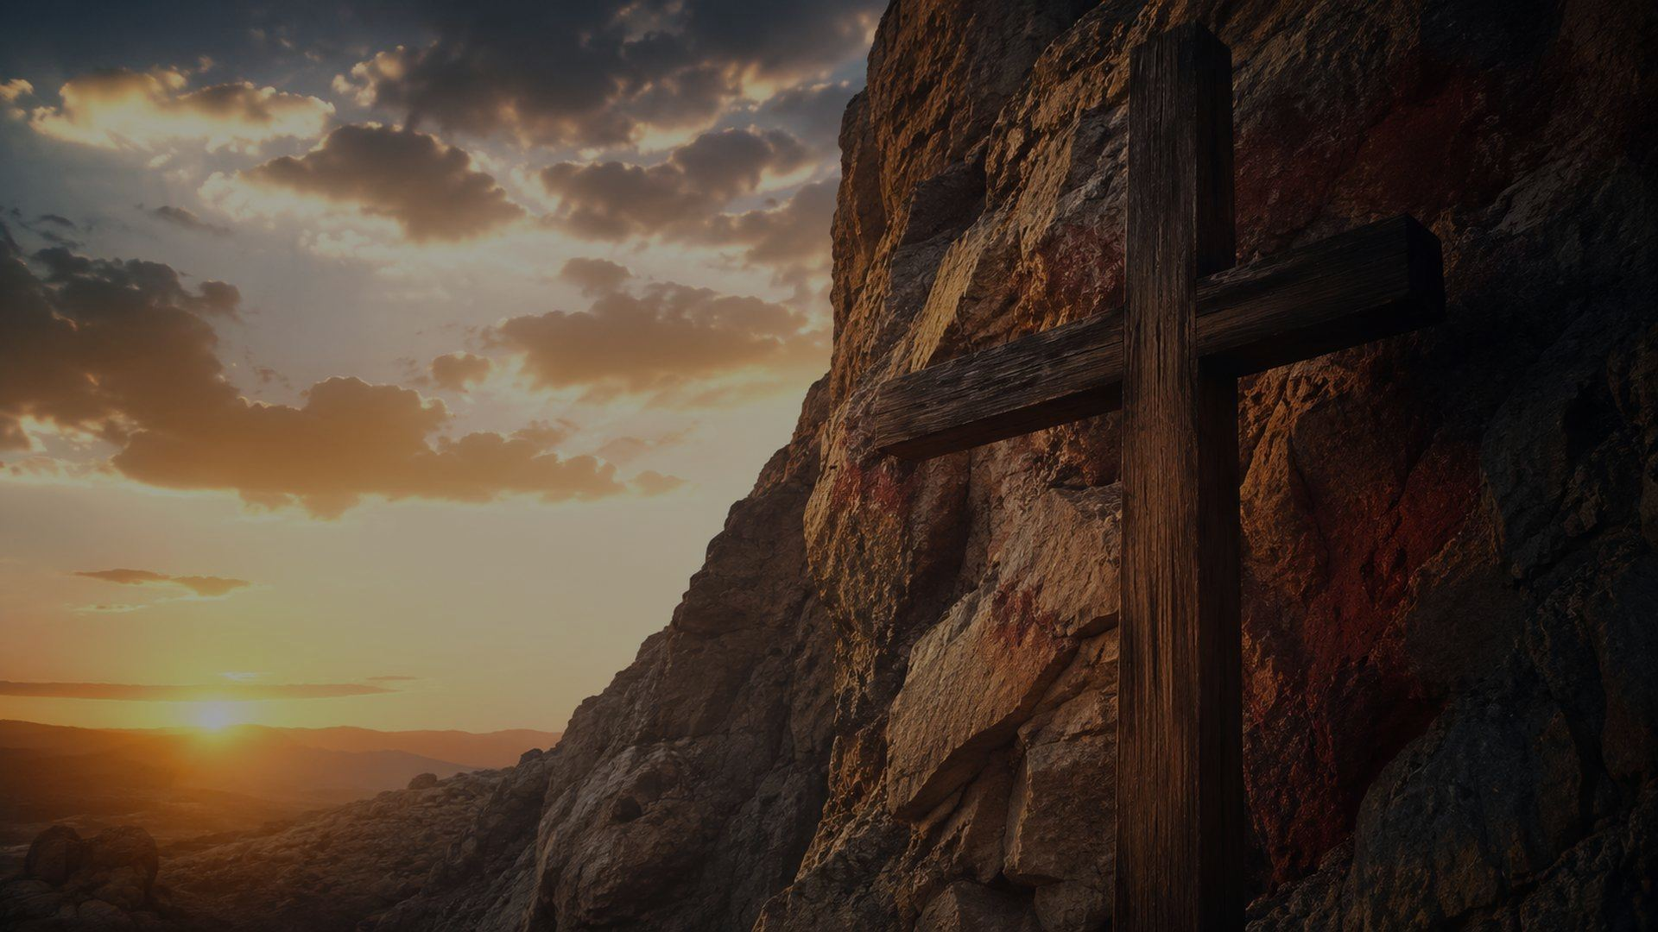
Closing Prayer
Lord Jesus Christ, our Rock and refuge, hide us from every false confidence. Cleanse us by your mercy, teach us to receive grace with empty hands, and keep us in your saving love until we see you face to face. Amen.
Prepared for teaching and small group use - hymninfo.com

Slide 22
HymnInfo Teaching Resource
Rock of Ages, Cleft for Me
© HymnInfo.com. Free for personal, church, classroom, and small-group teaching use. Please do not sell, repost, or redistribute as downloadable files without permission.
Prepared for teaching and small group use - hymninfo.com
Prepared for teaching and small group use - hymninfo.com

