Slide 1

Hymn of Promise
A hymn study on hidden promise, resurrection hope, and God's quiet work of renewal
First line: In the bulb there is a flower
Natalie Sleeth, 1985 • Tune: PROMISE • Primary Scripture: John 12:24
Prepared for teaching and small group use - hymninfo.com

Slide 2

Teaching Aim
A lesson that helps worshipers wait, trust, and hope
Understand
Feel
Practice
God often works beneath the surface before his promise is seen.
Hope can be gentle and strong, even when grief or uncertainty remains.
Wait with patience, pray with trust, and look for signs of renewal.
Prepared for teaching and small group use - hymninfo.com

Slide 3

Hymn Identity
Basic information for teachers and worship planners
Title: Hymn of Promise
First line: In the bulb there is a flower
Writer and composer: Natalie Sleeth
Tune: PROMISE
Meter: 8.7.8.7.D
Written as a choral anthem in 1985; later adapted for congregational singing
Prepared for teaching and small group use - hymninfo.com

Slide 4

Historical Background
Natalie Sleeth, PROMISE, and a hymn born from pastoral hope
Natalie Sleeth wrote the hymn as a choral anthem in early 1985.
Biographical accounts often connect the hymn with hope during her husband Ron Sleeth’s illness and death.
The anthem was later adapted for congregational singing and entered many Protestant and ecumenical hymnals.
The tune name PROMISE fits both the music and the central message of the text.
Prepared for teaching and small group use - hymninfo.com

Slide 5

Why This Hymn Matters Today
A gentle song for seasons of waiting, loss, and renewal
It gives the church truthful language for hope without denying grief.
It teaches resurrection through images that children and adults can grasp.
It serves Easter, funerals, memorial services, and pastoral-care settings.
It helps believers trust God’s hidden work when outcomes are unclear.
Prepared for teaching and small group use - hymninfo.com

Slide 6

Biblical Foundation
Seed, seasons, waiting, and the promise of life in Christ
Prepared for teaching and small group use - hymninfo.com

Slide 7
Scripture That Grounds the Hymn
Direct and thematic connections
John 12:24 — a grain falls, dies, and bears fruit.
1 Corinthians 15:36-38 — seed imagery helps the church speak of resurrection.
Romans 8:18-25 — creation groans while believers wait in hope.
Ecclesiastes 3:1-8 — every season is held within God’s time.
Isaiah 43:19 — God brings forth a new thing where life seemed impossible.
Prepared for teaching and small group use - hymninfo.com

Slide 8
John 12:24: Life Through Death
The seed image is at the heart of Christian hope
Jesus speaks of a grain that must fall into the earth and die before it bears fruit. The hymn’s nature imagery resonates with this biblical pattern: hiddenness, surrender, waiting, and the fruitfulness God gives.
Teaching emphasis: Christian hope is not vague optimism. It is grounded in God’s power to bring life where human sight sees only an ending.
Prepared for teaching and small group use - hymninfo.com

Slide 9
Romans 8: Waiting With Hope
Creation groans, but God has not finished his work
The present season may include suffering, decay, and unanswered questions.
Christian hope waits for the redemption God has promised.
The hymn gives worshipers a way to sing patiently, not triumphalistically.
Prepared for teaching and small group use - hymninfo.com

Slide 10
Hymn-Section Study
How the hymn moves from hiddenness to promise, from waiting to life
Prepared for teaching and small group use - hymninfo.com

Slide 11

Section 1: Hidden Promise
What is unseen may still be alive
The hymn begins with ordinary images from the created world.
A bulb, seed, and hidden growth become pictures of promise before fulfillment.
This is a teaching moment for patience: God’s work may be real before it is visible.
Scripture link: John 12:24; 1 Corinthians 15:36-38.
Prepared for teaching and small group use - hymninfo.com

Slide 12
Section 2: Seasons of Waiting
Winter is not the final word
Seasonal images teach that God’s timing includes dormancy, waiting, and renewal.
The hymn does not rush past grief or barrenness; it names the possibility of life within them.
This section works well for teaching Ecclesiastes 3 alongside Christian hope.
Pastoral point: waiting is not wasted when held before God.
Prepared for teaching and small group use - hymninfo.com

Slide 13

Section 3: Silence and Song
God’s promise can be present before it can be named
The hymn links the quietness of waiting with the coming of song.
Silence is not absence; it may be the hidden place where God prepares praise.
The musical setting supports this movement by unfolding gently rather than dramatically.
Scripture link: Romans 8:24-25; Isaiah 43:19.
Prepared for teaching and small group use - hymninfo.com

Slide 14
Section 4: Death and Resurrection Hope
The hymn moves from natural promise to Christian confession
Its imagery finally points beyond cycles of nature to the resurrection hope of the gospel.
In Christ, death is a defeated enemy, not merely a natural transition.
Use this section carefully in funerals: it can comfort without pretending grief is easy.
Scripture link: John 12:24; 1 Corinthians 15.
Prepared for teaching and small group use - hymninfo.com

Slide 15
The Hymn’s Recurring Movement
From hidden beginnings to revealed grace
Rather than relying on a separate refrain, the hymn repeats a pattern of contrast: what is hidden, silent, waiting, or unfinished is gathered into God’s promised future.
Teaching emphasis: The repeated movement teaches worshipers to look at life with resurrection-shaped imagination.
Prepared for teaching and small group use - hymninfo.com

Slide 16
Theological Themes
What the hymn teaches the church
Resurrection
Providence
Hope
God brings life beyond death.
God works before we can see the result.
Believers wait for what God has promised.
Creation
Comfort
Easter Faith
Nature can witness to God’s renewing work.
Grief is met with patient, gospel-shaped hope.
The risen Christ gives the hymn its deepest meaning.
Prepared for teaching and small group use - hymninfo.com

Slide 17
Musical and Literary Observations
A melody that supports quiet confidence
Tune: PROMISE, composed by Natalie Sleeth.
Common meter listing: 8.7.8.7.D.
The melody unfolds gently, fitting a text about emergence and patient hope.
Best sung with warmth and restraint; avoid rushing the phrases.
Choirs can help the congregation feel the movement from quietness to assurance.
Prepared for teaching and small group use - hymninfo.com

Slide 18
Pastoral and Worship Use
Where the hymn can serve the church well
Easter season and services centered on resurrection hope
Funerals, memorial services, and grief-care gatherings
Pastoral-care settings where people are living with uncertainty
Choir anthems or reflective congregational singing
Lessons on providence, waiting, seasons, and Christian hope
Prepared for teaching and small group use - hymninfo.com

Slide 19
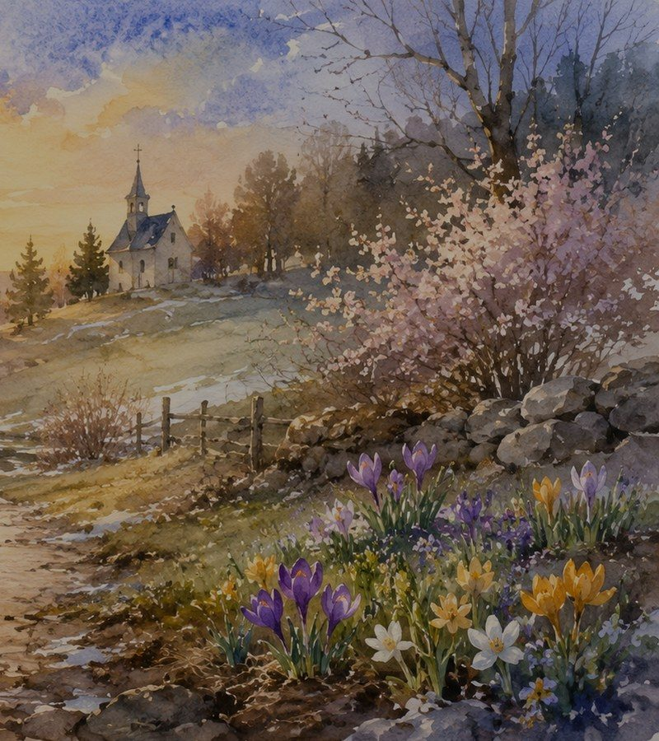
Teaching Questions
For discussion in class, choir, or small group
What does the hymn teach about hope that is not yet visible?
How do seed and season images help us speak about resurrection?
Where might this hymn comfort grieving people without sounding simplistic?
How does Romans 8 help us wait without despair?
What practices can help a church become a community of patient hope?
Prepared for teaching and small group use - hymninfo.com

Slide 20
Application: Living the Promise
Four practices for the week ahead
Name one place where you are waiting for God’s renewal.
Pray John 12:24 or Romans 8:24-25 slowly each day.
Encourage someone who is grieving or discouraged.
Look for one small sign of God’s grace that you might otherwise miss.
Prepared for teaching and small group use - hymninfo.com

Slide 21
Suggested 30-Minute Lesson Flow
Simple structure for Sunday school or choir devotion
0-5 min
Read John 12:24 and introduce the hymn’s hope-filled imagery.
5-15 min
Teach the hymn’s movement from hiddenness to revealed promise.
15-23 min
Discuss seasons of waiting and how the church can give comfort.
23-30 min
Pray for those living with grief, uncertainty, or change.
Prepared for teaching and small group use - hymninfo.com

Slide 22
Suggested 60-Minute Lesson Flow
A deeper session for hymn study or small-group teaching
Opening prayer and shared reflection on waiting (10 minutes)
Historical background and hymn identity (10 minutes)
Scripture study: John 12, Romans 8, 1 Corinthians 15 (18 minutes)
Hymn-section study with pastoral application (15 minutes)
Closing prayer for resurrection hope and patient trust (7 minutes)
Prepared for teaching and small group use - hymninfo.com

Slide 23
Closing Summary
What the hymn teaches us to believe
God’s promise may be hidden, but it is not absent. In Christ, death is not the final word. The church waits, sings, and serves in hope because God is already making all things new.
Prepared for teaching and small group use - hymninfo.com

Slide 24
Closing Prayer
A prayer for hope in God’s hidden work
Lord of life, teach us to trust you in the hidden seasons. Give us patience when we cannot yet see the flower, the song, or the harvest. Anchor our hope in Christ, who died and rose again, and make us people who comfort others with the promise of your new creation. Amen.
Prepared for teaching and small group use - hymninfo.com

Slide 25
For Teaching Use
Thank you for using this HymnInfo resource
© HymnInfo.com. Free for personal, church, classroom, and small-group teaching use. Please do not sell, repost, or redistribute as downloadable files without permission.
Prepared for teaching and small group use - hymninfo.com

