Slide 1

I Know Whom
I Have Believed
Assurance in the Faithful Christ
A Teaching Guide for Pastors, Teachers, and Worship Leaders
Text: Daniel W. Whittle • Tune: EL NATHAN by James McGranahan • Key Scripture: 2 Timothy 1:12
Prepared for teaching and small group use - hymninfo.com

Slide 2
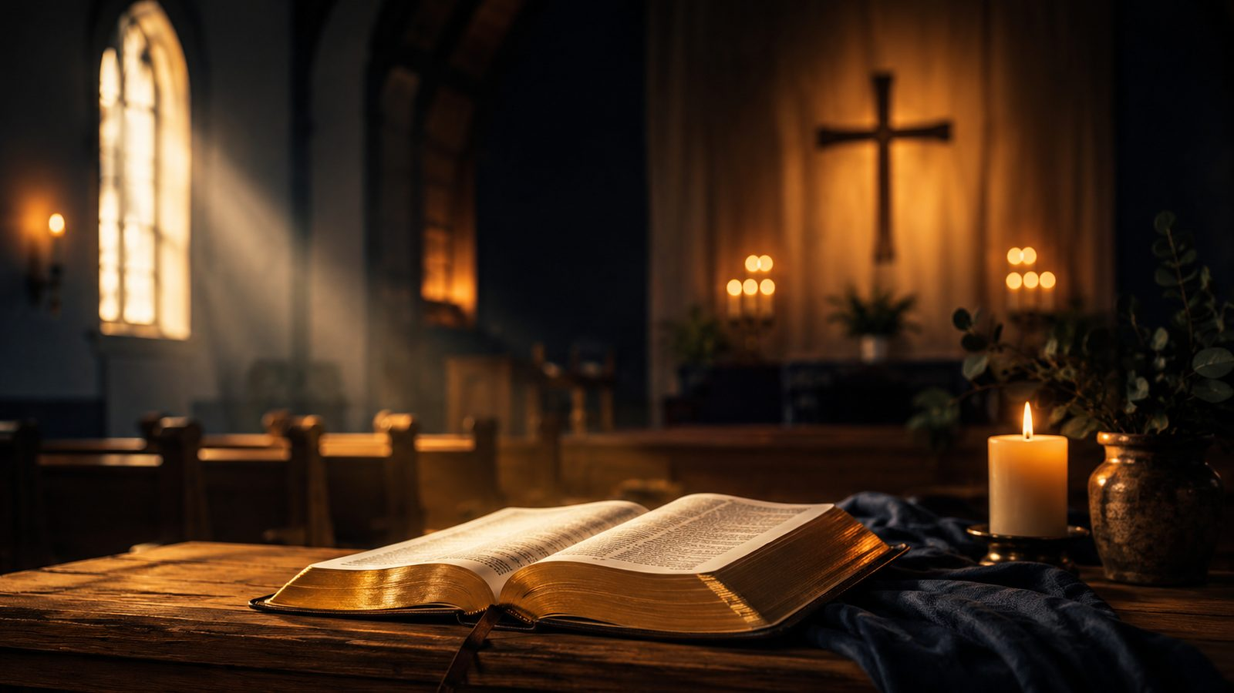
Teaching Aim
What this lesson helps the church receive
UNDERSTAND
Assurance rests in Christ’s faithfulness, not in complete knowledge of every mystery.
FEEL
The hymn gives courage to believers who carry questions, weakness, or uncertainty.
PRACTICE
Learners respond by entrusting themselves again to the Savior who is able to keep.
Prepared for teaching and small group use - hymninfo.com

Slide 3

Hymn Identity
A gospel testimony shaped by Scripture
TITLE AND FIRST LINE
“I Know Whom I Have Believed” opens with wonder before God’s gracious work.
TEXT
Daniel W. Whittle, an American evangelist and gospel hymn writer.
TUNE
EL NATHAN by James McGranahan, named after Whittle’s pseudonym.
DATE
Commonly associated with 1883 in hymnal references.
METER
Common meter with refrain, often listed as 8.6.8.6 with refrain.
SCRIPTURE
2 Timothy 1:12 supplies the central confession of assurance.
Prepared for teaching and small group use - hymninfo.com

Slide 4
Historical Background
Whittle, McGranahan, and gospel-song witness
Whittle and McGranahan worked in the evangelistic stream associated with Dwight L. Moody.
The hymn combines testimony, Scripture, and a strong refrain suited to congregational confidence.
The first known book publication appeared in Gospel Hymns No. 5, with earlier campaign leaflet use possible.
EL NATHAN became a durable tune for revival meetings, testimony services, and Protestant hymnals.
Prepared for teaching and small group use - hymninfo.com

Slide 5

Scripture and Assurance
Knowing Christ when we do not know everything
Prepared for teaching and small group use - hymninfo.com

Slide 6
Biblical Foundation
2 Timothy 1:12 at the center
Paul’s confidence is personal: he knows the One he has believed.
Assurance is grounded in God’s ability to guard what is entrusted.
The phrase “that day” points faith toward final hope and completion.
Faith does not require control of tomorrow before it trusts Christ today.
“I know him whom I have believed.”
Prepared for teaching and small group use - hymninfo.com

Slide 7

Why This Hymn Matters Today
Pastoral value for anxious and questioning believers
It gives the church a vocabulary for faith that is honest about unanswered questions.
It teaches assurance without pretending that believers understand all of God’s ways.
It turns the heart away from self-confidence and toward Christ’s keeping grace.
It strengthens public testimony by making Scripture the heart of assurance.
Prepared for teaching and small group use - hymninfo.com

Slide 8

The Hymn’s Inner Movement
From mystery to confession
The repeated pattern is not ignorance but humility: the believer does not claim full explanation.
Each uncertainty is answered by a stronger certainty: Christ is known, trusted, and able to keep.
The hymn’s center is not an idea about assurance but a person: Jesus Christ.
Its movement ends with hope before God’s final day.
Not all mysteries are answered; the Savior is known.
Prepared for teaching and small group use - hymninfo.com

Slide 9
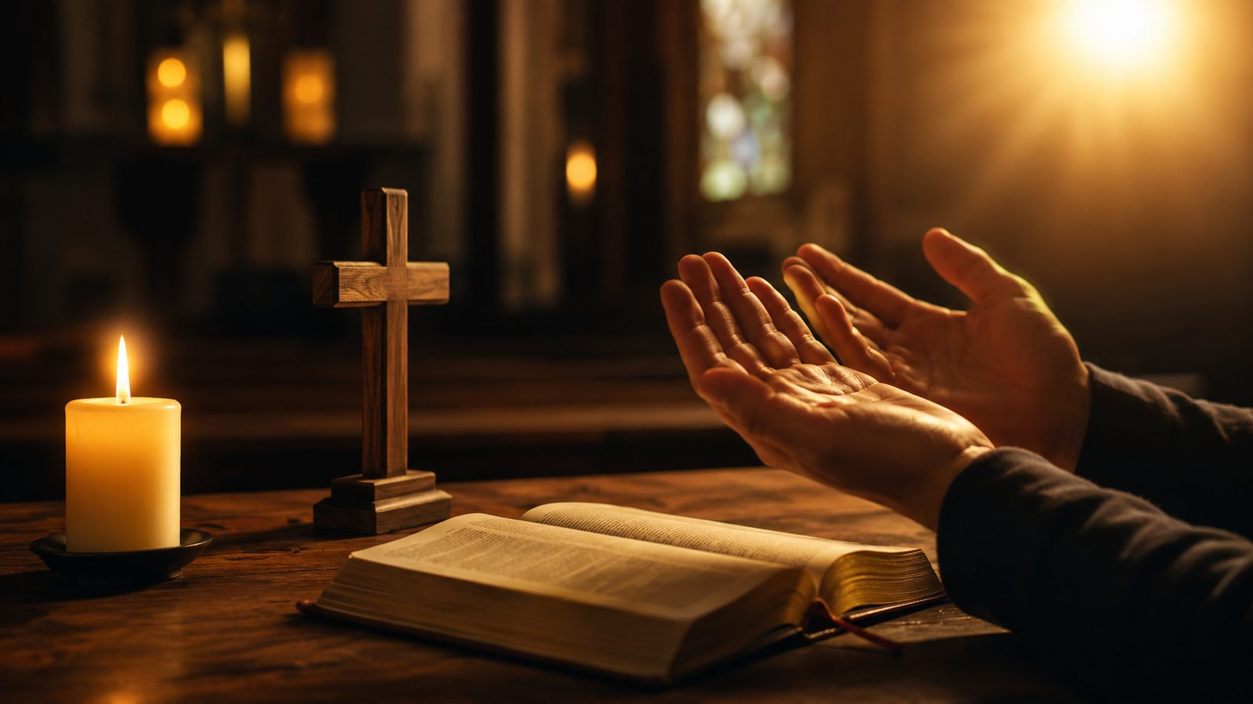
Grace Begins the Song
Wonder before God’s saving initiative
The hymn opens with astonishment that God’s wondrous grace has reached the sinner.
Ephesians 2:8-9 guards the lesson: salvation is God’s gift, not human achievement.
Teaching emphasis: assurance begins where boasting ends.
Pastoral word: weak faith may still rest on a strong Savior.
Prepared for teaching and small group use - hymninfo.com

Slide 10
Faith Hears the Word
The promise that forms trust
Romans 10:17 connects faith with hearing God’s word.
The hymn does not treat faith as a vague feeling, but as trust awakened by divine promise.
Congregational singing helps believers carry Scripture-shaped confidence into memory.
Teaching emphasis: faith rests on what God has spoken.
Prepared for teaching and small group use - hymninfo.com

Slide 11
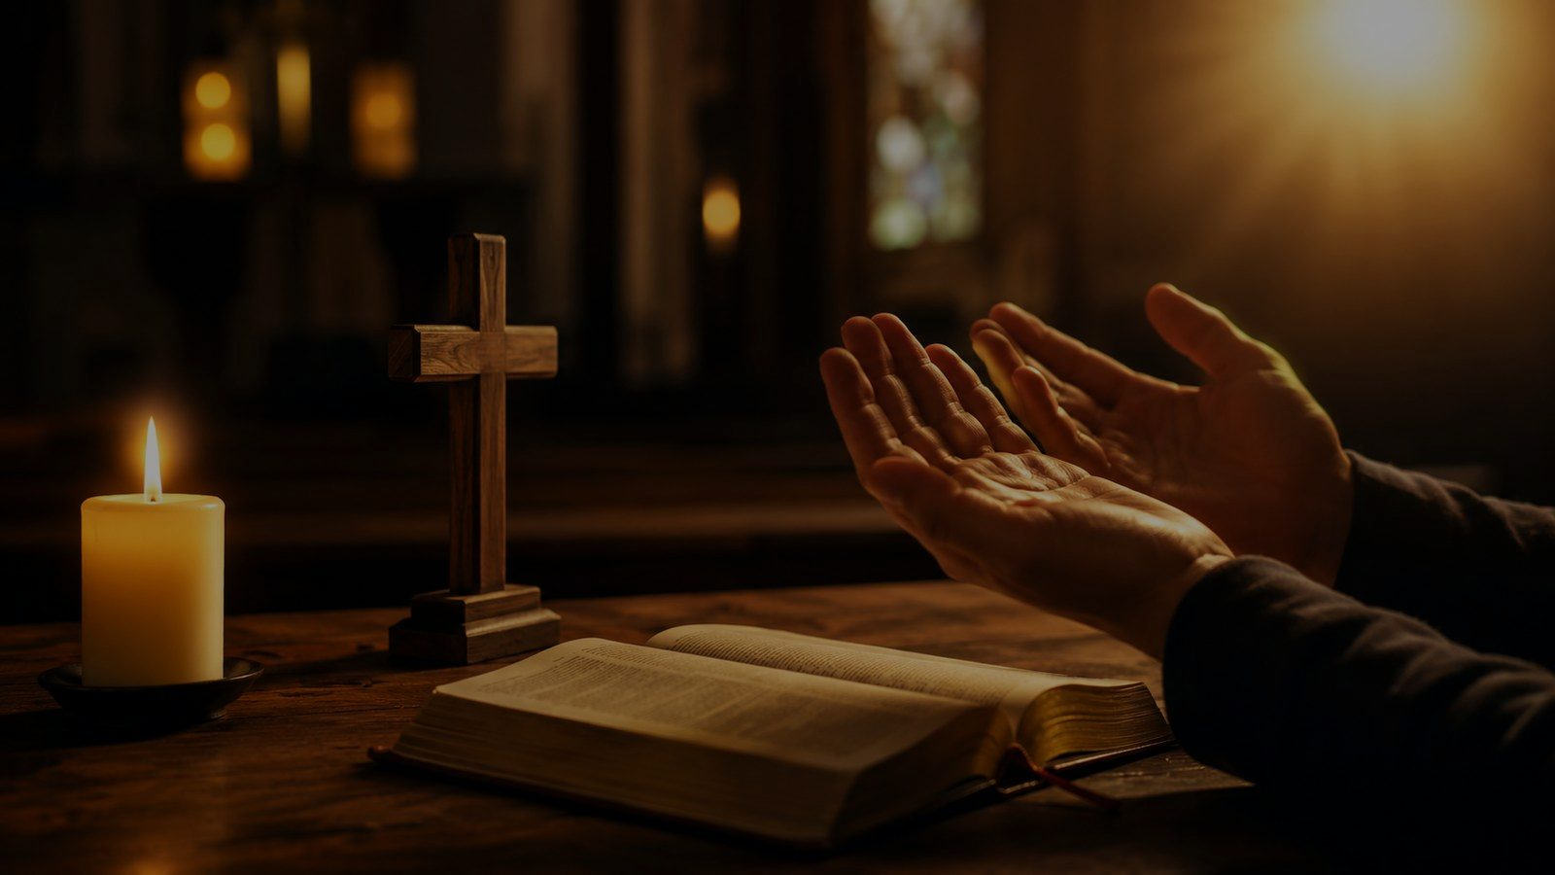
Christ Is Able to Keep
The heart of the hymn’s assurance
Prepared for teaching and small group use - hymninfo.com

Slide 12
What We Entrust to Christ
Life, guilt, weakness, and future
The hymn’s confidence is not confidence in our grip on Christ but in his faithful keeping.
The believer entrusts guilt to mercy, weakness to grace, questions to wisdom, and tomorrow to Christ.
Jude 24 deepens the theme: God is able to keep his people from stumbling.
Teaching emphasis: assurance is God-centered before it is experience-centered.
Prepared for teaching and small group use - hymninfo.com

Slide 13
Until That Day
Assurance with a future horizon
2 Timothy 1:12 looks toward a final day when God’s preserving power is fully displayed.
Philippians 1:6 teaches that God completes the good work he begins.
The hymn gives present courage because the ending is held by Christ.
Teaching emphasis: Christian hope is confidence in the Savior’s promise.
Prepared for teaching and small group use - hymninfo.com

Slide 14

The Refrain’s Power
A sung confession of assurance
The refrain gathers the hymn’s theology into a clear, memorable confession.
It shifts from questions to persuasion: faith is convinced of Christ’s ability.
The melody reinforces the testimony with strength and forward movement.
In worship, the refrain can function as congregational proclamation after Scripture.
Assurance sings best when Scripture gives it words.
Prepared for teaching and small group use - hymninfo.com

Slide 15
Theological Themes
What the hymn teaches
Grace
God’s saving initiative
Faith
Trust shaped by God’s word
Assurance
Confidence in Christ’s keeping power
Perseverance
God completes what he begins
Providence
Mystery held by divine wisdom
Hope
Looking toward the final day
Prepared for teaching and small group use - hymninfo.com

Slide 16
Literary and Musical Observations
Why the hymn works in congregational song
The text uses a repeated contrast: honest limits give way to known confidence.
This contrast makes the hymn candid without making it hopeless.
EL NATHAN has accessible gospel-song phrasing and a strong refrain climax.
The tune supports testimony singing: clear, confident, and memorable.
Prepared for teaching and small group use - hymninfo.com

Slide 17
Pastoral and Worship Use
Where the hymn serves the church well
Services emphasizing assurance, salvation, grace, perseverance, and testimony.
Prayer responses after Scripture readings from 2 Timothy, Ephesians, or Philippians.
Small group teaching on faith during uncertainty or seasons of doubt.
Congregational moments where believers confess trust in Christ together.
Prepared for teaching and small group use - hymninfo.com

Slide 18
Teaching Questions
For class, choir, or small group discussion
What is the difference between knowing answers and knowing Christ?
How does 2 Timothy 1:12 shape the hymn’s central assurance?
Why is it comforting that God is able to guard what we entrust to him?
How can a congregation sing about assurance with humility rather than pride?
What promise from Scripture should shape your confidence this week?
Prepared for teaching and small group use - hymninfo.com

Slide 19
Application
Practicing trust in the faithful Christ
Name one mystery you cannot resolve and bring it to Christ in prayer.
Memorize 2 Timothy 1:12 as a confession of assurance.
Encourage a believer who is struggling to rest in God’s keeping grace.
Let your testimony point beyond your experience to the reliability of Christ.
Faith entrusts itself to Christ before every answer is visible.
Prepared for teaching and small group use - hymninfo.com

Slide 20
Suggested Lesson Flow
Two ways to teach the hymn
30-MINUTE PLAN
1. Read 2 Timothy 1:12
2. Identify the hymn’s repeated contrast
3. Discuss grace and assurance
4. Sing or pray the central confession
5. Close with personal application
60-MINUTE PLAN
1. Historical background
2. Scripture study in 2 Timothy
3. Hymn-section study
4. Musical observations
5. Discussion and testimony
6. Prayer of entrustment
Prepared for teaching and small group use - hymninfo.com

Slide 21

Closing Prayer
Faithful Savior, teach us to trust you when our understanding is small. Guard what we entrust to you, strengthen our faith through your word, and keep us in your grace until that day. Amen.
Prepared for teaching and small group use - hymninfo.com

Slide 22
I Know Whom I Have Believed
Summary
The hymn gives the church a sturdy confession: we do not know every reason, method, or future detail, but we know Christ and trust his power to keep what we have committed to him.
© HymnInfo.com. Free for personal, church, classroom, and small-group teaching use. Please do not sell, repost, or redistribute as downloadable files without permission.
Prepared for teaching and small group use - hymninfo.com

