Slide 1
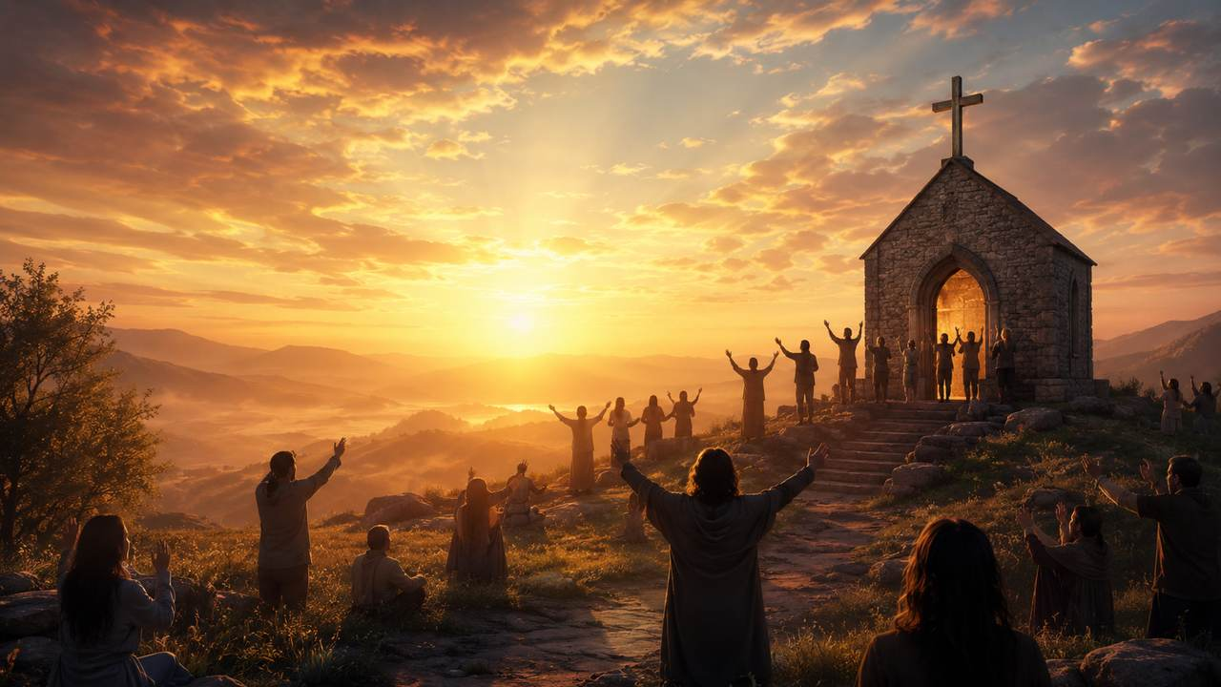
O for a Thousand Tongues to Sing
A hymn study on praise, testimony, and the saving name of Jesus
Charles Wesley · 1739 · commonly sung to AZMON
Prepared for teaching and small group use - hymninfo.com

Slide 2
Teaching Aim
What this session should form in learners
Hear
Feel
Go
Understand the hymn as praise born from grace
Receive the joy of Christ’s redeeming name
Practice witness through song and speech
By the end, learners should be able to connect Wesley’s praise to Scripture, sing the hymn with clearer conviction, and name one concrete way their testimony can become worship.
Prepared for teaching and small group use - hymninfo.com

Slide 3
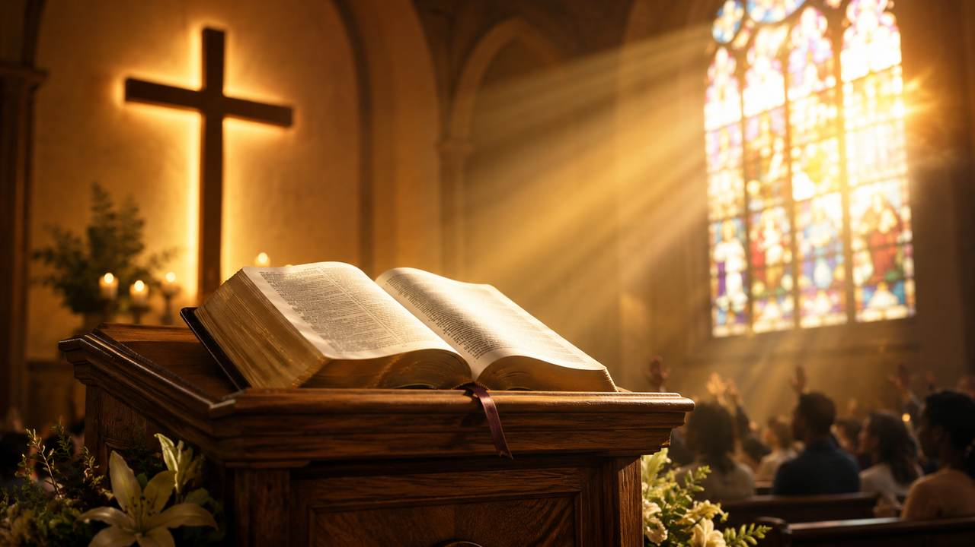
Hymn Identity
Title
O for a Thousand Tongues to Sing
First line
O for a thousand tongues to sing
Text
Charles Wesley, 1739
Common tune
AZMON
Tune composer
Carl Gotthelf Gläser; arranged by Lowell Mason
Meter
Common meter: 8.6.8.6
Primary Scripture
Philippians 2:9–11; Luke 4:18
Prepared for teaching and small group use - hymninfo.com

Slide 4

Historical Background
A conversion anniversary turned into congregational praise
Charles Wesley wrote the hymn in 1739 for the first anniversary of his evangelical conversion on May 21, 1738.
It first appeared within an eighteen-stanza poem in Hymns and Sacred Poems, 1740.
The now-familiar opening line later became the title and first stanza of the form many congregations sing today.
John Wesley gave the hymn a prominent place in the 1780 Methodist hymnal, helping anchor it in Methodist worship.
Teaching emphasis: this hymn turns personal grace into public witness.
Prepared for teaching and small group use - hymninfo.com

Slide 5
Why This Hymn Matters Today
Praise that refuses to stay private
Praise
Testimony
It gives the church large language for the greatness of Christ.
It teaches believers to speak of what grace has done.
Mission
Hope
It points praise outward, “through all the earth.”
It joins the church on earth with the worship of heaven.
Prepared for teaching and small group use - hymninfo.com

Slide 6
The Gospel in Song
Wesley’s praise moves from redeemed speech to the reign of Christ.
Prepared for teaching and small group use - hymninfo.com

Slide 7
Biblical Foundation
Psalm 35:28 — praise with the tongue all day long
Psalm 40:3 — God gives a new song that others may hear
Luke 4:18 — Christ brings good news, release, sight, and freedom
Philippians 2:9–11 — every tongue confesses Jesus as Lord
Revelation 5:12–13 — all creation blesses the Lamb
The hymn’s biblical movement is clear: grace gives song, song becomes witness, and witness anticipates heaven’s praise.
Prepared for teaching and small group use - hymninfo.com

Slide 8
A New Song in the Mouth
Psalm 40:3 and the grace that becomes praise
God gives the song before the church sings it.
The hymn does not begin with human achievement. It begins with grace so good that one voice feels too small.
Praise is not noise added to faith; it is faith learning to speak.
Prepared for teaching and small group use - hymninfo.com

Slide 9
The Name Above Every Name
Philippians 2:9–11
Wesley’s hymn gathers its praise around the person and saving work of Jesus Christ.
The church sings because the crucified and risen Christ is Lord.
Honor
Confession
Lordship
Glory
Prepared for teaching and small group use - hymninfo.com

Slide 10
Good News for the Broken
Luke 4:18 gives the hymn its liberating hope
Good news for the poor
Release for captives
Sight for the blind
Freedom for the oppressed
This is praise with pastoral weight: Christ’s name meets real human bondage, fear, sorrow, and sin.
Prepared for teaching and small group use - hymninfo.com

Slide 11
Praise Wider Than the Church Walls
Revelation 5:12–13
“Every created thing” joins the praise of the Lamb.
The hymn trains local worship to hear the future chorus of heaven and earth.
Prepared for teaching and small group use - hymninfo.com

Slide 12
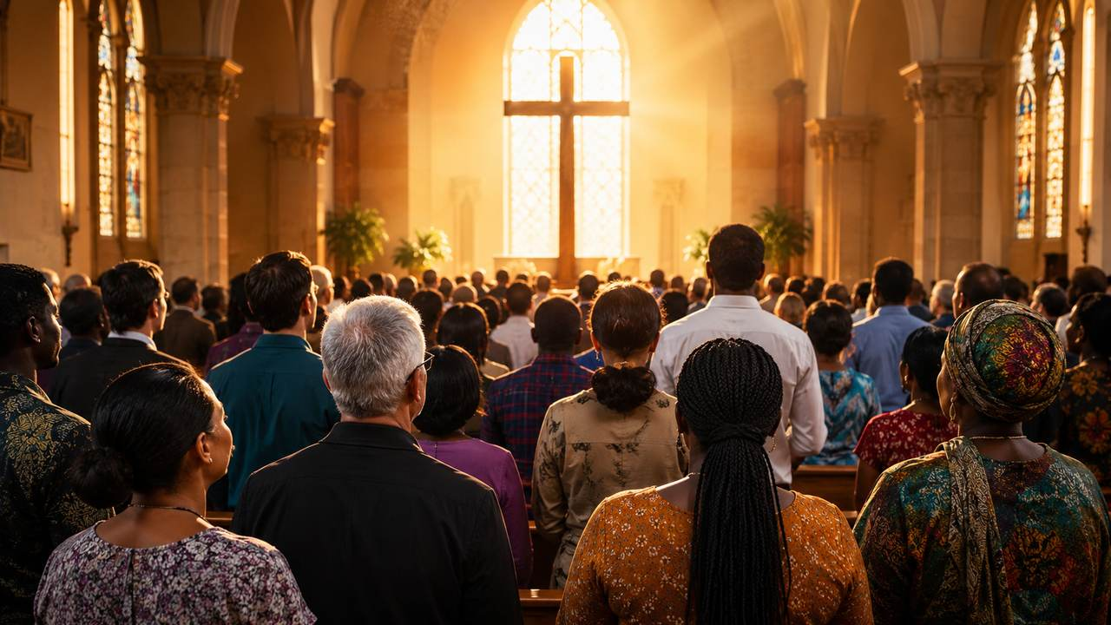
The Hymn’s Movement
From one converted heart to the praise of all creation
Grace received
The singer knows mercy personally.
Praise voiced
The tongue becomes an instrument of witness.
Christ proclaimed
Jesus’ name is announced as saving power.
Creation joins
Earth and heaven answer with praise.
Prepared for teaching and small group use - hymninfo.com

Slide 13
Hymn-Section Study
The familiar stanzas move like a testimony: longing, proclamation, freedom, and glory.
Prepared for teaching and small group use - hymninfo.com

Slide 14
The Opening Cry
More voices for more praise
The singer longs for multiplied speech because Christ’s grace is too large for one voice.
Teaching emphasis: Christian praise begins when grace overwhelms silence.
Many voices, one Redeemer.
Prepared for teaching and small group use - hymninfo.com

Slide 15
Assisted Proclamation
Praise depends on God’s help
Pray
Witn
Name
Prayer
Witness
Name
The singer asks God for help to proclaim.
Praise spreads outward beyond the singer.
The honor belongs to Christ, not to the worshiper.
Class prompt: What do we need God to do before our witness becomes faithful and fruitful?
Prepared for teaching and small group use - hymninfo.com

Slide 16
The Gospel Sets Prisoners Free
The hymn’s strongest pastoral claim
Christ breaks sin’s power.
Christ frees the captive conscience.
Christ cleanses what shame says cannot be cleansed.
Christ makes testimony possible.
Use this slide slowly. It is often where the hymn moves from beautiful poetry to direct pastoral care.
Prepared for teaching and small group use - hymninfo.com

Slide 17
The Lamb and the Whole Church
A hymn that ends in doxology
Wesley’s praise reaches its full horizon when the church on earth is joined with the saints above.
The hymn is not only testimony. It is doxology: all glory returns to God.
Prepared for teaching and small group use - hymninfo.com

Slide 18
Theological Themes
Grace, Christ’s name, liberation, witness, and global praise.
Prepared for teaching and small group use - hymninfo.com

Slide 19
What the Hymn Teaches
Five themes for careful teaching
Redeeming Grace
Christology
Liberation
God saves before we sing.
Jesus is the center of praise.
The gospel frees and heals.
Witness
Hope
Praise becomes proclamation.
Earth’s worship anticipates heaven.
Prepared for teaching and small group use - hymninfo.com

Slide 20
Musical Observations
Why AZMON carries the text well
Common meter makes it adaptable.
AZMON gives bright, direct congregational energy.
The tune supports strong opening worship.
Keep the tempo alive but not hurried.
Let the text carry gospel confidence.
Use clear accompaniment that encourages singing.
Prepared for teaching and small group use - hymninfo.com

Slide 21
Pastoral and Worship Use
Where this hymn serves well
Opening hymn of praise
Mission or evangelism emphasis
Baptism or conversion testimony
Church anniversary or heritage service
Services focused on the name of Jesus
Teaching on assurance and witness
Worship planning note: choose a tune and tempo that help the congregation sound like a people gladly proclaiming grace.
Prepared for teaching and small group use - hymninfo.com

Slide 22
Teaching Questions
For class or choir conversation
What makes one voice feel too small for Christ’s praise?
How does personal conversion become public witness?
Which biblical text best illuminates the hymn for you?
How should the church speak of freedom in Christ today?
What would change if our daily speech became more worshipful?
Prepared for teaching and small group use - hymninfo.com

Slide 23
Practice the Hymn This Week
Turn praise into daily witness
Spea
Sing
Serv
Tell
Speak
Sing
Serve
Tell
Name one mercy of Christ in conversation.
Use the hymn as morning prayer.
Let praise become concrete love.
Share a brief testimony with someone who needs hope.
The hymn asks not only, “Can I sing?” but also, “Will my life proclaim Christ?”
Prepared for teaching and small group use - hymninfo.com

Slide 24
Suggested Lesson Flow
Two options for church teaching
30-Minute Session
60-Minute Session
5 min — Open with Philippians 2:9–11
8 min — Historical background
10 min — Hymn movement and themes
5 min — Group response
2 min — Closing prayer
8 min — Opening reflection
12 min — Wesley and the Methodist context
15 min — Scripture study
15 min — Hymn-section discussion
7 min — Application planning
3 min — Prayer
Prepared for teaching and small group use - hymninfo.com

Slide 25
Closing Prayer
Lord Jesus Christ, give your church a new song of praise. Loosen our tongues to speak of your mercy, free our hearts from fear, and make our worship a faithful witness to your redeeming grace. Amen.
© HymnInfo.com. Free for personal, church, classroom, and small-group teaching use. Please do not sell, repost, or redistribute as downloadable files without permission.
Prepared for teaching and small group use - hymninfo.com

