Slide 1
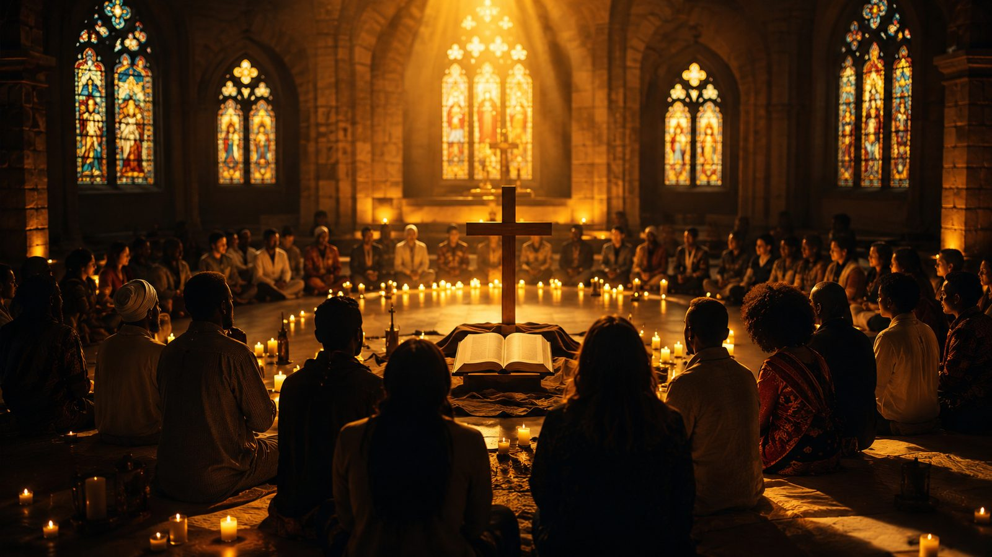
In Christ There Is No East or West
Christian Unity, Reconciliation, and the Global Church
A hymn study for teaching, worship planning, and Christian formation
Prepared for teaching and small group use - hymninfo.com

Slide 2
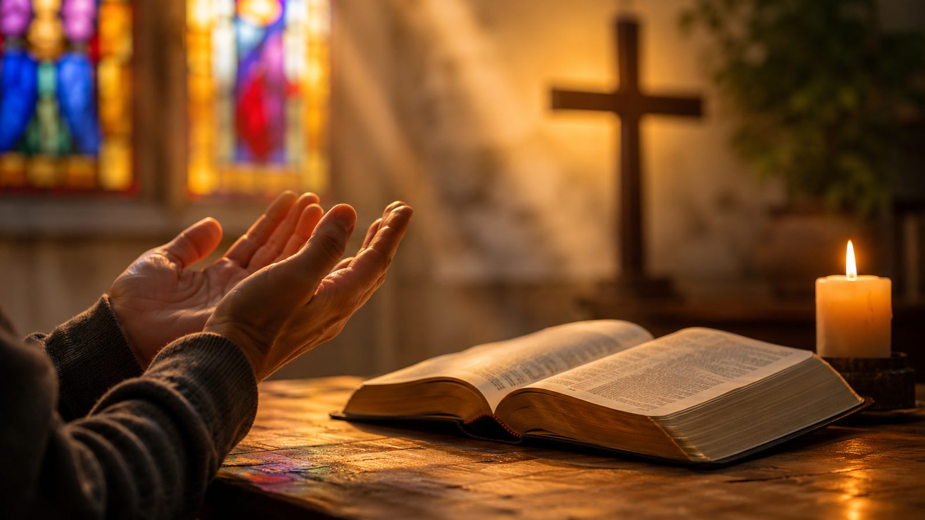
Teaching Aim
U
Understand
F
Feel
P
Practice
Christ creates one reconciled people through the cross.
The church belongs to every nation, tribe, people, and language.
Live fellowship that crosses boundaries in Christ.
Prepared for teaching and small group use - hymninfo.com

Slide 3
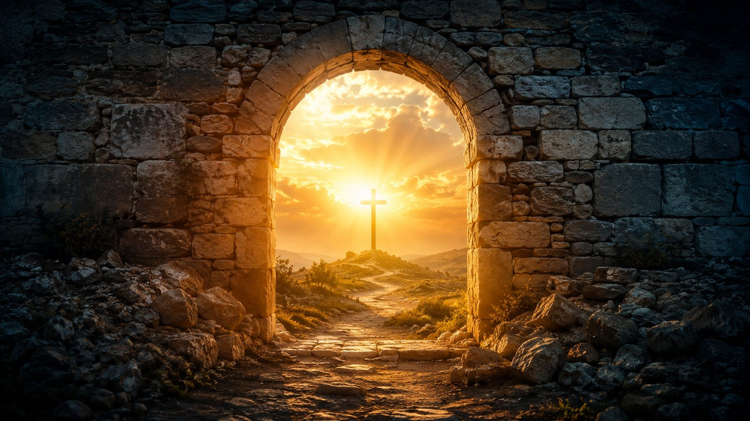
Hymn Identity
FIRST LINE
TEXT
In Christ there is no east or west
William Arthur Dunkerley, writing as John Oxenham
YEAR
COMMON TUNES
1908
ST. PETER; MCKEE
METER
PRIMARY SCRIPTURE
Common Meter, 8.6.8.6
Galatians 3:28
Prepared for teaching and small group use - hymninfo.com

Slide 4

Historical Background
Written for a 1908 London Missionary Society pageant.
Later printed in Bees in Amber and then adopted into hymnals.
Its setting explains the strong emphasis on worldwide Christian fellowship.
Prepared for teaching and small group use - hymninfo.com

Slide 5
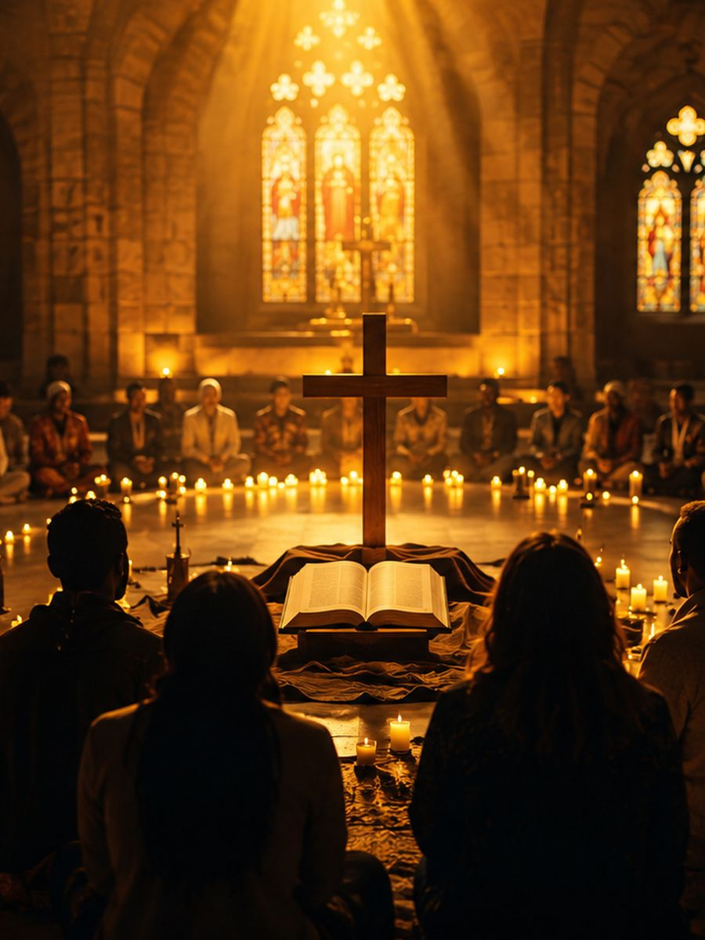
A Song for a Divided World
The hymn does not erase difference; it places difference under the lordship of Christ.
It asks the church to confess a unity deeper than nation, race, culture, language, or class.
Its message remains urgent wherever Christians are tempted to make boundaries stronger than the gospel.
Prepared for teaching and small group use - hymninfo.com

Slide 6
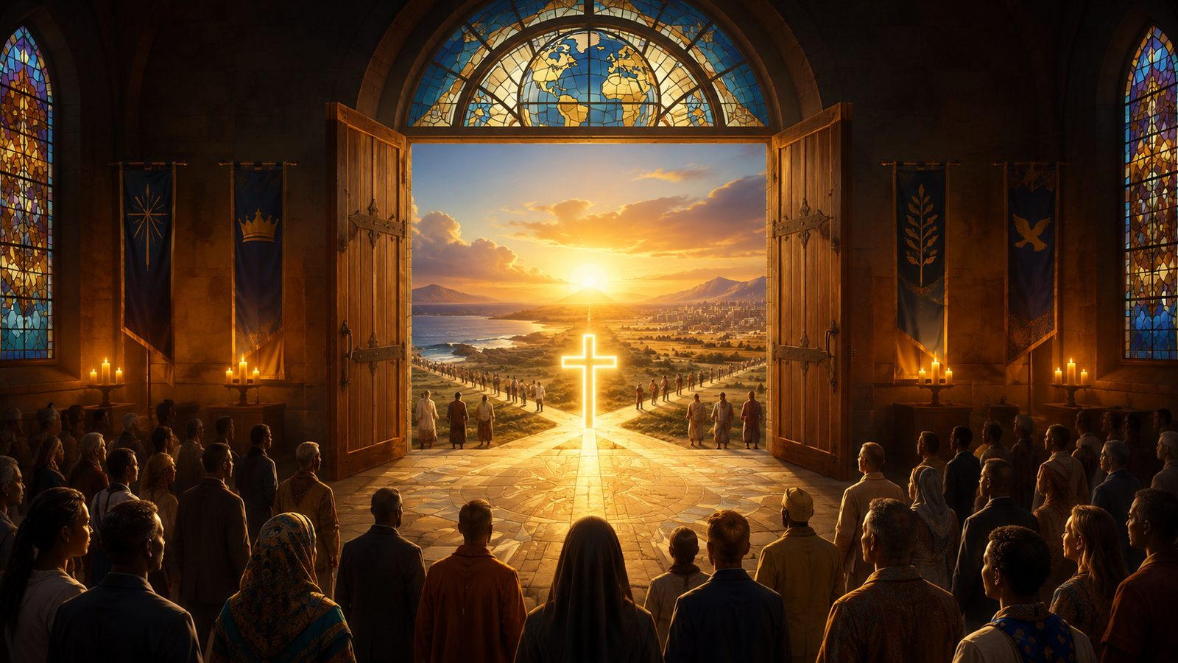
Biblical Foundation
One in Christ Jesus
Prepared for teaching and small group use - hymninfo.com

Slide 7

Galatians 3:28
“You are all one in Christ Jesus.”
The hymn’s central claim is not sentimental. It rests on union with Christ. In him, inherited divisions do not determine the identity of God’s people.
Prepared for teaching and small group use - hymninfo.com

Slide 8
Ephesians 2:14-18
“He is our peace.”
Christ breaks down hostility and creates one new humanity through the cross. The church’s unity is received before it is practiced.
Prepared for teaching and small group use - hymninfo.com

Slide 9
Stanza Study
From divided directions to one fellowship
Prepared for teaching and small group use - hymninfo.com

Slide 10

Stanza 1: Christ Overcomes Dividing Lines
The opening declaration names the compass points as symbols of human separation.
In Christ, geography and culture no longer have power to divide the body.
Teaching emphasis: Christian identity begins with belonging to Christ.
Prepared for teaching and small group use - hymninfo.com

Slide 11
Stanza 2: Shared Fellowship and Service
Unity becomes visible through kinship, service, welcome, and common mission.
The church is not a collection of competing tribes but one family in the Lord.
Teaching emphasis: unity must become practiced hospitality.
Prepared for teaching and small group use - hymninfo.com

Slide 12

Stanza 3: Joined Hearts and Hands
Many hymnals press the theme toward visible action and mutual commitment.
The test of unity is not whether we agree in theory, but whether we serve one another in Christ.
Teaching emphasis: the gospel forms both truthful hearts and open hands.
Prepared for teaching and small group use - hymninfo.com

Slide 13

Stanza 4: A Worldwide Fellowship
The final vision gathers north, south, east, and west into one communion.
The hymn looks ahead to Revelation’s multitude before God and the Lamb.
Teaching emphasis: local worship belongs to a global chorus.
Prepared for teaching and small group use - hymninfo.com

Slide 14
The Heart of the Hymn
Christ is greater than every wall we build
Prepared for teaching and small group use - hymninfo.com

Slide 15
Theological Themes
Union with Christ
Reconciliation through the cross
Christian fellowship
1
2
3
Global mission
Racial and cultural humility
Hope of the redeemed multitude
4
5
6
Prepared for teaching and small group use - hymninfo.com

Slide 16
Unity Is Gift Before Task
The church does not create unity from scratch; Christ has already made peace.
Our task is to receive that gift, repent of contradictions, and live it visibly.
Unity in Christ never excuses injustice; it calls the church to truthful reconciliation.
Prepared for teaching and small group use - hymninfo.com

Slide 17
Mission Without Superiority
The hymn was born in a missionary setting, yet its best reading humbles the church.
The gospel gathers all peoples around Christ, not around one culture’s dominance.
Christian mission bears witness to the Lamb who receives worship from every nation.
Prepared for teaching and small group use - hymninfo.com

Slide 18
Literary and Musical Observations
The text uses compass directions to symbolize global division and global fellowship.
Common Meter makes the hymn flexible for several tunes.
MCKEE, adapted from an African American spiritual melody by Henry Thacker Burleigh, gives the hymn a fitting musical witness to the richness of the church’s song.
Prepared for teaching and small group use - hymninfo.com

Slide 19
Pastoral and Worship Use
Use for World Communion, mission emphasis, Christian unity, reconciliation, and global church services.
Works well after Scripture readings from Galatians 3, Ephesians 2, John 17, or Revelation 7.
Choir leaders can teach the tune as a testimony to the church’s shared musical inheritance.
Prepared for teaching and small group use - hymninfo.com

Slide 20
Teaching Questions
Where do we still allow human divisions to shape fellowship more than Christ does?
How does Ephesians 2 deepen the hymn’s message?
What would visible unity look like in our congregation this month?
How can worship enlarge our love for the global body of Christ?
Prepared for teaching and small group use - hymninfo.com

Slide 21
Practice the Hymn
Pray for unity with repentance, not sentimentality.
Welcome believers who differ from you in culture, age, class, or background.
Support mission as shared witness, not cultural superiority.
Let worship train you for the fellowship of Revelation 7.
Prepared for teaching and small group use - hymninfo.com

Slide 22
Suggested Lesson Flow
30 minutes
Read Galatians 3:28; give background; discuss stanzas; close with prayer.
30
60 minutes
Add Ephesians 2, tune comparison, group discussion, and a practical reconciliation exercise.
60
Prepared for teaching and small group use - hymninfo.com

Slide 23
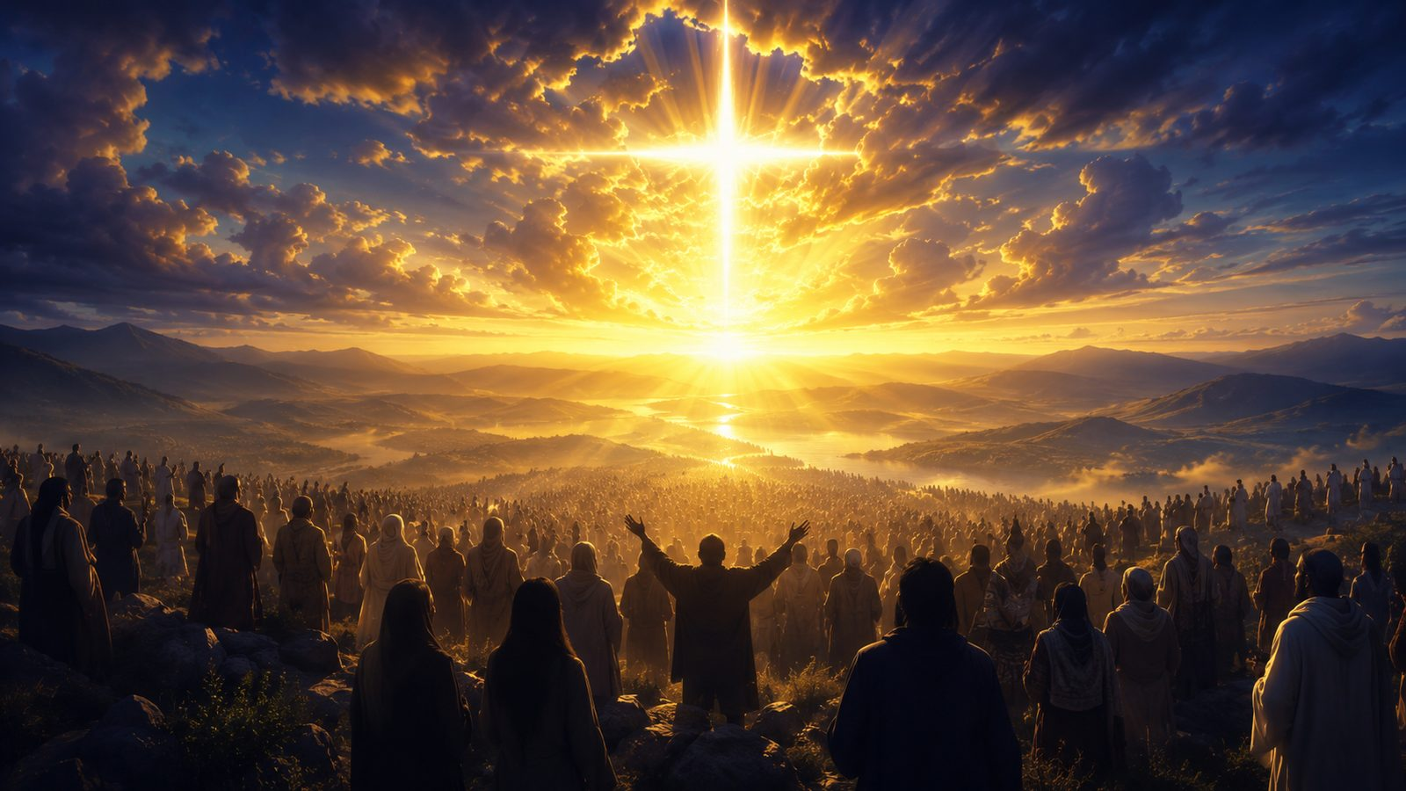
Closing Summary
In Christ, no human boundary has final authority over the church.
Through the cross, Christ has made peace and formed one people.
The church’s unity is a witness now and a preview of the coming multitude before the Lamb.
Prepared for teaching and small group use - hymninfo.com

Slide 24
Closing Prayer
Lord Jesus Christ, you are our peace. Make us one in you. Forgive what divides us, heal what sin has wounded, and teach us to receive your people as family until every nation worships before the Lamb. Amen.
Prepared for teaching and small group use - hymninfo.com
© HymnInfo.com. Free for personal, church, classroom, and small-group teaching use. Please do not sell, repost, or redistribute as downloadable files without permission.

