Slide 1

Jesus Is All the World to Me
A hymn study on Christ as life, joy, strength, friend, guide, and eternal hope
• First line: Jesus is all the world to me
• Words and music: Will Lamartine Thompson
• Tune: ELIZABETH | Year: 1904
• Primary Scripture: Philippians 3:8-9
Prepared for teaching and small group use - hymninfo.com
HymnInfo.com

Slide 2

Teaching Aim
What this session helps learners know, feel, and practice
KNOW
FEEL
LIVE
Understand
Receive
Practice
Christ is not one blessing among many; he is the believer’s life and final treasure.
The hymn gives warm assurance that Jesus remains faithful in sorrow, weakness, and joy.
A Christ-centered life grows through daily trust, gratitude, loyalty, and hope.
Prepared for teaching and small group use - hymninfo.com
HymnInfo.com

Slide 3

Hymn Identity
Basic facts for responsible teaching
Title
Jesus Is All the World to Me
First line
Jesus is all the world to me
Author / composer
Will Lamartine Thompson
Tune
ELIZABETH
Publication setting
American gospel hymnody, 1904
Central witness
Jesus is the believer’s all-sufficient friend and life.
Prepared for teaching and small group use - hymninfo.com
HymnInfo.com

Slide 4
Historical Background
Will L. Thompson and the American gospel song tradition
• Will Lamartine Thompson was an American songwriter, composer, and music publisher associated with East Liverpool, Ohio.
• He studied music in the United States and Germany and became known for gospel songs with clear devotional language and memorable melodies.
• This hymn is usually dated to 1904 and belongs to the warm testimonial style of late gospel hymnody.
• Thompson wrote both the words and the tune, commonly known as ELIZABETH.
Teaching caution
The hymn is best taught as a testimony of devotion to Christ rather than as a dramatic origin story. Its power lies in a simple, steady confession: Christ is enough for every season.
Prepared for teaching and small group use - hymninfo.com
HymnInfo.com

Slide 5
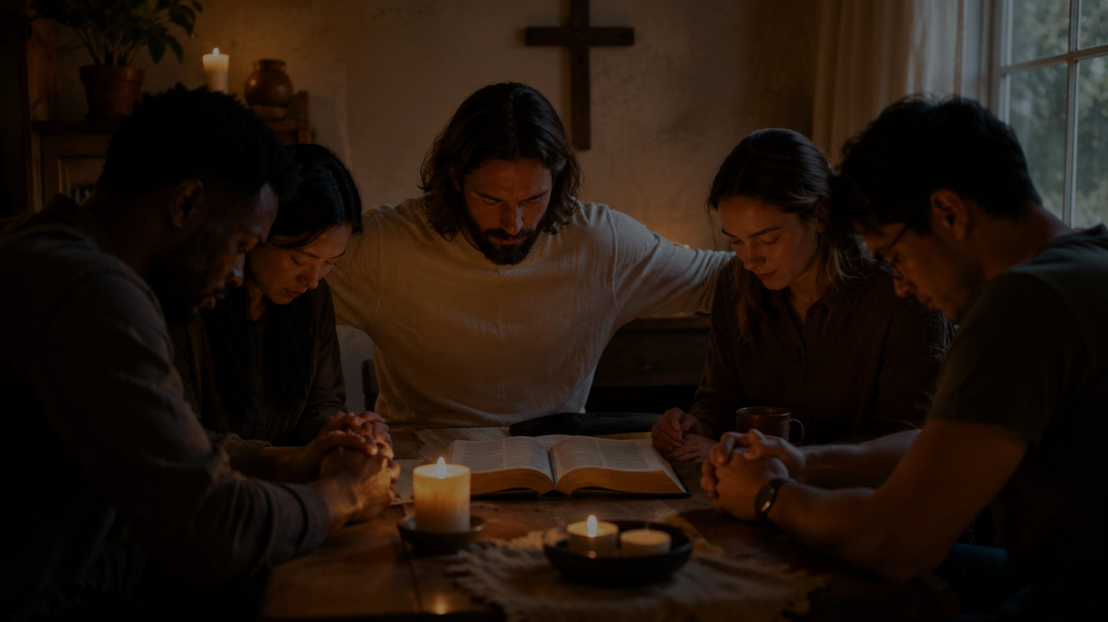
Why This Hymn Matters Today
A clear confession for distracted and weary hearts
Pastoral value
Worship value
It gives believers language for dependence, assurance, friendship with Christ, and hope beyond death.
It helps a congregation sing personal devotion without losing biblical substance.
Teaching value
Discipleship value
It gathers several major themes: abiding in Christ, faithful friendship, providence, and eternal life.
It asks whether Jesus truly shapes our choices, hopes, fears, loyalties, and daily habits.
Prepared for teaching and small group use - hymninfo.com
HymnInfo.com

Slide 6
Biblical Foundation
Christ is life, treasure, strength, and faithful companion
• Philippians 3:8-9 - the surpassing worth of knowing Christ
• Philippians 1:21 - to live is Christ
• John 15:5 - apart from Christ we can do nothing
• Psalm 73:25-26 - God is the strength and portion of the heart
• Hebrews 13:5-6 - the Lord will not forsake his people
• Colossians 3:1-4 - Christ is the believer’s life and future glory
Responsible connection
The hymn does not expound one passage line by line. It sings a biblical pattern: Christ is the believer’s life, abiding strength, daily friend, and eternal hope.
Prepared for teaching and small group use - hymninfo.com
HymnInfo.com

Slide 7

Hymn-Section Study
From Christ as life to Christ as eternal hope
Prepared for teaching and small group use - hymninfo.com
HymnInfo.com

Slide 8
1. Christ as Life, Joy, and Strength
The opening movement centers the whole Christian life on Jesus. The believer’s joy and strength are not self-made; they are received from the Savior who gives life and sustains faith.
Teaching emphasis
Ask learners: what would change if Christ were treated as the center rather than an accessory?
Scripture connections: Philippians 1:21, Philippians 3:8-9, Psalm 73:25-26
Prepared for teaching and small group use - hymninfo.com
HymnInfo.com

Slide 9
2. Christ as Friend in Trial
The second movement speaks to seasons of trouble. It does not promise a painless life; it testifies that Christ remains a faithful friend when the road is hard.
Teaching emphasis
Name real trials, then guide the class to speak honestly about Christ’s nearness and help.
Scripture connections: Hebrews 13:5-6, John 15:5
Prepared for teaching and small group use - hymninfo.com
HymnInfo.com

Slide 10
3. Loyalty, Guidance, and Daily Trust
The third movement turns gratitude into loyalty. Because Christ is true, the believer desires to be true to Christ in ordinary choices, unseen moments, and long obedience.
Teaching emphasis
Connect devotion with daily habits: prayer, Scripture, obedience, witness, and dependence.
Scripture connections: John 15:5, Colossians 3:1-4
Prepared for teaching and small group use - hymninfo.com
HymnInfo.com

Slide 11

4. Present Friendship and Eternal Hope
The final movement looks beyond the passing days of earthly life. The friend who sustains believers now will not abandon them at death; he is their eternal hope.
Teaching emphasis
Use this section gently in pastoral care, funerals, and conversations about Christian hope.
Scripture connections: John 14:6, Colossians 3:4
Prepared for teaching and small group use - hymninfo.com
HymnInfo.com

Slide 12
The Recurring Testimony
The hymn returns again and again to Christ as friend
How the repeated idea works
Pastoral note
• It personalizes doctrine without weakening it.
• It turns confession into prayer and testimony.
• It keeps the hymn warm, simple, and memorable.
• It teaches that Christ’s friendship is steady, not seasonal.
Friendship language must be taught with reverence. Jesus is not less than Lord because he is friend; he is the faithful Lord who draws near to his people.
Prepared for teaching and small group use - hymninfo.com
HymnInfo.com

Slide 13
Theological Themes
Six truths the hymn helps the church sing
Christ-centered life
Abiding dependence
Assurance
All of life finds its meaning in Christ.
Fruitful faith depends on remaining in him.
The Savior remains faithful through every season.
Providence
Devotion
Eternal hope
Christ guides, sustains, and blesses his people.
Love for Christ becomes loyalty in daily life.
The friendship of Christ carries believers beyond death.
Prepared for teaching and small group use - hymninfo.com
HymnInfo.com

Slide 14
Literary and Musical Observations
Simple words carrying deep devotion
• The text uses personal testimony rather than extended argument.
• It moves from present trust to future hope.
• The repeated friendship language gives the hymn a clear emotional center.
• The tone is affectionate, steady, and accessible.
Tune: ELIZABETH
Thompson’s melody supports a warm testimonial style. It should be sung with gentle confidence, not rushed sentimentality. Its accessible shape works well for congregational singing and personal devotion.
Prepared for teaching and small group use - hymninfo.com
HymnInfo.com

Slide 15
Pastoral and Worship Use
Where this hymn serves the church well
Assurance services
Thanksgiving and testimony
Use when the church needs to confess Christ’s nearness and faithfulness.
Use after personal testimonies or sermons on gratitude.
Pastoral care
Discipleship teaching
Use gently with those facing weakness, grief, or uncertainty.
Use to discuss loyalty, abiding, and daily trust.
Funeral or memorial contexts
Choir or congregation
Use where present comfort and eternal hope must be held together.
Sing with clarity and warmth so the testimony remains prayerful.
Prepared for teaching and small group use - hymninfo.com
HymnInfo.com

Slide 16
Teaching Questions
Move from observation to faith and practice
• What titles or roles for Jesus are emphasized in the hymn?
• Which Scripture passage best deepens your understanding of the hymn?
• How does the hymn speak to sadness, weakness, and trial?
• Why does the language of friendship with Christ matter pastorally?
• What would it mean for our church to sing this as a shared testimony?
• Where do you need to trust Jesus as life, strength, guide, and hope this week?
Prepared for teaching and small group use - hymninfo.com
HymnInfo.com

Slide 17
Application
Turning song into discipleship
Name your need
Abide daily
Practice gratitude
Walk in loyalty
Offer comfort
Where are you tempted to seek life apart from Christ?
Set aside a regular time to remain in Christ through Scripture and prayer.
Thank Christ for specific mercies rather than vague blessings.
Choose one concrete act of obedience this week.
Encourage someone with the truth of Christ’s faithful presence.
Prepared for teaching and small group use - hymninfo.com
HymnInfo.com

Slide 18
Suggested Lesson Flow
Two practical teaching options
30-minute class
60-minute class
• 5 min - sing or read the first line and title
• 7 min - historical and hymn identity overview
• 10 min - Scripture: Philippians 3 and John 15
• 6 min - section summary and application
• 2 min - closing prayer
• 8 min - opening reflection and singing
• 10 min - background and tune discussion
• 18 min - Scripture foundations
• 14 min - hymn-section study
• 8 min - group application
• 2 min - prayer
Prepared for teaching and small group use - hymninfo.com
HymnInfo.com

Slide 19
Closing Summary and Prayer
Jesus is not merely part of the believer’s world. He is life, strength, joy, friend, guide, and eternal hope.
Lord Jesus, teach us to find our life in you. Keep us faithful in trial, grateful in blessing, and hopeful until we see you in glory. Amen.
© HymnInfo.com. Free for personal, church, classroom, and small-group teaching use. Please do not sell, repost, or redistribute as downloadable files without permission.
Prepared for teaching and small group use - hymninfo.com
HymnInfo.com

