Slide 1
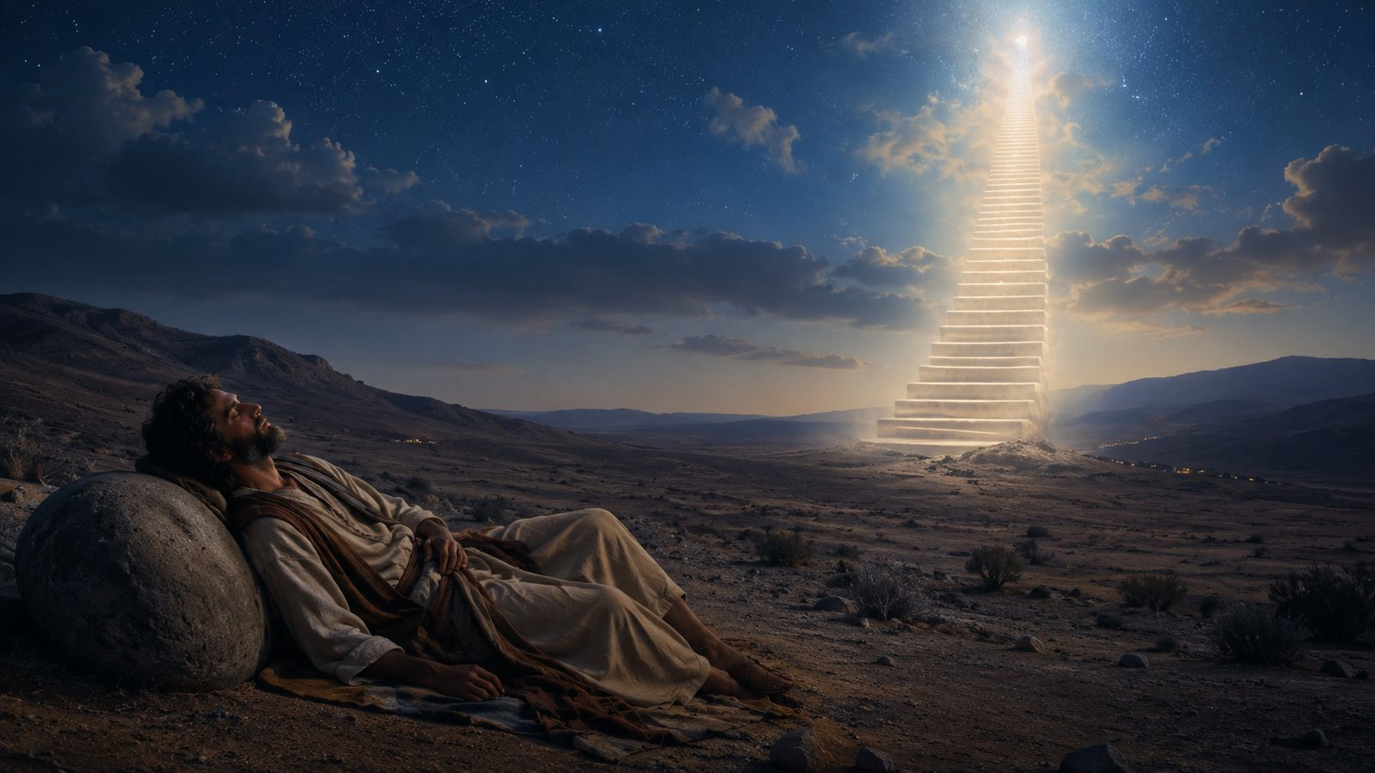
Nearer, My God, to Thee
A hymn study on pilgrimage, suffering, and nearness to God
First line: “Nearer, my God, to thee”
Sarah Flower Adams • 1841
Tune: BETHANY • Lowell Mason
Primary Scripture: Genesis 28:10-19
Prepared for teaching and small group use - hymninfo.com

Slide 2

Teaching Aim
What this hymn helps us do
Understand
Feel
Practice
How Genesis 28 shapes the hymn’s images of night, stone, ascent, and worship.
The honest longing to be nearer to God when the road is hard.
Turning lonely or painful places into prayer, trust, and worship.
Prepared for teaching and small group use - hymninfo.com

Slide 3

Hymn Identity
Text, tune, and biblical anchor
TITLE
Nearer, My God, to Thee
Central biblical picture
FIRST LINE
Nearer, my God, to thee
AUTHOR
Sarah Flower Adams (1805-1848)
A weary traveler, a stone pillow, a dream of heaven, and the discovery that God is present in the night.
PUBLICATION
Hymns and Anthems, 1841
TUNE COMMONLY USED IN AMERICA
BETHANY by Lowell Mason
METER
6.4.6.4.6.6.6.4
Prepared for teaching and small group use - hymninfo.com

Slide 4
Historical Background
A devotional hymn rooted in Jacob’s dream
• Sarah Flower Adams wrote the hymn for William Johnson Fox’s 1841 collection Hymns and Anthems.
• The hymn turns Genesis 28 into a personal prayer for nearness to God.
• Lowell Mason’s BETHANY later became the most familiar American tune for the text.
• The hymn crossed many church traditions because its longing is simple, biblical, and pastoral.
• Its association with the Titanic is widely repeated, though details about the exact hymn tune remain debated.
Teaching caution: present the Titanic story as a cultural association, not as the main meaning of the hymn.
Prepared for teaching and small group use - hymninfo.com

Slide 5

Why This Hymn Matters Today
• It gives language to longing without denying pain.
• It teaches believers to seek God in the night, not only in comfort.
• It joins pilgrimage, worship, and heavenly hope.
• It is pastorally useful in grief, uncertainty, and prayer.
Prepared for teaching and small group use - hymninfo.com

Slide 6

Biblical Foundation
• Psalm 73:28 - nearness to God is good.
• James 4:8 - draw near and God draws near.
• Hebrews 10:22 - approach God with a true heart.
• Matthew 16:24 - discipleship may involve a cross.
Genesis 28:10-19
Jacob’s lonely night becomes Bethel - a place of promise, awe, and divine presence.
Prepared for teaching and small group use - hymninfo.com

Slide 7
A Lonely Place Becomes Bethel
Teaching the hymn through Genesis 28
Prepared for teaching and small group use - hymninfo.com

Slide 8

Hymn Movement 1
A prayer for nearness, even through the cross
The opening prayer
• Matthew 16:24
• Hebrews 10:22
• A longing shaped by discipleship
The hymn does not ask for an easy road first. It asks for God himself.
Teaching emphasis: the cross does not mean God is far away; in Christ, the cross becomes the way of communion.
Prepared for teaching and small group use - hymninfo.com

Slide 9
Hymn Movement 2
The lonely night
Jacob’s darkness and stone give the hymn its emotional honesty. Faith is not forced to pretend that the ground is soft.
Ask learners: Where do people today feel like wanderers with the sun gone down?
Prepared for teaching and small group use - hymninfo.com

Slide 10

Hymn Movement 3
The opened way
The hymn’s upward imagery comes from God’s revelation, not human achievement. God opens the way; the believer responds in trust.
Prepared for teaching and small group use - hymninfo.com

Slide 11

Hymn Movement 4
Stones turned into worship
Jacob raises the stone as a witness. The hymn asks whether grief can become an altar - not because grief is good, but because God is present.
Pastoral note: comfort before explanation.
Prepared for teaching and small group use - hymninfo.com

Slide 12
Hymn Movement 5
Homeward hope
The hymn ends by looking beyond pilgrimage to the fullness of God’s presence. The final hope is not escape from earth only, but communion with God.
Revelation-shaped worship: the longing to be nearer becomes everlasting praise.
Prepared for teaching and small group use - hymninfo.com

Slide 13
Theological Themes
What the hymn teaches the church to confess
Pilgrimage
Presence
Suffering
Faith often begins on a road, not in comfort.
God meets his people in unexpected places.
Hardship is named honestly, never romanticized.
Worship
Hope
Christ
Stones of grief may become markers of mercy.
Earthly longing points toward final communion.
Jesus is the living way by which heaven opens.
Prepared for teaching and small group use - hymninfo.com

Slide 14
Literary and Musical Observations
How text and tune carry the longing
• The text is built around repeated longing: nearer to God.
• Genesis 28 imagery gives the hymn a strong narrative backbone.
• The emotional movement rises from night and stone toward praise and hope.
• BETHANY’s rising contour supports the hymn’s upward prayer.
• A moderate tempo preserves both tenderness and confidence.
Tune note
BETHANY is usually sung reflectively, but not so slowly that the hymn loses its sense of pilgrimage.
Prepared for teaching and small group use - hymninfo.com

Slide 15
Pastoral and Worship Use
• Funerals and memorial services
• Services of prayer and comfort
• Teaching on Genesis 28
• Pastoral care and grief support
• Lessons on pilgrimage and hope
Use the hymn gently. Many worshipers carry personal grief when they sing it.
Prepared for teaching and small group use - hymninfo.com

Slide 16
Teaching Questions
For Sunday school, choir, or hymn study
• How does Genesis 28 shape the hymn’s central images?
• What does it mean to draw nearer to God during hardship?
• How can worship name pain without losing hope?
• Why does the hymn move upward - from stone, to dream, to praise?
• How does Christ deepen the church’s understanding of nearness to God?
Prepared for teaching and small group use - hymninfo.com

Slide 17
Application
• Name one hard place honestly before God.
• Read Genesis 28 as a prayer before sleep.
• Turn one grief into a marker of God’s presence.
• Draw near through Christ with a true heart.
• Encourage someone who feels far from God.
Prepared for teaching and small group use - hymninfo.com

Slide 18
Suggested 30-Minute Lesson Flow
0-5
Read Genesis 28:10-19
5-10
Introduce Adams, Fox, and BETHANY
10-18
Trace the hymn’s movement: night, stone, dream, worship, hope
18-25
Discuss grief, nearness, and Bethel moments
25-30
Close with prayer and one practice for the week
Prepared for teaching and small group use - hymninfo.com

Slide 19
Suggested 60-Minute Lesson Flow
Gather
Study
Interpret
Apply
Pray
Sing or listen to one stanza, then read Genesis 28.
Teach the historical background and biblical images.
Discuss each hymn movement with Scripture.
Invite testimony about “Bethel” moments.
Close with a guided prayer of nearness and trust.
Prepared for teaching and small group use - hymninfo.com

Slide 20
Closing Summary
The hymn teaches the church to pray for God himself: in the night, on the road, under the cross, and in hope of home.
Jacob woke up to God’s presence. The church sings so that we may wake up too.
Prepared for teaching and small group use - hymninfo.com

Slide 21
Closing Prayer
God of Bethel, meet us in the night and keep your promise to us. Through Jesus Christ, draw us nearer than fear, nearer than grief, and nearer than our own strength can reach. Make our hard places holy with your presence, and lead us home in hope. Amen.
© HymnInfo.com. Free for personal, church, classroom, and small-group teaching use. Please do not sell, repost, or redistribute as downloadable files without permission.
Prepared for teaching and small group use - hymninfo.com

