Slide 1

Lead Me, Lord
A hymn study on guidance, righteousness, and trust
First line: “Lead me, Lord, lead me in thy righteousness”
Samuel Sebastian Wesley • 1861 • Psalm 5:8 and Psalm 4:8
TEACHING GUIDE
Prepared for teaching and small group use - hymninfo.com
© HymnInfo.com. Free for personal, church, classroom, and small-group teaching use. Please do not sell, repost, or redistribute as downloadable files without permission.

Slide 2

Teaching Aim
What this lesson should form in the hearts and habits of learners
1
2
3
Understand
Feel
Practice
the biblical prayer for righteous guidance in Psalm 5:8 and the assurance of Psalm 4:8.
the peace of depending on the Lord rather than self-direction.
prayerful discernment through Scripture, obedience, and worship.
Prepared for teaching and small group use - hymninfo.com
© HymnInfo.com. Free for personal, church, classroom, and small-group teaching use. Please do not sell, repost, or redistribute as downloadable files without permission.

Slide 3

Hymn Identity
A short biblical prayer from a larger choral anthem
Title
Lead Me, Lord
Tune name
LEAD ME, LORD
First line
Lead me, Lord, lead me in thy righteousness
Meter
Irregular
Composer
Samuel Sebastian Wesley
Primary Scriptures
Psalm 5:8; Psalm 4:8
Year
1861
Original setting
Final movement of “Praise the Lord, O My Soul”
The text joins a request for righteous guidance with the promise of safety in God.
The piece is often sung as a choral anthem, prayer response, or brief devotional hymn.
Prepared for teaching and small group use - hymninfo.com
© HymnInfo.com. Free for personal, church, classroom, and small-group teaching use. Please do not sell, repost, or redistribute as downloadable files without permission.

Slide 4

Teaching Guide Contents
A lesson path from Scripture to prayerful practice
1
Hymn snapshot
2
Psalm foundations
3
Historical background
4
Theological reflection
5
Prayer and guidance
6
Music and choral use
7
Teaching discussion
8
Ministry application
9
Lesson flow
10
Closing prayer
Prepared for teaching and small group use - hymninfo.com
© HymnInfo.com. Free for personal, church, classroom, and small-group teaching use. Please do not sell, repost, or redistribute as downloadable files without permission.

Slide 5
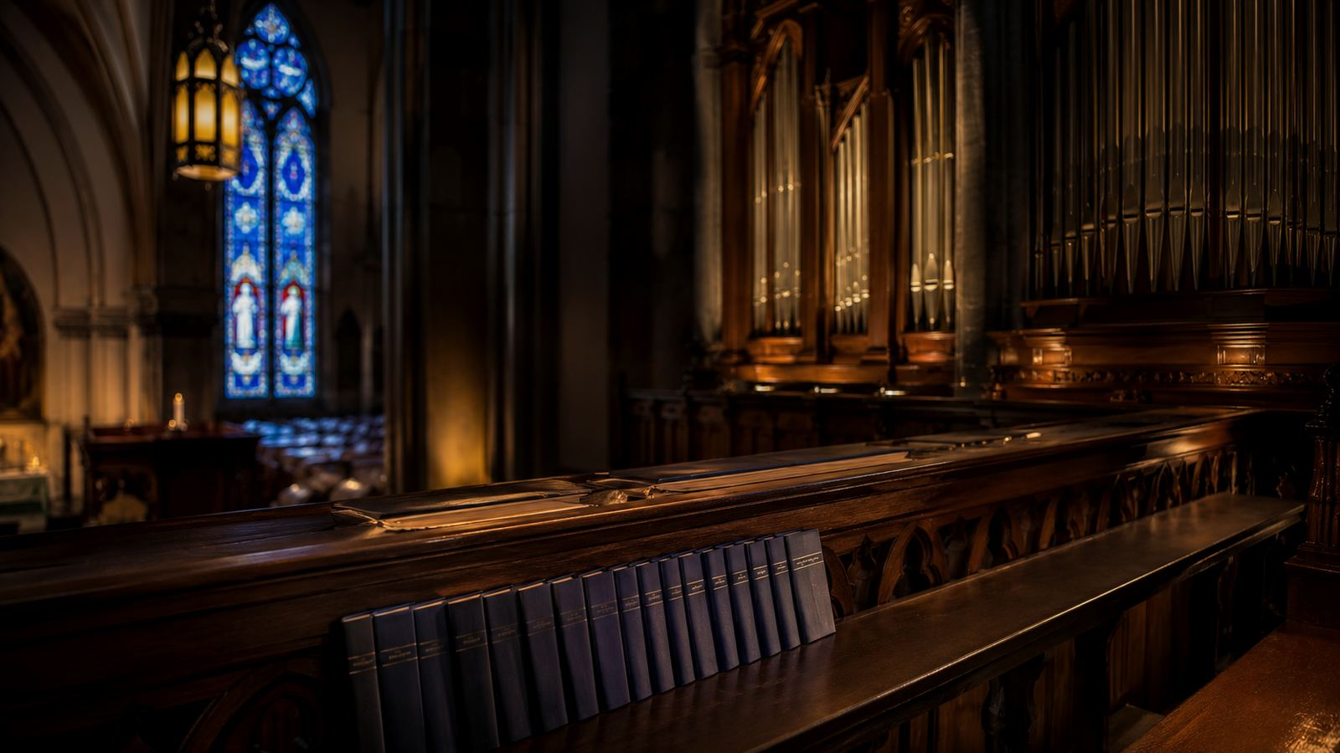
Historical Background
Samuel Sebastian Wesley served the English cathedral tradition as organist, composer, and reforming church musician.
“Lead Me, Lord” comes from the final movement of Wesley’s 1861 verse anthem “Praise the Lord, O My Soul.”
The wider anthem draws from several psalms and closes with a simple prayer for guidance and peace.
Teaching emphasis: show how a short biblical prayer became a durable church song.
Prepared for teaching and small group use - hymninfo.com
© HymnInfo.com. Free for personal, church, classroom, and small-group teaching use. Please do not sell, repost, or redistribute as downloadable files without permission.

Slide 6

Why This Hymn Matters Today
Guidance is a spiritual need, not only a practical question
It gives the church a concise sung prayer for moments of uncertainty.
It teaches that God’s way is righteous before it is convenient.
It joins direction and rest: the Lord leads, and the Lord keeps.
It serves choir, congregation, and individual devotion without needing much explanation.
Pastoral value: pray it before decisions, dedications, services of commitment, or quiet moments of surrender.
Prepared for teaching and small group use - hymninfo.com
© HymnInfo.com. Free for personal, church, classroom, and small-group teaching use. Please do not sell, repost, or redistribute as downloadable files without permission.

Slide 7
Biblical Foundation
Psalm 5:8
“Lead me, Yahweh, in your righteousness because of my enemies. Make your way straight before my face.”
The prayer asks for moral direction, not merely information.
God’s righteousness defines the path.
The “straight way” is the life ordered before God.
Prepared for teaching and small group use - hymninfo.com
© HymnInfo.com. Free for personal, church, classroom, and small-group teaching use. Please do not sell, repost, or redistribute as downloadable files without permission.

Slide 8
The Assurance of God’s Presence
The prayer for guidance rests in the God who gives peace
Psalm 4:8
“In peace I will both lay myself down and sleep, for you, Yahweh alone, make me live in safety.”
Safety is not grounded in control, but in the Lord’s care.
Peace becomes possible when trust is placed in God alone.
The hymn carries both supplication and rest.
Prepared for teaching and small group use - hymninfo.com
© HymnInfo.com. Free for personal, church, classroom, and small-group teaching use. Please do not sell, repost, or redistribute as downloadable files without permission.

Slide 9
Supporting Scriptures
Guidance belongs to the whole biblical life of trust
Psalm 23:3
Proverbs 3:5–6
The Shepherd guides in paths of righteousness for his name’s sake.
Trust in the Lord rather than leaning on one’s own understanding.
Psalm 5:8
Psalm 4:8
Ask the Lord to make the way straight before you.
Rest in the Lord who alone makes his people dwell safely.
Prepared for teaching and small group use - hymninfo.com
© HymnInfo.com. Free for personal, church, classroom, and small-group teaching use. Please do not sell, repost, or redistribute as downloadable files without permission.

Slide 10
Hymn Section Study
Prayer for righteous guidance
The central cry is simple: God must lead.
The desired path is righteousness, not mere success.
The song teaches the congregation to ask before acting.
Guidance begins with surrender to God’s character.
Teaching move: ask learners to name decisions where “righteousness” should matter more than speed or preference.
Prepared for teaching and small group use - hymninfo.com
© HymnInfo.com. Free for personal, church, classroom, and small-group teaching use. Please do not sell, repost, or redistribute as downloadable files without permission.

Slide 11
Hymn Section Study
The straight path before God
The biblical image is a path made clear before the face of the believer.
This does not remove every difficulty, but it calls the heart toward obedience.
The prayer assumes that God’s way can be trusted even when circumstances are not simple.
Connection: Proverbs 3:5–6 teaches trust that refuses self-reliance and acknowledges the Lord in all ways.
Prepared for teaching and small group use - hymninfo.com
© HymnInfo.com. Free for personal, church, classroom, and small-group teaching use. Please do not sell, repost, or redistribute as downloadable files without permission.

Slide 12
Hymn Section Study
Peace and safety in the Lord alone
The prayer for leading is paired with the confidence that God keeps his people.
Psalm 4:8 gives the spiritual posture: lie down, sleep, and rest in the Lord’s safety.
The hymn is brief, but it moves the singer from dependence to assurance.
For discussion
What keeps believers from resting after they have asked God to lead?
Prepared for teaching and small group use - hymninfo.com
© HymnInfo.com. Free for personal, church, classroom, and small-group teaching use. Please do not sell, repost, or redistribute as downloadable files without permission.

Slide 13
Theological Themes
Four truths carried by this short prayer
Divine guidance
Human dependence
The Lord leads his people into a righteous way.
We need more than instinct, experience, or speed.
Holy obedience
Assured rest
God’s direction forms character, not only decisions.
The Lord’s care gives peace even before everything is resolved.
Prepared for teaching and small group use - hymninfo.com
© HymnInfo.com. Free for personal, church, classroom, and small-group teaching use. Please do not sell, repost, or redistribute as downloadable files without permission.

Slide 14
Literary and Musical Observations
The text is a compact psalm-prayer, not a long narrative hymn.
Its musical character is subdued, direct, and prayerful.
The chorale-like texture allows the words to remain central.
Its brevity makes it effective as a response, dedication, or choral prayer.
Choir note
Sing for clarity of prayer. Avoid treating the piece as display; its strength is reverent simplicity.
Prepared for teaching and small group use - hymninfo.com
© HymnInfo.com. Free for personal, church, classroom, and small-group teaching use. Please do not sell, repost, or redistribute as downloadable files without permission.

Slide 15
Pastoral and Worship Use
Where the hymn can serve the gathered church
Prayer response
Dedication
Decision moments
after preaching on guidance or obedience
for leaders, teachers, choir, or ministries
before congregational votes or discernment
Pastoral care
Choir rehearsal
Personal devotion
for anxious, weary, or uncertain believers
as a lesson in prayerful tone and balance
as a morning or evening prayer
Prepared for teaching and small group use - hymninfo.com
© HymnInfo.com. Free for personal, church, classroom, and small-group teaching use. Please do not sell, repost, or redistribute as downloadable files without permission.

Slide 16
Choir and Congregation
Teaching the hymn as prayer, not performance
Begin with the psalm text before rehearsing the music.
Shape phrases so the prayer sounds humble and unhurried.
Keep accompaniment supportive, allowing the text to lead.
Invite singers to pray the words inwardly before singing outwardly.
Use a familiar edition approved for your worship setting and observe any publisher instructions for reproduction.
Prepared for teaching and small group use - hymninfo.com
© HymnInfo.com. Free for personal, church, classroom, and small-group teaching use. Please do not sell, repost, or redistribute as downloadable files without permission.

Slide 17
Teaching Questions
Guide the class from observation to faithful response
What does it mean to be led in righteousness rather than merely toward success?
Why do guidance and safety belong together in this hymn?
How can a short sung prayer form the church’s instincts over time?
Where do believers most often lean on their own understanding?
What practices help us ask, listen, obey, and rest?
Prepared for teaching and small group use - hymninfo.com
© HymnInfo.com. Free for personal, church, classroom, and small-group teaching use. Please do not sell, repost, or redistribute as downloadable files without permission.

Slide 18
Application
Name the path before asking for the outcome.
Pray Psalm 5:8 at the beginning of the day.
Submit decisions to Scripture and wise counsel.
Choose righteousness over convenience.
Rest after prayer, entrusting safety to God.
A simple weekly practice: “Lord, make your way straight before me today.”
Prepared for teaching and small group use - hymninfo.com
© HymnInfo.com. Free for personal, church, classroom, and small-group teaching use. Please do not sell, repost, or redistribute as downloadable files without permission.

Slide 19
Suggested Lesson Flow
Two practical ways to teach this hymn
30-minute lesson
60-minute lesson
Read Psalm 5:8 and Psalm 4:8 (5 min)
Tell the anthem background (5 min)
Discuss guidance and safety (10 min)
Sing or pray the hymn (5 min)
Close with one application (5 min)
Open with a guidance question (5 min)
Study four Scriptures (15 min)
Explore Wesley and church use (10 min)
Group discussion (15 min)
Choir or congregational practice (10 min)
Closing prayer (5 min)
Prepared for teaching and small group use - hymninfo.com
© HymnInfo.com. Free for personal, church, classroom, and small-group teaching use. Please do not sell, repost, or redistribute as downloadable files without permission.

Slide 20
Closing Summary
This hymn teaches the church to ask the Lord for a righteous path.
It joins guidance with trust, prayer with rest, and obedience with peace.
Its usefulness lies in reverent simplicity: God leads; God keeps.
Pastoral closing: We do not need to see every step when the Lord makes the path straight before us.
Prepared for teaching and small group use - hymninfo.com
© HymnInfo.com. Free for personal, church, classroom, and small-group teaching use. Please do not sell, repost, or redistribute as downloadable files without permission.

Slide 21
Closing Prayer
Lord, lead us in your righteousness. Make your way straight before us. Give us the courage to obey, the humility to listen, and the peace to rest in your care. Keep our worship, our decisions, and our daily walk close to your will. Amen.
© HymnInfo.com. Free for personal, church, classroom, and small-group teaching use. Please do not sell, repost, or redistribute as downloadable files without permission.
Prepared for teaching and small group use - hymninfo.com
© HymnInfo.com. Free for personal, church, classroom, and small-group teaching use. Please do not sell, repost, or redistribute as downloadable files without permission.

