Slide 1
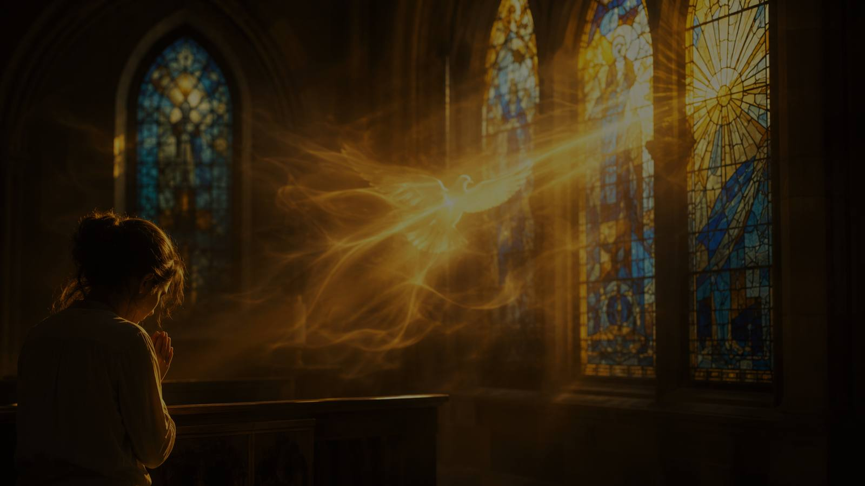
Let It Breathe on Me
A gospel song of prayer for the Holy Spirit’s renewing breath
Magnolia Lewis-Butts • 1942 • John 20:22
Hymn Study Teaching Guide
Prepared for teaching and small group use - hymninfo.com

Slide 2
Teaching Aim
What this lesson should accomplish
U
F
P
Understand
Feel
Practice
John 20:22 anchors the song’s prayer for the Spirit.
Dependence on God is the posture of renewal.
Pray for the Spirit’s work in worship and witness.
Prepared for teaching and small group use - hymninfo.com

Slide 3
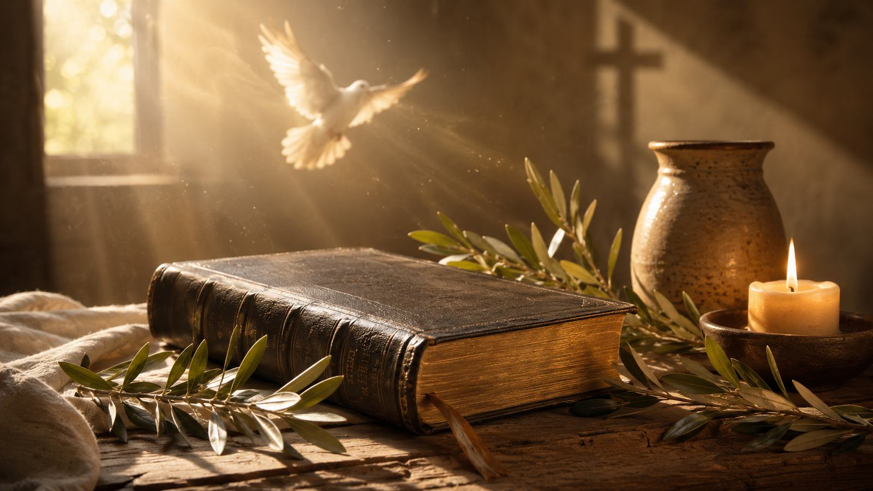
Hymn Identity
Key facts for teachers and worship planners
Title: Let It Breathe on Me
First line: Let it breathe on me
Writer and composer: Magnolia Lewis-Butts
Common date: 1942
Tune: LET IT BREATHE ON ME
Meter: irregular meter
Dominant image: the breath of the risen Christ, bringing Spirit, life, renewal, and witness.
Prepared for teaching and small group use - hymninfo.com

Slide 4

Biblical Breath
The song begins where Scripture teaches us to pray: with Christ, the Spirit, and the life only God can give.
Prepared for teaching and small group use - hymninfo.com

Slide 5
Biblical Foundation
John 20:22 - the risen Jesus breathes on his disciples.
Acts 2:1-4 - the Spirit fills the gathered church with power.
Ezekiel 37:9-10 - divine breath brings life to what was dead.
Psalm 51:10-12 - the heart needs renewal and restored joy.
Titus 3:5-6 - the Spirit renews through Christ’s mercy.
Teaching emphasis: the song is a prayer for God’s life-giving presence, not a technique for stirring emotion.
Prepared for teaching and small group use - hymninfo.com

Slide 6
Scripture Pathway
Five passages that help the class read the song faithfully
1
2
3
4
5
John 20:22
Acts 2:1-4
Ezekiel 37:9-10
Psalm 51:10-12
Titus 3:5-6
Receive the Holy Spirit
Wind, fire, and witness
Breath gives life
A renewed heart
Renewal through Christ
A 30-minute lesson can walk this pathway as a brief Bible study before discussing worship use.
Prepared for teaching and small group use - hymninfo.com

Slide 7

Song Study
The hymn is best taught by tracing its central images: breath, life, renewal, worship, and witness.
Prepared for teaching and small group use - hymninfo.com

Slide 8
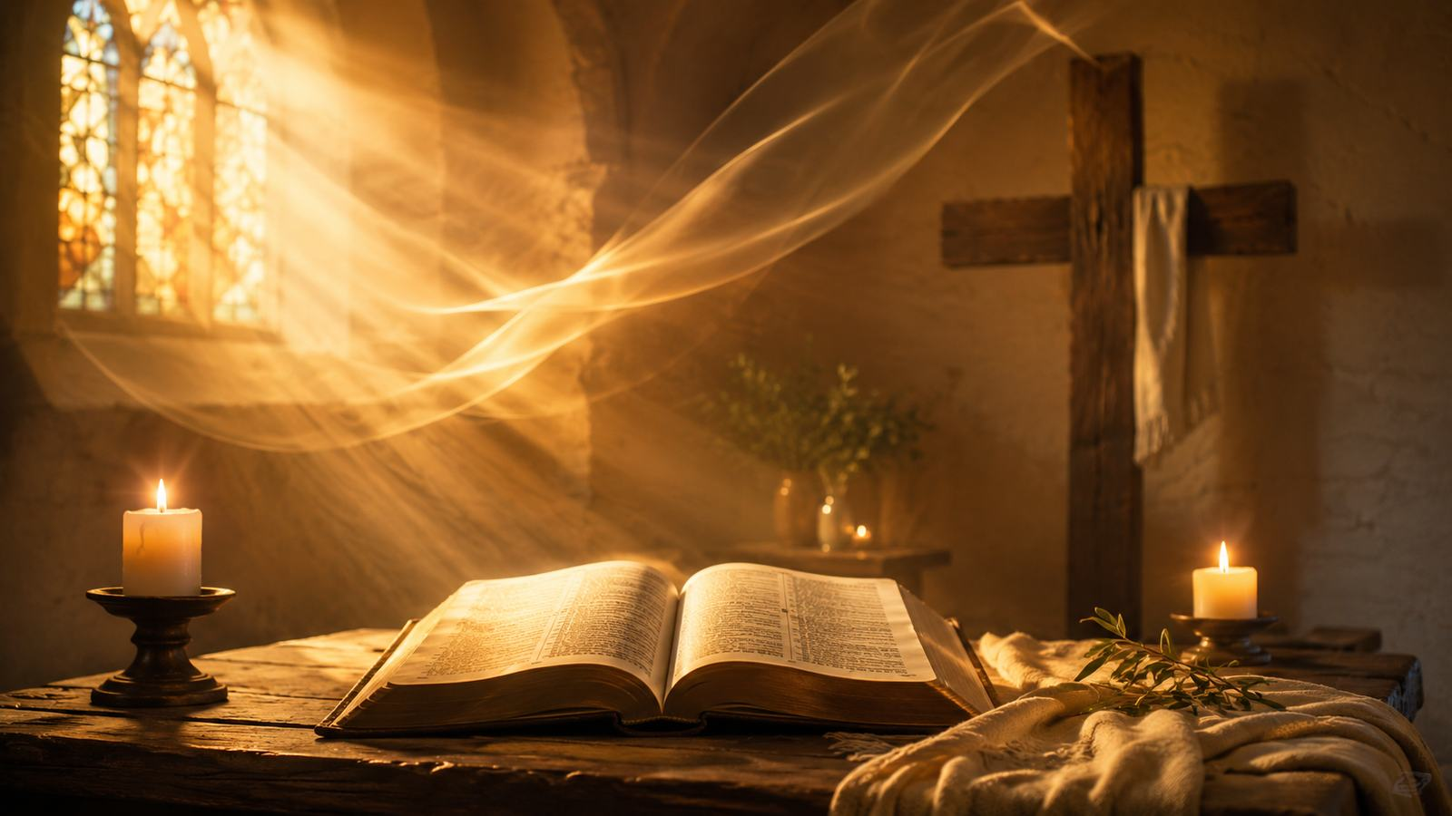
Prayer for Breath
A humble plea for God’s living presence
The song begins with need rather than self-confidence.
Breath language makes prayer personal, bodily, and dependent.
The class should hear the prayer as a request for the Spirit’s work, not a demand for a particular feeling.
Connect this prayer to the risen Christ in John 20:22.
Prepared for teaching and small group use - hymninfo.com

Slide 9

Breath That Gives Life
Ezekiel’s valley teaches that God’s breath brings life where human power cannot. The hymn’s prayer belongs to people who know their need for divine renewal.
Teaching question: Where do we need God to breathe new life?
Prepared for teaching and small group use - hymninfo.com

Slide 10
Renewal for Worship
The Spirit restores honest prayer and living praise
1
2
3
Clean Heart
Restored Joy
Willing Spirit
Psalm 51 asks God to create and renew.
The Spirit does not ignore sorrow; he restores joy in salvation.
Renewal moves from prayer to obedience.
Prepared for teaching and small group use - hymninfo.com

Slide 11
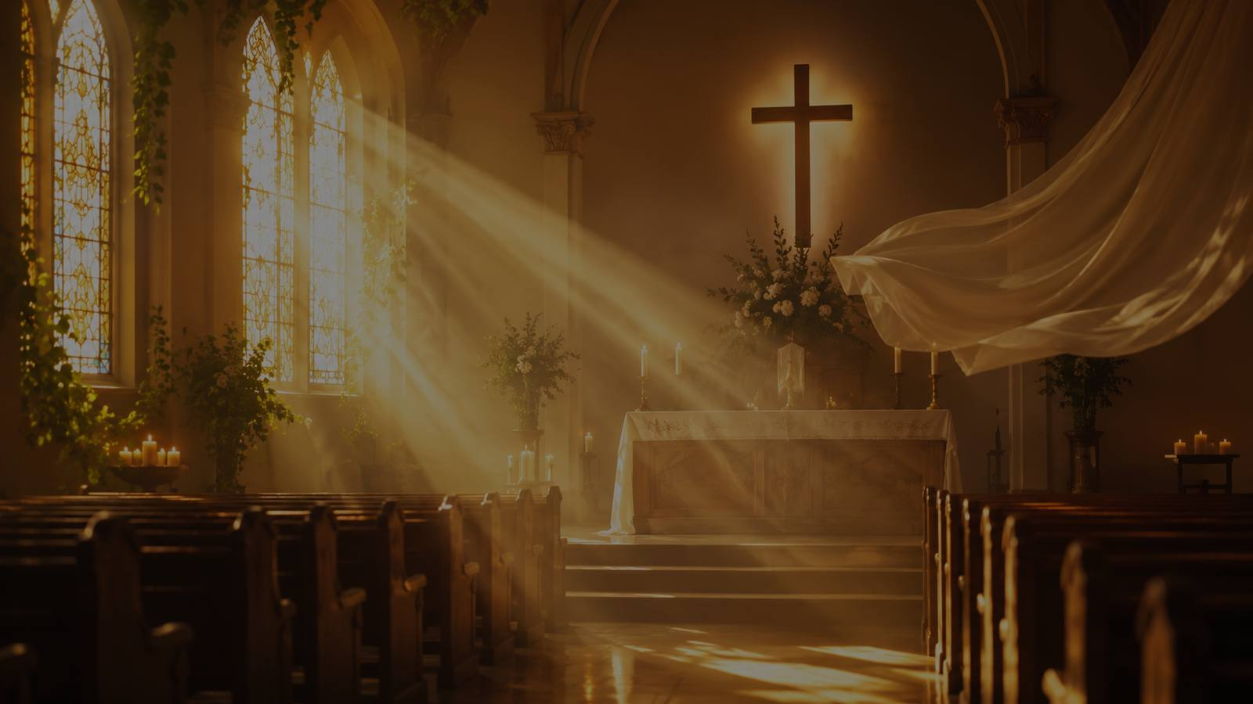
Power for Witness
Acts 2 reminds the church that the Spirit’s breath is not only for comfort. God renews his people so they can speak, serve, forgive, and bear witness.
From fear to courage
From private prayer to public witness
From fatigue to faithful service
From scattered hearts to one worshiping body
Prepared for teaching and small group use - hymninfo.com

Slide 12
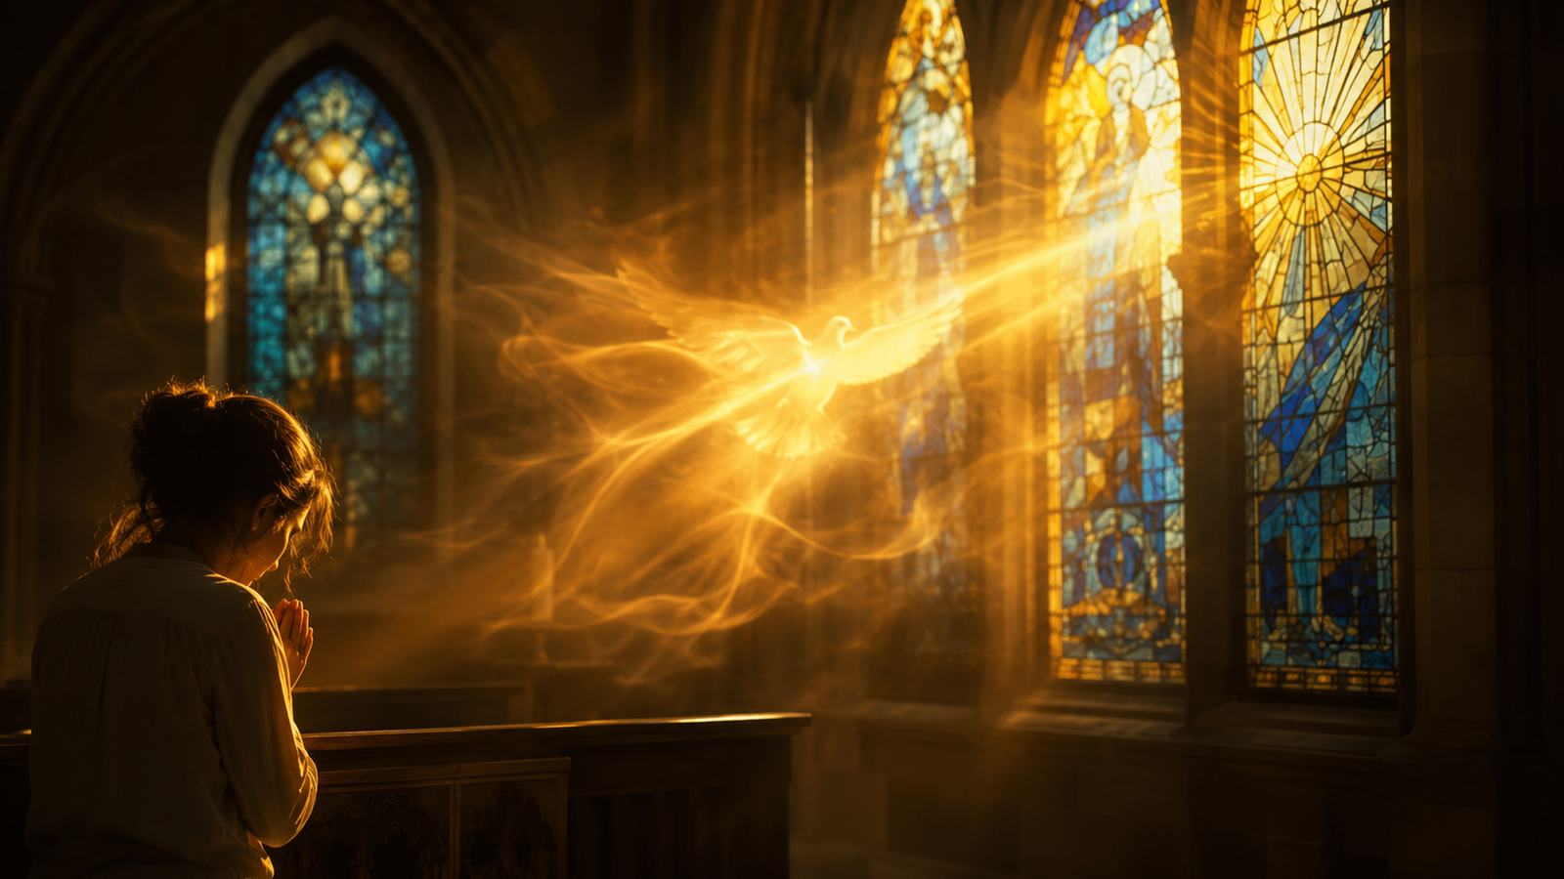
The Central Prayer
How the song functions in congregational singing
A repeated prayer can teach the whole church to ask together for renewal. The strength of this gospel song is its clarity: God’s people need the Spirit’s breath for worship, holiness, and service.
Use it as prayer, not as performance.
Prepared for teaching and small group use - hymninfo.com

Slide 13
Theological Themes
Major ideas to teach carefully
Holy Spirit
Prayer
Renewal
A
B
C
God’s renewing presence
Humble dependence
Fresh life for weary hearts
Presence
Pentecost
Grace
D
E
F
God with his people
Power for witness
Life received, not produced
Prepared for teaching and small group use - hymninfo.com

Slide 14
Literary and Musical Observations
Teaching the sound and shape of the song
The text is concise and prayer-like.
The repeated request gives the congregation one shared voice.
The central image is breath: life, renewal, and Spirit.
The tone should be reverent and expectant.
The tune is commonly treated as irregular meter.
The melody is brief, memorable, and suited for prayer response.
It can be led by soloist, choir, piano, organ, or congregation.
Avoid rushing; let the prayer breathe.
Prepared for teaching and small group use - hymninfo.com

Slide 15
Pastoral and Worship Use
Pentecost services
Prayer meetings and renewal services
Response after Scripture or sermon
Quiet congregational prayer
Choir or solo leadership before congregational response
Pastoral caution: do not manipulate emotion. Let Scripture, prayer, and silence make room for the Spirit’s work.
Prepared for teaching and small group use - hymninfo.com

Slide 16
Teaching Questions
For class discussion or choir rehearsal
How does John 20:22 shape the meaning of the song?
What is the biblical relationship between breath, Spirit, and life?
Why can a short repeated prayer be strong in congregational worship?
How can churches seek renewal without forcing emotional display?
What would Spirit-led worship and witness look like in our congregation?
Prepared for teaching and small group use - hymninfo.com

Slide 17
Suggested Lesson Flow
Choose a 30-minute or 60-minute path
30 Minutes
60 Minutes
Opening prayer - 2 min
John 20:22 - 8 min
Hymn background - 6 min
Themes and worship use - 8 min
Closing prayer - 6 min
Opening reflection - 6 min
Scripture pathway - 18 min
Song-section study - 16 min
Worship planning discussion - 10 min
Prayer response - 10 min
Prepared for teaching and small group use - hymninfo.com

Slide 18
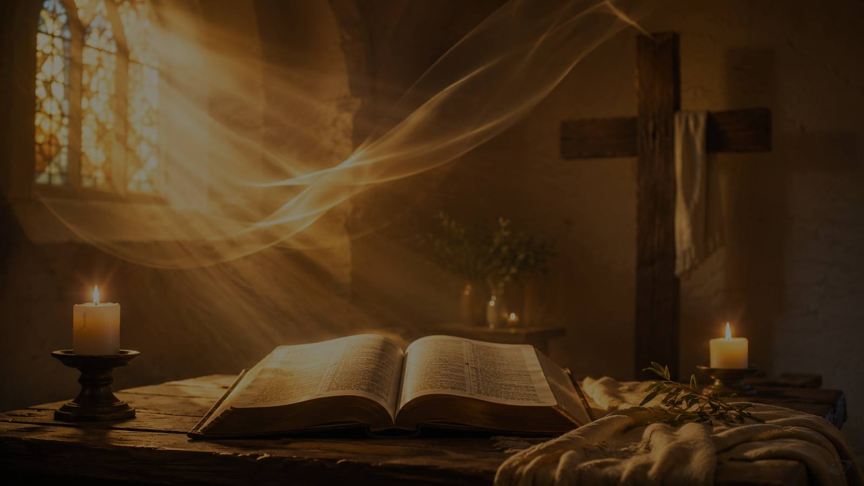
Closing Prayer
Risen Christ, breathe your Spirit upon us. Renew dry hearts, restore joy, and send us out in faithful witness. Amen.
© HymnInfo.com. Free for personal, church, classroom, and small-group teaching use. Please do not sell, repost, or redistribute as downloadable files without permission.
Prepared for teaching and small group use - hymninfo.com

