Slide 1

I Surrender All
All to Jesus I surrender • Judson W. Van DeVenter • Winfield Scott Weeden • 1896
Prepared for teaching and small group use - hymninfo.com
1

Slide 2

Teaching Aim
1
Understand
2
Feel
3
Practice
Consecration grows from the mercy of God.
The freedom of belonging wholly to Christ.
A daily offering of trust and obedience.
Prepared for teaching and small group use - hymninfo.com
2

Slide 3

Hymn Identity
Title: I Surrender All
First line: All to Jesus I surrender
Text: Judson W. Van DeVenter; Music: Winfield Scott Weeden
Tune: SURRENDER; Meter: 8.7.8.7 with refrain
First published in Gospel Songs of Grace and Glory, 1896
Gospel hymn of consecration, discipleship, and devotion
Prepared for teaching and small group use - hymninfo.com
3

Slide 4
Historical Setting
A gospel song shaped by personal decision and evangelistic worship
Prepared for teaching and small group use - hymninfo.com
4

Slide 5
Van DeVenter and Weeden
Judson W. Van DeVenter was an American hymn writer, evangelist, art teacher, and musician.
Hymn accounts connect the text with his vocational struggle and his decision to give himself to evangelistic ministry.
Winfield Scott Weeden composed the tune SURRENDER and worked with Van DeVenter in evangelistic settings.
The hymn belongs to a gospel-song tradition where congregational singing often became a moment of prayerful response.
Prepared for teaching and small group use - hymninfo.com
5

Slide 6

Why This Hymn Matters Today
It gives believers plain words for renewed consecration.
It keeps discipleship personal without reducing it to private feeling.
It can support confession, recommitment, baptismal reflection, prayer, and altar response.
It needs careful teaching: surrender is a response to grace, not a way to earn God’s favor.
Prepared for teaching and small group use - hymninfo.com
6

Slide 7
Biblical Foundation
“Present your bodies as a living sacrifice.”
Prepared for teaching and small group use - hymninfo.com
7

Slide 8
Romans 12:1-2
Living sacrifice • transformed mind • discerning obedience
Paul roots consecration in “the mercies of God.”
The whole self becomes worship: body, mind, habits, desires, and relationships.
Transformation comes through renewed thinking, not mere outward pressure.
This passage is the strongest biblical lens for the hymn’s central prayer.
Prepared for teaching and small group use - hymninfo.com
8

Slide 9

Other Scripture Connections
Luke 9:23-24 - discipleship involves self-denial and taking up the cross.
Luke 14:33 - Jesus calls for undivided allegiance.
Galatians 2:20 - the surrendered life is life in union with Christ.
Philippians 3:7-8 - all gains are revalued in light of knowing Christ.
Prepared for teaching and small group use - hymninfo.com
9

Slide 10
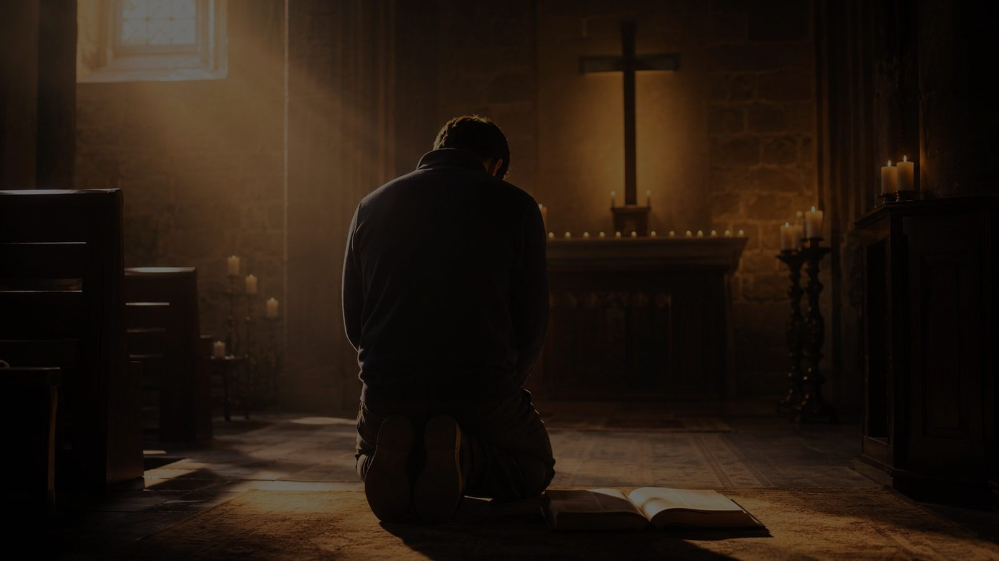
Hymn-Section Study
Five movements of consecration and trust
Prepared for teaching and small group use - hymninfo.com
10

Slide 11
1. Whole-Life Offering
The hymn begins with the whole person brought before Jesus.
Surrender is freely given, not forced by fear.
Teaching emphasis: trust grows from knowing Christ’s character.
Prepared for teaching and small group use - hymninfo.com
11

Slide 12
2. Humility at Christ’s Feet
The prayer moves from intention to posture: humility before the Savior.
Lesser loves are released so Christ may be loved without rivalry.
Teaching emphasis: self-denial is not self-hatred, but reordered love.
Prepared for teaching and small group use - hymninfo.com
12

Slide 13
3. Made Wholly Christ’s
The hymn asks for the Spirit’s filling and divine power.
Consecration is linked with sanctification, not self-improvement alone.
Teaching emphasis: God forms what we offer to him.
Prepared for teaching and small group use - hymninfo.com
13

Slide 14
4. Self-Giving and Blessing
The believer offers the self and asks to be filled with love and strength.
Surrender should produce obedience, service, and holy affection.
Teaching emphasis: the surrendered life becomes useful in Christ’s hands.
Prepared for teaching and small group use - hymninfo.com
14

Slide 15
5. Joy in Full Salvation
The closing movement joins surrender with joy, salvation, and praise.
The hymn does not end in loss, but in glad belonging.
Teaching emphasis: Christ receives the life in order to fill it with himself.
Prepared for teaching and small group use - hymninfo.com
15

Slide 16

The Refrain as Prayer
The repeated confession makes the hymn easy to remember and hard to sing casually.
In worship, repetition can become either sentiment or sincere prayer; teaching helps the congregation choose prayer.
A slower tempo and a moment of silence can let the refrain become personal response rather than performance.
Prepared for teaching and small group use - hymninfo.com
16

Slide 17
Theological Themes
Grace before response
Consecration as whole-life worship
Discipleship under the lordship of Christ
Sanctification by the Spirit
Joyful obedience and freedom in Christ
Prayerful recommitment in the gathered church
Prepared for teaching and small group use - hymninfo.com
17

Slide 18
Consecration, Not Earning Salvation
The hymn should not be taught as a human work that wins acceptance from God.
Romans 12 begins with mercy. Surrender follows grace.
The believer offers the self because Christ has already given himself.
This distinction protects tender consciences and keeps the gospel clear.
Prepared for teaching and small group use - hymninfo.com
18

Slide 19
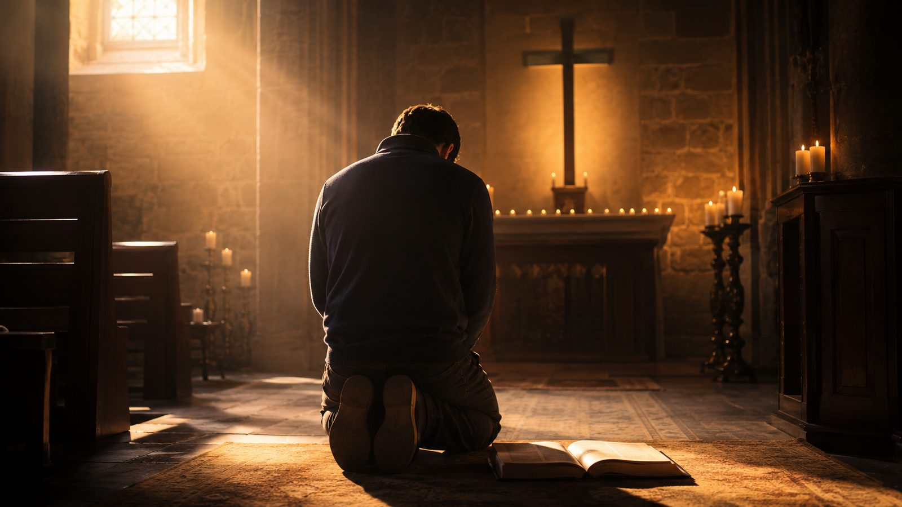
Literary and Musical Observations
Tune: SURRENDER, composed by Winfield Scott Weeden.
Meter commonly given as 8.7.8.7 with refrain.
The melody is flowing and memorable, designed for congregational participation.
The refrain gives the hymn its devotional force and invitation character.
Moderate tempo keeps the song prayerful rather than merely sentimental.
Prepared for teaching and small group use - hymninfo.com
19

Slide 20
Pastoral and Worship Use
Services of recommitment or renewal
Sermons on discipleship, obedience, sanctification, or Romans 12
Baptismal reflection or confirmation teaching
Personal prayer, altar response, or devotional worship
Pastoral caution: invite surrender through grace, not guilt-driven pressure.
Prepared for teaching and small group use - hymninfo.com
20

Slide 21
Teaching Questions
What does Romans 12:1-2 teach about surrender?
How is surrender to Christ different from passive resignation?
What areas of life are hardest to offer to God?
How can churches invite commitment without manipulating emotion?
How does Galatians 2:20 connect surrender with union with Christ?
Prepared for teaching and small group use - hymninfo.com
21

Slide 22
Application: Surrender This Week
Name one area of life to offer to Christ each morning.
Practice one hidden act of obedience that no one else needs to see.
Release one lesser attachment that is shaping your choices too strongly.
Pray before making a decision: “Lord, make me willing to obey.”
Let surrender lead to concrete love for a real person.
Prepared for teaching and small group use - hymninfo.com
22

Slide 23
Suggested Lesson Flow
30 minutes: open with Romans 12:1-2, give brief background, discuss surrender and grace, close in silent prayer.
60 minutes: add hymn-section study, compare Luke 9 and Galatians 2, discuss worship use, and write a personal prayer of consecration.
Optional choir note: sing one stanza reflectively, then speak the Scripture before singing the refrain again.
Prepared for teaching and small group use - hymninfo.com
23

Slide 24
Closing Summary
The hymn’s central word is “all,” but its foundation is mercy.
Christ does not ask for what he himself has not given: he gave himself first.
Surrender is the free, grateful offering of the whole self to the Lord who saves, renews, and leads.
Prepared for teaching and small group use - hymninfo.com
24

Slide 25
Closing Prayer
Merciful Savior, receive our lives as an offering of gratitude. Free us from divided loyalties, renew our minds, and teach us to follow you with joyful trust. Amen.
© HymnInfo.com. Free for personal, church, classroom, and small-group teaching use. Please do not sell, repost, or redistribute as downloadable files without permission.
Prepared for teaching and small group use - hymninfo.com
25

