Slide 1

Lord of the Dance
A hymn study on Christ, discipleship, suffering, and resurrection joy
First line: “I danced in the morning when the world was begun”
Sydney Carter, 1963 • Melody adapted from SIMPLE GIFTS
Primary Scripture: Matthew 4:18–22
Prepared for teaching and small group use - hymninfo.com

Slide 2

Teaching Aim
What this session should form in learners
☩
Understand
The song retells the Gospel story through movement: creation, calling, cross, and resurrection.
♪
Feel
A sober joy: gladness that does not skip the suffering of Christ.
→
Practice
Follow Christ actively, not as spectators but as disciples joined to his mission.
Prepared for teaching and small group use - hymninfo.com

Slide 3
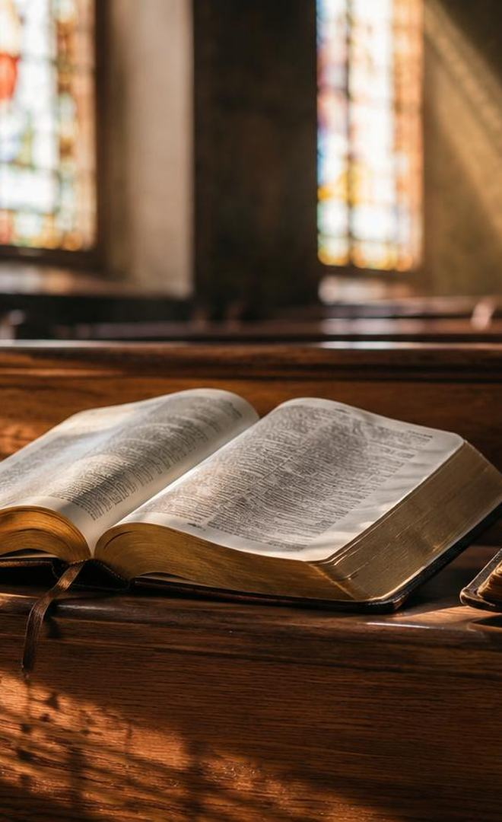
Hymn Identity
A modern folk carol for teaching the story of Jesus
Title
Lord of the Dance
First line
I danced in the morning when the world was begun
Text
Sydney Bertram Carter, 1963
Tune
Adapted from SIMPLE GIFTS
Original Shaker melody
Traditionally attributed to Joseph Brackett Jr.
Key emphasis
Joyful discipleship rooted in Christ’s death and resurrection
Prepared for teaching and small group use - hymninfo.com

Slide 4

Historical Background
• Sydney Carter wrote the song in 1963 and called it a carol.• It uses folk idiom to tell the story of Jesus in a vivid first-person narrative.• The melody draws from SIMPLE GIFTS, a Shaker tune often linked with Joseph Brackett Jr.• Its quick spread in schools, youth gatherings, and hymnals shows the power of a memorable tune joined to a dramatic Gospel story.
Folk melody
Gospel narrative
Joyful movement
Prepared for teaching and small group use - hymninfo.com

Slide 5

Why This Hymn Matters Today
Joyful faith needs biblical depth
It helps people remember the full arc of Christ’s story.
It gives worship a language of movement and response.
It works well with children, youth, and intergenerational teaching.
It needs careful framing so the metaphor serves the Gospel rather than replacing it.
Teach the song as Gospel story, not mere religious cheerfulness.
Prepared for teaching and small group use - hymninfo.com

Slide 6

Biblical Foundation
John 1:1–3
Matthew 4:18–22
The Word before creation
The call to follow
John 19:17–30
Matthew 28:5–7
The way of the cross
The announcement of resurrection
The hymn is an imaginative retelling. Scripture gives the boundaries and the center.
Prepared for teaching and small group use - hymninfo.com

Slide 7

Hymn Section Study 1
Christ before the world began
The opening movement is cosmic: Christ is placed before creation.
John 1 anchors this picture in the eternal Word, not in vague spirituality.
Teaching emphasis: Christian joy begins with who Christ is before it becomes what we do.
Scripture anchor: John 1:1–3
Prepared for teaching and small group use - hymninfo.com

Slide 8
Hymn Section Study 2
The call to join Christ’s way
The song’s energy points toward response: Christ calls, and disciples follow.
Matthew 4 shows discipleship as concrete movement, not admiration from a distance.
Teaching emphasis: following Jesus requires reordering life around his voice.
Scripture anchor: Matthew 4:18–22
Prepared for teaching and small group use - hymninfo.com

Slide 9
Hymn Section Study 3
A generation that will not respond
Jesus once described people who would not join either joy or lament.
The dance image can expose the danger of spiritual refusal.
Teaching emphasis: the Gospel calls for honest response, not detached spectatorship.
Scripture anchor: Matthew 11:16–17
Prepared for teaching and small group use - hymninfo.com

Slide 10

Hymn Section Study 4
The Cross
The hymn’s joy passes through suffering, rejection, and death. Its movement must never make the cross feel decorative or light.
Teaching emphasis: Christian joy is cruciform. It is shaped by Christ’s costly love.
Scripture anchor: John 19:17–30
Prepared for teaching and small group use - hymninfo.com

Slide 11

Hymn Section Study 5
Resurrection joy and witness
The Gospel movement does not end at the grave.
Matthew 28 turns fear into proclamation: Christ is risen.
Teaching emphasis: resurrection joy sends the church into witness, not escapism.
Scripture anchor: Matthew 28:5–7
Prepared for teaching and small group use - hymninfo.com

Slide 12
The Central Invitation
The repeated call gathers the whole song into one pastoral question: Will we follow Christ through his story into resurrection life?
1
Hear
2
Follow
3
Witness
Christ’s voice in Scripture.
Move from admiration to obedience.
Carry Easter hope into the world.
Prepared for teaching and small group use - hymninfo.com

Slide 13
Theological Themes
What the song can teach when framed carefully
Christology
Discipleship
Jesus is central to creation, calling, cross, and resurrection.
Faith becomes active following.
Joy
Cruciform life
Christian gladness is rooted in Easter.
The path of Christ passes through costly obedience.
Witness
Resurrection creates a sending people.
Prepared for teaching and small group use - hymninfo.com

Slide 14
Teaching the Metaphor Wisely
Let the image serve the Gospel
Affirm poetic imagination as a gift for worship and memory.
Keep the biblical story clearer than the metaphor itself.
Explain that joy in the hymn is not denial of sin, suffering, or death.
Handle Passion language carefully and reject collective blame of Jewish people.
Prepared for teaching and small group use - hymninfo.com

Slide 15
Literary and Musical Observations
Folk energy with narrative force
The first-person voice makes the narrative immediate and memorable.
The tune’s folk-like contour encourages participation.
The recurring call gives the congregation a musical act of response.
A lively tempo helps the hymn move; excessive speed weakens the story.
Prepared for teaching and small group use - hymninfo.com

Slide 16

Pastoral and Worship Use
Eastertide
Discipleship services
Emphasize resurrection joy and witness.
Pair with Gospel call narratives.
Youth or intergenerational worship
Choir rehearsal
Teach the story before singing.
Shape tempo so the text remains clear.
Prepared for teaching and small group use - hymninfo.com

Slide 17
Choir and Congregational Notes
Sing with joy, but keep the story intelligible
Begin with a clear introduction so the congregation enters confidently.
Avoid rushing the narrative; each section needs breath.
Let accompaniment support movement without making the song feel comic or casual.
Consider a spoken Scripture reading before the hymn in teaching settings.
Prepared for teaching and small group use - hymninfo.com

Slide 18
Teaching Questions
For class, choir, or worship planning discussion
What does the image of dance communicate about following Christ?
Where does the metaphor need biblical boundaries?
How does the hymn move from creation to resurrection?
What makes Christian joy different from mere optimism?
How should churches frame the Passion material with care?
Prepared for teaching and small group use - hymninfo.com

Slide 19
Application
Responding as followers of the risen Christ
Move from spectatorship to obedience.
Let joy be honest about suffering and rooted in the resurrection.
Use creative worship language responsibly and biblically.
Bear witness to Christ in speech, mercy, and faithful living.
Christian joy follows the risen Lord.
Prepared for teaching and small group use - hymninfo.com

Slide 20
Suggested Lesson Flow
Two ways to teach the hymn
30 minutes
60 minutes
• Read Matthew 4
• Give brief background
• Trace the Gospel arc
• Discuss one application
• Pray
• Open with John 1
• Teach background
• Study four Gospel scenes
• Discuss metaphor and limits
• Plan worship use
• Pray for discipleship
Prepared for teaching and small group use - hymninfo.com

Slide 21
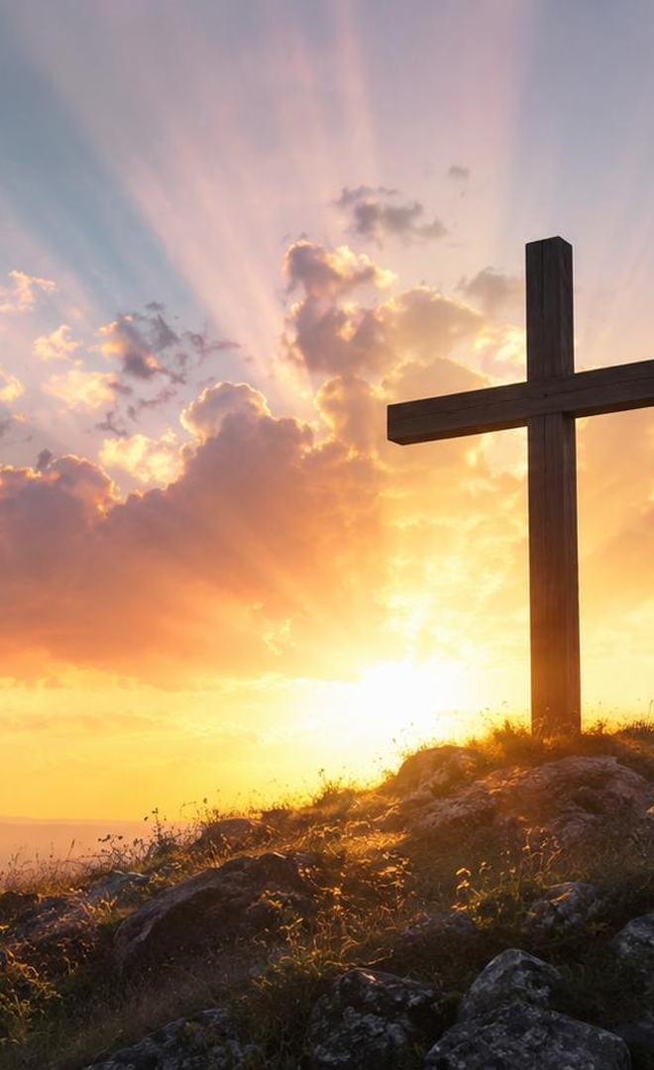
Pastoral Cautions
Truthfulness in joyful worship
Do not let the lively tune make the cross seem incidental.
Do not teach the metaphor as a replacement for biblical language about Christ.
Avoid readings of the Passion that blame an ethnic or religious group collectively.
Do not let performance energy overpower congregational prayer and response.
Prepared for teaching and small group use - hymninfo.com

Slide 22

Closing Summary and Prayer
Christ is Lord from the beginning, caller of disciples, crucified Savior, and risen leader of his people. The church follows with sober joy.
Lord Jesus, lead us from spectatorship into faithful following. Teach us joy shaped by the cross and strengthened by your resurrection. Amen.
Prepared for teaching and small group use - hymninfo.com

Slide 23
For Teaching and Small Group Use
© HymnInfo.com. Free for personal, church, classroom, and small-group teaching use. Please do not sell, repost, or redistribute as downloadable files without permission.
Prepared for teaching and small group use - hymninfo.com

