Slide 1
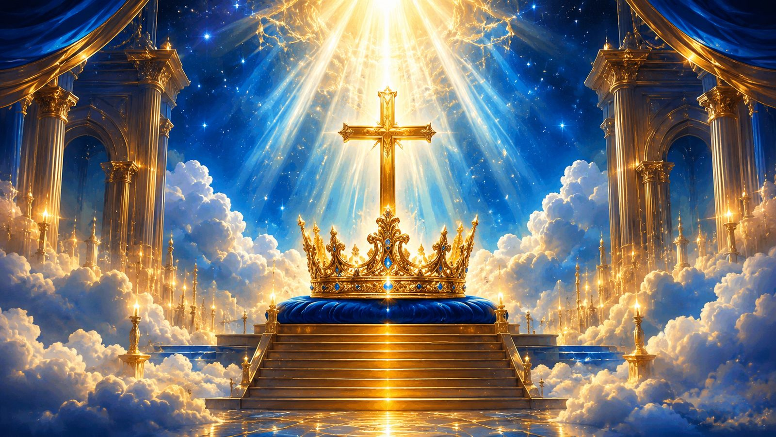
All Hail the Power
of Jesus' Name
Teaching Guide
First line: All hail the power of Jesus' name
Text: Edward Perronet • 1779
Tune: CORONATION • Oliver Holden
Primary Scripture: Philippians 2:9-11
A hymn of Christ's exalted name, saving reign, and universal praise.
Prepared for teaching and small group use - hymninfo.com

Slide 2

Teaching Aim
By the end of the lesson, learners should:
1
Understand
2
Feel
3
Practice
Christ is exalted because the crucified Savior has been raised and enthroned by the Father.
Reverent confidence before the name above every name, especially when earthly powers appear strong.
Sing, pray, and live with visible allegiance to Jesus as Lord of all.
The hymn does more than praise Christ; it trains the church to give him the crown in worship, decision, obedience, and hope.
Prepared for teaching and small group use - hymninfo.com

Slide 3
Hymn Identity
Title
All Hail the Power of Jesus' Name
Core confession
First line
All hail the power of Jesus' name
Jesus bears the name above every name, reigns over every authority, saves by grace, and receives the everlasting praise of his people.
Lyricist
Edward Perronet
Common tune
CORONATION
Composer
Oliver Holden
Year
1779
The repeated coronation language turns congregational singing into an act of allegiance.
Alternate tune
DIADEM
Prepared for teaching and small group use - hymninfo.com

Slide 4

Historical Background
Edward Perronet wrote the hymn in the setting of eighteenth-century evangelical renewal. Though associated with the Wesleys and early Methodism, Perronet is remembered most for this single, majestic hymn of praise.
Oliver Holden composed CORONATION in 1793. Its bold, stately movement gives the hymn a public, processional character. Many congregations also know the hymn with DIADEM, another grand setting.
The text became widely loved because it combines clear biblical doctrine with strong congregational language: Christ is not merely admired; he is crowned.
Across generations, the hymn has helped churches sing the lordship of Christ with conviction, especially in services of praise, mission, ordination, and Christ the King emphasis.
Prepared for teaching and small group use - hymninfo.com

Slide 5

Why This Hymn Matters Today
Worship
Allegiance
Hope
It centers the church on the exalted Christ rather than on mood, preference, or personality.
It asks worshipers to give Christ the highest loyalty in public and private life.
It strengthens believers with the final victory and universal praise of Jesus.
In a divided and anxious world, the hymn teaches a steady confession: the throne is not empty, and the final song belongs to Christ.
Prepared for teaching and small group use - hymninfo.com

Slide 6
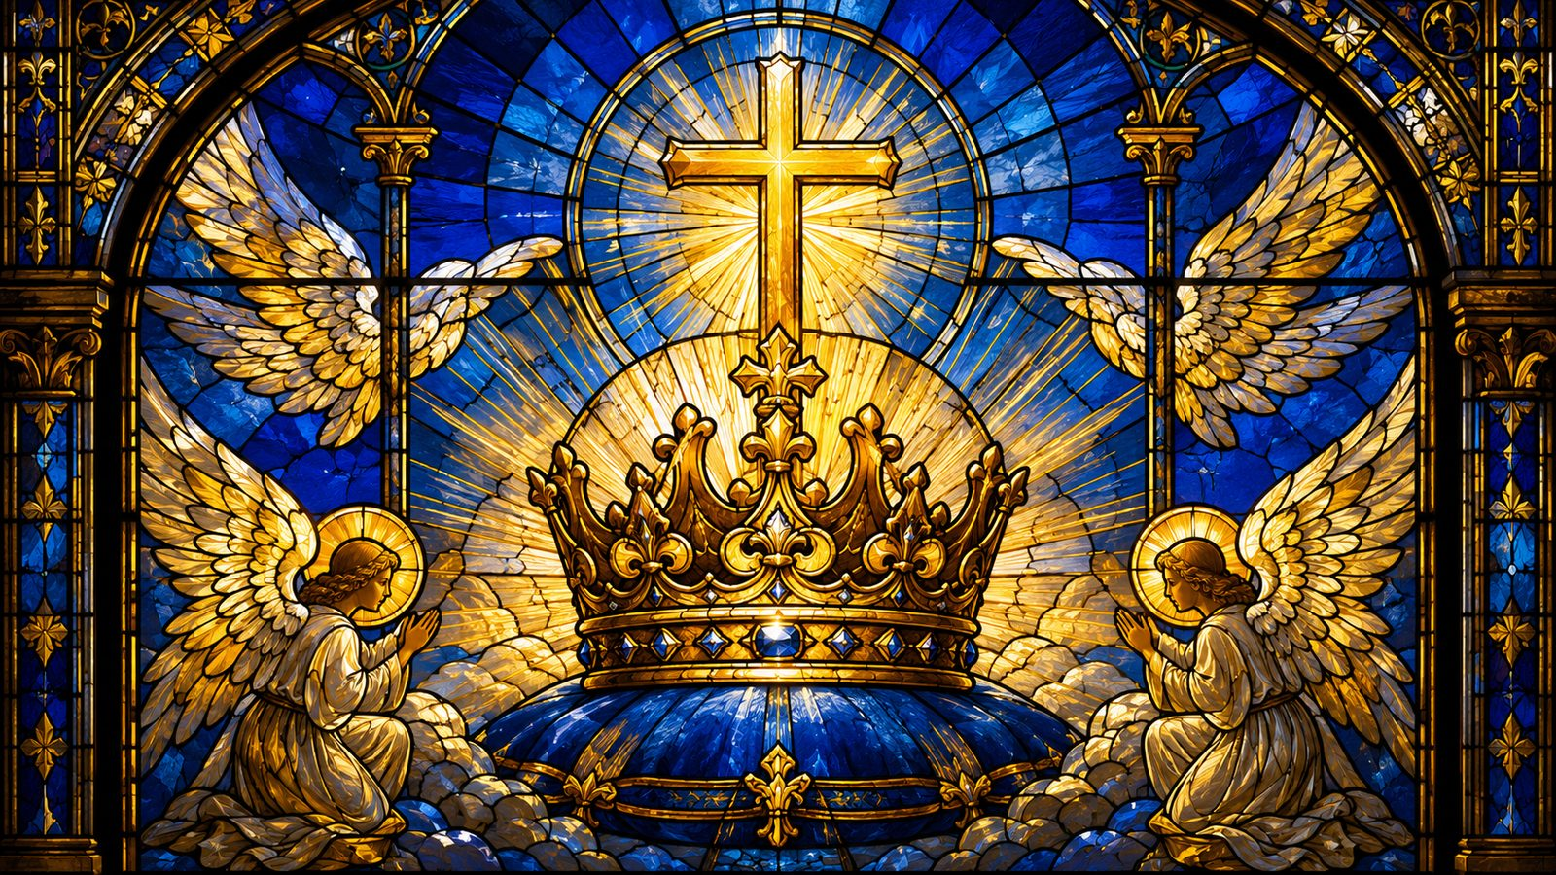
Biblical Foundation
The exalted name, the worthy Lamb, and the Lord of all creation
Prepared for teaching and small group use - hymninfo.com

Slide 7
Biblical Foundation
P
Philippians 2:9-11
R
Revelation 5:11-13
Every knee bows and every tongue confesses that Jesus Christ is Lord.
The Lamb receives blessing, honor, glory, and dominion from all creation.
A
Acts 4:12
E
Ephesians 1:20-22
There is salvation in no other name under heaven.
Christ is seated above every rule, authority, power, and dominion.
Teaching emphasis: the hymn is not simply royal imagery. It is biblical confession set to music.
Prepared for teaching and small group use - hymninfo.com

Slide 8
Hymn Movement
From heavenly summons to redeemed praise and everlasting song
Prepared for teaching and small group use - hymninfo.com

Slide 9
Stanza 1: Heaven Honors the Name
The opening summons moves the worshiper into the heavenly court. Angels fall before the name of Jesus, and the church joins a worship already underway in heaven.
Key Scripture
Hebrews 1:6
“Let all the angels of God worship him.”
Teaching focus: Christ is not exalted by our praise as though he lacked honor. We crown him because God has already exalted him.
Prepared for teaching and small group use - hymninfo.com

Slide 10
Stanza 2: Grace Gives the Song
The hymn calls redeemed people to hail the Savior who rescued them by grace. Praise is not earned by spiritual achievement; it rises from mercy received.
Saved by grace
The hymn joins praise to salvation: Christ is crowned by those he has redeemed.
For teaching: ask learners how worship changes when it begins with grace rather than performance.
Acts 4:12
The saving name of Jesus is the church's only sure ground.
Prepared for teaching and small group use - hymninfo.com

Slide 11
Stanza 3: Every Tribe and Nation
The circle widens.
The hymn refuses to keep Christ small. Every people group, every language, every place, and every power belongs under the lordship of Jesus. This is not domination by force but the rightful worship of the Redeemer King.
Mission connection: Christian witness invites the nations into the praise that Revelation already promises will fill creation.
Revelation 5:13
Prepared for teaching and small group use - hymninfo.com

Slide 12
Stanza 4: The Everlasting Song
Present praise rehearses future worship.
The final movement looks toward the sacred throng gathered around Christ. The church sings now because, in the end, all creation will confess what is already true: Jesus Christ is Lord.
Pastoral note: this stanza is especially fitting when the church needs hope beyond grief, conflict, or weariness.
Prepared for teaching and small group use - hymninfo.com

Slide 13
The Coronation Refrain
The recurring phrase “Lord of all” functions like a congregational vow. Each repetition places Christ's crown back where it belongs.
Worship
Sing with strength, not haste. Let the refrain sound like proclamation.
Teaching
It is simple enough for children to remember and strong enough to carry mature Christian doctrine.
Ask: where does my life still resist the words I am singing?
Prepared for teaching and small group use - hymninfo.com

Slide 14
Theological Themes
1
Exaltation
2
Salvation
3
Sovereignty
God has raised and enthroned Jesus.
The saving name is Jesus alone.
Christ reigns over every authority.
4
Worship
5
Mission
6
Hope
Angels and redeemed sinners bow before him.
Every tribe and nation belongs in the song.
The church anticipates the everlasting praise of heaven.
Prepared for teaching and small group use - hymninfo.com

Slide 15
Literary and Musical Observations
The text moves from heaven to earth, from angels to redeemed sinners, from particular people to every tribe, and finally to the everlasting song. Its widening scope is part of its power.
Choir / Worship Planner Tip
Use a firm tempo and broad dynamic growth so the final stanza sounds like the whole congregation joining the heavenly chorus.
CORONATION gives the hymn a bold, stately character. DIADEM offers a broader, more expansive setting. Both can serve the same confession with different musical color.
Prepared for teaching and small group use - hymninfo.com

Slide 16
Pastoral and Worship Use
Opening Hymn
Christ the King
Mission Emphasis
Begins worship with Christ's lordship, not with human need.
A natural fit for services focused on Christ's reign and exaltation.
Connects the praise of Jesus to every tribe and nation.
Ordination
Funeral Hope
Frames ministry as service under Christ's crown.
Points grief toward the everlasting song before the Lamb.
Prepared for teaching and small group use - hymninfo.com

Slide 17

Teaching Questions
1.
What does it mean to crown Jesus Lord in ordinary life?
2.
How does Philippians 2 connect humility, cross, and exaltation?
3.
Why does the hymn summon both angels and redeemed sinners?
4.
What rival loyalties compete with Christ's lordship?
5.
How does Revelation 5 enlarge our view of congregational worship?
6.
Where does your church need renewed confidence in the reign of Christ?
Prepared for teaching and small group use - hymninfo.com

Slide 18
Suggested Lesson Flow
30-minute class
60-minute class
1
Read Philippians 2:9-11
1
Open with Revelation 5
2
Introduce Perronet and CORONATION
2
Compare tune character
3
Teach the hymn movement
3
Study each stanza movement
4
Discuss worship as allegiance
4
Discuss one rival loyalty
5
Plan a congregational application
5
Close with prayer and singing
6
Pray the final response together
Prepared for teaching and small group use - hymninfo.com

Slide 19
Closing Summary and Prayer
The hymn gathers the church around one great confession: Jesus Christ is Lord. Angels worship him, sinners are saved by him, nations belong to him, and the everlasting song will crown him Lord of all.
Lord Jesus Christ, receive our worship, reorder our loyalties, and make our lives a faithful confession of your reign. Amen.
© HymnInfo.com. Free for personal, church, classroom, and small-group teaching use. Please do not sell, repost, or redistribute as downloadable files without permission.
Prepared for teaching and small group use - hymninfo.com

