Slide 1
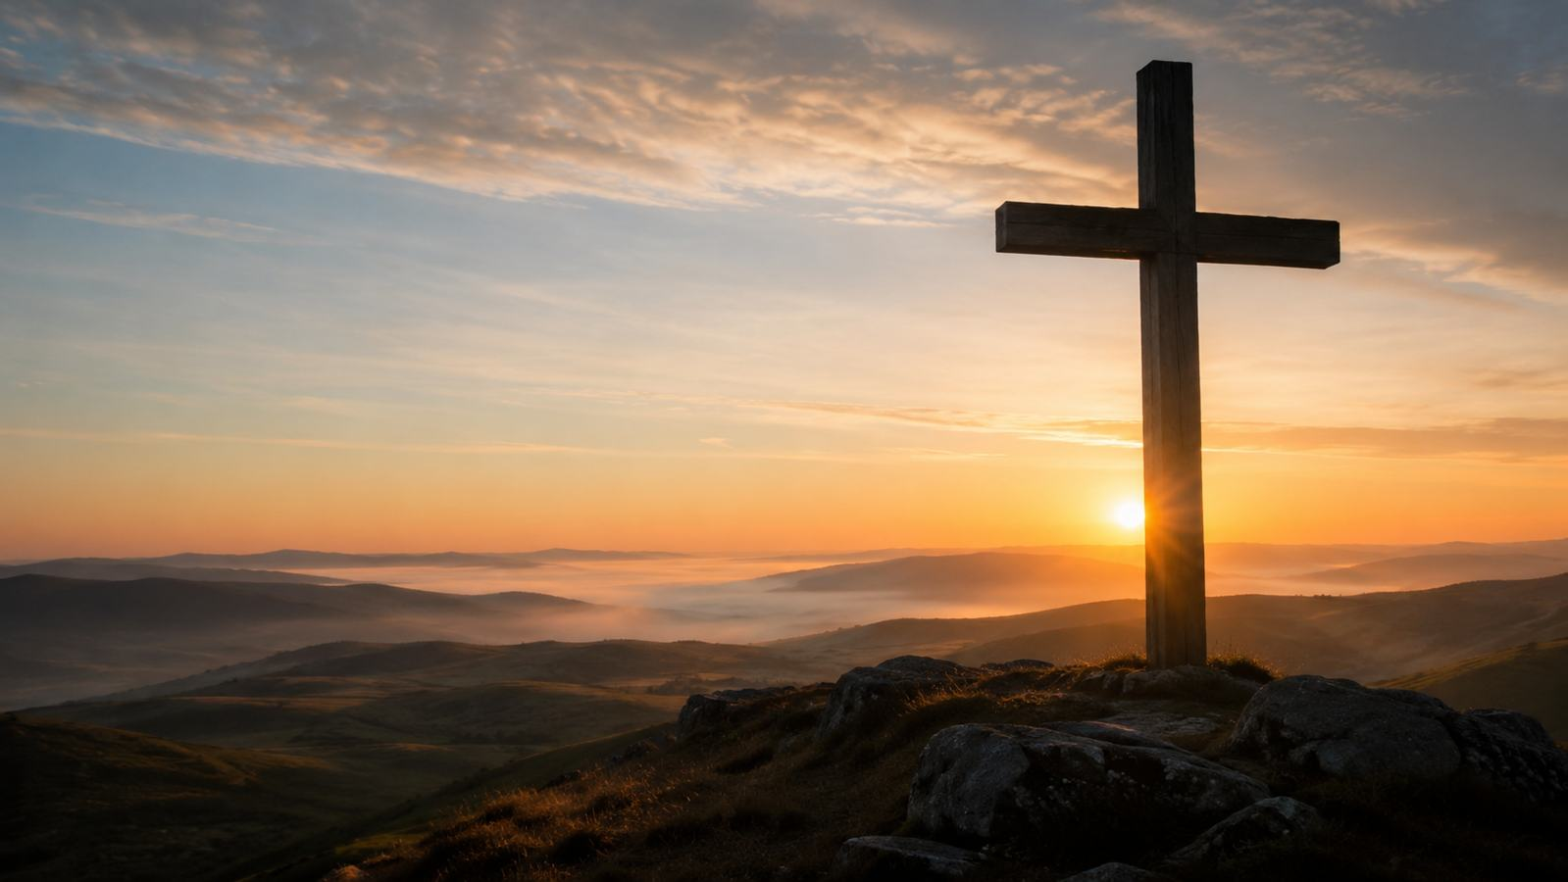
Abide with Me
A hymn study on Christ's abiding presence in life and death
First line: “Abide with me; fast falls the eventide”
Words: Henry Francis Lyte (1847)
Tune: EVENTIDE, William Henry Monk (1861)
Primary Scripture: Luke 24:29
Prepared for teaching and small group use - hymninfo.com

Slide 2
Teaching Aim
Learners should understand
Learners should feel and practice
The hymn is a prayer for the nearness of Christ.
Its evening imagery speaks both to daily life and mortality.
Christian comfort is rooted in Christ, not in circumstances.
A deeper peace in seasons of change and loss.
Confidence that Christ remains when other comforts fail.
Daily dependence through prayer, Scripture, and worship.
The study moves from the Emmaus plea to abiding communion and final hope.
Prepared for teaching and small group use - hymninfo.com

Slide 3
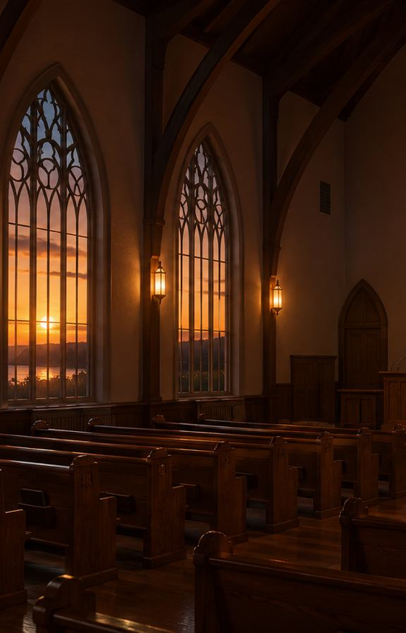
Hymn Identity
Essential facts
Tune and setting
Title: Abide with Me
First line: Abide with me; fast falls the eventide
Text: Henry Francis Lyte, Anglican priest and hymn writer
Date: 1847, near the end of Lyte’s life
Tune: EVENTIDE
Composer: William Henry Monk, 1861
Meter: 10.10.10.10
Associated with evening worship, funerals, and pastoral care
Prepared for teaching and small group use - hymninfo.com

Slide 4
Why This Hymn Matters Today
Pastoral value
Worship and teaching value
Gives honest words for weakness, grief, and uncertainty.
Rejects shallow optimism without surrendering hope.
Helps believers pray when they have few words.
Connects Scripture, doctrine, and prayer in memorable form.
Teaches divine presence, perseverance, and hope.
Works well in corporate worship and private devotion.
Its enduring power is its combination of realism and trust.
Prepared for teaching and small group use - hymninfo.com

Slide 5

Historical Background
Henry Francis Lyte wrote as a pastor, poet, and suffering believer.
Prepared for teaching and small group use - hymninfo.com

Slide 6
Henry Francis Lyte
Life and ministry
Spiritual setting
Born in Scotland and educated in Ireland.
Served as an Anglican priest in Devon.
Known for pastoral care and spiritually reflective hymns.
The hymn was written in 1847 during declining health.
It reflects personal frailty and steady hope in Christ.
Lyte died later that same year from tuberculosis.
The hymn should be heard as a prayer from a pastor who knew both suffering and grace.
Prepared for teaching and small group use - hymninfo.com

Slide 7
William Henry Monk and EVENTIDE
Monk’s contribution
Why the tune fits
English church musician, composer, and editor.
Key musical editor of Hymns Ancient and Modern.
Composed EVENTIDE for the hymn in 1861.
Dignified, flowing, and prayerful.
Clear enough for congregational singing.
Carries quiet grief without losing hope.
Text and tune became closely joined in English-speaking worship.
Prepared for teaching and small group use - hymninfo.com

Slide 8
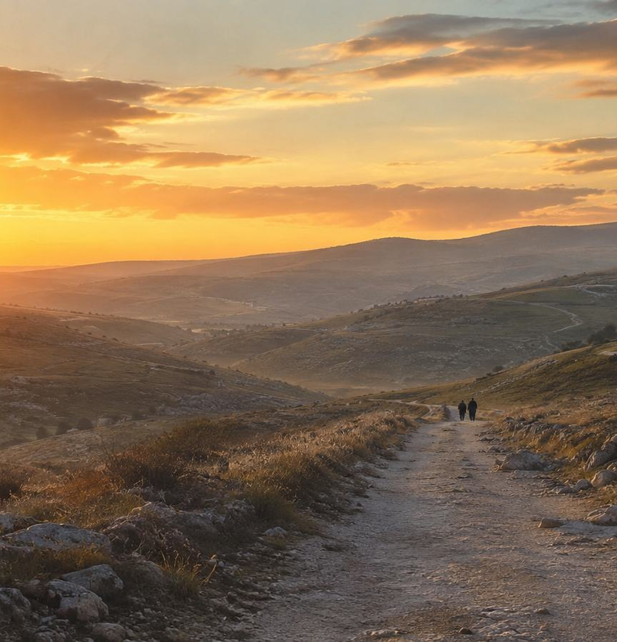
Biblical Foundation
“Stay with us, for it is almost evening.”
— Luke 24:29
The Emmaus disciples ask the risen Christ to remain with them.
The hymn turns that biblical plea into lifelong prayer.
Evening becomes a picture of need, dependence, and hope.
Prepared for teaching and small group use - hymninfo.com

Slide 9
Scripture Connections
Presence and abiding
Comfort and victory
Luke 24:29 - Christ remains with his disciples.
John 15:4-5 - Believers must remain in Christ.
Hebrews 13:5 - God will not leave or forsake his people.
Psalm 23:4 - God is with his people through death’s valley.
1 Corinthians 15:54-57 - Death is swallowed up in victory.
The hymn joins companionship now with resurrection hope.
The hymn is not mere sentiment; its comfort is biblical.
Prepared for teaching and small group use - hymninfo.com

Slide 10
Stanza-by-Stanza Study
The hymn moves from evening need to eternal morning.
Prepared for teaching and small group use - hymninfo.com

Slide 11
Stanza 1: Evening Need
What the stanza says
Teaching emphasis
The light is fading and darkness is deepening.
Human helpers and comforts are fragile.
The singer asks the Lord to remain near.
Faith begins by naming need honestly.
Christ is the help of the helpless.
Prayer is not weakness; it is dependence rightly directed.
Scripture link: Luke 24:29 and Psalm 23:4.
Prepared for teaching and small group use - hymninfo.com

Slide 12
Stanza 2: Change and Decay
What the stanza says
Teaching emphasis
Life moves swiftly toward its close.
Earthly joys and glories pass away.
The unchanging Lord is the believer’s stability.
Christian hope does not deny change.
God’s constancy answers human transience.
This stanza invites wise, sober trust.
Scripture link: Hebrews 13:5 and John 15:4-5.
Prepared for teaching and small group use - hymninfo.com

Slide 13
Stanza 3: Grace for Every Hour
What the stanza says
Teaching emphasis
The believer needs Christ’s presence continually.
Grace alone can resist temptation and sustain faith.
Christ is both guide and stay through cloud and sunshine.
Sanctification is ongoing dependence.
The hymn asks for presence, not only rescue.
Christ is needed in ordinary hours as well as crisis.
Scripture link: John 15:4-5.
Prepared for teaching and small group use - hymninfo.com

Slide 14
Stanza 4: Courage before Death
What the stanza says
Teaching emphasis
With Christ near, fear loses its power.
Tears remain real, but bitterness is overcome.
The hymn echoes the biblical taunt against death.
Christian comfort is not denial of grief.
Christ’s nearness changes the meaning of suffering.
Victory belongs to God through Jesus Christ.
Scripture link: 1 Corinthians 15:54-57 and Psalm 23:4.
Prepared for teaching and small group use - hymninfo.com

Slide 15
Stanza 5: Eternal Morning
What the stanza says
Teaching emphasis
The singer asks to see the cross in the final hour.
Earth’s shadows give way to heaven’s morning.
The prayer covers both life and death.
The cross anchors final hope.
Death is faced through Christ’s victory.
The hymn ends not in darkness but dawning light.
Scripture link: 1 Corinthians 15:54-57.
Prepared for teaching and small group use - hymninfo.com

Slide 16
Theological Movement
Vulnerability → Dependence → Victory
Evening need: Lord, remain with me.
Daily discipleship: I need your presence every hour.
Final hope: the cross shines through the gloom.
The hymn teaches courage by leading worshipers to Christ.
Prepared for teaching and small group use - hymninfo.com

Slide 17
Theological Themes
Theme | Scripture Connection | Teaching Direction
Divine presence | Luke 24:29; Hebrews 13:5 | Christ remains with his people.
Abiding communion | John 15:4-5 | Daily fruitfulness depends on union with Christ.
Comfort in mortality | Psalm 23:4 | The Shepherd is present in the valley.
Victory over death | 1 Corinthians 15:54-57 | The cross and resurrection answer final fear.
Perseverance | John 15; Psalm 23 | Faith continues through cloud and sunshine.
Prepared for teaching and small group use - hymninfo.com

Slide 18
Literary Observations
Images and movement
Tone and purpose
Eventide, darkness, and shadows create a tender evening frame.
The repeated plea “abide with me” gives unity and urgency.
The hymn moves from present weakness to final glory.
Prayerful rather than argumentative.
Realistic about decay and sorrow.
Confident because Christ is unchanging.
The poem’s emotional power lies in disciplined, biblical longing.
Prepared for teaching and small group use - hymninfo.com

Slide 19
Musical Observations
Tune character
Congregational use
EVENTIDE has a dignified, flowing melodic line.
The tune supports quiet congregational reflection.
Its range is accessible for most churches.
Best sung with a steady, unhurried tempo.
Organ or gentle piano accompaniment fits well.
Choirs should preserve clarity and prayerfulness.
The music should carry the text gently, not overwhelm it.
Prepared for teaching and small group use - hymninfo.com

Slide 20
Pastoral and Worship Use
Service placements
Teaching settings
Evening worship or prayer meetings.
Funerals and memorial services.
Lent, Holy Week, Easter hope, and communion services.
Services centered on comfort, perseverance, or mortality.
Sunday school study on Luke 24 or John 15.
Small group discussion on suffering and hope.
Choir rehearsal reflection before singing.
Pastoral care visits and devotional reading.
Use it with sensitivity: its strength is quiet courage, not emotional pressure.
Prepared for teaching and small group use - hymninfo.com

Slide 21
Teaching Questions
Observation and understanding
Reflection and application
What images in the hymn show human weakness?
How does the hymn contrast change with God’s constancy?
What does it mean to ask Christ to abide?
How does the cross change the way believers face death?
What practices help us live aware of Christ’s presence?
How can a church sing this hymn as communal prayer?
Invite honest answers; this hymn often touches grief, aging, and fear.
Prepared for teaching and small group use - hymninfo.com

Slide 22
Suggested Lesson Flow
30-minute plan
60-minute plan
5 min - Read Luke 24:29 and introduce the hymn.
8 min - Brief historical background.
10 min - Study two key stanzas.
5 min - Discussion and application.
2 min - Closing prayer.
10 min - Scripture reading and opening reflection.
10 min - Lyte, Monk, and hymn identity.
20 min - Stanza-by-stanza study.
10 min - Theological themes and musical use.
10 min - Prayer, discussion, and singing.
Prepared for teaching and small group use - hymninfo.com

Slide 23
Application: Practice Abiding
This week
As a church
Pray the first line of the hymn each evening.
Read Psalm 23 slowly and name where you need comfort.
Encourage someone grieving or anxious with Christ’s promise.
Confess where you lean on fading comforts.
Make room for songs of lament and hope.
Teach people to face mortality biblically.
Use silence before singing to invite prayer.
Point every comfort back to Christ.
The hymn becomes fruitful when sung and practiced.
Prepared for teaching and small group use - hymninfo.com

Slide 24
Closing Summary and Prayer
Abide with Me teaches the church to pray for Christ’s presence in every hour: the ordinary day, the changing world, the hour of temptation, the valley of death, and the hope of eternal morning.
Prayer: Lord Jesus Christ, remain with us. Teach us to abide in you when comforts fail, to trust your grace in every hour, and to face life and death with hope in your cross and resurrection. Amen.
Prepared for teaching and small group use - hymninfo.com

