Slide 1

My Faith Looks Up to Thee
My faith looks up to thee
Ray Palmer, 1830 | Tune: OLIVET by Lowell Mason, 1831
A hymn study on faith, prayer, forgiveness, consecration, guidance, and final hope
Prepared for teaching and small group use - hymninfo.com
1

Slide 2

Teaching Aim
Understand, feel, and practice the prayer of faith
1
Understand
2
Feel
3
Practice
Faith looks to Christ as the Lamb of Calvary: the Savior who forgives, strengthens, guides, and receives his people.
The hymn leads worshipers into humble dependence, quiet confidence, and renewed love for Christ.
Use the hymn as a personal prayer: receive grace, surrender the whole life, and follow Christ through darkness.
Prepared for teaching and small group use - hymninfo.com
2

Slide 3

Hymn Identity
Title
My Faith Looks Up to Thee
A personal prayer addressed to Christ, widely received in nineteenth-century American Protestant hymnody.
First line
My faith looks up to thee
Text
Ray Palmer, 1830
Tune
OLIVET
Composer
Lowell Mason, 1831
Meter
6.6.4.6.6.6.4
Primary Scripture
Hebrews 12:1-2
Prepared for teaching and small group use - hymninfo.com
3

Slide 4

Historical Background
A private prayer that became a congregational hymn
Ray Palmer wrote the hymn in 1830 as a young man preparing for ministry.
He later described it as a text born from personal faith, not originally written for public use.
Lowell Mason composed OLIVET for the text and published it in 1831 in Spiritual Songs for Social Worship.
The hymn soon became one of the best-known American devotional hymns of the nineteenth century.
Teaching note: Let the class see how private prayer can become shared worship when the church recognizes faithful biblical language.
Prepared for teaching and small group use - hymninfo.com
4

Slide 5
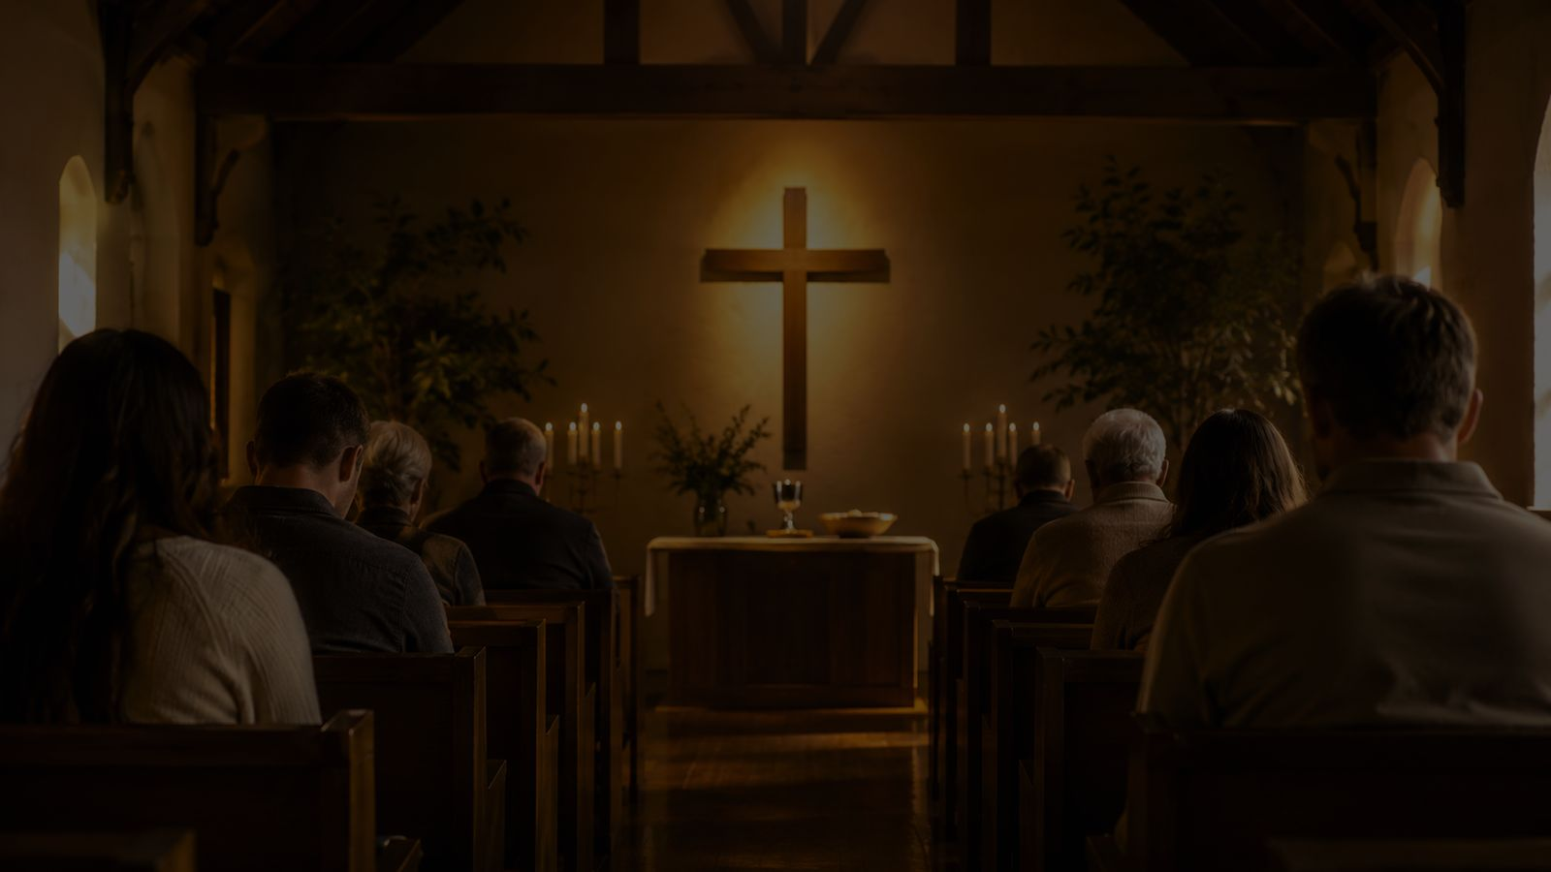
Why This Hymn Matters Today
Faith is not vague optimism; it is trust directed to Christ
For Worship
For Discipleship
For Pastoral Care
For Prayer
It gives congregations a simple, prayerful language for confession, Communion, Lent, and renewal.
It moves from forgiveness to consecration, showing faith as both beginning and daily dependence.
It names darkness, sorrow, wandering, weakness, and death without losing confidence in Christ.
It can be sung or spoken as a personal prayer when words feel hard to find.
Prepared for teaching and small group use - hymninfo.com
5

Slide 6
Biblical Foundation
Hebrews 12:1-2
Looking to Jesus, the author and perfecter of faith.
John 1:29
Christ as the Lamb of God who takes away sin.
The hymn turns doctrine into direct prayer: faith looks, asks, trusts, follows, and hopes.
Ephesians 2:8-9
Salvation by grace through faith, not merit.
Psalm 121:1-2
The lifted eyes of prayer and dependence.
Galatians 2:20
Life lived by faith in the Son of God who loved and gave himself.
Prepared for teaching and small group use - hymninfo.com
6

Slide 7
Stanza 1: Faith Looks to Christ
The hymn begins with a single spiritual action: faith looking to Christ.
Christ is addressed as the Lamb of Calvary, the crucified Savior who removes guilt.
The prayer asks for forgiveness and a whole-life belonging to Christ.
Teaching emphasis: Christian faith is personal trust in a living Savior, not mere religious feeling.
Scripture: John 1:29; Ephesians 2:8-9; Hebrews 12:2
Prepared for teaching and small group use - hymninfo.com
7

Slide 8
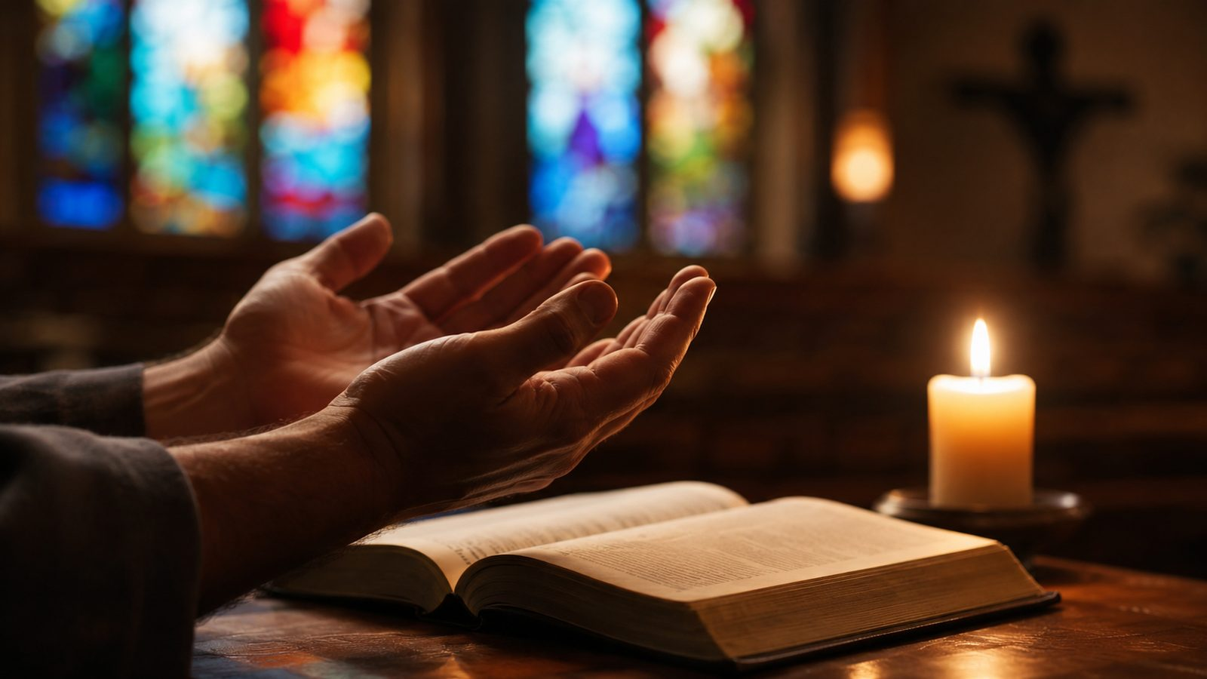
Stanza 2: Grace Strengthens Love
Forgiveness becomes consecrated devotion
From guilt to grace
The second movement asks Christ to enrich weak faith and make the heart more alive to his love.
From grace to zeal
Devotion is not self-produced enthusiasm; it is kindled by Christ’s sacrifice and sustained by grace.
Teaching emphasis
A forgiven person prays to love Christ more deeply and serve him more faithfully.
Scripture: Galatians 2:20; 1 Peter 1:8-9
Prepared for teaching and small group use - hymninfo.com
8

Slide 9

Stanza 3: Christ Guides the Pilgrim
The Christian life is pictured as a journey through darkness and confusion.
The hymn asks Christ to be guide, comforter, and protector from wandering.
Sorrow is not denied; it is brought before the Savior who leads through it.
Teaching emphasis: guidance is not only information; it is the presence of Christ with his people.
Scripture: Psalm 121:1-2; Psalm 139:10
Prepared for teaching and small group use - hymninfo.com
9

Slide 10
Stanza 4: Faith at the End
The final stanza faces death without bravado or despair.
The believer asks Christ to bear the soul safely through the final passage.
The hymn ends with trust in Christ’s receiving grace.
Teaching emphasis: the same Savior who forgives and guides also keeps his people to the end.
Scripture: John 3:16; 1 Peter 1:8-9
Prepared for teaching and small group use - hymninfo.com
10

Slide 11
The Movement of the Hymn
From present faith to final hope
Look
Ask
Love
Follow
Hope
Faith turns to Christ
The soul seeks forgiveness
Grace deepens devotion
Christ guides the pilgrim
The Savior receives his own
This progression makes the hymn useful as a lesson in Christian perseverance: grace begins the life of faith, shapes daily obedience, and carries the believer home.
Prepared for teaching and small group use - hymninfo.com
11

Slide 12
Theological Themes
A compact prayer with deep pastoral reach
Grace
Faith
Atonement
Salvation is received, not earned.
Trust is directed to Christ himself.
The Lamb of Calvary removes guilt.
Consecration
Guidance
Hope
The forgiven life belongs wholly to Christ.
Christ leads through darkness and sorrow.
Faith rests in Christ at death and beyond.
Prepared for teaching and small group use - hymninfo.com
12

Slide 13
Literary and Musical Observations
The text is direct address to Christ, which makes it naturally prayerful.
Its images move from Calvary to pilgrimage to final passage.
The meter 6.6.4.6.6.6.4 gives the hymn a compact devotional shape.
OLIVET is singable and restrained, supporting the words without distracting from them.
A moderate tempo helps the congregation sing it as prayer rather than performance.
Choir director note: Shape phrases gently, keep diction clear, and let the tune’s simplicity serve the prayer.
Prepared for teaching and small group use - hymninfo.com
13

Slide 14
Pastoral and Worship Use
Where this hymn can serve the church well
Confession
Communion
As a sung prayer for forgiveness and renewed trust.
As preparation to receive Christ’s grace with humble faith.
Lent
Renewal
As reflection on the Lamb of Calvary and the cost of grace.
As a response to preaching on surrender, guidance, or perseverance.
Pastoral Care
Small Groups
As prayer for those facing uncertainty, grief, weakness, or fear of death.
As a devotional frame for prayer and testimony.
Prepared for teaching and small group use - hymninfo.com
14

Slide 15
Teaching Questions
For class discussion and personal reflection
What does it mean for faith to “look” to Christ?
Why is Christ addressed as the Lamb of Calvary?
How does forgiveness lead to consecration rather than passivity?
Where does the hymn name sorrow, darkness, or weakness honestly?
How can the church teach faith as daily dependence, not only first belief?
Why is it important that the final stanza faces death in prayer?
Prepared for teaching and small group use - hymninfo.com
15

Slide 16
Practice This Week
Pray
Confess
Begin each day with a short prayer of dependence on Christ.
Name guilt honestly before God and receive mercy through Christ.
Follow
Encourage
Ask where Christ is guiding you through a present darkness.
Share a word of hope with someone whose faith feels faint.
Hope
Reflect on the promise that Christ keeps his people to the end.
Prepared for teaching and small group use - hymninfo.com
16

Slide 17
Suggested Lesson Flow
Two teaching plans for different settings
30-Minute Plan
60-Minute Plan
5 min - Opening prayer and hymn identity
8 min - Scripture: Hebrews 12:1-2 and John 1:29
10 min - Four-part hymn movement
5 min - Discussion question
2 min - Closing prayer
8 min - Sing or read the hymn prayerfully
12 min - Historical and musical background
18 min - Stanza-by-stanza teaching
12 min - Scripture connections and themes
7 min - Pastoral application
3 min - Prayer of consecration
Prepared for teaching and small group use - hymninfo.com
17

Slide 18
Closing Summary and Prayer
Faith looks to Christ for mercy, grace, guidance, and final hope. The hymn teaches the church to pray with humility and confidence: the Savior who forgives also leads and keeps.
Lord Jesus Christ, Lamb of Calvary, turn our eyes toward you. Strengthen fainting hearts, guide us through darkness, and keep us faithful until our journey is complete. Amen.
© HymnInfo.com. Free for personal, church, classroom, and small-group teaching use. Please do not sell, repost, or redistribute as downloadable files without permission.
Prepared for teaching and small group use - hymninfo.com
18

