Slide 1

My Lord, What a Morning
A hymn study on resurrection hope, holy awe, and the final trumpet
Prepared for teaching and small group use - hymninfo.com

Slide 2
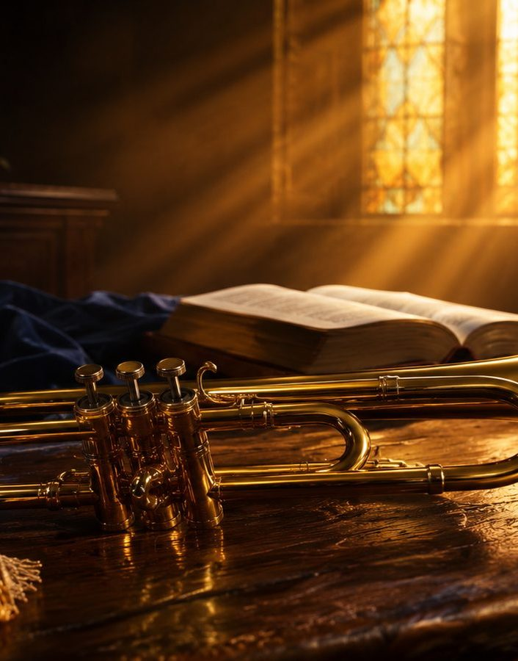
Teaching Aim
Help learners hear Christian hope through the spiritual tradition.
Hear
Understand
Hope
Feel
Live
Practice
Trace the hymn through Scripture: trumpet, resurrection, judgment, and new creation.
Hold grief and hope together without sentimental shortcuts.
Comfort one another and live as people of the coming dawn.
Prepared for teaching and small group use - hymninfo.com

Slide 3
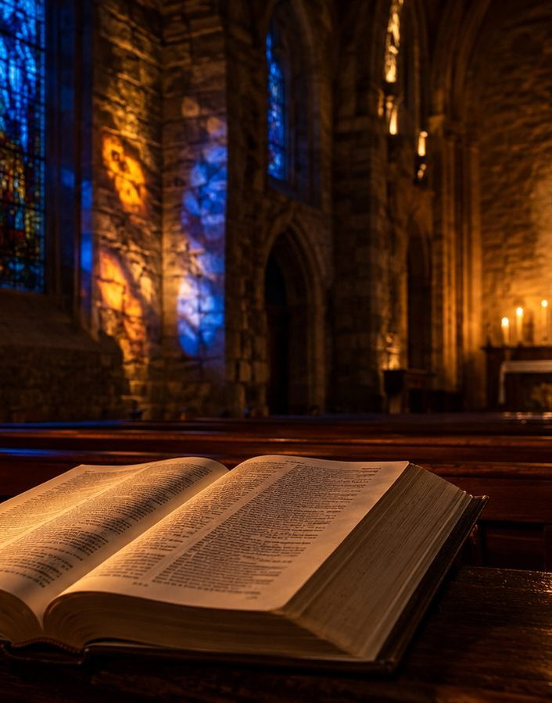
Hymn Identity
African American spiritual • Resurrection and Second Coming
First line: “You’ll hear the trumpet sound.”
Tradition: African American spiritual, preserved through communal singing and later hymnals.
Primary themes: hope, resurrection, salvation, final judgment, and Christ’s appearing.
Modern hymnals often use congregational arrangements, including settings associated with William Farley Smith.
The hymn sings about the final morning from within the experience of mourning.
Prepared for teaching and small group use - hymninfo.com

Slide 4
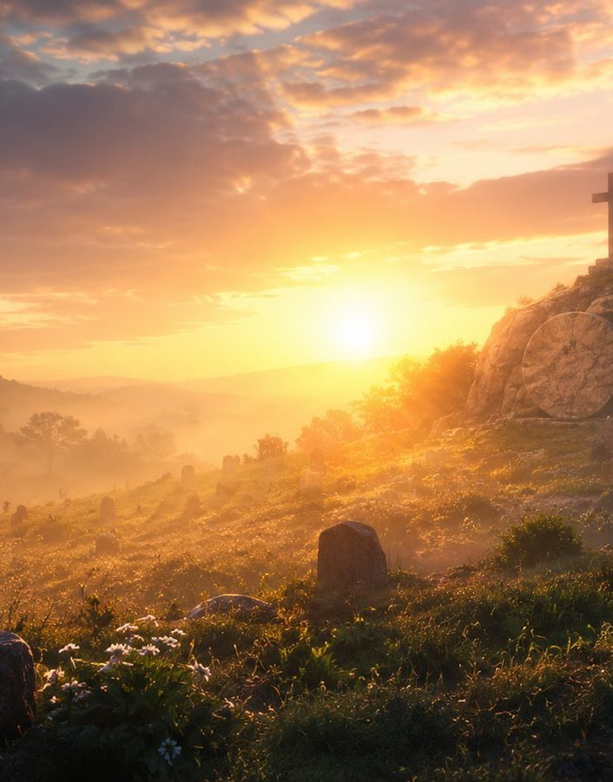
Why This Spiritual Matters
A song formed where sorrow and faith had to live together
It gives the church a vocabulary for grief that does not surrender hope.
It teaches eschatology as worship, not speculation.
It honors a tradition where biblical hope became a song of endurance.
It points beyond present suffering to God’s final justice and mercy.
The future of God steadies the faithful in the present.
Prepared for teaching and small group use - hymninfo.com

Slide 5
Historical Background
A spiritual carried by memory, worship, and hope
The hymn belongs to the nineteenth-century African American spiritual tradition.
Spirituals joined biblical imagination with lived endurance under oppression.
Printed collections and later hymnals helped preserve these songs for wider Christian worship.
The “morning / mourning” echo deepens the hymn: dawn is promised to those who have known sorrow.
Prepared for teaching and small group use - hymninfo.com

Slide 6
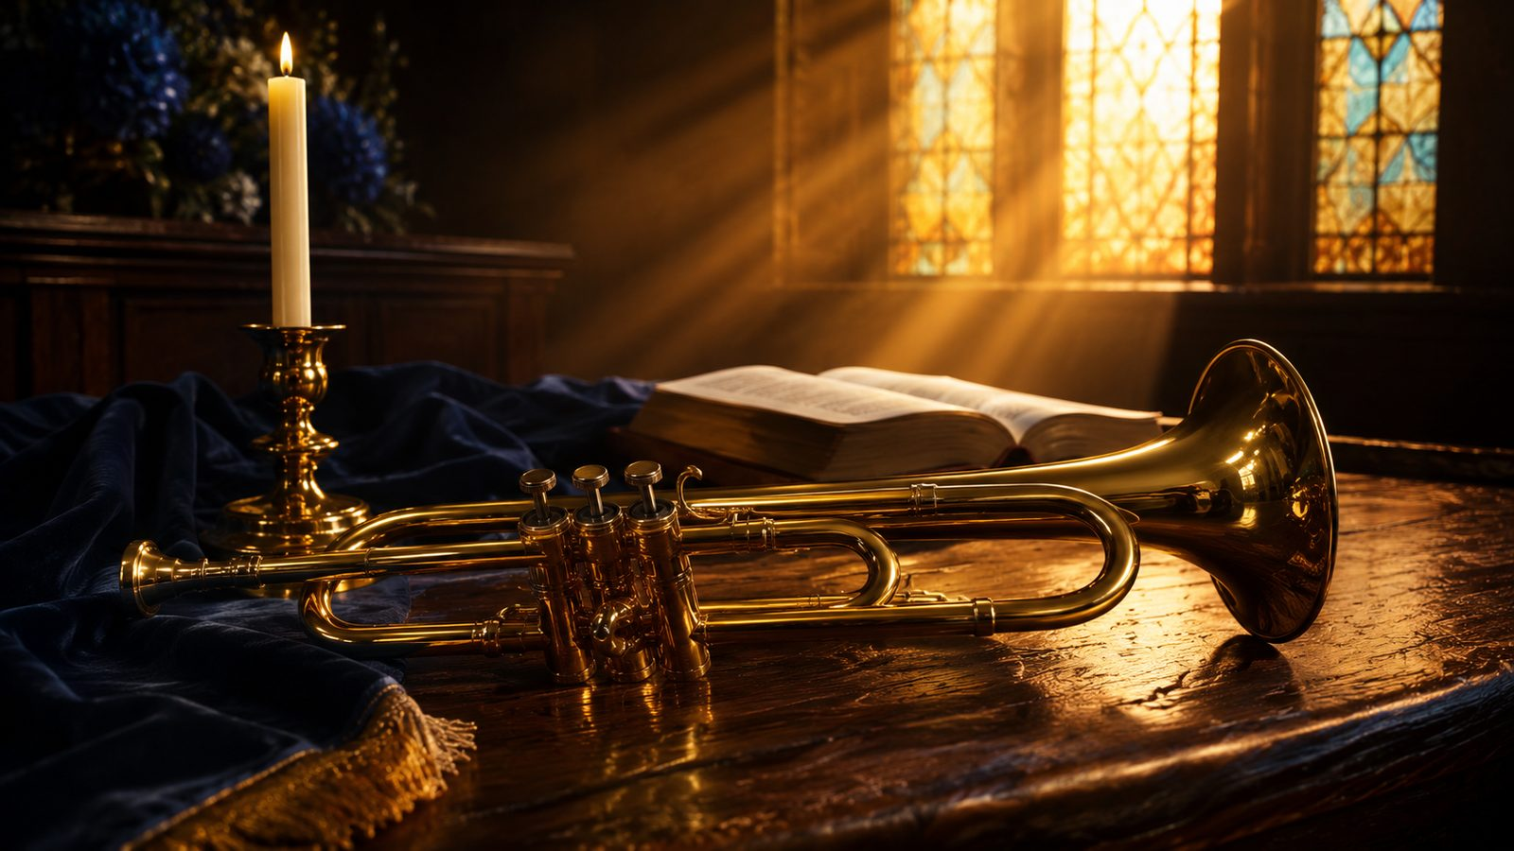
The Trumpet and the Final Day
Scripture gives the hymn its sound of holy expectation.
Prepared for teaching and small group use - hymninfo.com

Slide 7
Biblical Foundation
A trumpet, a gathering, a resurrection, a kingdom
1 Thessalonians 4:16-17: the Lord descends and the dead in Christ rise first.
1 Corinthians 15:52: the trumpet sounds and the dead are raised incorruptible.
Matthew 24:30-31: the Son of Man comes with glory and gathers his people.
Revelation 21:4: death and mourning give way to God’s final comfort.
Prepared for teaching and small group use - hymninfo.com

Slide 8
The Trumpet Is Not Noise
It is the summons of the Lord
The trumpet announces that history is not drifting; Christ reigns and will appear.
The hymn’s opening image is public, unmistakable, and royal.
For the church, this sound calls for reverence, readiness, and courage.
Christian hope is anchored in the Lord’s action, not in human optimism.
Prepared for teaching and small group use - hymninfo.com

Slide 9
The Dead in Christ Will Rise
Resurrection is the center of Christian hope
The final morning is not escape from the body but redemption of the body.
Death is real, but it is not sovereign.
The promise gives strength to those who mourn without pretending sorrow is small.
The hymn helps the congregation sing faith beside the grave.
Prepared for teaching and small group use - hymninfo.com

Slide 10

When the Heavens Are Shaken
Cosmic imagery tells us the world will answer to God
Scripture uses sky, stars, trumpet, and clouds to speak of God’s final intervention.
These images are not meant to feed speculation but to awaken holy awe.
The powers of the present age are temporary.
The Creator will renew what sin and death have wounded.
Prepared for teaching and small group use - hymninfo.com

Slide 11

Morning and Mourning
The song holds dawn and lament in one breath
“Morning” points toward resurrection dawn and the breaking of God’s kingdom.
“Mourning” names sorrow, judgment, grief, and the cost of waiting.
Together, the words guard the hymn from shallow cheerfulness or hopeless despair.
Christian hope speaks truthfully about pain and boldly about God’s promise.
The coming dawn does not erase tears by ignoring them; God answers them.
Prepared for teaching and small group use - hymninfo.com

Slide 12
Theological Themes
Six truths to teach with care.
✦
Christ’s appearing
↥
Resurrection
The Lord himself will come.
The dead will be raised.
⚖
Judgment
☾
Hope under suffering
God will set all things right.
Faith waits without denying pain.
☀
New creation
♪
Communal witness
Death and tears will pass away.
The church sings hope together.
Prepared for teaching and small group use - hymninfo.com

Slide 13
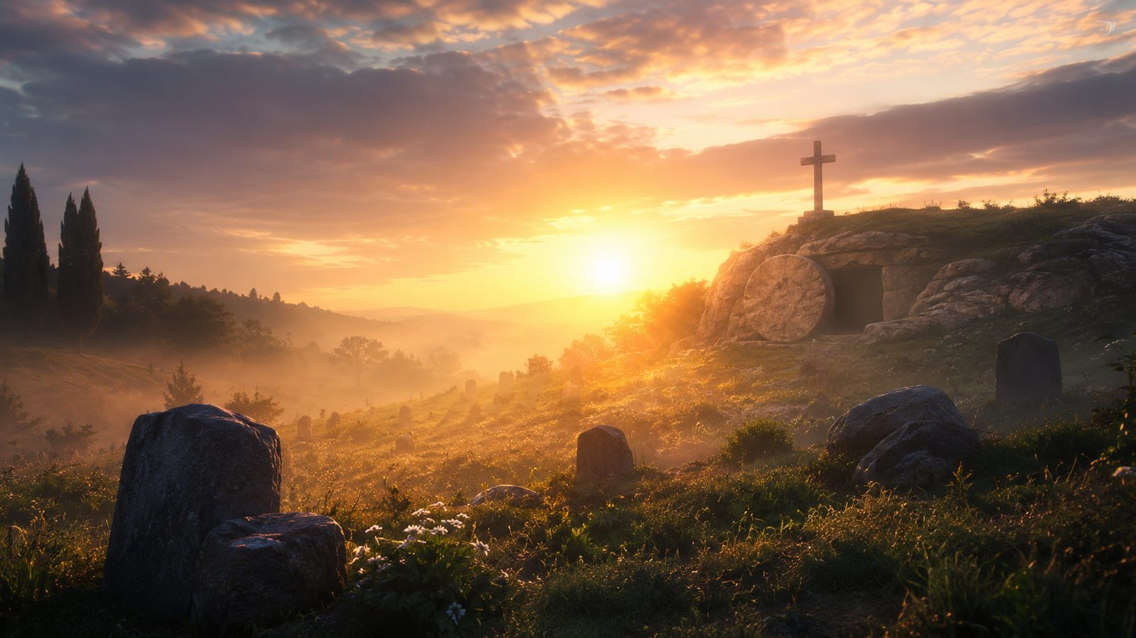
Hope Forged in Sorrow
The spiritual tradition teaches the church to sing with memory and reverence.
Prepared for teaching and small group use - hymninfo.com

Slide 14
A Spiritual, Not Just a Style
Receive it as testimony
African American spirituals carry biblical faith through suffering, endurance, and communal worship.
They should be sung with respect for the history that gave them voice.
The hymn’s power comes from both Scripture and lived longing for God’s deliverance.
Teaching the hymn well means honoring both its theology and its heritage.
Prepared for teaching and small group use - hymninfo.com

Slide 15

Singing with Reverence
Pastoral guidance for worship leaders and choirs
Choose a tempo that allows the words to carry awe and weight.
Let the dynamic shape move from quiet expectation to confident hope.
Avoid treating the spiritual as performance color; let it remain congregational prayer.
Frame the song with Scripture so its final-day imagery is heard clearly.
Prepared for teaching and small group use - hymninfo.com

Slide 16
Musical Observations
Simple melody, deep force
The tune lends itself to call-and-response sensibility and communal participation.
Repetition helps the congregation inhabit the central image rather than merely analyze it.
The melody should be sung with restraint, dignity, and room for silence.
Arrangements can serve the song when they preserve its spiritual gravity.
Prepared for teaching and small group use - hymninfo.com

Slide 17
Pastoral and Worship Use
Where this hymn can serve the church
Advent: waiting for Christ’s appearing.
Eastertide: proclaiming resurrection hope.
Funerals and memorials: comforting the grieving with biblical promise.
All Saints and services of remembrance: singing hope across generations.
Justice and lament services: naming sorrow before God’s future.
Prepared for teaching and small group use - hymninfo.com

Slide 18
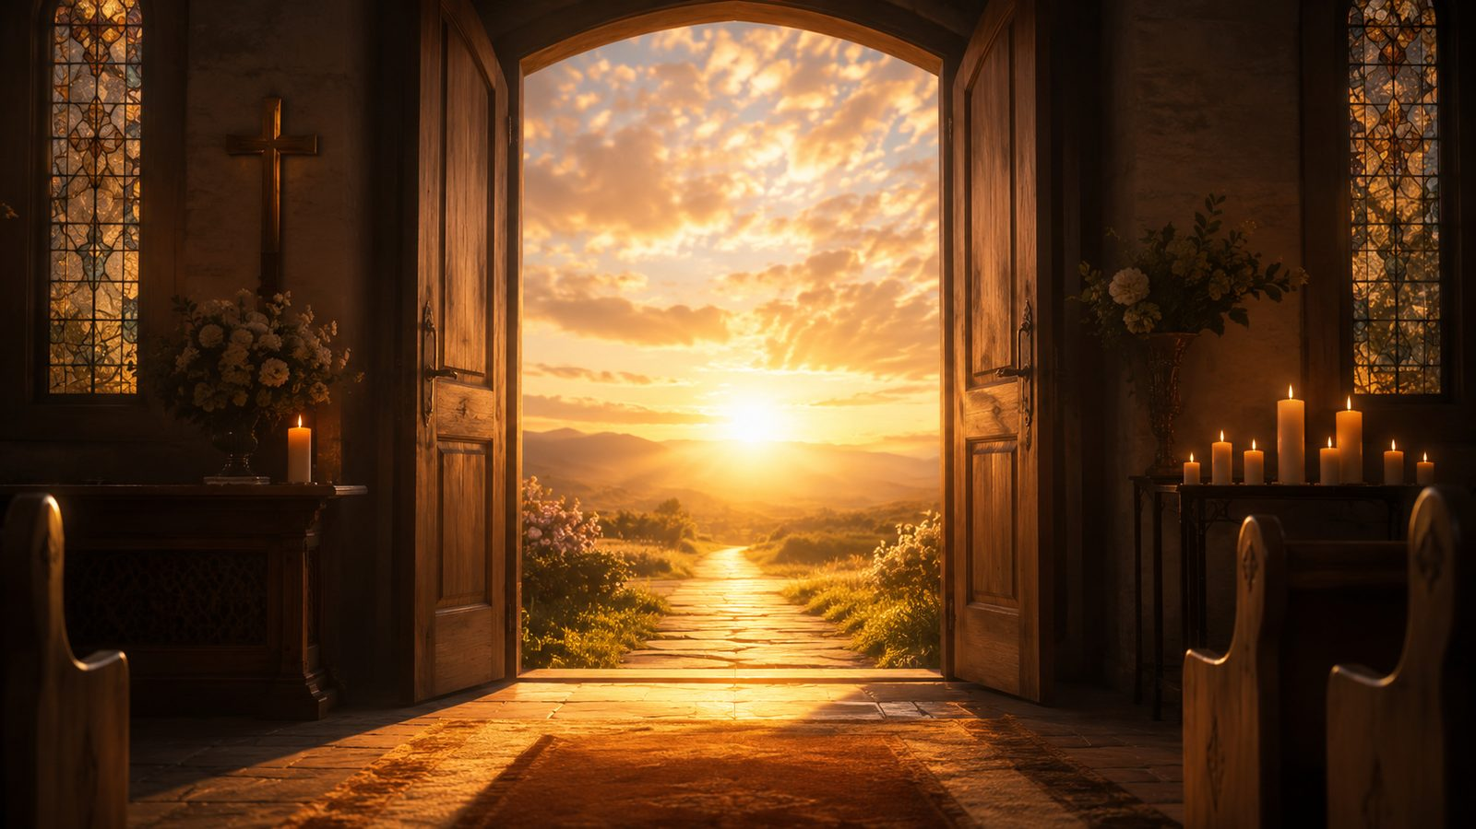
Teaching the Hymn
Move from biblical image to faithful response.
Prepared for teaching and small group use - hymninfo.com

Slide 19
Hymn-Section Study
A teaching path through the central images
The trumpet: Christ summons creation and gathers his people.
The dead are raised: resurrection answers the grave.
The stars fall: every false security is shaken before God.
The morning comes: God’s kingdom dawns after suffering and waiting.
Prepared for teaching and small group use - hymninfo.com

Slide 20
Lesson Flow
A 45-60 minute teaching plan
1
Read
1 Thessalonians 4:13-18
2
Hear
Sing or listen reverently
3
Teach
Explain trumpet, resurrection, and final hope
4
Discuss
Morning and mourning in Christian life
5
Pray
Comfort one another with the promise
Prepared for teaching and small group use - hymninfo.com

Slide 21
Application: Live Toward the Dawn
Hope becomes a way of life
Comfort the grieving with Scripture, presence, and prayer.
Practice patient endurance when justice seems delayed.
Reject despair by remembering Christ’s resurrection and return.
Worship with the saints who carried faith through suffering.
Let the coming kingdom shape present obedience.
Prepared for teaching and small group use - hymninfo.com

Slide 22
Closing Summary
What the congregation should carry home
The Lord will come with power and glory.
The trumpet will sound and the dead in Christ will rise.
The present world, with its sorrows and powers, will not last forever.
God’s final morning will answer the mourning of his people.
Therefore, we wait, worship, comfort, and witness in hope.
Prepared for teaching and small group use - hymninfo.com

Slide 23
Closing Prayer
Risen Lord, keep us faithful until the final trumpet. Comfort those who mourn, strengthen those who suffer, and teach your church to wait with courage. Let the coming morning of your kingdom shape our worship, our witness, and our love. Amen.
© HymnInfo.com. Free for personal, church, classroom, and small-group teaching use. Please do not sell, repost, or redistribute as downloadable files without permission.
Prepared for teaching and small group use - hymninfo.com

