Slide 1
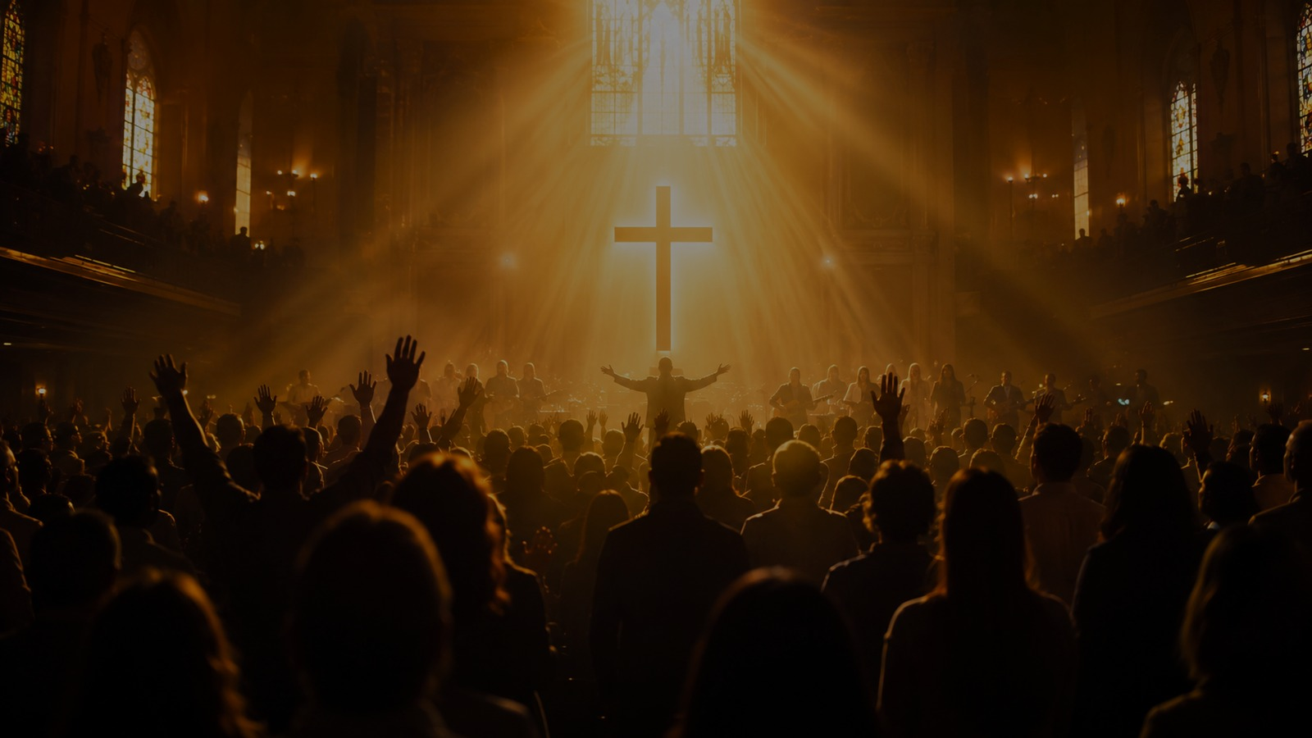
To God Be the Glory
A teaching guide on grace, redemption, praise, and gospel proclamation
Fanny J. Crosby • William H. Doane • 1870
Notes:
Open by singing or reading the refrain. Emphasize that the hymn is a public doxology grounded in the saving work of Christ.

Slide 2

Why This Hymn Matters
The gospel in doxological form
It begins with God’s action: “great things He hath done.”
It summarizes salvation through the gift, death, pardon, and promised return of Jesus Christ.
It transforms congregational praise into invitation: “come to the Father, through Jesus the Son.”
It teaches the church to return all glory to God rather than to human effort.
Notes:
This slide sets the purpose of the lesson: to show that praise is not generic optimism but a response to redemption accomplished by God.

Slide 3

Hymn Identity
Title, text, tune, and themes
First line: To God be the glory great things he hath done
Text: Fanny J. Crosby, one of the most prolific gospel hymn writers in Christian history.
Tune: TO GOD BE THE GLORY by William H. Doane, Crosby’s frequent collaborator.
Core themes: grace, salvation, praise, redemption, evangelism, and the glory of God.
Notes:
Briefly introduce Crosby and Doane. Avoid making the hymn only biographical; its center is God’s saving work.

Slide 4
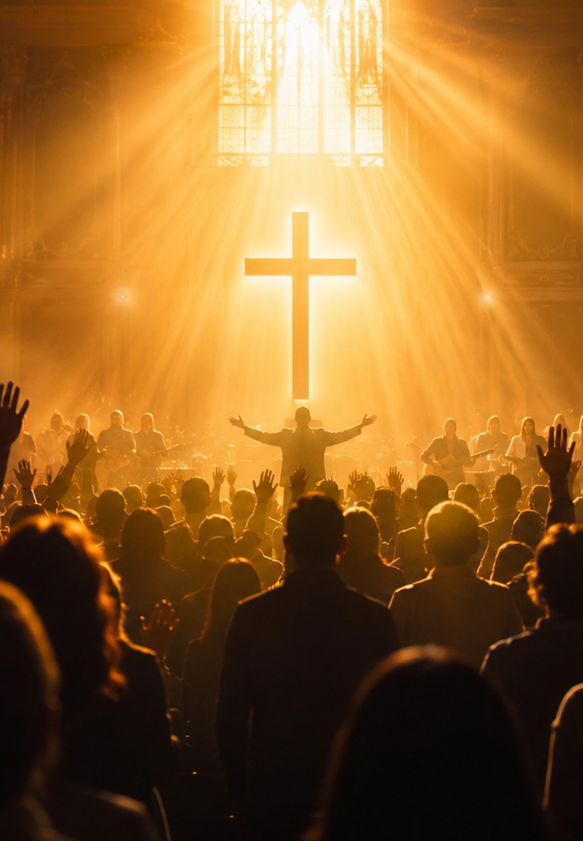
Historical Background
1870 publication and wider use
The hymn is documented in Doane’s Songs of Devotion in 1870 and later appeared in Brightest and Best in 1875.
The 1875 date is common in hymnals, but 1870 is the best currently documented year for early publication.
It became especially popular in Britain through revivalist use, then regained prominence in American evangelistic worship.
Its later use in Billy Graham crusades helped establish its twentieth-century familiarity.
Notes:
Use the date question to model careful hymnological teaching: acknowledge 1875 while using 1870 for the database and study materials.

Slide 5
The Gospel Movement
From God’s gift to God’s glory
Verse 1: God loved the world and gave His Son.
Verse 2: Christ’s blood secures redemption and pardon.
Verse 3: God’s present works anticipate the greater wonder of seeing Jesus.
Refrain: the whole earth is summoned to hear, rejoice, come, and glorify God.
“Oh, come to the Father, through Jesus the Son, and give Him the glory...”
Refrain
Notes:
Show the hymn as a compact gospel outline. It moves from the Father’s love to the Son’s atonement, to the believer’s pardon, to the final vision of Christ.

Slide 6

Biblical Foundations
Key texts beneath the hymn
Ephesians 2:8-9 — glory belongs to God
Psalm 115:1 — salvation by grace
John 3:16 — God gave His Son
Romans 5:1-2 — peace and access by faith
Hebrews 9:11-12 — eternal redemption
Revelation 5:12-13 — cosmic praise to the Lamb
Notes:
Read one or two of these texts aloud. Psalm 115:1 and John 3:16 are especially helpful before singing.

Slide 7
Verse 1: God Gives the Son
Love, atonement, and the opened life gate
The opening line directs attention to God before it describes human response.
John 3:16 stands behind the hymn’s claim that God loved the world and gave His Son.
“Atonement for sin” names the cost of salvation.
The “life gate” image points to access, invitation, and eternal life.
Notes:
Preach the verse as the gospel in miniature: love gives, Christ yields, sinners are invited in.

Slide 8
Verse 2: Perfect Redemption
Pardon promised to the believer
“Purchase of blood” echoes the New Testament language of costly redemption.
The promise is “to every believer,” not to the morally impressive only.
The phrase “vilest offender” dramatizes the reach of grace.
Immediate pardon emphasizes assurance grounded in Christ, not human worthiness.
Notes:
Clarify that the hymn is not minimizing sin; it is magnifying the sufficiency of Christ’s redemption.

Slide 9

Verse 3: Present Joy and Future Wonder
God’s works now; Jesus seen then
The hymn celebrates what God has taught and done in the present.
Christian rejoicing is “through Jesus the Son,” not through religious performance.
The closing hope is personal and Christ-centered: “when Jesus we see.”
Future glory deepens present praise rather than replacing it.
Notes:
Let the class see the eschatological note: the hymn ends not in vague heaven, but in wonder at seeing Jesus.

Slide 10
The Refrain as Worship and Witness
Praise that calls the earth to hear
“Praise the Lord” is repeated as summons, confession, and response.
“Let the earth hear His voice” turns congregational singing outward.
“Let the people rejoice” ties evangelistic invitation to joy.
“Come to the Father through Jesus the Son” is both worship and gospel proclamation.
Praise is public theology: the church announces what God has done and invites others to come.
Teaching emphasis
Notes:
Invite participants to sing the refrain as a response after each major teaching point.

Slide 11
Theological Center
Grace from beginning to end
God receives glory because God initiates and completes salvation.
Christ’s death is not incidental; it is the atoning center of the hymn.
Faith receives what grace provides.
Pardon is promised because of Christ’s work, not because of human merit.
Notes:
This is where you can connect the hymn with Ephesians 2:8-9 and Romans 5:1-2.

Slide 12
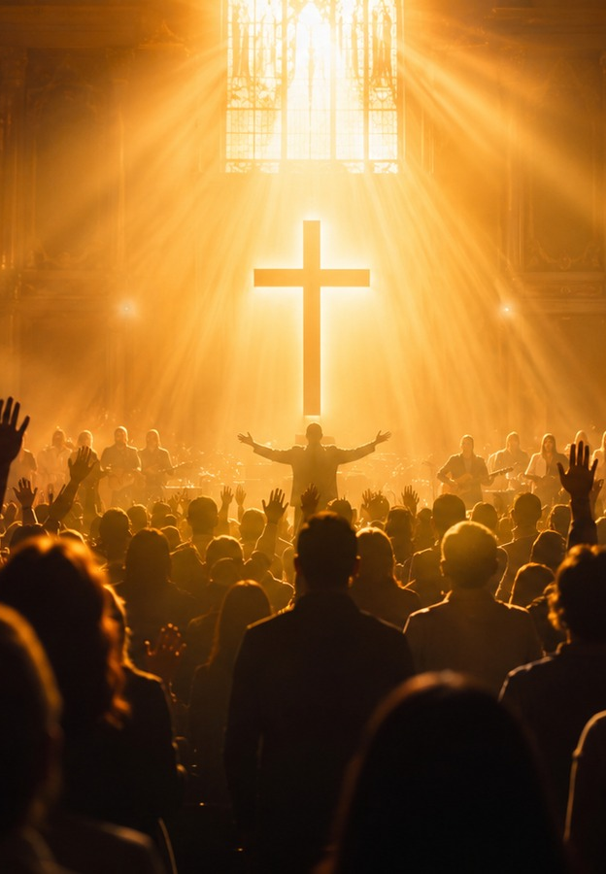
Musical Notes
A buoyant gospel tune for strong congregational praise
Tune name: TO GOD BE THE GLORY by William H. Doane.
Meter: 11.11.11.11 with refrain.
The broad melody and energetic refrain support confident congregational singing.
Use a lively but not rushed tempo so the words remain clear and the refrain retains joy.
Notes:
Musicians should avoid making the hymn ponderous. Its theology is weighty, but its musical posture is jubilant.

Slide 13
Church Impact
A hymn that travelled through revival and evangelism
Widely used across Protestant traditions as a hymn of praise and gospel invitation.
Especially influential in British revivalist circles before becoming strongly established in American worship.
Evangelistic campaigns helped cement its twentieth-century recognition.
Its endurance comes from combining objective gospel truth with memorable congregational praise.
Notes:
Ask participants where they have heard the hymn and what emotions or memories it carries, then return the focus to its gospel content.

Slide 14
Teaching Plan
A 45-minute guide
5 min — Sing or read the refrain; identify the main verbs: praise, hear, rejoice, come, give.
10 min — Historical background: Crosby, Doane, 1870/1875 publication history.
15 min — Bible study: Psalm 115:1, John 3:16, Ephesians 2:8-9, Revelation 5.
10 min — Verse-by-verse discussion and pastoral applications.
5 min — Close by singing all stanzas as a prayer of praise and invitation.
Notes:
This slide equips the teacher to run the session.

Slide 15
Closing Application
Give God public thanks for specific works of grace.
Rest in Christ’s finished work rather than personal merit.
Share the promise of pardon and eternal life with others.
Let worship become gospel proclamation.
“To Him who sits on the throne, and to the Lamb be the blessing, the honor, the glory...”
Revelation 5:13
Notes:
Close with the refrain. Invite the group to name one specific “great thing” God has done and to give Him glory publicly.

