Slide 1
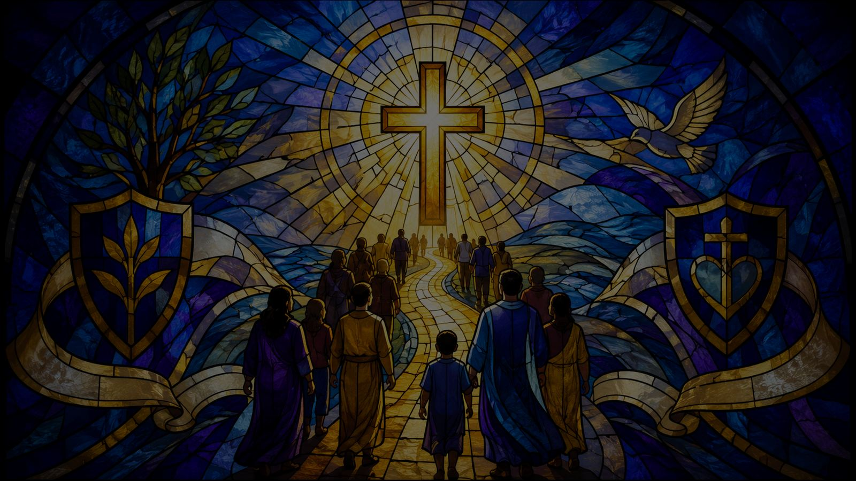
Onward, Christian Soldiers
Following Christ with unity, courage, and faithful witness
Teaching Guide
Prepared for teaching and small group use - hymninfo.com

Slide 2
Teaching Aim
Understand the hymn as a careful Christian call to spiritual perseverance.
Understand
Feel
Practice
Read the hymn through Ephesians 6, where the struggle is spiritual rather than against people.
Hear the courage, unity, and shared resolve of the church following Christ.
Turn strong language into humble discipleship, witness, and congregational unity.
✚
☼
→
Prepared for teaching and small group use - hymninfo.com

Slide 3

Hymn Identity
A processional hymn shaped by the language of the cross.
Title
Onward, Christian Soldiers
First line
Onward, Christian soldiers
Text
Sabine Baring-Gould, 1865
Tune
ST. GERTRUDE - Arthur Seymour Sullivan, 1871
Meter
6.5.6.5 D with refrain
Prepared for teaching and small group use - hymninfo.com

Slide 4
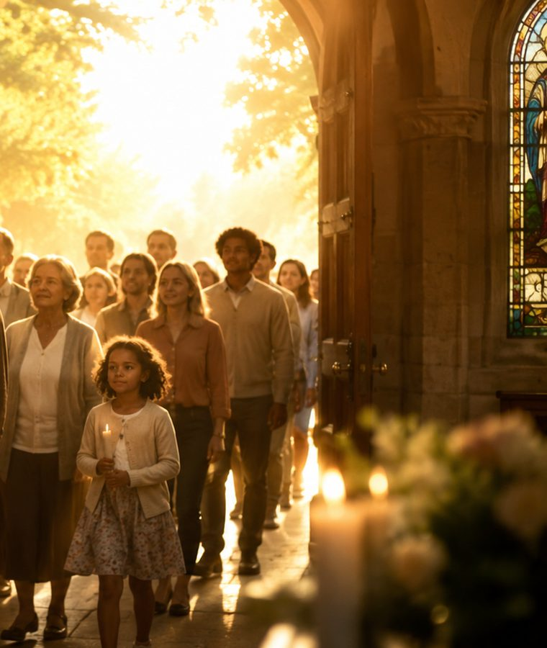
Historical Background
Written for movement, worship, and the church gathered in procession.
•
Sabine Baring-Gould wrote the text in 1865 while serving in Yorkshire.
•
It was prepared for children walking to a church festival, then later received wider hymnbook use.
•
Arthur S. Sullivan’s tune ST. GERTRUDE gave the hymn its sturdy, memorable processional character.
•
The hymn is best taught with careful attention to Scripture and symbolic language.
Prepared for teaching and small group use - hymninfo.com

Slide 5

Biblical Foundation
The church stands in God’s strength, not its own.
Ephesians 6:10-17
2 Timothy 2:3-4
The church stands in God’s strength; the struggle is not against flesh and blood.
Faithful discipleship requires endurance, discipline, and loyalty to Christ.
Matthew 16:18
Ephesians 4:4-6
Christ promises that his church will not finally be overcome.
The church is one body with one Lord, one faith, and one hope.
Teaching frame
Ephesians 6 explicitly says the struggle is not against flesh and blood. This keeps the hymn’s imagery under the rule of Christlike love.
Prepared for teaching and small group use - hymninfo.com

Slide 6
1
Under the Cross of Christ
The hymn begins with Christ leading, not the church asserting itself.
Prepared for teaching and small group use - hymninfo.com

Slide 7
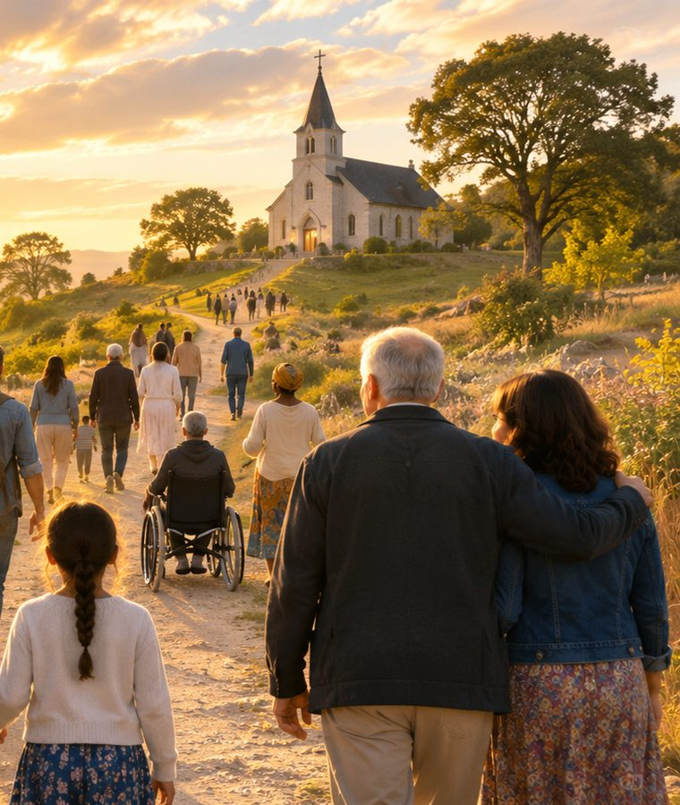
Christ Leads the Church
The cross goes before the congregation.
•
The hymn’s first movement is not a celebration of human strength.
•
It points the church to Christ’s leadership, Christ’s cross, and Christ’s victory.
•
Discipleship begins when the church follows rather than controls.
Teaching move: ask, “What changes when Christ leads the procession?”
Prepared for teaching and small group use - hymninfo.com

Slide 8

Hymn Section 1
A call to follow Christ under the sign of the cross.
Image
Meaning
Scripture
The church moves behind the cross. The metaphor is processional before it is confrontational.
Christ’s people are gathered, directed, and strengthened by the Lord who goes before them.
Matthew 16:18 and 1 Corinthians 15:57 place the church’s confidence in Christ.
Prepared for teaching and small group use - hymninfo.com

Slide 9
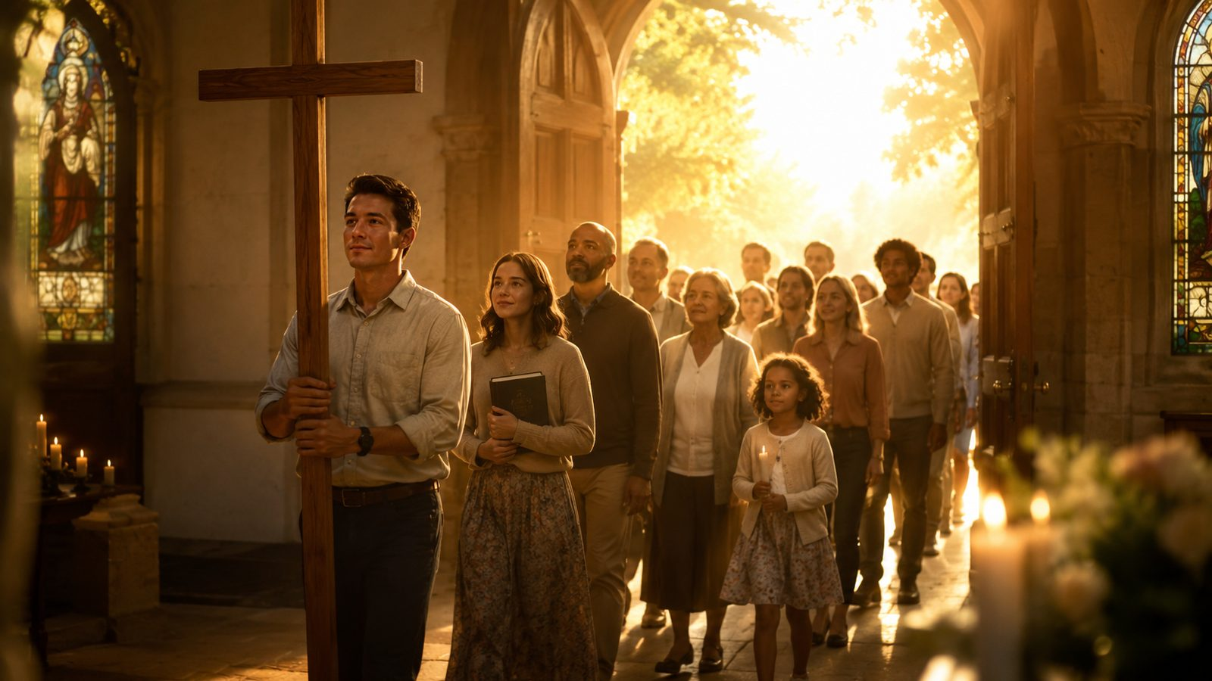
A Processional Origin
A hymn designed for embodied, gathered worship.
Baring-Gould wrote the text for a practical church occasion: children moving together to worship. That origin matters. The hymn is not a private meditation; it is a song for a people walking together.
Ministry insight: movement, unity, and song can teach the body what the heart needs to learn.
Prepared for teaching and small group use - hymninfo.com

Slide 10

2
One Body, One Hope
The hymn’s corporate language calls the church away from isolated discipleship.
Prepared for teaching and small group use - hymninfo.com

Slide 11
The Church Moves Together
Unity is a witness, not merely an internal preference.
One Lord
One body
Christ gathers the church around himself.
Believers walk together rather than alone.
One hope
One charity
The church presses forward with shared confidence.
Love governs the way the church advances.
Ephesians 4:4-6 gives the biblical grammar for the hymn’s unity.
Prepared for teaching and small group use - hymninfo.com

Slide 12

Scripture Focus: Ephesians 4
The church’s unity is a gift to guard and a calling to practice.
•
One body: discipleship is corporate.
Discussion prompt
•
One Spirit: unity is more than organization.
What weakens unity in a congregation: fear, pride, nostalgia, suspicion, or competing missions?
•
One Lord: Christ is the center of the church’s identity.
•
One faith and one baptism: shared confession shapes shared life.
Prepared for teaching and small group use - hymninfo.com

Slide 13

Christ Sustains His Church
Earthly powers rise and fall, but Christ’s promise holds.
•
The hymn gives confidence without arrogance.
•
The church endures because Christ builds and preserves it.
•
This confidence should produce patient faithfulness, not triumphalism.
Key Scripture: Matthew 16:18
Prepared for teaching and small group use - hymninfo.com

Slide 14

Hymn Section 3
The church’s hope rests on Christ’s promise.
The contrast
The caution
The comfort
Kingdoms and thrones are unstable. Christ’s church rests on a stronger foundation.
Do not turn confidence into pride. The promise belongs to Christ, not to our institutional strength.
The weary church can stand because the Lord remains faithful.
Prepared for teaching and small group use - hymninfo.com

Slide 15
3
Standing Against Evil
Christian warfare language must be governed by Ephesians 6 and the love of Christ.
Prepared for teaching and small group use - hymninfo.com

Slide 16
Interpreting the Imagery Responsibly
The hymn should never be used to bless hatred or violence.
Not against people
Against evil
Under Christ
Ephesians 6 says our struggle is not against flesh and blood. People are neighbors, not targets.
The church resists sin, falsehood, fear, pride, injustice, and spiritual opposition.
All courage must be cruciform: truthful, humble, patient, and full of love.
Prepared for teaching and small group use - hymninfo.com

Slide 17

Ephesians 6: The Armor of God
God equips believers to stand firm.
Truth
Righteousness
Peace
No faithful witness without truthfulness.
Integrity matters in conflict.
The gospel prepares the feet for reconciliation.
Faith
Salvation
Word of God
Trust guards the heart under pressure.
Hope protects the mind.
Scripture gives discernment and courage.
Prepared for teaching and small group use - hymninfo.com

Slide 18
Discipline and Endurance
The image of a soldier in 2 Timothy points to loyalty, not aggression.
•
Endure hardship without bitterness.
•
Stay loyal to the Lord who enlisted you.
•
Refuse distractions that weaken obedience.
•
Keep courage tied to love and self-control.
Prepared for teaching and small group use - hymninfo.com

Slide 19
Theological Themes
What the hymn teaches when read through Scripture.
Christ’s leadership
Spiritual warfare
Church unity
The cross goes before the church.
The struggle is against evil, not people.
The body follows one Lord together.
Perseverance
Mission
Hopeful victory
Believers endure under Christ’s command.
The church advances through witness and service.
Thanks be to God through Jesus Christ.
Prepared for teaching and small group use - hymninfo.com

Slide 20
Literary and Musical Observations
A march-like tune serving a processional text.
•
Tune: ST. GERTRUDE, composed by Arthur S. Sullivan in 1871.
•
Meter: 6.5.6.5 D with refrain.
•
The rhythm is sturdy and memorable, suited for procession and congregational singing.
•
The text uses repeated movement language to form the congregation’s shared resolve.
Choir note: choose a tempo that supports dignity and text clarity rather than haste.
Prepared for teaching and small group use - hymninfo.com

Slide 21
Pastoral and Worship Use
Use with clarity, Scripture, and humility.
•
Appropriate for mission, commitment, procession, unity, and perseverance.
•
Frame with Ephesians 6 to avoid misunderstanding.
•
Useful for teaching the church to stand firm without becoming combative.
•
Works well with congregational singing, choir, organ, brass, or piano.
Pastoral caution: strong imagery needs careful explanation.
Prepared for teaching and small group use - hymninfo.com

Slide 22
Suggested Lesson Flow
A 45-minute teaching map
1
2
3
4
5
Open
Ground
Teach
Apply
Pray
Ask what it means to follow Christ together.
Read Ephesians 6 and Ephesians 4.
Walk through history, imagery, and theology.
Name faithful courage without hostility.
Ask Christ to lead the church in unity and witness.
Prepared for teaching and small group use - hymninfo.com

Slide 23
Application for the Church
Courage shaped by the cross.
For the fearful
For the divided
Stand in the strength of the Lord.
Practice the unity you sing.
For the zealous
For the weary
Let courage be governed by love.
Trust Christ’s promise to sustain his church.
Prepared for teaching and small group use - hymninfo.com

Slide 24

Closing Prayer
Lord Jesus, lead your church by the cross. Strengthen us against evil, heal our divisions, give courage to the weary, and make our witness humble, truthful, and full of love. Amen.
© HymnInfo.com. Free for personal, church, classroom, and small-group teaching use. Please do not sell, repost, or redistribute as downloadable files without permission.
Prepared for teaching and small group use - hymninfo.com

