Slide 1

Rescue the Perishing
A hymn study on compassionate mission and the mercy of Jesus
Frances Jane Crosby, 1869 | William H. Doane, RESCUE
Prepared for teaching and small group use - hymninfo.com

Slide 2

Teaching Aim
Understand the hymn, feel its compassion, and practice its call.
Understand
Why gospel mission begins in the mercy of Christ.
Feel
The tenderness and urgency of compassionate witness.
Practice
Prayer, care, restoration, and humble gospel service.
Prepared for teaching and small group use - hymninfo.com

Slide 3

Hymn Identity
Title: Rescue the Perishing
First line: Rescue the perishing, care for the dying
Author: Frances Jane Crosby (1820-1915)
Composer: William Howard Doane (1832-1915)
Tune: RESCUE; gospel-song meter with refrain
Year written: 1869; published in 1870 in a gospel-song collection
Prepared for teaching and small group use - hymninfo.com

Slide 4
Historical Background
Fanny Crosby wrote the hymn during the rise of American gospel song.
Its language fits mission halls, Sunday schools, revival meetings, and urban outreach.
The hymn is closely associated with Crosby’s concern for people facing spiritual danger and social neglect.
Doane’s melody gave the text a direct, memorable form for congregational singing.
A gospel hymn shaped by compassion, urgency, and confidence in Christ.
Prepared for teaching and small group use - hymninfo.com

Slide 5

Fanny Crosby: Compassionate Witness
Crosby was one of the most prolific hymn writers of the nineteenth century.
Her gospel songs often speak directly to sinners, seekers, the weary, and the brokenhearted.
This hymn shows her pastoral concern: truth is joined to tears, patience, and mercy.
Teachers should present her not only as a writer, but as a mission-minded Christian worker.
Prepared for teaching and small group use - hymninfo.com

Slide 6
William H. Doane and the Tune RESCUE
Doane was a Baptist lay musician, editor, composer, and frequent Crosby collaborator.
The tune uses the direct style of nineteenth-century gospel song: clear melody, firm rhythm, strong refrain.
Its musical strength lies in making the congregation both hear and carry the call to mercy.
Sing it with tenderness as well as energy.
Prepared for teaching and small group use - hymninfo.com

Slide 7
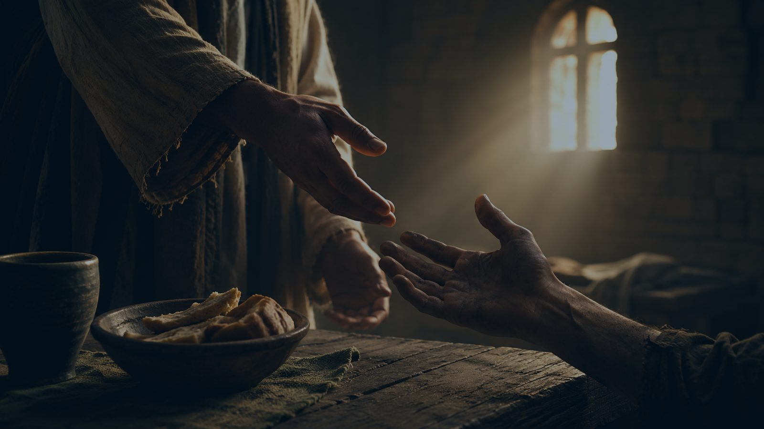
Why This Hymn Matters Today
It keeps evangelism tied to compassion, not superiority.
It reminds the church that people are not projects; they are neighbors to be loved.
It calls believers to patient restoration when someone wanders or falls.
It centers hope in Jesus, who is merciful and able to save.
Prepared for teaching and small group use - hymninfo.com

Slide 8

BIBLICAL FOUNDATION
The mercy of God seeks, saves, and restores.
Prepared for teaching and small group use - hymninfo.com

Slide 9
Scripture Foundations
PRIMARY TEXTS
James 5:19-20: turning back the wanderer
Luke 15:4-7: seeking the lost sheep
Jude 22-23: mercy toward those in danger
SUPPORTING TEXTS
Ezekiel 33:11: God calls sinners to turn and live
Luke 19:10: the Son of Man seeks and saves the lost
These passages ground mission in God’s own mercy.
Prepared for teaching and small group use - hymninfo.com

Slide 10
Hymn Study: Compassionate Rescue
The opening movement names spiritual danger without treating people harshly.
The call is active: care, weep, lift, and tell of Jesus.
The hymn does not separate gospel witness from practical mercy.
Teaching emphasis: the church is called to approach the fallen with tears, not pride.
Prepared for teaching and small group use - hymninfo.com

Slide 11
Refrain Study: Mercy at the Center
The refrain gathers the hymn’s message into a repeated commission.
It does not end with human ability, but with the mercy and saving power of Jesus.
The refrain should be sung as both assurance and assignment.
Teaching emphasis: Christ saves; the church witnesses and serves.
Prepared for teaching and small group use - hymninfo.com

Slide 12

Hymn Study: Patient Pleading
The second movement emphasizes persistence rather than quick judgment.
Christian witness is earnest, but it must also be gentle.
The hymn trusts that grace is still being offered to the penitent.
Teaching emphasis: gospel urgency and pastoral gentleness belong together.
Prepared for teaching and small group use - hymninfo.com

Slide 13
Hymn Study: Grace Restores the Heart
The hymn looks beneath outward brokenness to the human heart God can restore.
Kindness is not a small matter; it may awaken what sin and sorrow have buried.
Restoration is possible because grace is stronger than ruin.
Teaching emphasis: never write off a person whom Christ is able to renew.
Prepared for teaching and small group use - hymninfo.com

Slide 14
Hymn Study: Strength for the Labor
The final movement turns mission into patient Christian service.
The worker is not sent alone; the Lord provides strength for the task.
Restoration takes time, prayer, and careful shepherding.
Teaching emphasis: faithful mission is sustained by God’s strength, not human zeal alone.
Prepared for teaching and small group use - hymninfo.com

Slide 15
THEOLOGICAL THEMES
Grace makes the church merciful and active.
Prepared for teaching and small group use - hymninfo.com

Slide 16
Theological Themes
GOSPEL CONVICTIONS
Salvation is found in Jesus Christ.
Grace can restore broken lives.
Repentance is a gracious summons to life.
Mission flows from God’s mercy.
CHRISTIAN PRACTICES
Compassion for the wounded and wandering.
Prayerful witness and patient pleading.
Restoration of those who have fallen.
Service among the neglected and overlooked.
Prepared for teaching and small group use - hymninfo.com

Slide 17
Literary and Musical Observations
Imperative verbs give the hymn its missionary force.
Images of danger, tears, restoration, and mercy move the heart toward action.
The refrain fixes attention on Jesus rather than on the worker.
The tune RESCUE is direct and memorable, well suited for mission emphasis.
Prepared for teaching and small group use - hymninfo.com

Slide 18
Pastoral and Worship Use
Mission Sunday or evangelism emphasis
Services focused on mercy ministry or outreach
Teaching on Luke 15, James 5, or Jude 22-23
Commissioning volunteers, small groups, or care teams
Prayer gatherings for people who have wandered from faith
Prepared for teaching and small group use - hymninfo.com

Slide 19
Teaching Questions
How does the hymn keep mission tied to compassion?
What does Luke 15 teach us about God’s pursuit of the lost?
Why must gospel witness be both truthful and gentle?
Where might our church need a more patient ministry of restoration?
How can we serve people in need without treating them as projects?
Prepared for teaching and small group use - hymninfo.com

Slide 20
Practicing the Hymn This Week
Pray by name for someone who is wandering, wounded, or far from Christ.
Choose one concrete act of mercy: visit, call, invite, feed, listen, or encourage.
Speak of Jesus with humility, not pressure or pride.
Support a local ministry serving the poor, addicted, lonely, or overlooked.
Ask God for a softer heart and steadier courage.
Prepared for teaching and small group use - hymninfo.com

Slide 21
Suggested Lesson Flow
30 MINUTES
Read Luke 15:4-7 and James 5:19-20.
Introduce Crosby, Doane, and the gospel-song setting.
Study the refrain and one stanza summary.
Close with one practical mercy commitment.
60 MINUTES
Read all key Scripture passages.
Walk through each hymn movement.
Discuss mission without superiority.
Plan one group response of prayer or service.
Prepared for teaching and small group use - hymninfo.com

Slide 22
Choir and Worship Planner Notes
The hymn works best when sung with conviction and tenderness.
Avoid a rushed tempo; let the words of care and mercy breathe.
Use the refrain to reinforce the gospel hope at the heart of the hymn.
A soloist or choir may introduce a stanza, with the congregation joining the refrain.
Pair with Scripture, prayer for the lost, or commissioning for local outreach.
Prepared for teaching and small group use - hymninfo.com

Slide 23
Closing Summary and Prayer
Jesus is merciful. Jesus saves. The church is sent to love, seek, and restore.
Merciful Savior, give us Your compassion for people who are wounded, wandering, or far from You. Make our witness truthful, gentle, patient, and full of hope. Strengthen our hands for service and soften our hearts for prayer. Amen.
© HymnInfo.com. Free for personal, church, classroom, and small-group teaching use. Please do not sell, repost, or redistribute as downloadable files without permission.
Prepared for teaching and small group use - hymninfo.com

