Slide 1

Seek Ye First
Seek ye first the kingdom of God
Karen Lafferty • 1972 • Scripture Song
Primary Scripture: Matthew 6:33
A hymn study on kingdom priority, prayer, trust, and the word of God
Prepared for teaching and small group use - hymninfo.com

Slide 2




Teaching Aim
What this lesson should form in the people of God
Understand
Feel
Practice
Jesus calls disciples to seek the Father’s reign and righteousness before every lesser priority.
Let the words become a quiet release from anxiety and a renewed confidence in God’s care.
Turn daily decisions, prayers, and habits toward the kingdom of God first.
Prepared for teaching and small group use - hymninfo.com

Slide 3
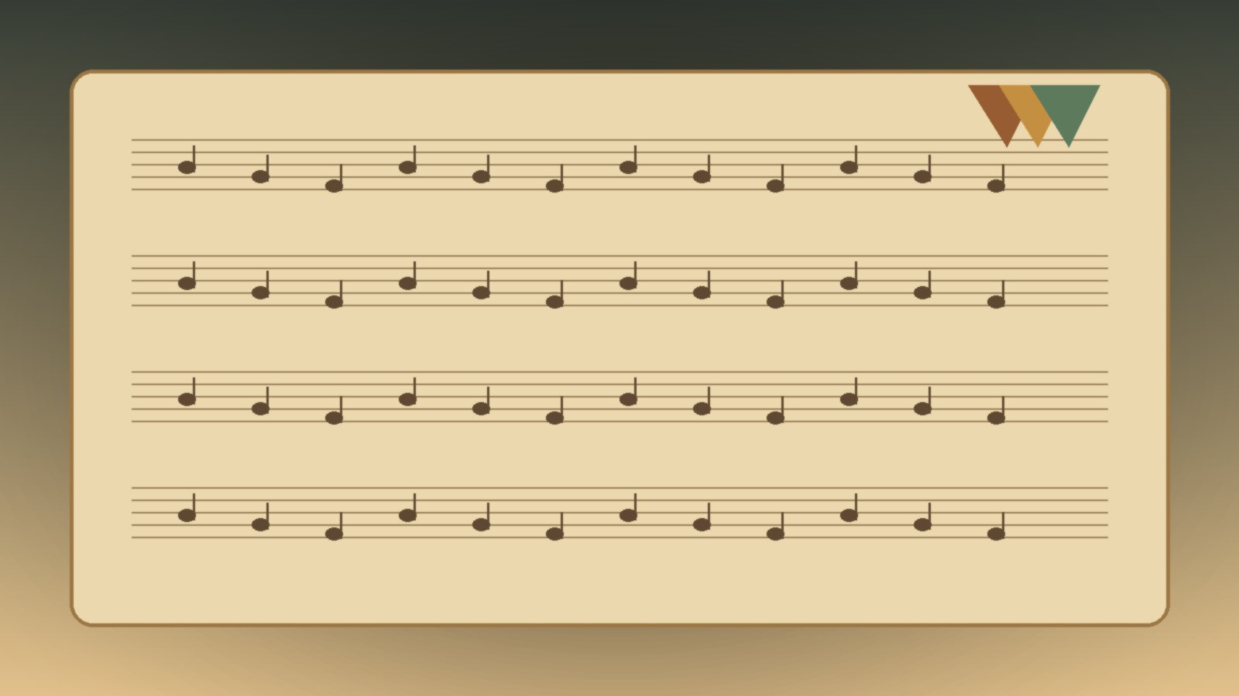
Hymn Identity
A compact Scripture song for congregational memory
Title
Seek Ye First
First line
Seek ye first the kingdom of God
Writer and composer
Karen Lafferty
Common date
1972
Tune names
SEEK YE FIRST, LAFFERTY, or SEEK YE
Form
Scripture song with alleluia response; irregular meter
Prepared for teaching and small group use - hymninfo.com

Slide 4

Historical Background
A Scripture chorus from the worship renewal of the early 1970s
Karen Lafferty wrote the song in the early 1970s, in a setting where Scripture was being memorized and sung in simple musical forms.
Its opening line draws directly from Jesus’ teaching in the Sermon on the Mount.
The song spread through prayer meetings, youth gatherings, renewal fellowships, and later denominational hymnals.
Its strength is not length or complexity, but the way it lets Scripture become congregational prayer.
Prepared for teaching and small group use - hymninfo.com

Slide 5

Why This Hymn Matters Today
A sung reordering of Christian priorities
For anxious hearts
For busy churches
The song places daily needs under the Father’s care rather than under fear.
It asks whether ministry activity is still ordered by God’s kingdom.
For worship formation
For discipleship
It helps Scripture move from the page to memory, prayer, and obedience.
It joins seeking, asking, trusting, and living by God’s word.
Prepared for teaching and small group use - hymninfo.com

Slide 6
Biblical Foundation
The song belongs inside the Sermon on the Mount
Matthew 6:33
Matthew 7:7-8
Kingdom priority and trust in the Father’s provision
Persistent prayer: ask, seek, and knock
Matthew 4:4 / Deuteronomy 8:3
Luke 12:31
Life sustained by the word that proceeds from God
A parallel kingdom command joined to freedom from anxiety
Prepared for teaching and small group use - hymninfo.com

Slide 7
Sung Scripture
When biblical words are sung, they can lodge in memory and shape ordinary choices.
Prepared for teaching and small group use - hymninfo.com

Slide 8
Hymn Section Study 1
Seeking the kingdom first
The opening movement takes the disciple to Jesus’ words about priority, trust, and righteousness.
In Matthew 6, seeking first is not a religious slogan; it is a response to anxiety, divided loyalty, and daily need.
Teaching emphasis: the kingdom of God becomes the organizing center of life, not a decorative add-on to life.
Teacher prompt: Where do church members most feel pressure to put God’s kingdom second?
Prepared for teaching and small group use - hymninfo.com

Slide 9
Hymn Section Study 2
Prayer that keeps seeking
The song also draws worshipers toward Jesus’ teaching on asking, seeking, and knocking.
Prayer is not presented as technique, but as trusting persistence before a generous Father.
The movement from seeking the kingdom to asking in prayer keeps obedience from becoming self-reliance.
Congregational connection: Prayer becomes the breath of kingdom-first living.
Prepared for teaching and small group use - hymninfo.com

Slide 10

Hymn Section Study 3
Living by the word of God
The biblical background reaches from Deuteronomy 8 to Jesus’ temptation in Matthew 4.
God’s people learn that bread is a gift, but bread is not the whole of life.
Teaching emphasis: Scripture feeds faith, corrects desire, and teaches dependence on the Father.
Do not separate provision from formation: God feeds his people and trains their trust.
Prepared for teaching and small group use - hymninfo.com

Slide 11

The Alleluia Response
Praise after Scripture and prayer
The response turns teaching into worship.
It gives the congregation a simple way to answer Christ’s commands with praise.
Its simplicity helps children, youth, and adults join the same act of faith.
Choir note
Keep the response gentle and unhurried. Let harmony support the congregation rather than overpower it.
Prepared for teaching and small group use - hymninfo.com

Slide 12
Theological Themes
Four anchors for teaching
Kingdom
Righteousness
Prayer
God’s reign sets the first priority for the disciple.
Seeking God includes a formed life, not only religious desire.
The Father welcomes persistent asking, seeking, and knocking.
Provision
Scripture
Trust
Daily needs are held within the Father’s faithful care.
God’s word sustains life deeper than bread alone.
Faith refuses to let anxiety become the master of the heart.
Prepared for teaching and small group use - hymninfo.com

Slide 13
Literary and Musical Observations
A short song designed for memory
The text functions as Scripture meditation rather than as a narrative hymn.
Its repeated response creates space for contemplation, not merely repetition.
The melody is accessible and lyrical, supporting small groups, children’s ministry, and congregational singing.
The irregular meter reflects its chorus-like shape and its connection to sung Scripture rather than formal hymn stanza structure.
Prepared for teaching and small group use - hymninfo.com

Slide 14
Pastoral and Worship Use
Where the song serves the church well
Call to worship
Prayer response
Children and youth
Begin worship by setting hearts on God’s reign.
Sing after intercessions or a prayer about anxiety and provision.
Use the song to help younger believers remember Jesus’ words.
Offertory or commitment
Teaching series
Small groups
Connect giving, trust, and kingdom priorities.
Pair with Sermon on the Mount lessons.
Use as a closing sung prayer after discussion.
Prepared for teaching and small group use - hymninfo.com

Slide 15
Teaching Questions
Move from text to faithful practice
What does Matthew 6 say people are tempted to seek before the kingdom?
How does Jesus connect kingdom priority with the Father’s care?
What changes when prayer is understood as asking, seeking, and knocking before a good Father?
How can a short Scripture song form memory differently than a spoken reading?
Which habits help a congregation seek God’s kingdom first together?
Prepared for teaching and small group use - hymninfo.com

Slide 16
Application
Practices for kingdom-first discipleship
Begin with the kingdom
Pray persistently
Name one decision this week and ask what faithfulness to God’s reign requires.
Bring one ongoing concern to the Father each day without surrendering to panic.
Return to Scripture
Simplify one desire
Memorize Matthew 6:33 in its full context of trust and anxiety.
Release one lesser priority that has been crowding out obedience.
Encourage another believer
Remind someone that the Father knows what his children need.
Prepared for teaching and small group use - hymninfo.com

Slide 17
Suggested Lesson Flow
Two ways to teach the hymn
30 min
Read Matthew 6:25-34; teach kingdom priority; discuss one application; close in prayer.
60 min
Add historical context, prayer teaching from Matthew 7, Scripture dependence from Matthew 4, and small-group discussion.
Prepared for teaching and small group use - hymninfo.com

Slide 18
Choir and Worship Leader Notes
Let the song remain Scripture in the mouth of the people
Use a tempo that allows the biblical words to be heard without dragging the alleluia response.
Keep accompaniment transparent; the congregation should not feel hurried or overwhelmed.
If using a choir or ensemble, let harmony serve the response rather than turn the song into a performance.
Consider placing the song after a Scripture reading so worshipers hear the biblical setting before singing.
Prepared for teaching and small group use - hymninfo.com

Slide 19

Closing Summary
Seek Ye First sings the words of Jesus back into the life of the church.
It joins kingdom priority, persistent prayer, trust in provision, and dependence on the word of God.
Its simplicity is a strength when it is taught within the full biblical context.
Prepared for teaching and small group use - hymninfo.com

Slide 20
Closing Prayer
Father, turn our hearts toward your kingdom before every lesser desire. Teach us to trust your care, to pray with patience, and to live by every word you speak. Make our congregation a people whose first seeking is your reign and righteousness. Through Jesus Christ our Lord. Amen.
Prepared for teaching and small group use - hymninfo.com

Slide 21
Seek Ye First
For church teaching, small groups, choir rehearsal, worship planning, and sermon preparation.
© HymnInfo.com. Free for personal, church, classroom, and small-group teaching use. Please do not sell, repost, or redistribute as downloadable files without permission.
Prepared for teaching and small group use - hymninfo.com

